Slide 1
Unit 9: Natural Disaster
•
P71- Skills 1

Slide 2
I. Reading

Slide 3
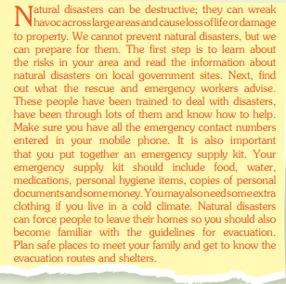
Ex1: Read an article about how to prepare for a natural disaster. Look at the words in the box,then find them in the article and underline them. What do they mean?
1

Slide 4
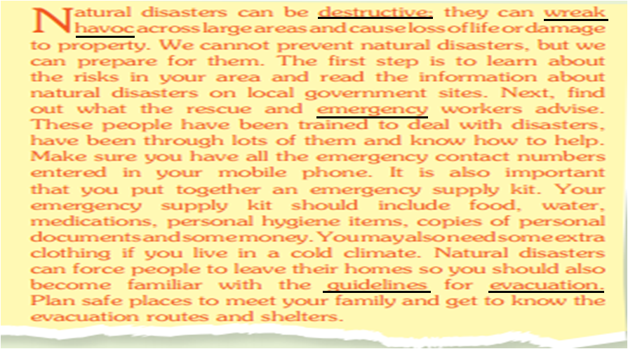
Ex1: Read an article about how to prepare for a natural disaster. Look at the words in the box,then find them in the article and underline them. What do they mean?

Slide 5
Vocabulary:
E’ssential (adj): cần thiết
- ‘wreak havoc (V.ph): tàn phá
- de’structive (adj): phá hoại
- ‘guidelines (n): hướng dẫn
- e’mergency (n): trường hợp khẩn cấp
Destroy (v)
Destruction (n)
Destructive (adj)

Slide 6
2. Read the article and answer the questions
1. Why are natural disasters destructive ?
Because they can wreak havoc across large areas and cause loss of life or damage to property.
2. What are the first things to do to prepare for natural disasters ?
Learn about the risks in your area and read the information about natural disasters on local government sites.
3.What should you enter in your mobile phone ? Why ?
Enter all the emergency contact numbers in your mobile phone so you can call the rescue and emergency workers if necessary.
4. What items should an emergency supply kit include ?
Your emergency supply kit should include food, water,medication, personal hygiene items, copies of personal documents and some money.
5. What do you need to know in case of evacuation ?
We need to know the evacuation routes and shelters.

Slide 7
SPEAKING
3a. Readthe news reports ( A-C) and match each one to the correct picture (1-3)
Keys:
1.C
2.B
3.A

Slide 8
3.b. Work in pairs. Each pair can choose one of reports in 3a. Role play telling each about the news.
EX:
A.Did you watch the news last night ?
B. No, I didn’t. What’s happened ?
A.There was a powerful earthquake on Monday.
B. That’s shocking! Where was it ?

Slide 9
4a. Make a list of things to do before, during and after each of the disasters in your area.
Disasters | Things to do
 | Before | During | After

Slide 10
4b. Discuss what you should do in the event of a natural disaster in your area.
EX:
A.Did should you do to prepare for floods in your area?
B. First. I’ll make sure I have a disaster plan...
A. What should you do during a flood ?
B. During a flood, I should try to get to higher ground as quickly as possible...

