Slide 1


Unit 9: english in the world
Lesson 3: SKILLS 1

Slide 2
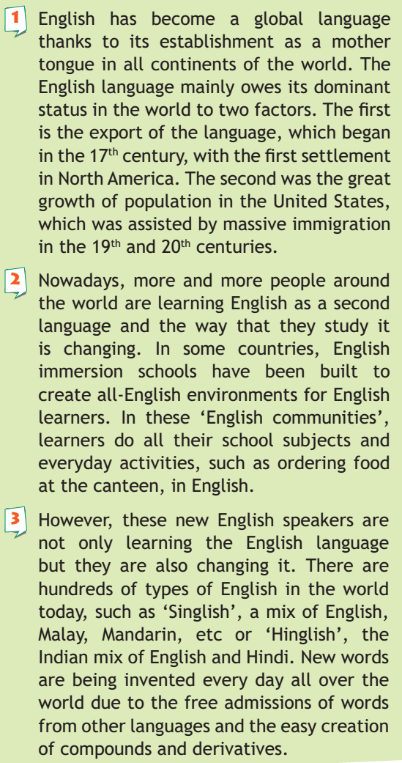
-> establishment (n):việc thành lập, establish (v) /ɪˈstæblɪʃ/
-> dominant (adj): /ˈdɒmɪnənt/ trội, ưu thế. Dominance (n)
settlement (n) :sự định cư , settle (v) /ˈsetl/ :định cư
assist (v) = help
immersion school: /ɪˈmɜːʃn/ trường chuyên
admission (n): sự thu nạp
derivatives (n) /dɪˈrɪvətɪv/ : sự phát sinh

Slide 3
VOCABULARY
- establishment (n):việc thành lập, establish (v) /ɪˈstæblɪʃ/
- dominant (adj): /ˈdɒmɪnənt/ trội, ưu thế. Dominance (n)
- settlement (n) :sự định cư , settle (v) /ˈsetl/ :định cư
- assist (v) = help – assitance (n)
- immersion school: /ɪˈmɜːʃn/ trường chuyên
- admission (n): sự thu nạp
- derivatives (n) /dɪˈrɪvətɪv/ : sự phát sinh

Slide 4
2 a. Read the text and match the headings (a-c) to the paragraphs (1-3).
a. A changing language.
b. A global language.
c. Learning English almost 24 hours day.

Slide 5
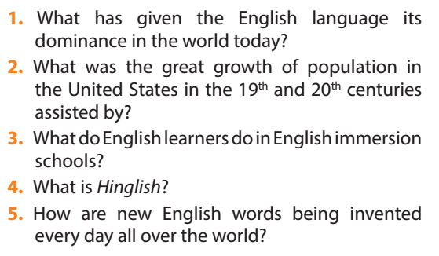
2 b. Read the text again and answer the questions.

Slide 6
2 b. Read the text again and answer the questions.
What has given the English language its dominance in the world today?
2. What was the great growth of population in the United States in the 19th and 20th centuries assisted by?
3. What do English learners do in English immersion schools?
4. What is Hinglish?
5. How are new English words being invented every day all over the world?
It is the export of the English language and the great growth of
population in the United States that has led to its dominance in
the world today.
- Massive immigration.
- They do all their school subjects and everyday activities in English.
- It is a blend of English and Hindi words and phrases.
They are being invented every day all over the world due to the free
admissions of words from other languages and the easy creation of
compounds and derivatives.

Slide 7
2 b. Read the text again and answer the questions.
3. What do English learners do in English immersion schools?
- They do all their school subjects and everyday activities in English.

Slide 8
2 b. Read the text again and answer the questions.
4. What is Hinglish?
5. How are new English words being invented every day all over the world?
- It is a blend of English and Hindi words and phrases.
They are being invented every day all over the world due to the free admissions of words from other languages and the easy creation of compounds and derivatives.

Slide 9
2 b. Read the text again and answer the questions.
1. It is the export of the English language and the great growth of population in the United States that has led to its dominance in the world today.
2. Massive immigration.
3. They do all their school subjects and everyday activities in English.
4. It is a blend of English and Hindi words and phrases.
5. They are being invented every day all over the world due to the free admissions of words from other languages and the easy creation of compounds and derivatives.

Slide 10

Ways to improve your English

Slide 11
hOMEWORK
- Learn vocabulary by heart.
Read the 3 passages again
Prepare skill 2 (Write EX 1,2 into your exercise books)

Slide 12


