Slide 1
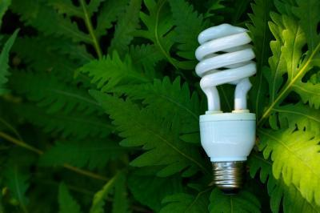
Unit 10 - A closer look 2

Slide 2
Next week we will study Unit 11.
Next week we will study Unit 11.
Future simple - future actions, predictions, hopes, etc.
I. The future continuous
This time next week we will be studying Unit 11.
This time next week we will be studying Unit 11.
Future continuous - an action in progress at a definite
point of time in the future.
Form
(+) S + will be + V_ing
(- ) S + will not be + V_ing
(?) Will + S + be + V_ing?
A definite point of time
tomorrow, by 2020, at 8.00 tomorrow morning, on Sunday/ this time next week/ month/ year/ summer, etc.

Slide 3
EX1 Complete the sentences using the future continuous form of the verbs in brackets.
1. On Sunday, they __________ (put) solar panels on the roof of our house to get power.
2. At 9 o’clock on Monday, we _________ (take) a test on sources of energy.
3. At this time next week, my dad ________ (install) new glass in the windows to stop heat escaping.
4. By 2020, people in Viet Nam ___________ (spend) a lot of money on heating.
5. By the middle of the 21st century, people in developing countries _____________ (use) energy from the sun, the wind, and the water. Write what these students will be doi
will be putting
will be taking
will be installing
, will be spending
will be using

Slide 4
Ex 2 . Write what these students will be doing tomorrow afternoon.
1. Jenny/give a talk about saving energy.
=> Jenny will be giving a talk about saving energy .
2. Helen/put solar panels in the playground.
3. Susan/check cracks in the water pipes.
4. Jake/put low energy light bulbs in the classrooms.
5. Kate/show a fi lm on types of renewable energy sources.

Slide 5
Ex 3 . Complete the conversation with the verbs in brackets. Use either the future simple or the future continuous tense.
Tom: What will we do to save electricity, Dad?
Tom’s dad: First, we (1. watch) ____________ less TV.
Tom: ________ we ________ (2. put) solar panels on our roof for the heating and hot water?
Tom’s dad: Yes, and this time next week, we (3. have) _____________ a free solar shower.
Tom: What about transport? I mean, how ________ we (4. travel) _________________ to school and to work?
Tom’s dad: Well, we won’t use our car. We (5. walk or cycle) _______________ to cut air pollution.
Tom: So at 7 o’clock tomorrow, you (6. cycle) ____________ to work, and I (7. go) ___________ to school on my skateboard.
Tom’s dad: Great idea!
Will watch
Will
put
Will be having
Will
travel
Will walk and cycle
Will be cycling
Will be going

Slide 6
Activity 4.
Work in pairs . Tell your partner what you will be doing at the following point of time.
Example: This time tomorrow
I will be learning English this time tomorrow.
Or
This time tomorrow, I will be learning English.
1. tomorrow afternoon
2. this weekend
3. this time next week
4. when you are fifteen years old

Slide 7
II. The future simple passive
Form
(+) S + will be + Vpp (by O)
(- ) S + will not be + Vpp (by O)
(?) Will + S + be + Vpp (by O)?
Examples
- Solar panels will be put on the roof of the houses.
- The exercises will be finished tomorrow.
- Low energy light bulbs will be used widely.
NOTES
1. Passive form is used when:
- the doer is not known and not important
- the object is not important
2. If the doer is definite and still important, we can add “ by O ” at the end of the sentence.

Slide 8
Ex 5 .Complete the magazine article with the passive form of the verbs below.
place solve provide store use
We are looking for cheap, clean, and eff ective sources of energy. These types of energy won’t cause pollution or waste natural resources. Solar power is one of these energy sources. It will (1) __________ freely by the sun. One percent of the solar energy that reaches the earth will be enough to provide electricity for the whole population of the world. Solar energy will (2) __________by many countries around the world. Solar panels will (3) ____________ on the roofs of houses and other buildings and the sun’s energy will be used to heat water. The energy will (4) ___________ for a long time. We hope that by using solar energy the problem of the energy shortage will (5) ________________.
be provided
be used
be placed
be stored
be solved

Slide 9
Ex 6 . Change the sentences into the passive voice.
Example: We will use low energy light bulbs
Low energy light bulbs will be used.
We will use waves as an environmentally friendly energy source.
=> Waves will ___________________________________.
2. They will install a network of wind turbines to generate electricity.
A network of wind turbines will ________________.
3. In the countryside, people will burn plants to produce heat.
=> In the countryside, plants will _________________.
4. We will reduce energy consumption as much as possible.
=> Energy consumption will _____________________.
5. We will develop alternative sources of energy.
=> Alternative sources of energy will _____________.
6. We will use solar energy to solve the problem of energy shortage.
=> Solar energy will ____________________
be used as an environmentally friendly energy source.
be installed to make electricity.
be burnt to produce heat.
be reduced as much as possible.
be developed
be used to solve the problem of the shortage of energy

Slide 10
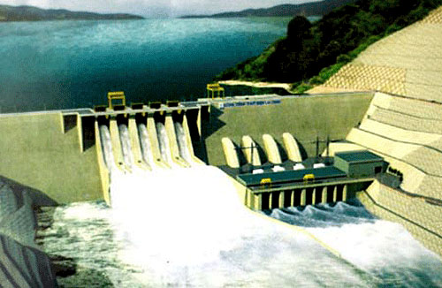
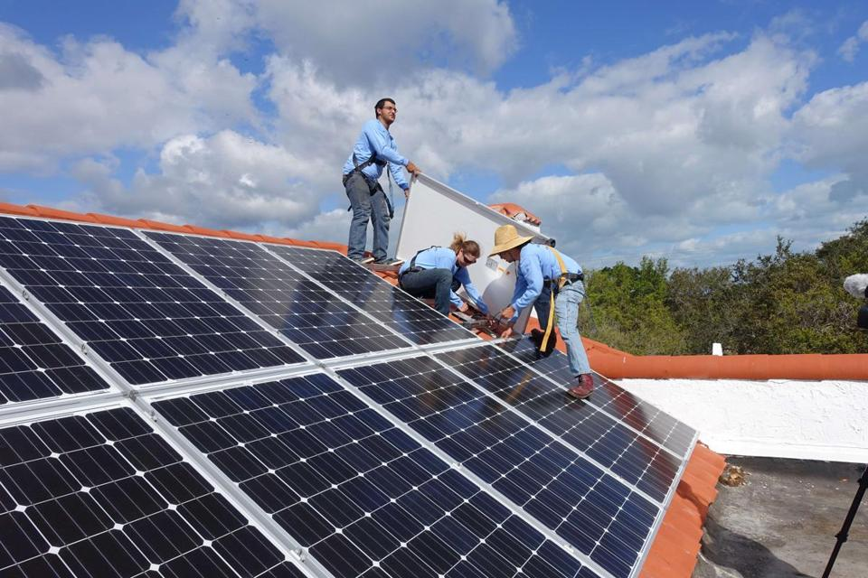
Look at the pictures and write what will be done in the future
Activity 5.
* Suggestions
A hydro power station will be built in the region to increase the electricity.
Solar panels will be put / installed on the roof of the buildings.

Slide 11
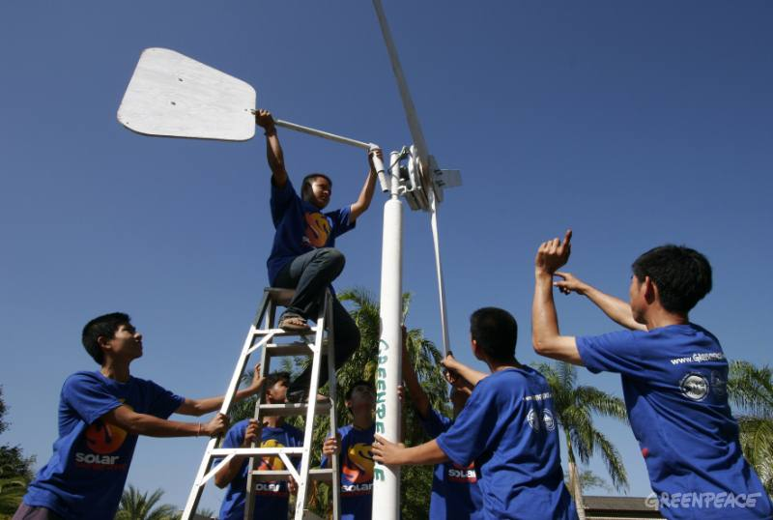
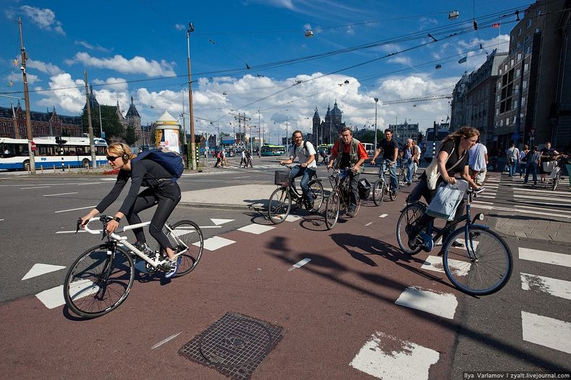
Look at the pictures and write what will be done in the future
Activity 5.
* Suggestions
A network of wind turbines will be installed to generate electricity.
Bicycles will be used to travel in the city

Slide 12
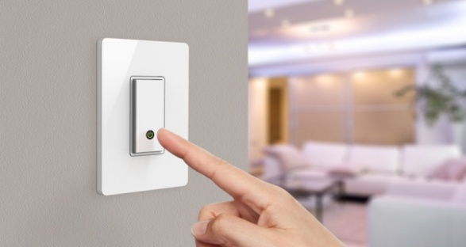
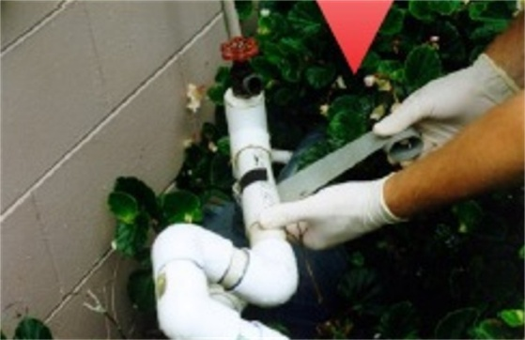
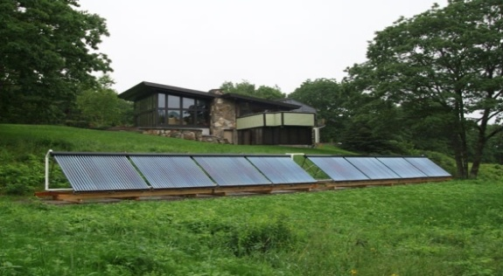
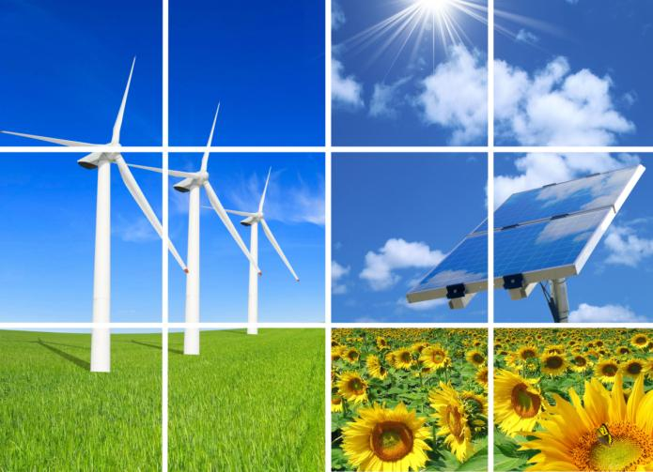
Activity 6.
Write what these students will be doing tomorrow afternoon.
1, Jenny will be giving a talk
about saving energy.
2, Helen will be putting solar
panels in the playground.
3, Susan will be checking cracks
in the water pipes.
4, Jack will be putting low energy
light bulbs in the classrooms.
5, Kate will be showing a film on
types of renewable energy
sources.

Slide 13
Activity 7.
Change these sentences into the passive voice.
Example. We will use lower energy light bulbs.
Lower energy light bulbs will be used
1. Waves will be used as an environmentally
friendly energy source.
2. A network of wind turbines will be installed to
make electricity.
3. In the countryside , plants will be burntn to
produce heat.
4. Energy consumption will be reduced as much
as possible.
5. Alternative sources of energy will be developed.
6.Solar energy will be used to solve the problem
of the shortage of energy.

Slide 14
Homework
- Learn by heart all the new words.
- Prepare for next lesson ( find the meaning of
the new words in the next lesson )
- Do B3,4,5,6 ( workbook)
- Redo section 2,6, – students’ book

