Slide 1
Unit 4
Did you go to
the party?
Lesson 1

Slide 2
VOCABULARY

Slide 3
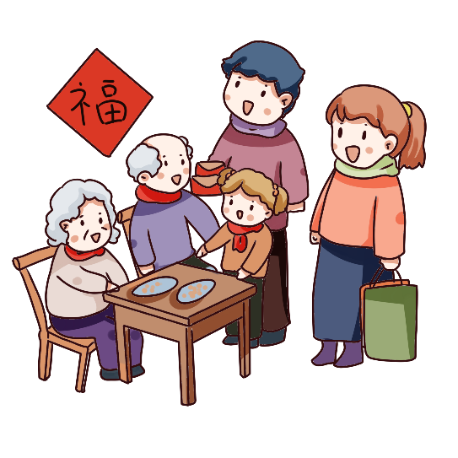
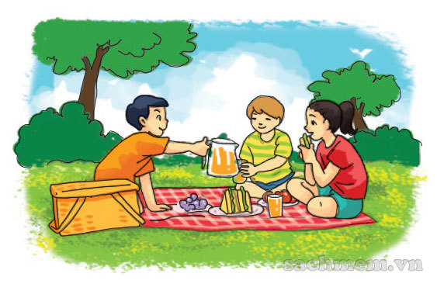
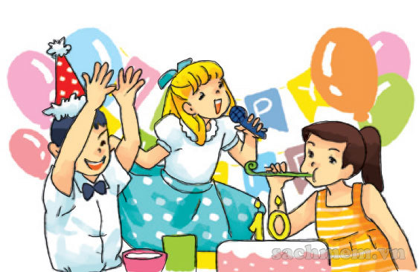
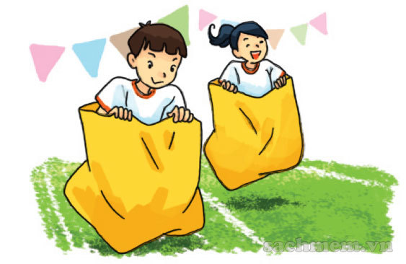
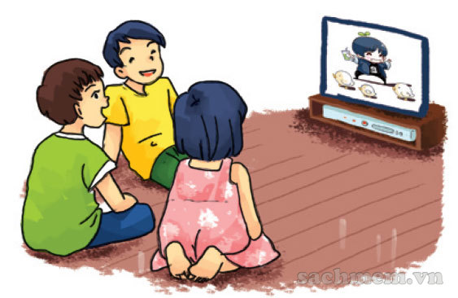
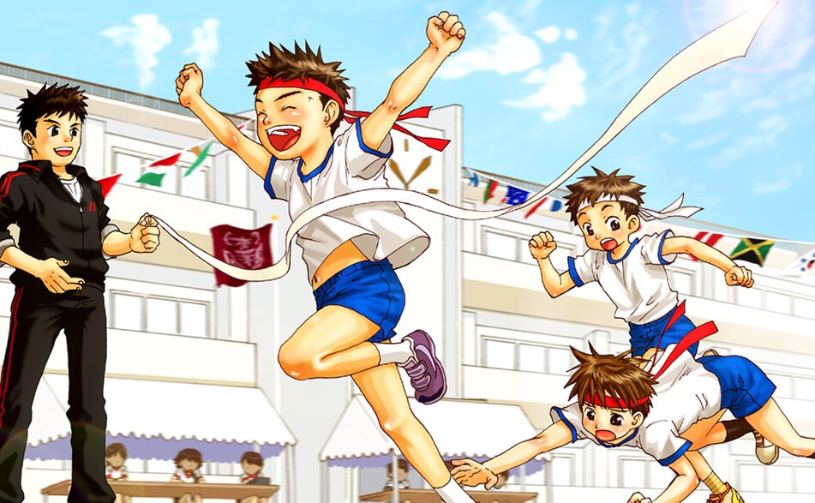
A. Vocabulary
visit my
grandparents
go on a picnic
enjoy a party
Đi dã ngoại
Thích bữa tiệc
Đi thăm ông bà
join the funfair
watch cartoon
sport festival
Tham gia hội trại
Xem hoạt hình
Lễ hội thể thao

Slide 4
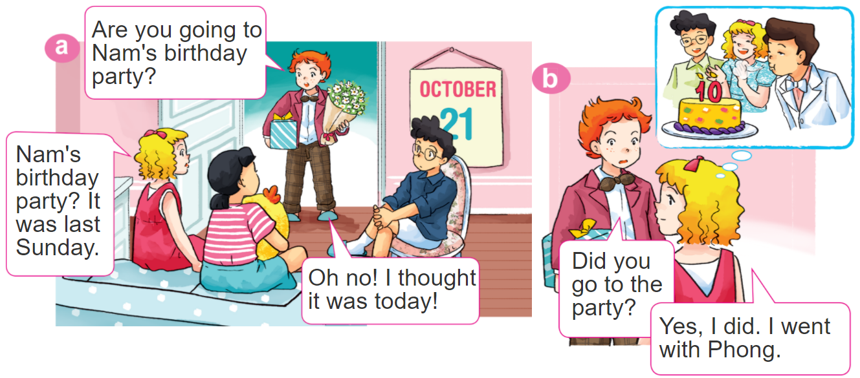

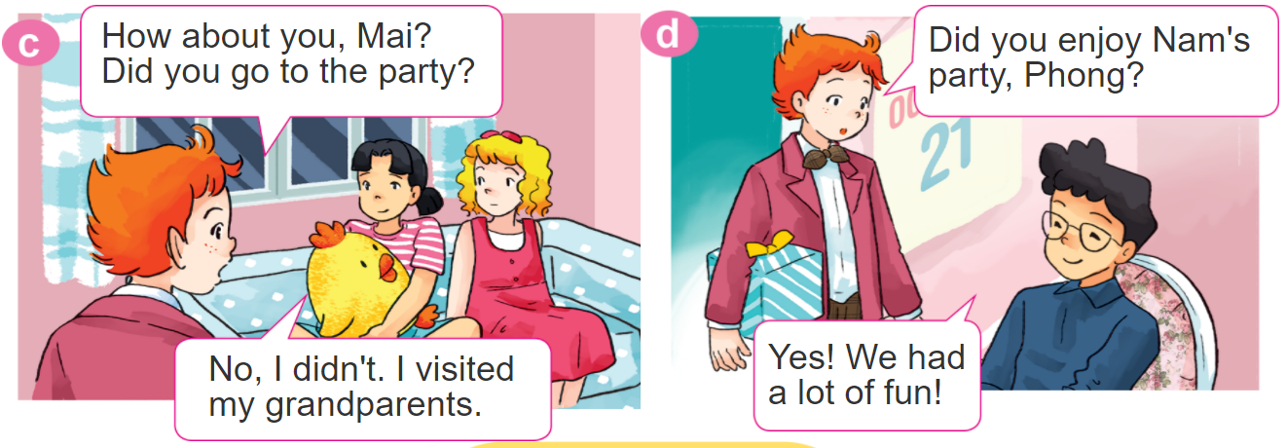
1. Look, listen and repeat.

Slide 5
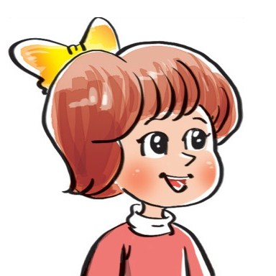

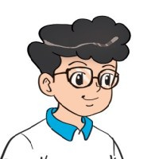

2. Point and say
Yes. I did.
Did you _________?
No, I didn't.
go on a picnic
watch TV
enjoy a party
join the funfair

Slide 6

3. Let’s talk
Did you go on a picnic?
Yes. I did.
Did you enjoy the weekend?
No, I didn't.
Did you watch TV?

Slide 7
B. Grammar
Hỏi và đáp bạn đã làm gì đó phải không:
Did you ___________?
+ activity
Yes. I did.
No, I didn't.

Slide 8




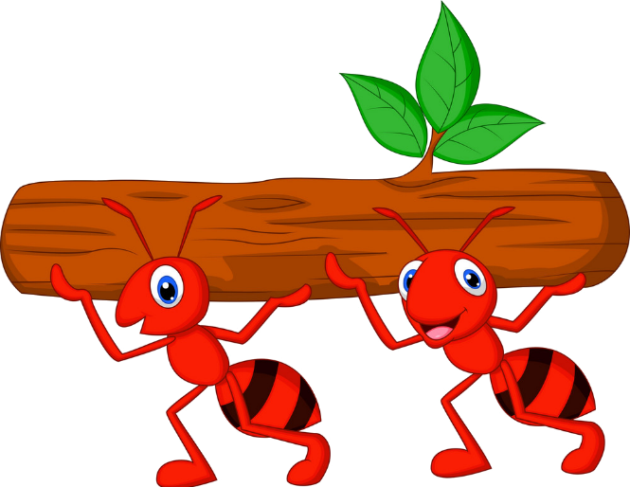



Kiến chăm chỉ
PLAY

Slide 9

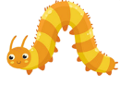





Did you join the festival?
Yes, I did.
Next
Notes:
Ms Huyền Phạm - 0936.082.789 – YOUTUBE: MsPham. Facebook: Dạy và học cùng công nghệ.

Slide 10
Did you visit your grandparents?
Yes, I did.
Next
Notes:
Ms Huyền Phạm - 0936.082.789 – YOUTUBE: MsPham. Facebook: Dạy và học cùng công nghệ.

Slide 11
Did you watch cartoon
No, I didn’t.
Next
Notes:
Ms Huyền Phạm - 0936.082.789 – YOUTUBE: MsPham. Facebook: Dạy và học cùng công nghệ.

Slide 12
Did you join the funfair?
No, I didn’t.
Next
Notes:
Ms Huyền Phạm - 0936.082.789 – YOUTUBE: MsPham. Facebook: Dạy và học cùng công nghệ.

Slide 13
Did you enjoy a party?
Yes, I did.
Next
Notes:
Ms Huyền Phạm - 0936.082.789 – YOUTUBE: MsPham. Facebook: Dạy và học cùng công nghệ.

Slide 14
WELL DONE!
EXIT
Notes:
Ms Huyền Phạm - 0936.082.789 – YOUTUBE: MsPham. Facebook: Dạy và học cùng công nghệ.

Slide 15
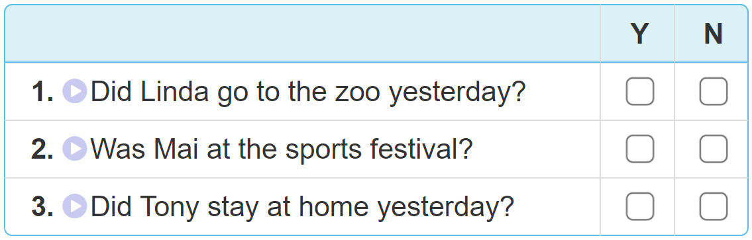

4. Listen and tick Yes (Y) or No (N).

Slide 16
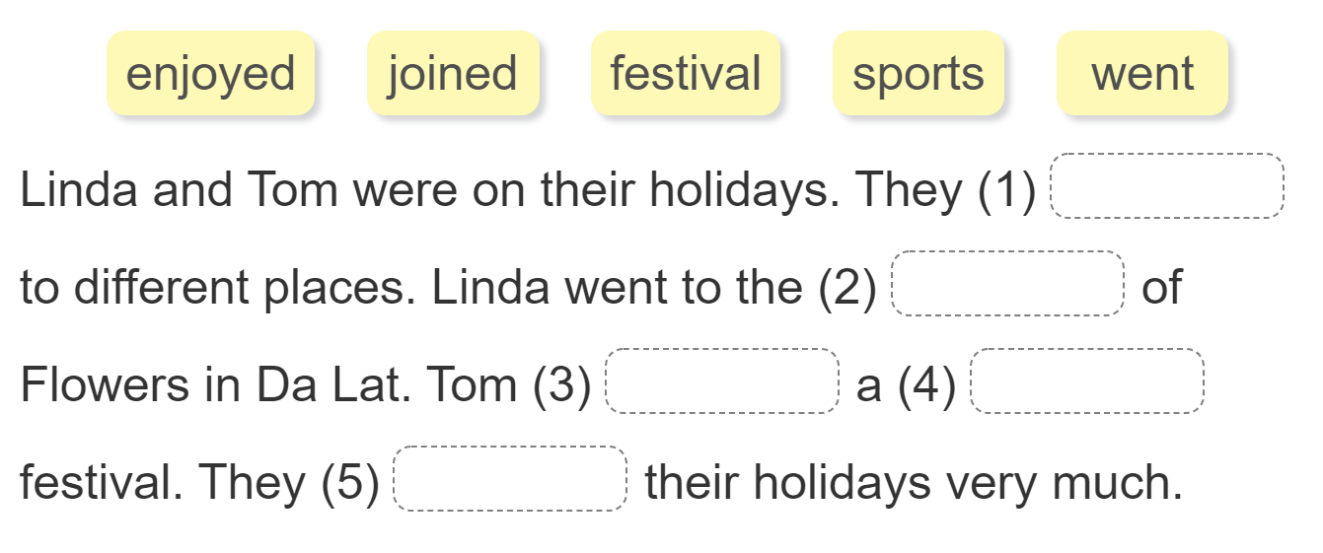
5. Read and complete.
went
festival
joined
sports
enjoyed

Slide 17
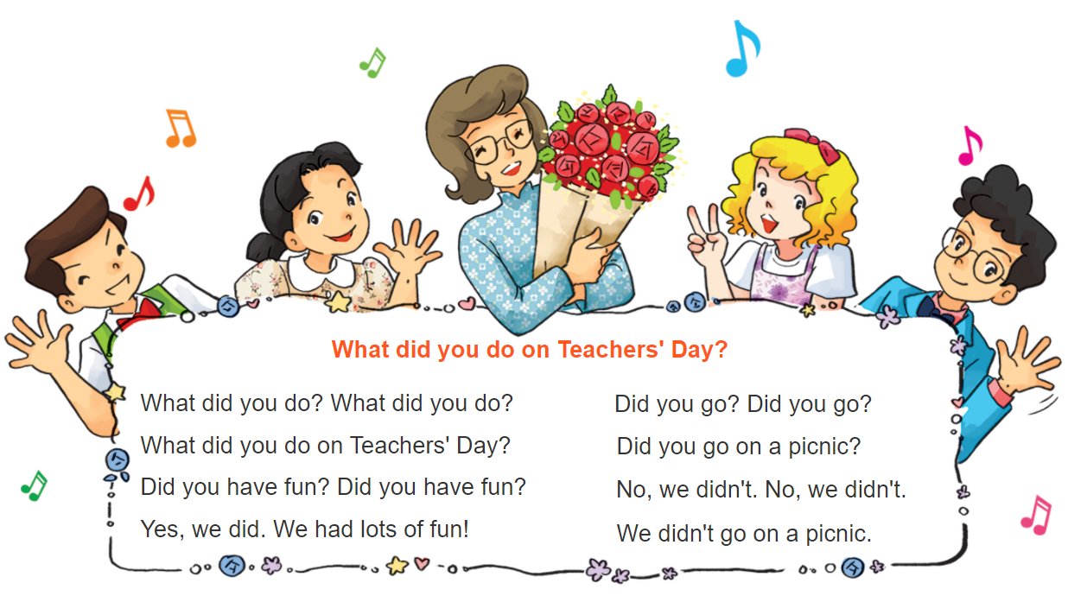

6. Let’s sing

