Slide 1
Unit 3
Where did you go
on holiday?
Lesson 1

Slide 2
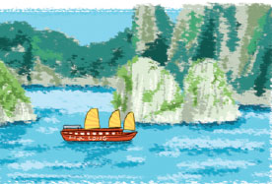
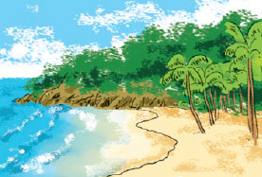
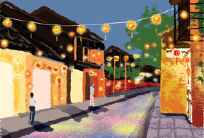
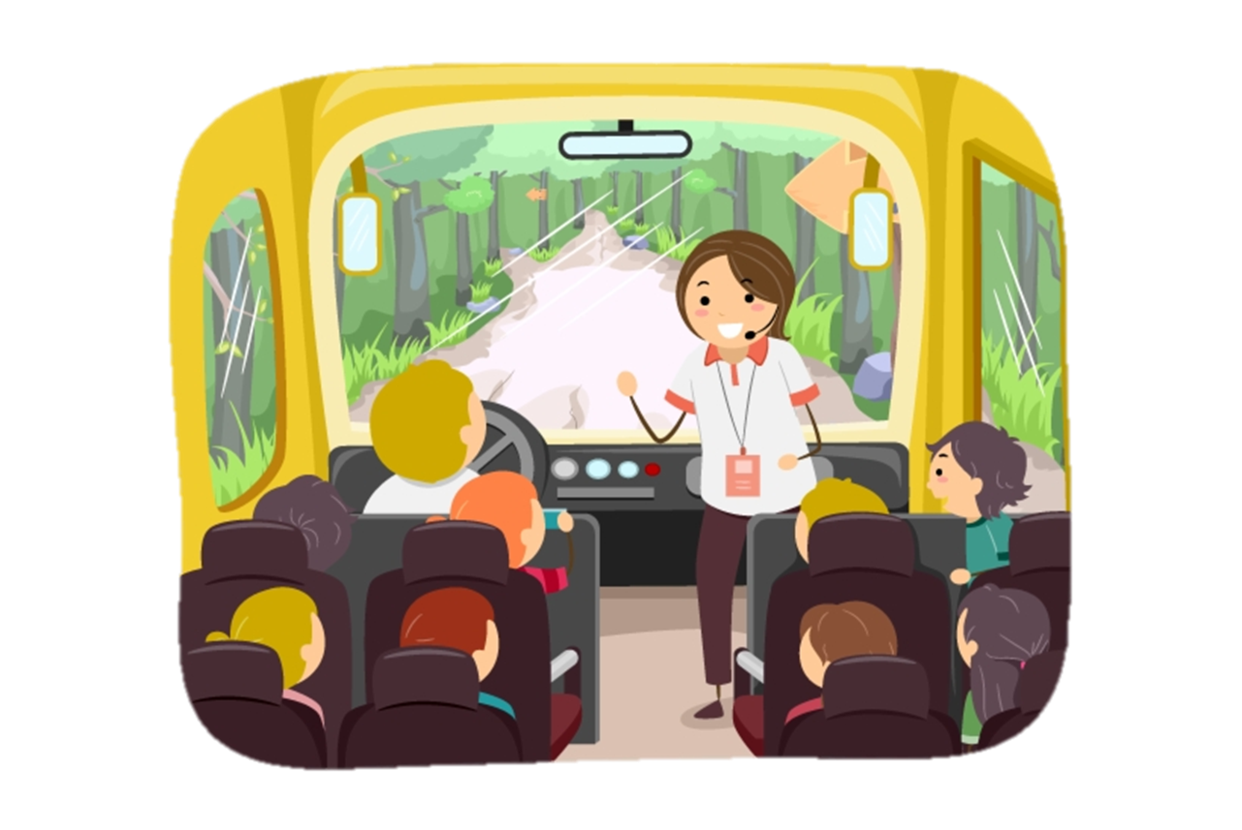

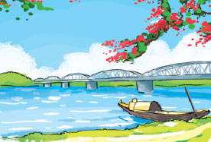
Vocabulary
Ha Long Bay
Phu Quoc Island
Hoi An Ancient Town
Vịnh Hạ Long
Đảo Phú Quốc
Phố cổ Hội An
Hue Imperial City
trip
holiday
Cố đô Huế
Chuyến đi
Kì nghỉ

Slide 3
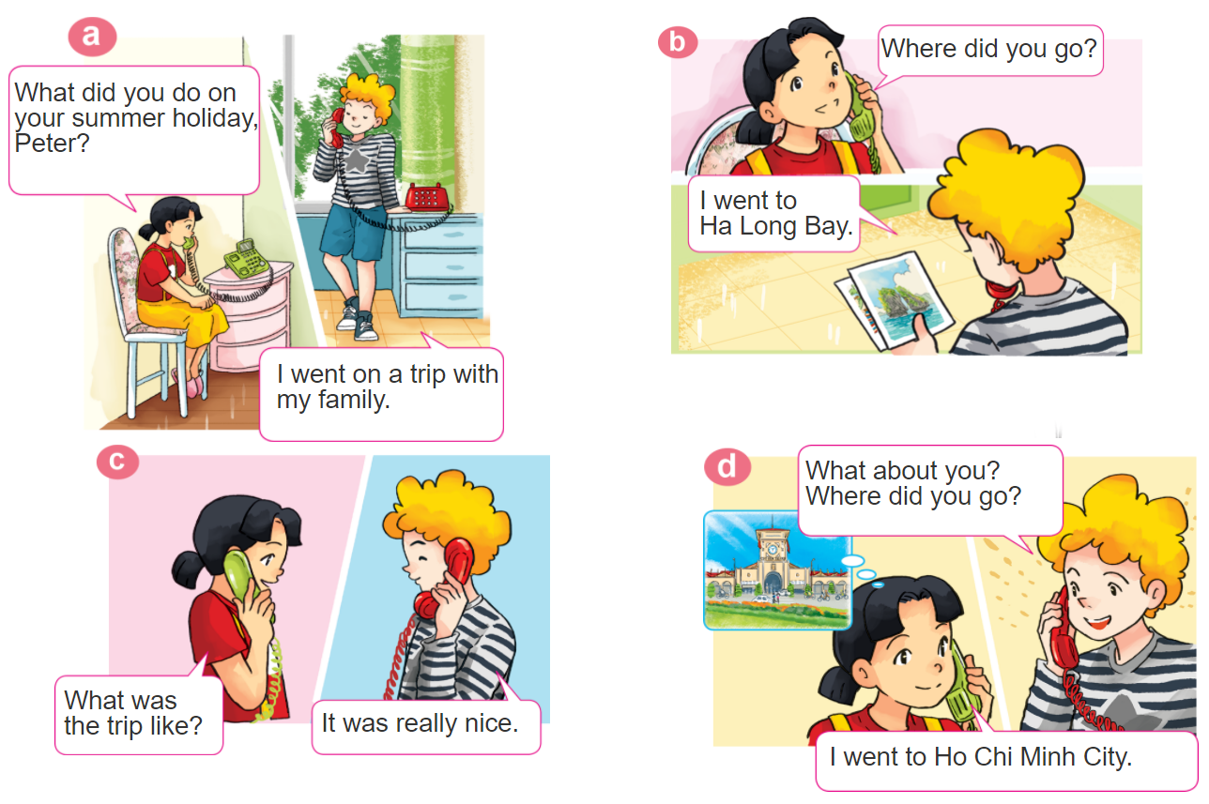

1. Look, listen and repeat

Slide 4




2. Point and say
Where did you go on holiday?
I went to ____________.
Ha Long Bay
Hue
Imperial City
Hoi An
Ancient Town
Phu Quoc Island

Slide 5
3. Let’s talk.
Hỏi và đáp bạn đã đi đâu
Where did you go on holiday?
(Bạn đã đi đâu vào kì nghỉ ?)
I went to ____________.
+ place
Hỏi và đáp bạn đã làm gì
What did you do on holiday?
(Bạn đã làm gì vào kì nghỉ ?)
I ____________.
+ activity

Slide 6
Structures
Hỏi và đáp chuyến đi như thế nào
What was the trip like ?
(___________như thế nào?)
It was ____________.
+ tính từ miêu tả

Slide 7
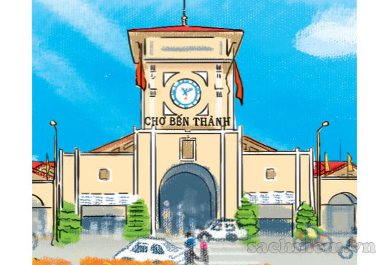
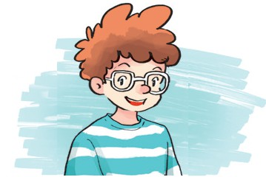
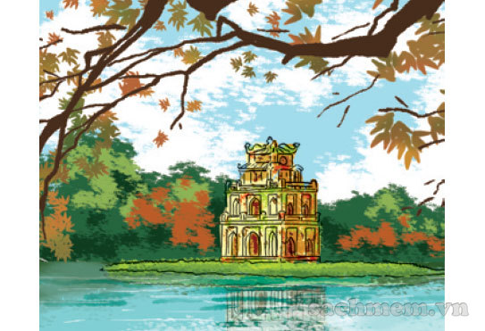

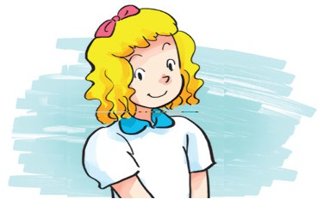
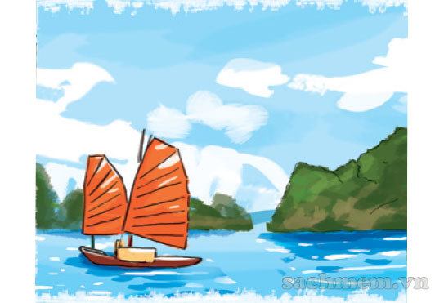

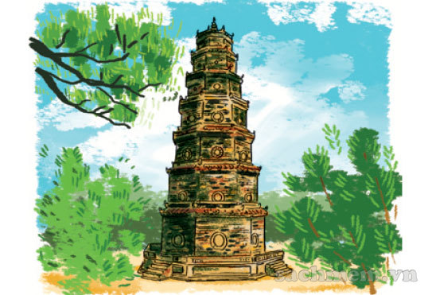
4. Listen and match
a
1
b
2
3
c
4
d

Slide 8
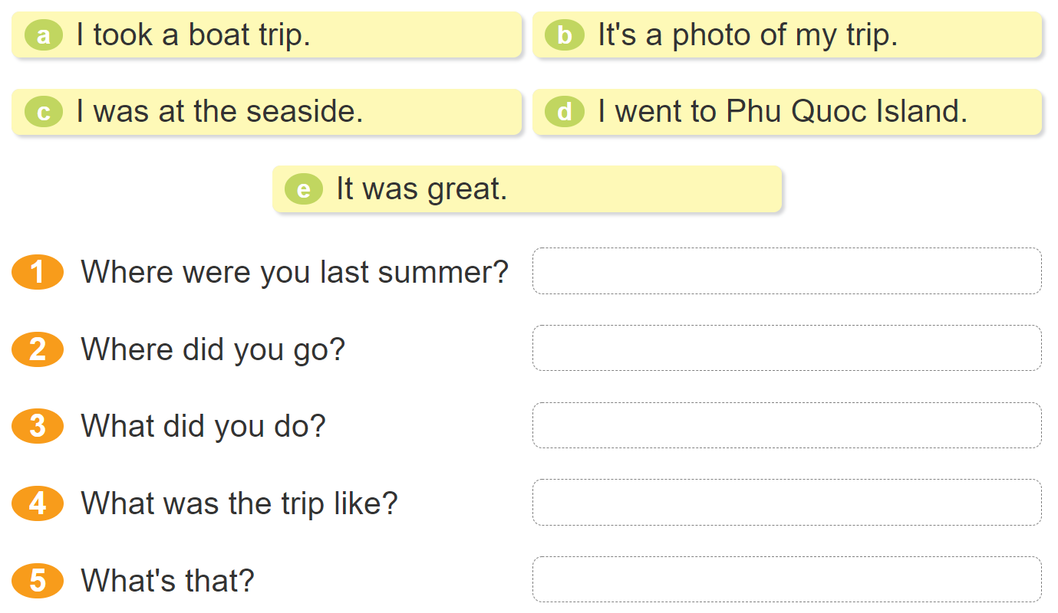






5. Read and match.

Slide 9

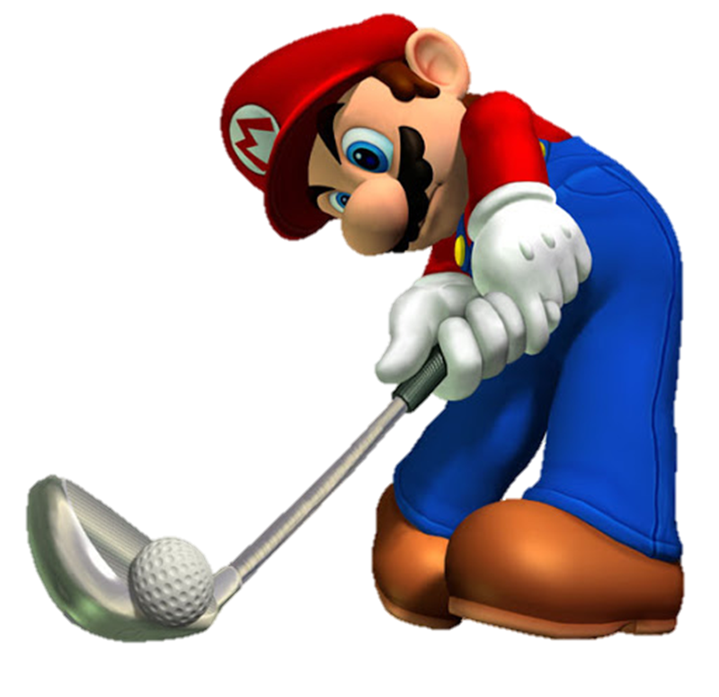
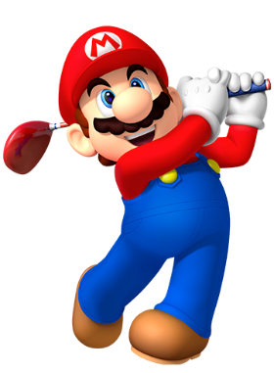

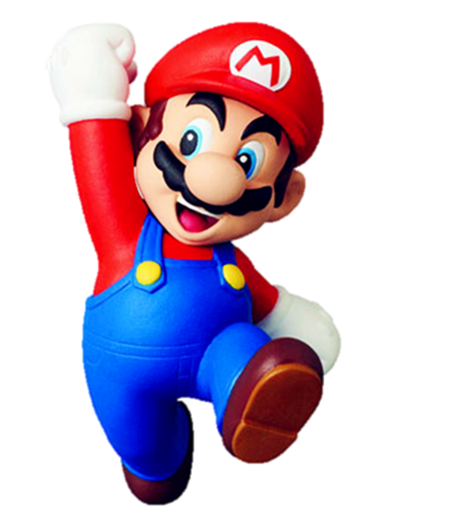


Slide 10






Where did you go on holiday?
I went to school.
I went to Hue Imperial City.
I went to HaNoi.

Slide 11
Where did you go on holiday?
I went to HaNoi.
I went to Ho Chi Minh City.
I went to Hoi An
Ancient Town.

Slide 12
Where did you go on holiday?
I went to HaLong Bay.
I went to Phu Quoc Island.
I went to Hue Imperial city.

Slide 13
Where did you go on holiday?
I went to
Ha Long Bay.
I went to Phu Quoc Island.
I went to Cat Ba Island.

Slide 14
Where did you go on holiday?
I went to Phu Quoc Island.
She went to Phu Quoc Island.
He went to Phu Quoc Island.

Slide 15



