Slide 1
Unit 7
How do you
leArn English
Lesson 2

Slide 2
VOCABULARY

Slide 3
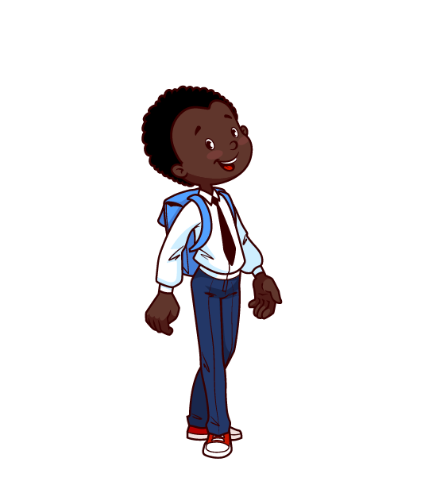

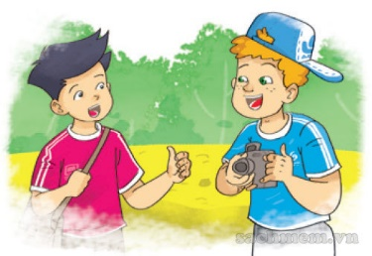
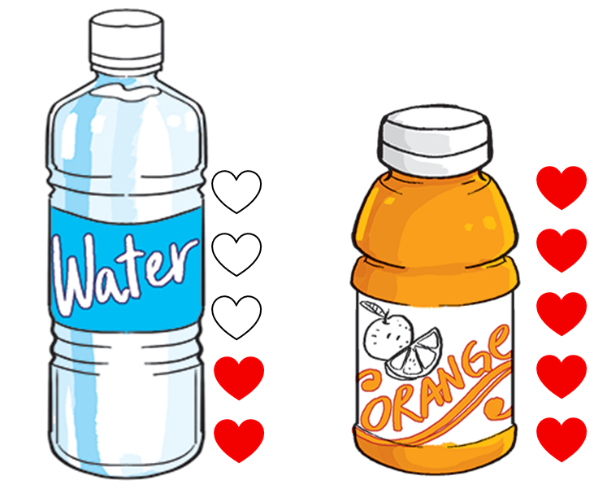
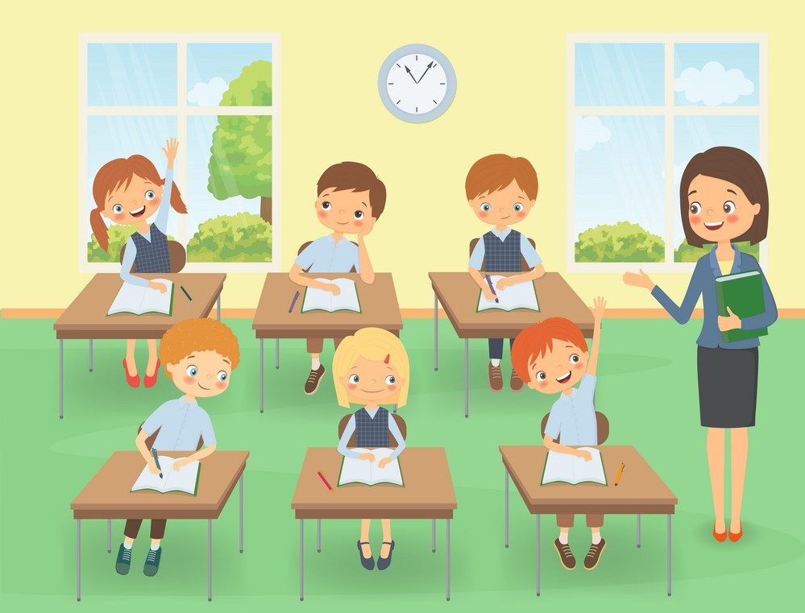
A. Vocabulary
French
English
French
language
foreign
/frentʃ/
/ˈlæŋɡwɪdʒ/
/ˈfɔːrən/
Tiếng Pháp
Ngôn ngữ
Nước ngoài
talk
favourite
learn
/tɔːk/
/ˈfeɪvərɪt/
/lɜːrn/
Nói chuyện
Yêu thích
Học

Slide 4
GRAMMAR

Slide 5
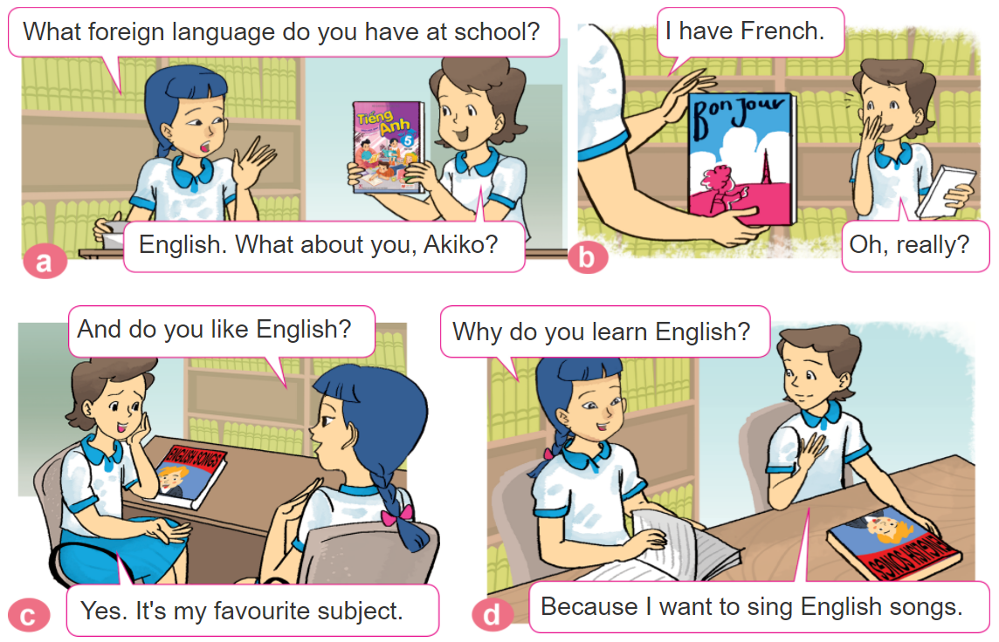

1. Look, listen and repeat.

Slide 6
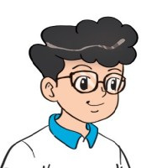

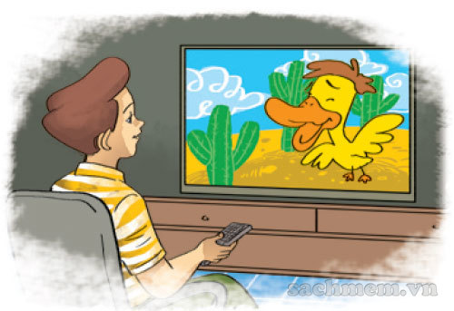

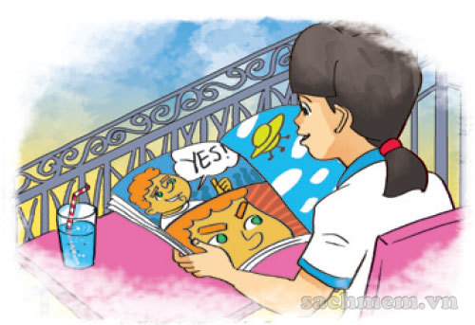
2. Point and say
Why do you learn English?
Because I want to __________.
watch English cartoons on TV
talk with my foreign friends
read English comic books

Slide 7
B. Grammar
Hỏi và trả lời vì sao bạn thích học Tiếng Anh:
(Tại sao bạn thích học Tiếng Anh)
Why do you learn English?
Because I want to ____________.
+ lí do thích học
(Bởi vì tớ muốn ______________)

Slide 8

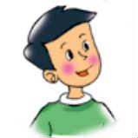
3. Let’s talk
How do you
learn English?
I _____________
Because I want to ______.
Why do you learn English?

Slide 9
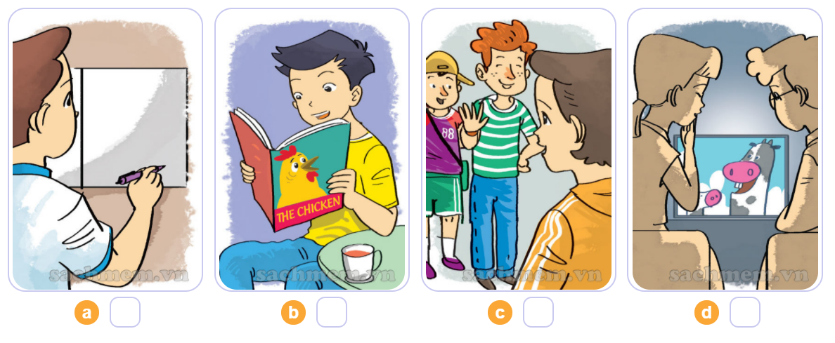
4. Listen and number
2
4
1
3

Slide 10
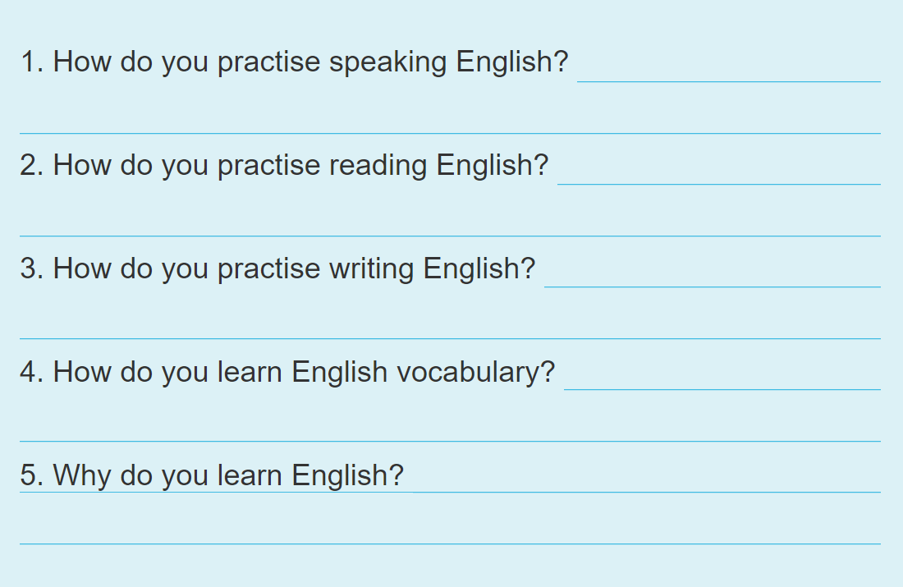
5. Write about you.
I speak English every day.
I read short stories in English.
I write emails to my friends.

Slide 11
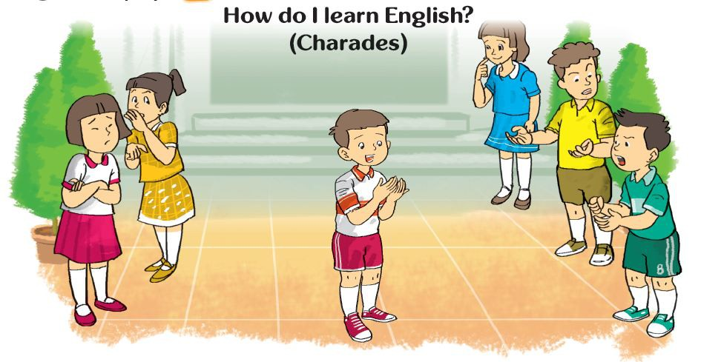
6. Let’s play

Slide 12


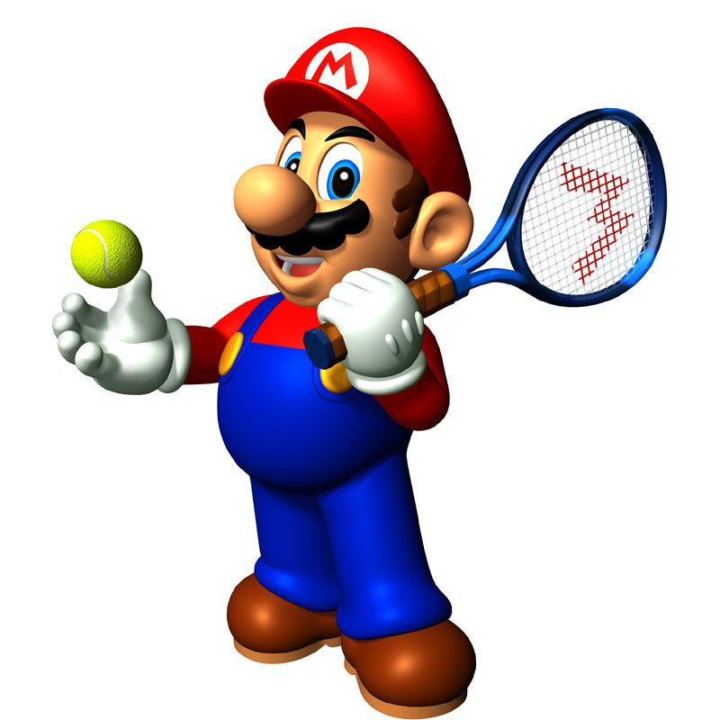





Slide 13
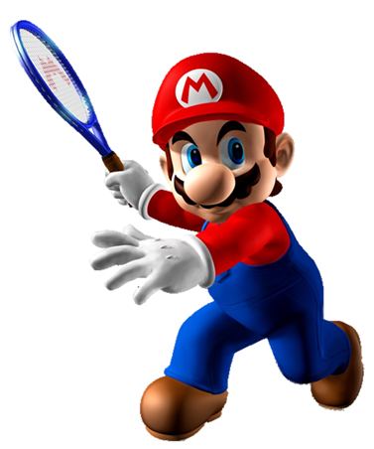
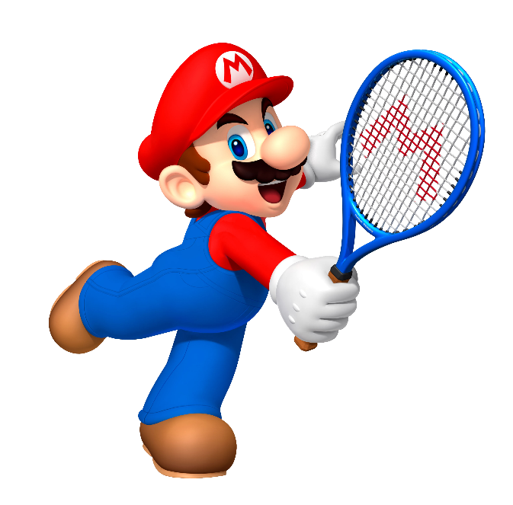


What
How
______ do you learn English?
Because I want to be an English teacher.
Why

Slide 14
Because I want to watch English cartoons on TV.
Because I want to talk with my foreign friends.
Why do you learn English?
Because I want to read English comic books.

Slide 15
Why do you learn nglish?
Because I want to watch English cartoons on TV.
Why do you learn English?
Because I want to talk with my foreign friends.

Slide 16
They is my friend
This is your friend
Why do you learn English?
This is my friend

Slide 17
How do you learn English?
Why do you learn English?
Because I want to
sing English song.
Do do you like to learn English?

Slide 18
do
are
How _____ you learn English?
were

Slide 19
I watch English cartoons on TV.
I read English comic books.
How do you
learn English?
I talk with my foreign friends.

Slide 20
I watch English cartoons on TV.
I talk with my foreign friends.
How do you
learn English?
I read English comic books.

Slide 21
I sing English song.
I talk with my foreign friends.
How do you
learn English?
I watch English cartoons on TV.

Slide 22
Time’s up!

