Slide 1




















Notes:
Để nguyên trang bìa như này, chỉ thay đổi tên bài trong quá trình làm. Logo của sách Wonderful World

Slide 2
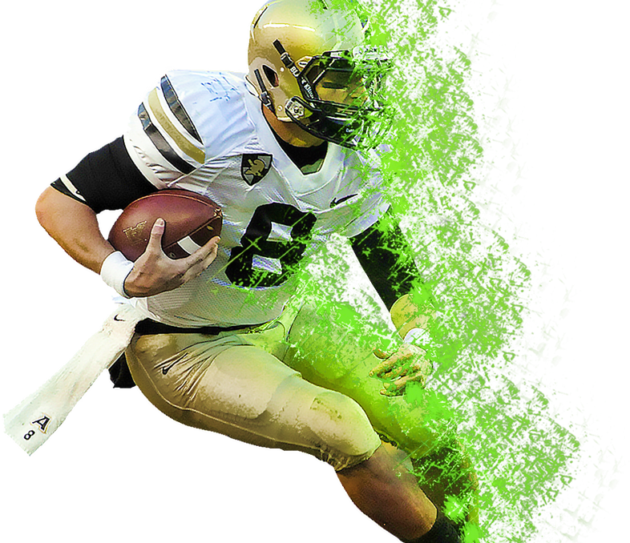
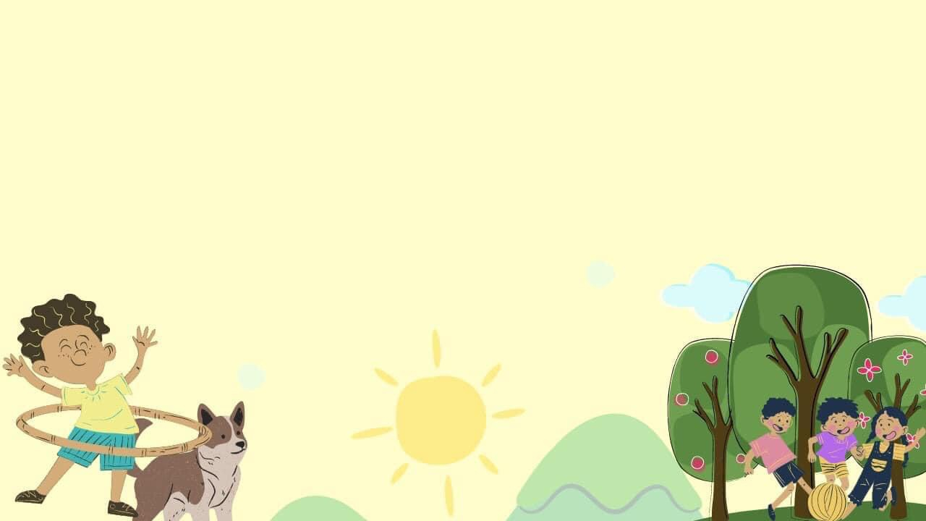

Unit 7
My Favourite Sport
Lesson 2. Task 4,5,6
Notes:
Font chữ chỉnh lại

Slide 3

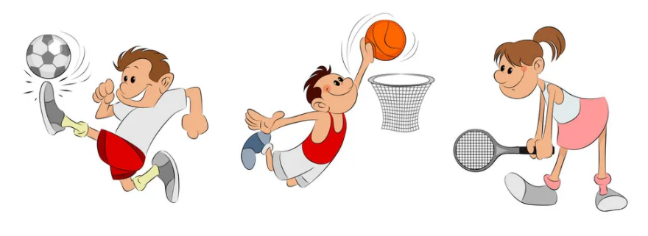
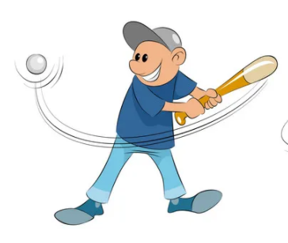
1.Warm Up
Quick Eyes Game
Within 10,7,5 seconds ,
look and remember the positions of the words

Slide 4

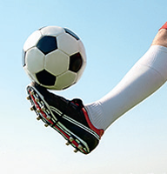
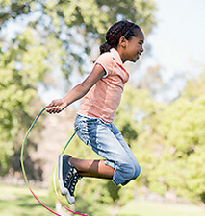
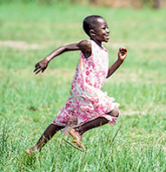





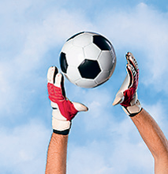

Challenge 1 10 seconds
1
2
3
4
5

Slide 5
Challenge 2 7 seconds
1
2
3
4
5

Slide 6
Challenge 3 5 seconds
1
2
3
4
5

Slide 7
2.Presentation

Slide 8
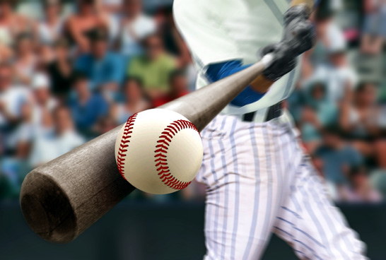
not
I’m not kicking the ball.
I’m hitting the ball.

Slide 9
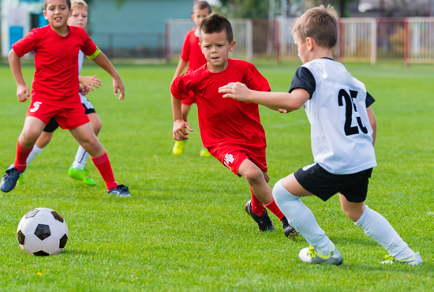
not
He’s not jumping.
He’s running.

Slide 10

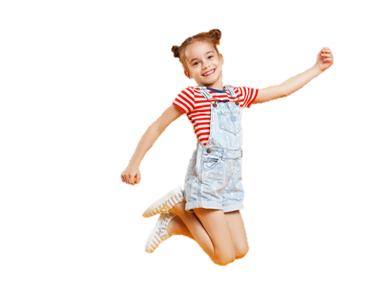
not
She’s not running.
She’s jumping .

Slide 11

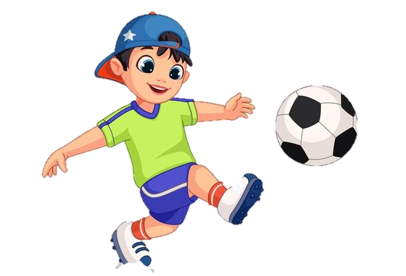
Which is correct ?
A. He’s jumping.
B. He’s not hitting the ball.
C. He’s not playing football.
D. He’s hitting the ball

Slide 12




Task 4. Listen and repeat. TR 7.6
I’m not kicking the ball.
I’m hitting the ball.
He’s not jumping.
He’s running.
She’s not running.
She’s jumping .

Slide 13


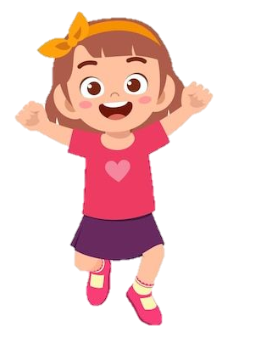
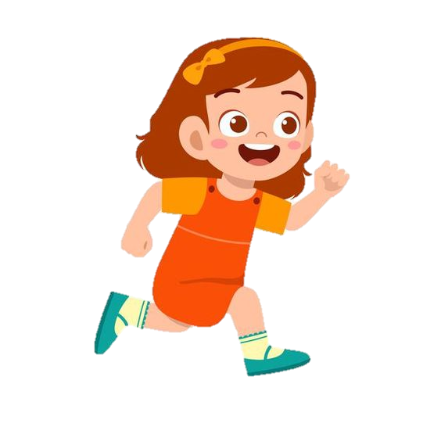

DO IT
She is running.
Notes:
A student write or give the requirement. Other Sts follow and get the stars if they can do right action. Or both of them can do it, they can play rock, papers, scissors to find the winner.

Slide 14


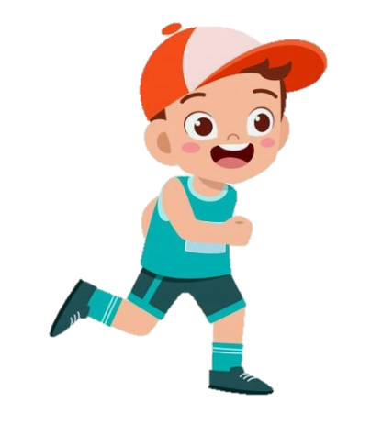
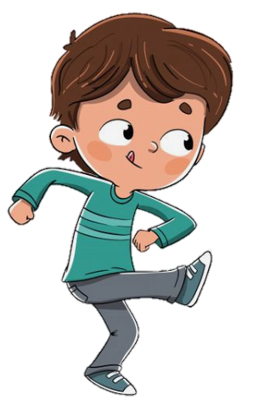
He’s not playing football.

Slide 15

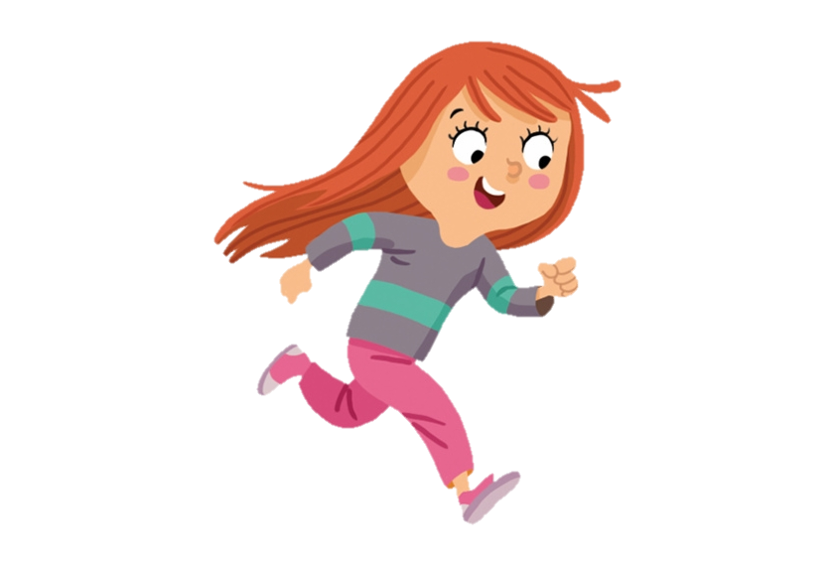
She isn’t jumping.

Slide 16

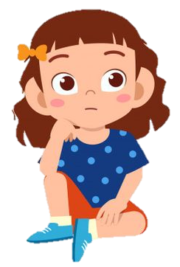
Who am I ?
CHECKING GAME
Listen and choose the correct picture.

Slide 17

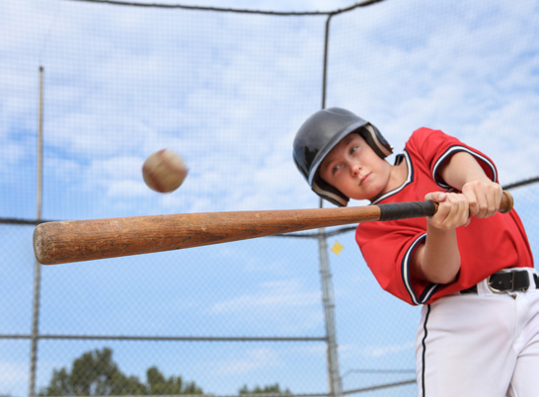
Who am I ?

Slide 18


Who ?

Slide 19
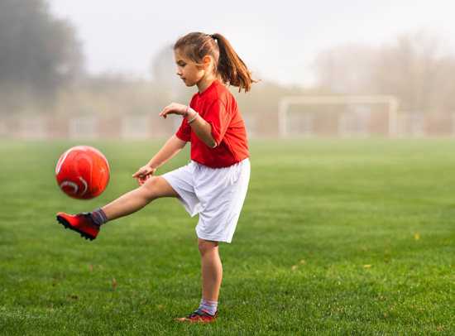
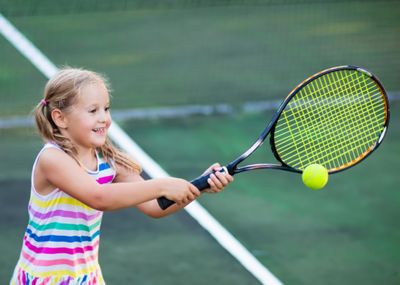
Who ?

Slide 20


3.Practice
Task 5. Look and say

Slide 21










Game

Slide 22


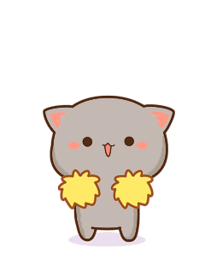


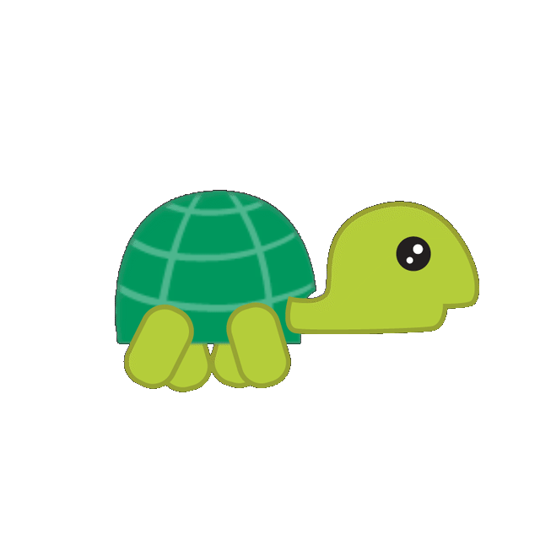

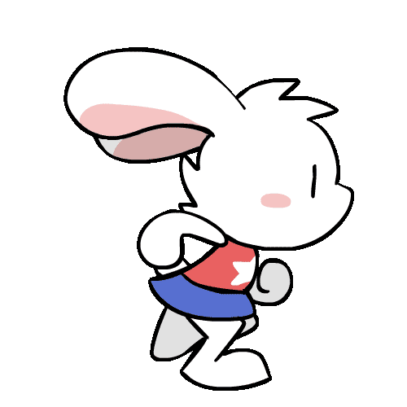
The turtle and the rabbit

Slide 23








Rabbit
Turtle
Notes:
T clicks rabit and turtle to move these animals.

Slide 24

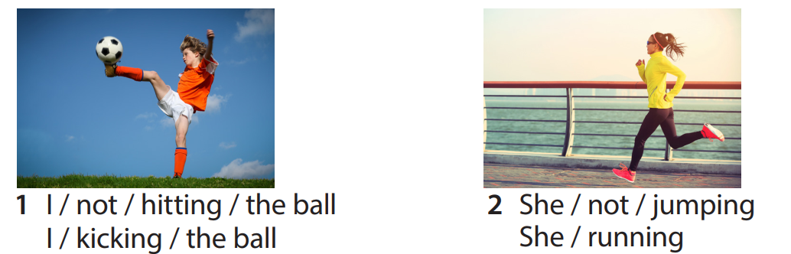
I’m not hitting the ball.
I’m kicking the ball.

Slide 25
She’s not jumping.
She’s running.

Slide 26
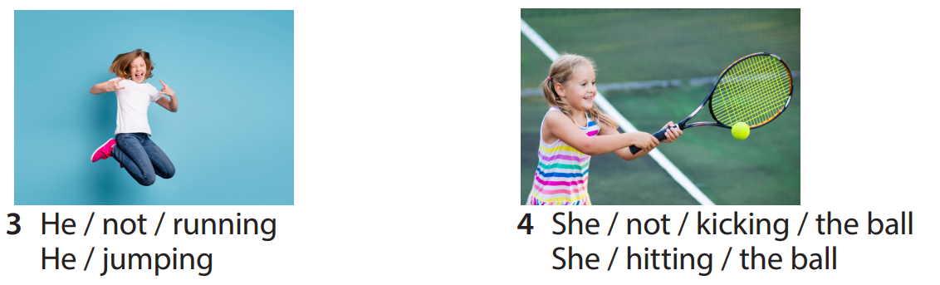
He’s not running.
He’s jumping.

Slide 27

She’s not kicking the ball.
She’s hitting the ball.

Slide 28


She………….kicking the ball.
isn’t
is
isn’t

Slide 29
He………….running.
is
A. isn’t
B. is

Slide 30
4.Production
Task 6. Draw and write. Say.

Slide 31

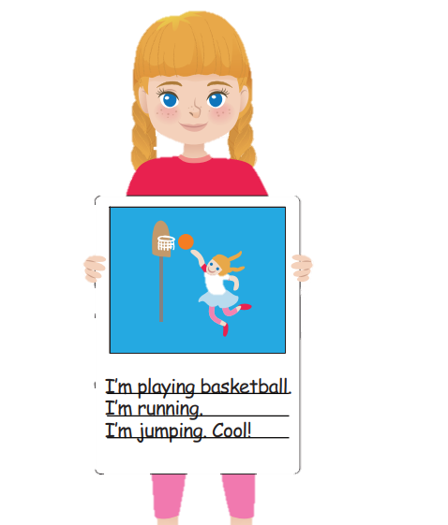
“What is your favourite sport ?”
Draw and write what you are doing when you play.

Slide 32
5.Assessment
Choose the correct answer.

Slide 33

She…………running
a. ‘s b. isn’t c. am
2. She’s …………..the ball
a. catching b. kicking c. hitting
3. He …………the ball.
a. ‘s kicking b. isn’t hitting c. ’s hitting
Notes:
Sts choose the correct option. If they do it right, give the dice for them to row and get stars.

Slide 34




Thank you & goodbye!

