Slide 1

Unit 5: Sports and hobbies
Lesson 3.2
Page 75

Slide 2
Lesson Outline
Warm-up
Listening
Consolidation
Wrap-up

Slide 3
Objectives
By the end of this lesson, students will be able to pronounce the sound /tʃ / and talk about their school timetables.
Phonic: /tʃ /
Structure: May I watch TV?
- Yes, you may./No, you may not

Slide 4

WARM UP

Slide 5
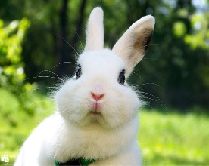
Hidden
Pictures
Guessing
Game

Slide 6
HOW TO PLAY
Hidden Picture Games
- Ask students to choose a color.
Click on the colored shapes. This will reveal the hidden picture.
As the shapes disappear, students should try to guess the word.

Slide 7
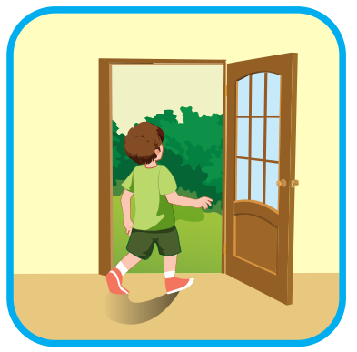

go out
SHOW

Slide 8

watch TV
SHOW

Slide 9
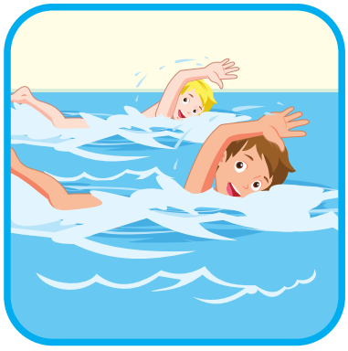
go swimming
SHOW

Slide 10
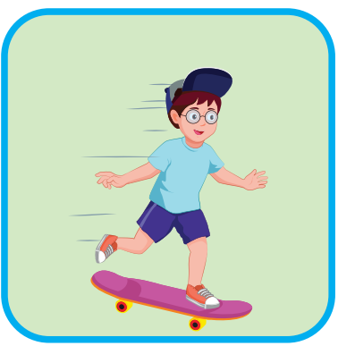
go skateboarding
SHOW

Slide 11

It’s time to learn …

Slide 12

Phonics
/tʃ/

Slide 13
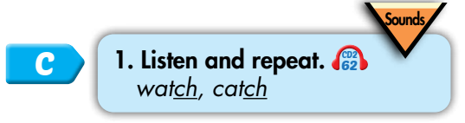

/tʃ/
watch
catch

Slide 14


/tʃ/, /tʃ/, /tʃ/,
/tʃ/, /tʃ/, /tʃ/,
watch, catch,
/tʃ/, /tʃ/, /tʃ/.
/tʃ/, /tʃ/, /tʃ/, /tʃ/, /tʃ/, /tʃ/, watch, catch, /tʃ/, /tʃ/, /tʃ/.
Click to follow the lyrics.
Notes:
GV click lần 1 để follow lyric 1
Gv click lần 2 để follow lyric 2

Slide 15

Listening

Slide 16
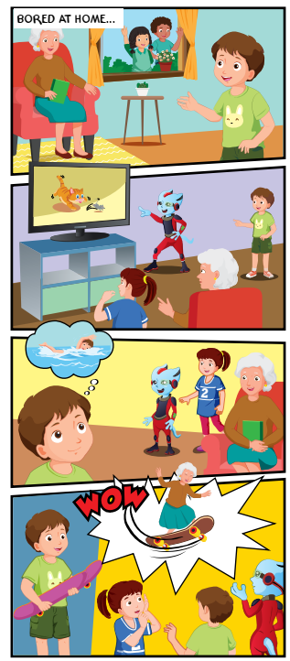

1
Where are the kids?
2
Who is with them?
3
What is Grandma doing?
4

Slide 17

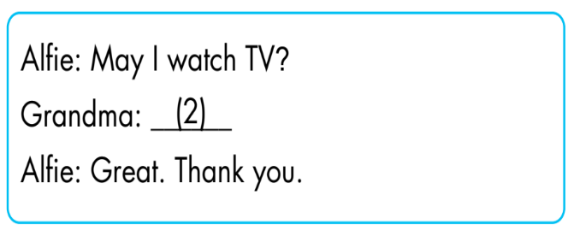
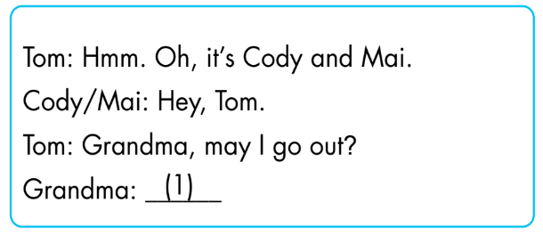
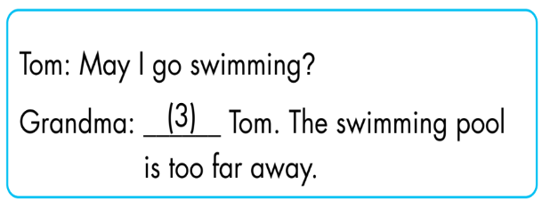
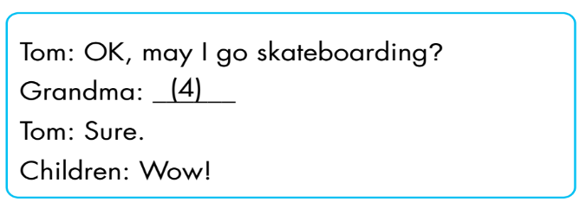
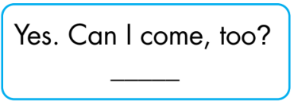
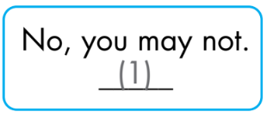
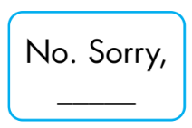
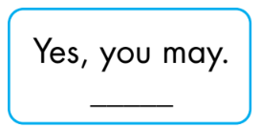
(4)
(3)
(2)

Slide 18
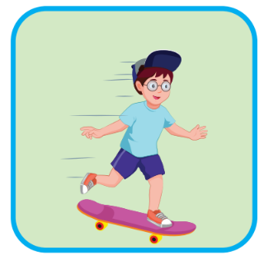
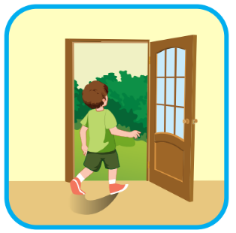


Extra Practice
WB, page 53.
1
2
3
4
May I go
skateboarding?
May I watch TV?
May I go out?
May I go swimming?
❌
✓
❌
✓
Click on the number to hear the sound.

Slide 19

Practice

Slide 20
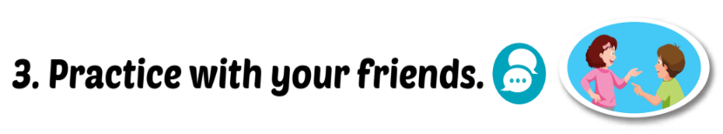
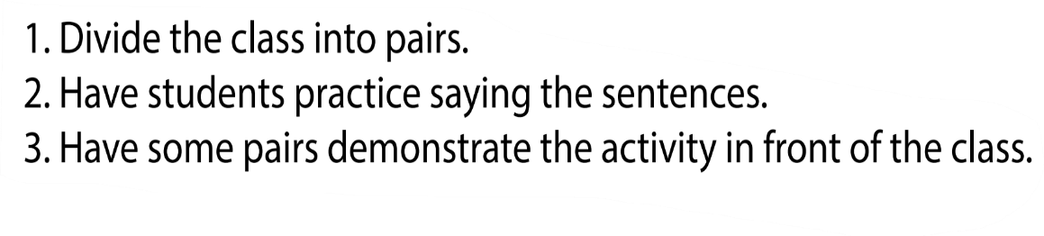


Yes, you may/ No, you may not.
May I watch TV?

Slide 21

THE SLAP GAME 🙌🏽

Slide 22
May I go out?
Yes, you may
Yes, I may

Slide 23
May I go skateboarding?
No, you may not
Yes, I may

Slide 24
May I …TV?
go
watch

Slide 25
May I go …?
swimming
swiming

Slide 26
… go out?
I may
May I

Slide 27

CONSOLIDATION

Slide 28
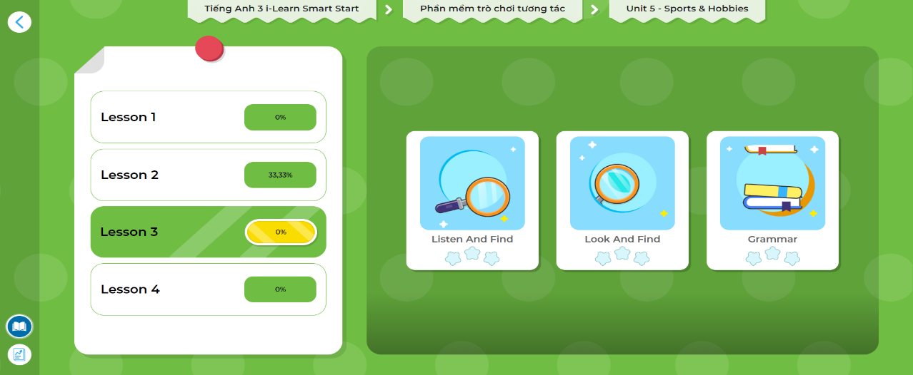
LET’S PLAY!
Click here to play the games!

Slide 29

WRAP-UP

Slide 30

Let’s play

Slide 31


How to play
. Listen to a sound
. Choose the correct answer

Slide 32






Click here
Wat TV
Watch VT
Wach TV
Watch TV

Slide 33
Click here
go swim
go swiming
go swimming
swimming

Slide 34
Click here
skateboarding
go
skateboarding
go skateboading
go skate

Slide 35


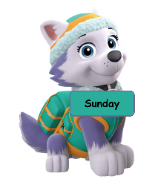
Click here
going out
go out
out
go ou

Slide 36
Click here
No, you may
Yes, I may
Yes, you may
Yes, you may not

Slide 37
Today’s lesson
Phonics
/tʃ/
Structures/ Sentence patterns
May I watch TV?
- Yes, you may/ No, you may not…

Slide 38
Homework
Practice the vocabularies/ structures and make sentences using them.
Do the exercises on page 53 WB
Do the exercises in Tiếng Anh 3 i-Learn Smart Start Notebook on page 36.
Prepare the next lesson (page 76 SB)
Play the consolidation games in Tiếng Anh 3 i-Learn Smart Start DHA App on www.eduhome.com.vn

Slide 39

Lesson 3
Stay positive and have a nice day!

