Slide 1
Unit 10
Where were you yesterday?
Lesson 3

Slide 2
REVIEW

Slide 3






PRERENT WHEEL
10
50
30
30
20
Good job!
SPIN/STOP
SPIN/STOP
SPIN/STOP
SPIN/STOP
SPIN/STOP
SPIN/STOP
SPIN/STOP
SPIN/STOP
SPIN/STOP
SPIN/STOP
SPIN/STOP
SPIN/STOP
SPIN/STOP
SPIN/STOP
SPIN/STOP
40
SPIN/STOP
60
60
40
20
30
10
50
Notes:
Ms Huyền Phạm - 0936.082.789 – YOUTUBE: MsPham. Facebook: Dạy và học cùng công nghệ.

Slide 4

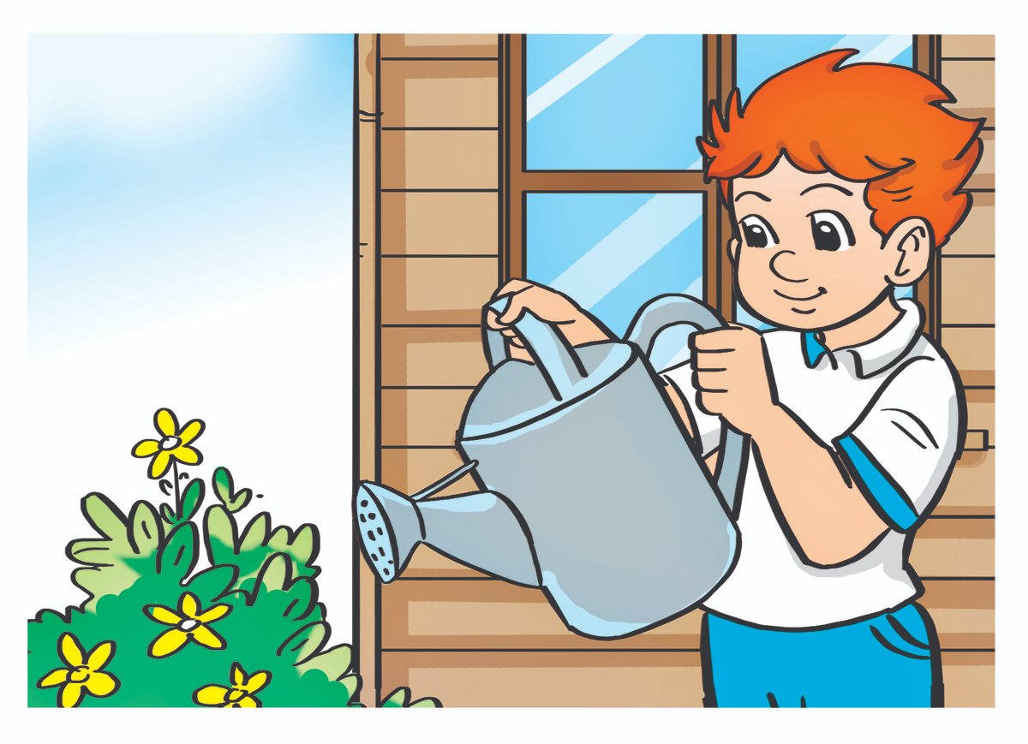

Answer
I was at home.
Where were you yesterday?
Notes:
Ms Huyền Phạm - 0936.082.789 – YOUTUBE: MsPham. Facebook: Dạy và học cùng công nghệ.

Slide 5

Answer
I was at school.
Where were you yesterday?
Notes:
Ms Huyền Phạm - 0936.082.789 – YOUTUBE: MsPham. Facebook: Dạy và học cùng công nghệ.

Slide 6

Answer
I was in the school library.
Where were you yesterday?
Notes:
Ms Huyền Phạm - 0936.082.789 – YOUTUBE: MsPham. Facebook: Dạy và học cùng công nghệ.

Slide 7

Answer
I was in the zoo.
Where were you yesterday?
Notes:
Ms Huyền Phạm - 0936.082.789 – YOUTUBE: MsPham. Facebook: Dạy và học cùng công nghệ.

Slide 8
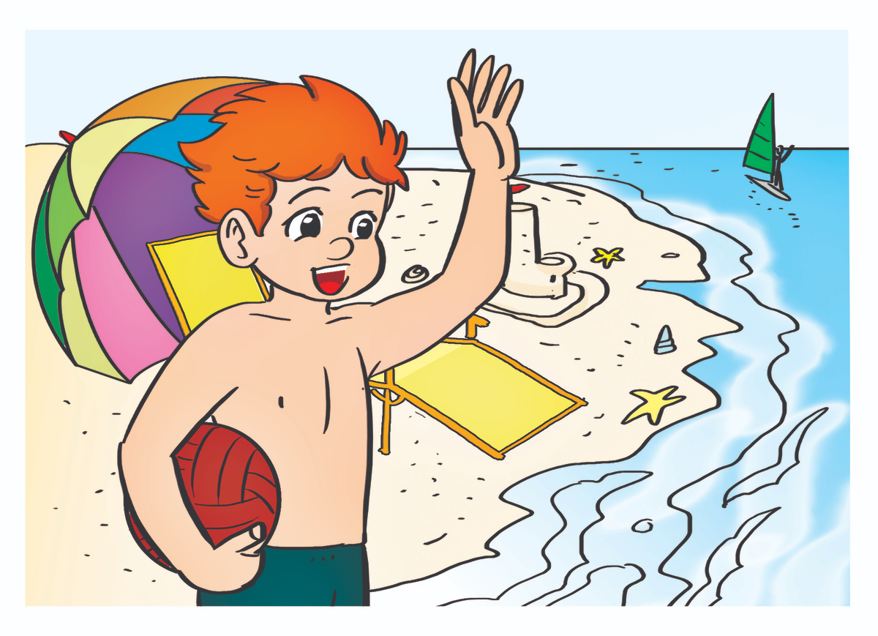
Answer
I was on the beach.
Where were you yesterday?
Notes:
Ms Huyền Phạm - 0936.082.789 – YOUTUBE: MsPham. Facebook: Dạy và học cùng công nghệ.

Slide 9
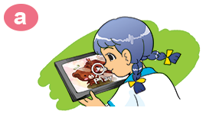
Answer
I watched a video.
What did you do yesterday?
Notes:
Ms Huyền Phạm - 0936.082.789 – YOUTUBE: MsPham. Facebook: Dạy và học cùng công nghệ.

Slide 10

Answer
I listened to music.
What did you do yesterday?
Notes:
Ms Huyền Phạm - 0936.082.789 – YOUTUBE: MsPham. Facebook: Dạy và học cùng công nghệ.

Slide 11
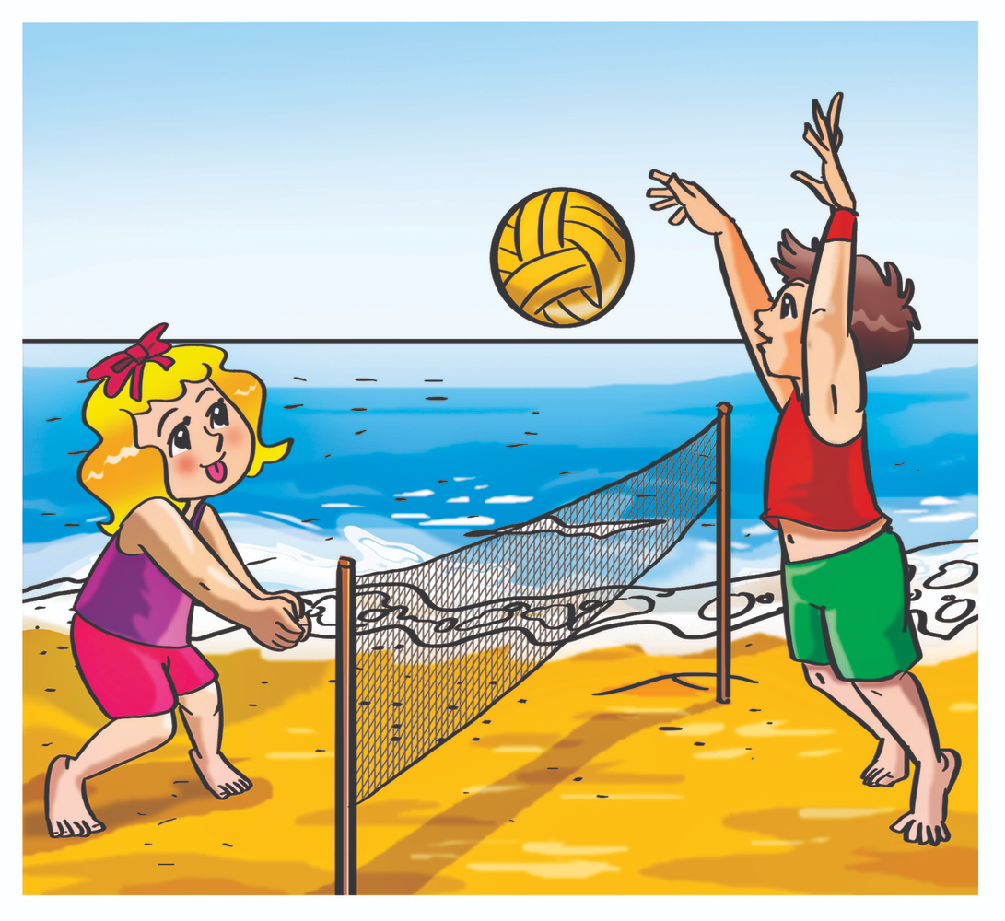
Answer
What did you do yesterday?
__________?
I played volleyball.
Notes:
Ms Huyền Phạm - 0936.082.789 – YOUTUBE: MsPham. Facebook: Dạy và học cùng công nghệ.

Slide 12
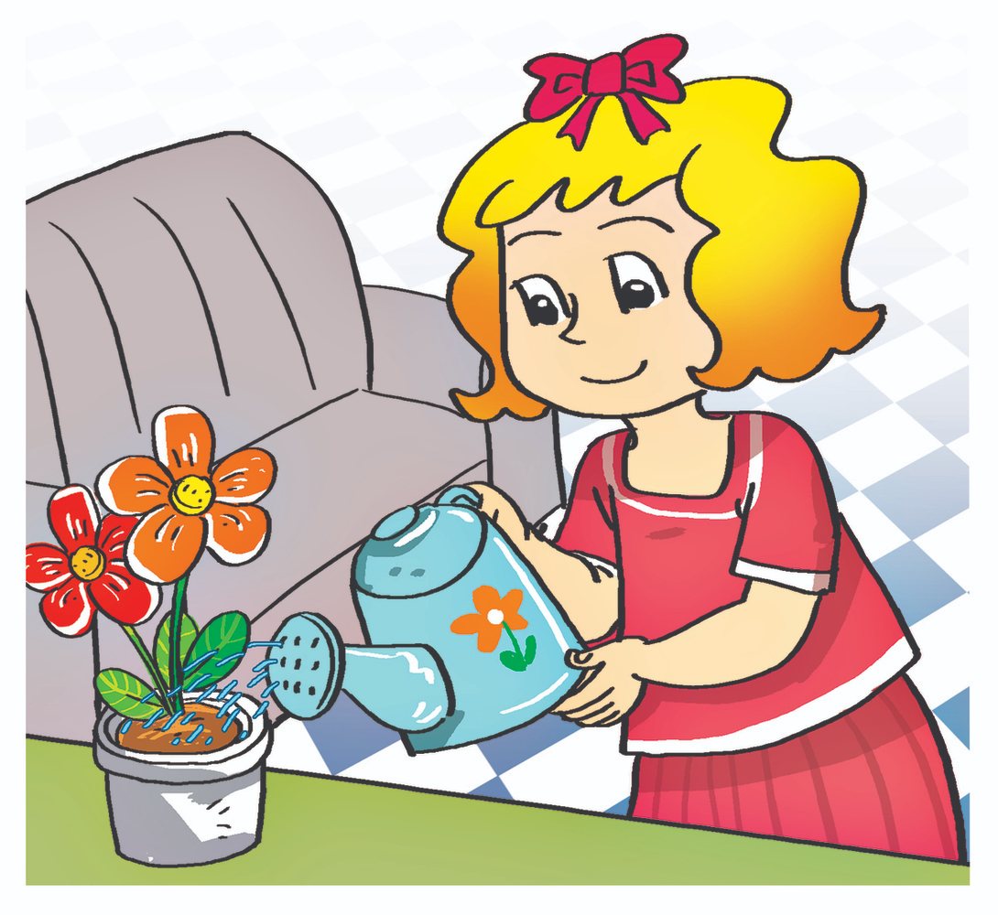
Answer
I watered the flowers.
What did you do yesterday?
Notes:
Ms Huyền Phạm - 0936.082.789 – YOUTUBE: MsPham. Facebook: Dạy và học cùng công nghệ.

Slide 13
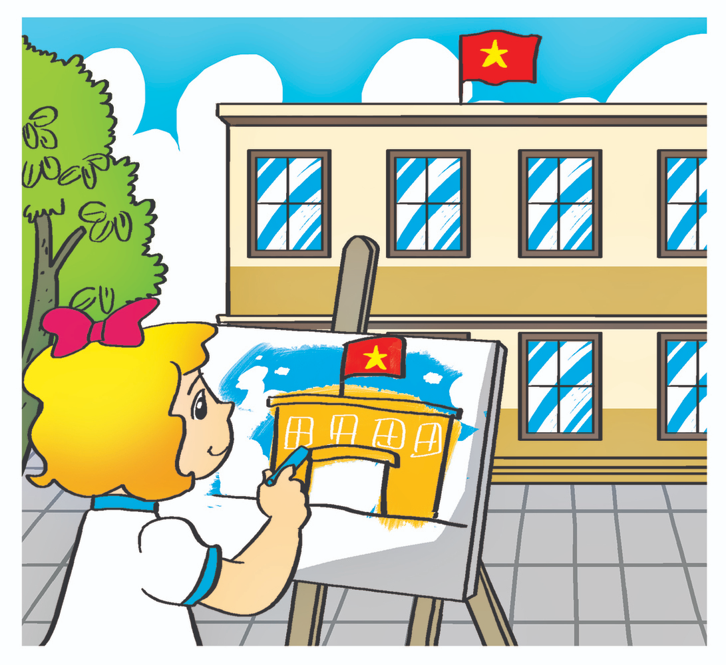
Answer
I painted a picture.
What did you do yesterday?
Notes:
Ms Huyền Phạm - 0936.082.789 – YOUTUBE: MsPham. Facebook: Dạy và học cùng công nghệ.

Slide 14
PHONICS

Slide 15
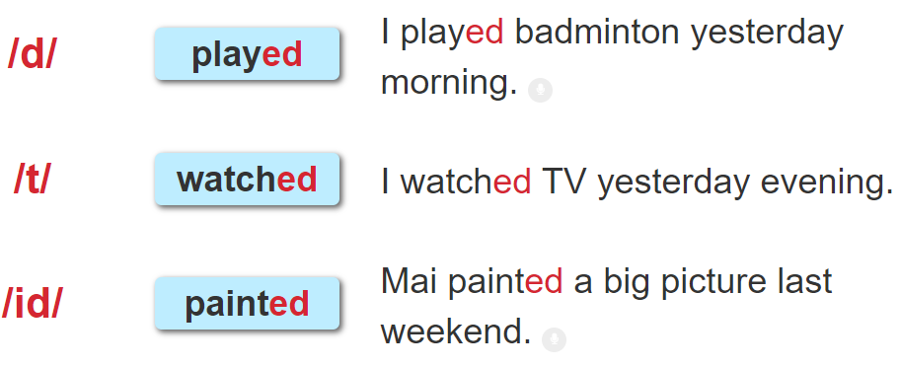

1. Listen and repeat.

Slide 16
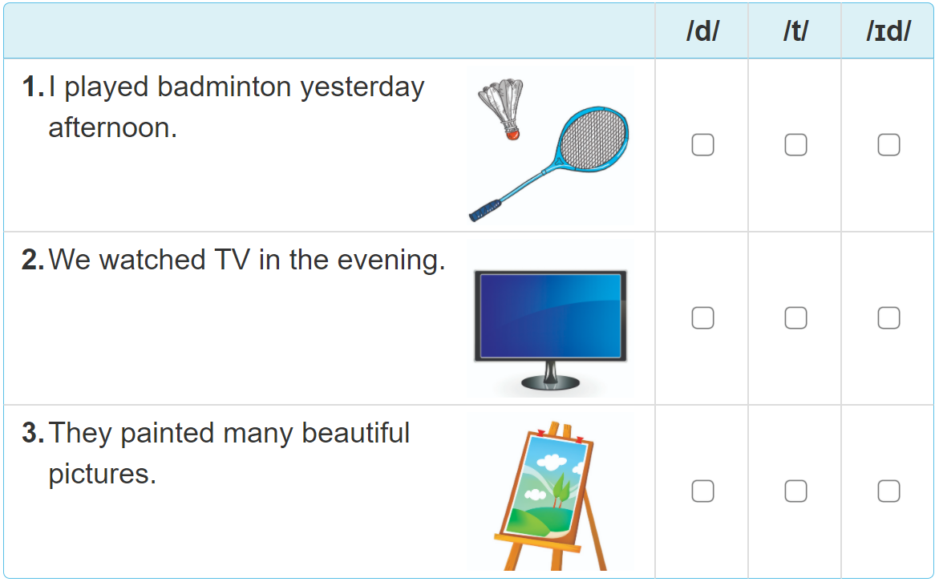

2. Listen and tick. Then write and say aloud

Slide 17
PRACTISE

Slide 18
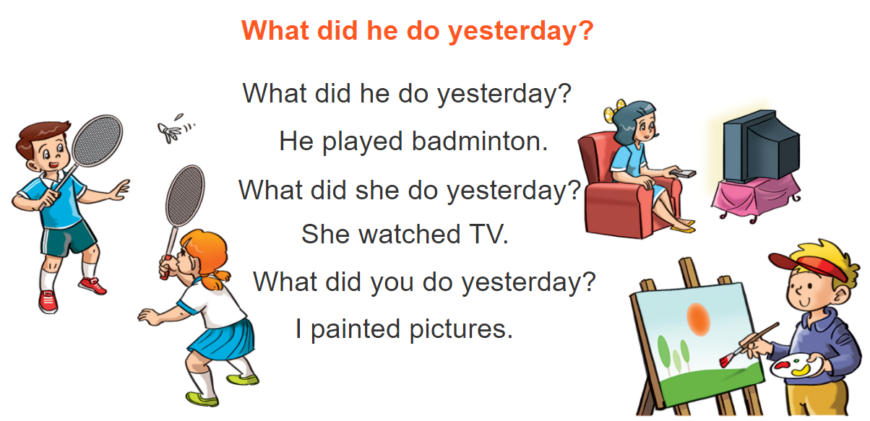



3. Let’s chant

Slide 19
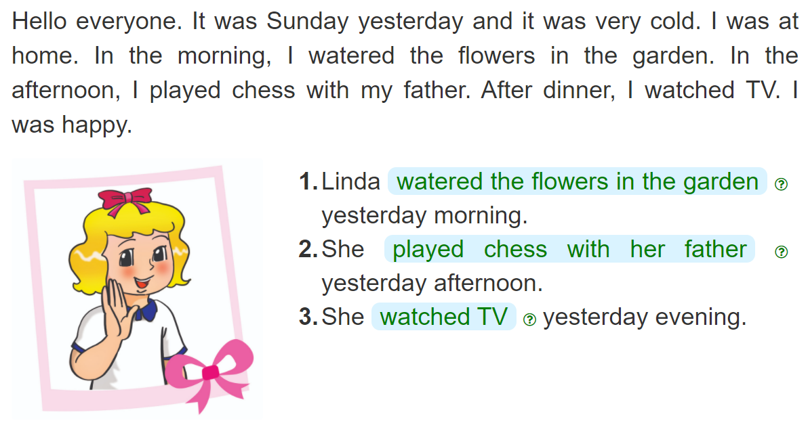
4. Read and complete
_______________________________________________
_______________________________________________
__________________

Slide 20
5. Write about you
Yesterday, I was __________________.
In the morning, I__________________.
In the afternoon, I _________________.
In the evening, I___________________.

Slide 21
6. Project
Work in pairs. Ask your partners where they were and what they did last weekend. Then tell the class about it.

Slide 22



THANK YOU!
Welcome to join with me!
MsPham Powerpoint
Mspham

