Slide 1
Unit 10
Where were you yesterday?
Lesson 2

Slide 2
VOCABULARY

Slide 3
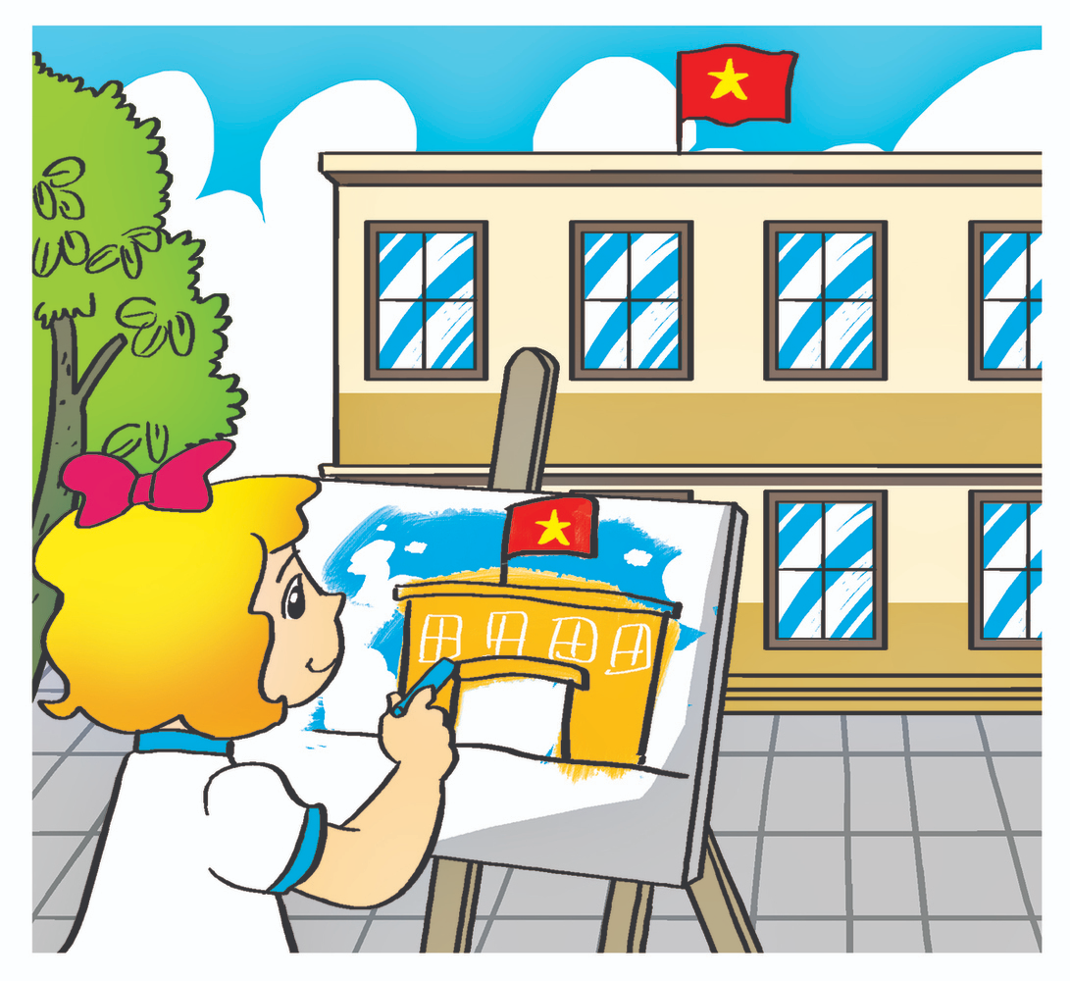
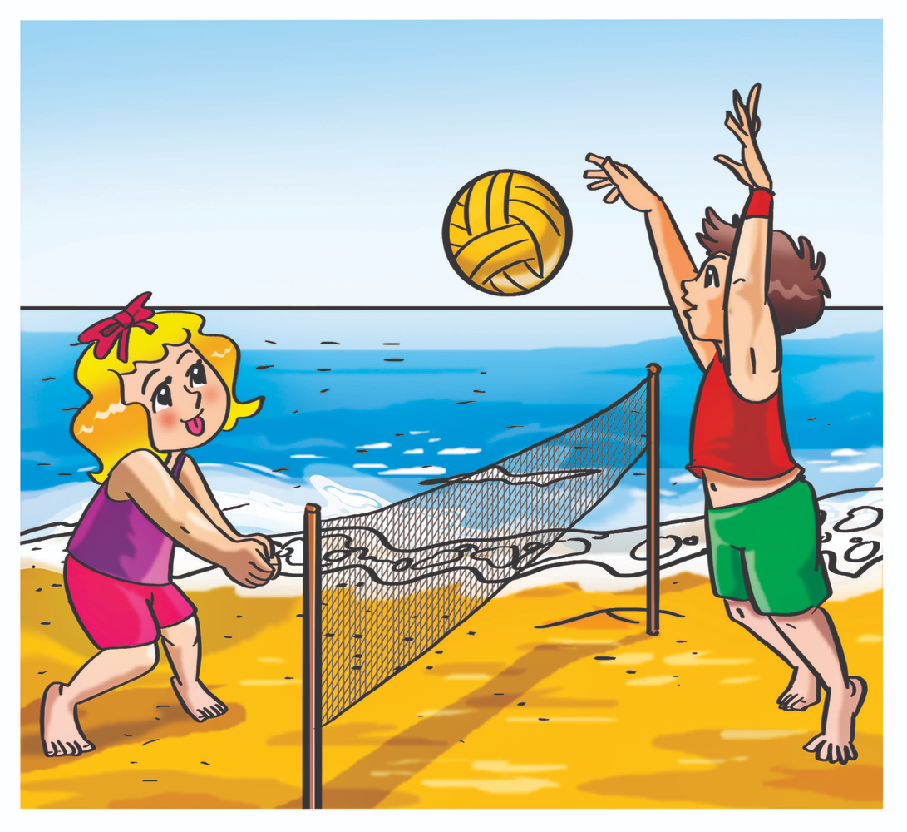
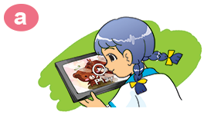

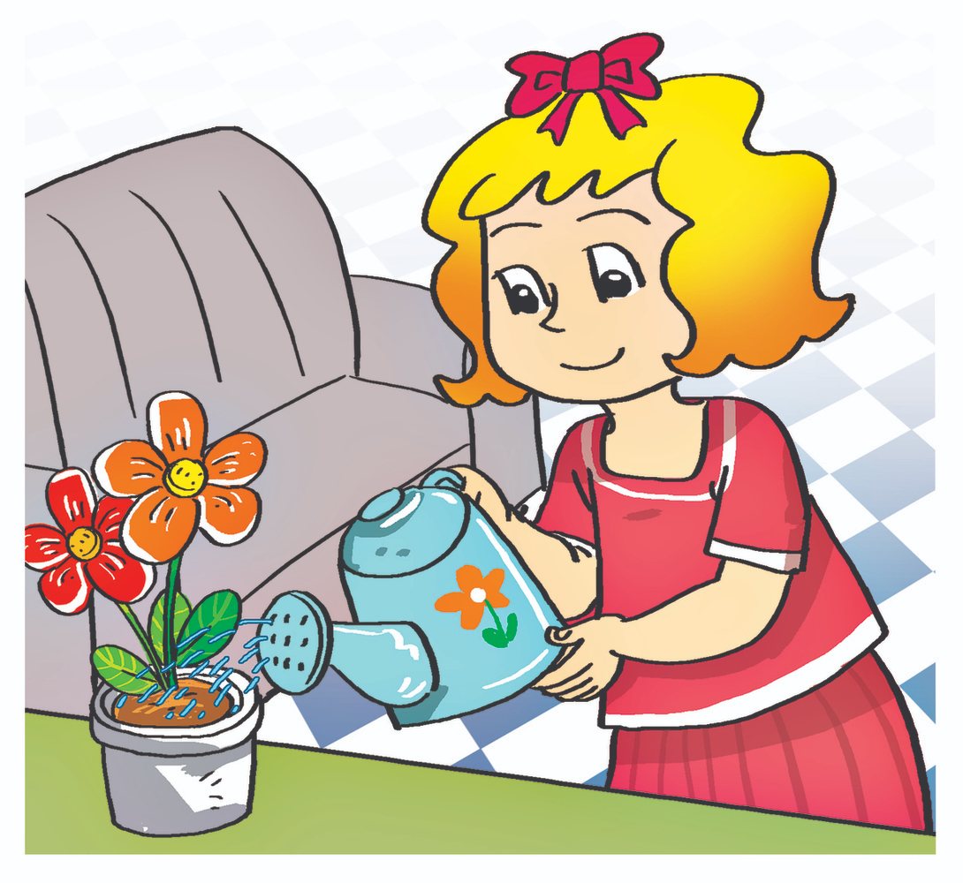
A. Vocabulary
V
paint
play
watch
listen
water
/peɪnt/
/pleɪ/
/wɑːtʃ/
/ˈlɪsn/
/ˈwɔːtər/
Vẽ
Chơi
Xem
Nghe
Tưới cây
V-ed
painted
played
watched
listened
watered
/peɪntɪd/
/pleɪd/
/wɑːtʃt/
/ˈlɪsnd/
/ˈwɔːtərd/
Đã vẽ
Đã chơi
Đã xem
Đã nghe
Đã tưới cây

Slide 4
A. Vocabulary
watch
paint
water
listen
play

Slide 5
GRAMMAR

Slide 6
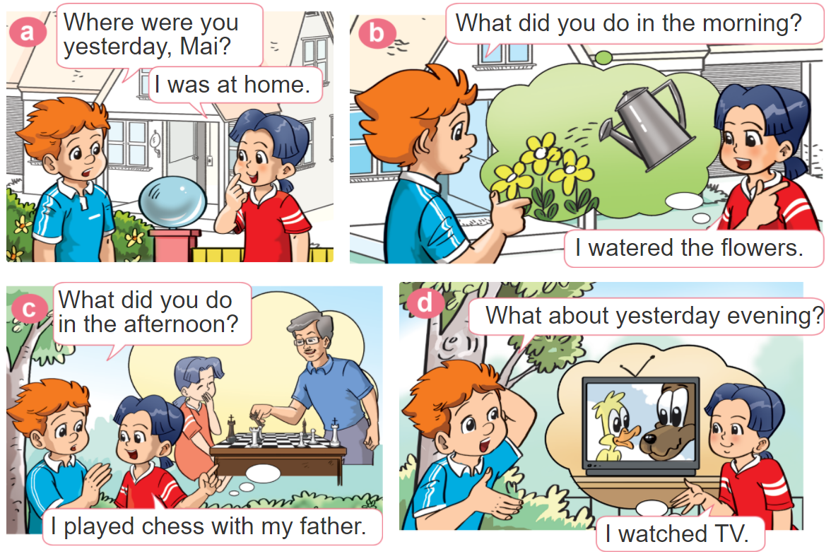

1. Look, listen and repeat.

Slide 7

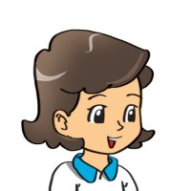
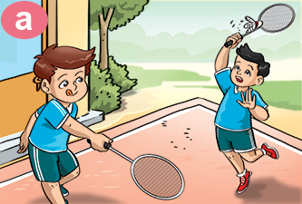
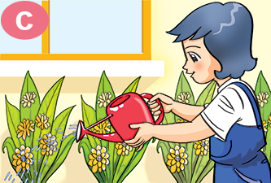
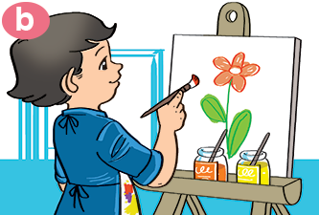
2. Point and say
What did you do yesterday?
I ________________.
played badminton
watered the flowers
painted a picture

Slide 8
B. Grammar
Hỏi và trả lời bạn đã làm gì:
(Bạn đã làm gì ngày hôm qua?)
What did you do yesterday?
+ V-ed
I ________.
(Tớ đã _________)

Slide 9











Đi tìm PIKACHU

Slide 10





What did you do yesterday?
I watched a video.
I watch a video.
I was watch a video.

Slide 11
What did you do yesterday?
I was listened
to music.
I like listening
to music.
I listened
to music.

Slide 12
What did you do yesterday?
I painted a picture.
I played volleyball.
I played football.

Slide 13
What did you do yesterday?
I watered the
flowers.
I played
badminton.
I maked
the flowers.

Slide 14
What did you do yesterday?
I played with
my friends
I watered
the flowers.
I painted
a picture.

Slide 15
________ yesterday?
What do you do
What did you do
What do you like
I watered the flowers.

Slide 16
What did you do _______?
today
yesterday
tomorrow
I painted a picture.

Slide 17
What ____ you do yesterday?
are
were
did
I played badminton.

Slide 18


Excellent!

Slide 19
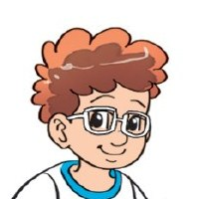

3. Let’s talk
Where were you
yesterday?
I was _________.
What did you do?
I _________.

Slide 20

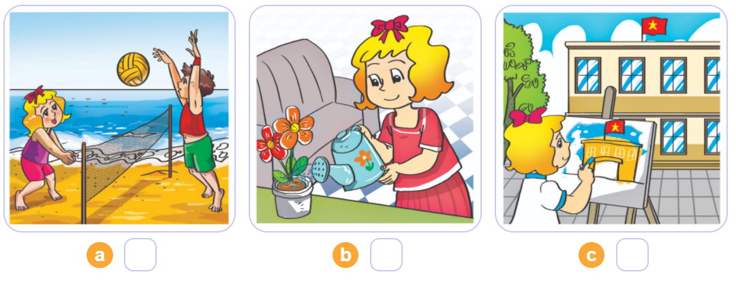
4. Listen and number
1
2
3
3
1
2

Slide 21
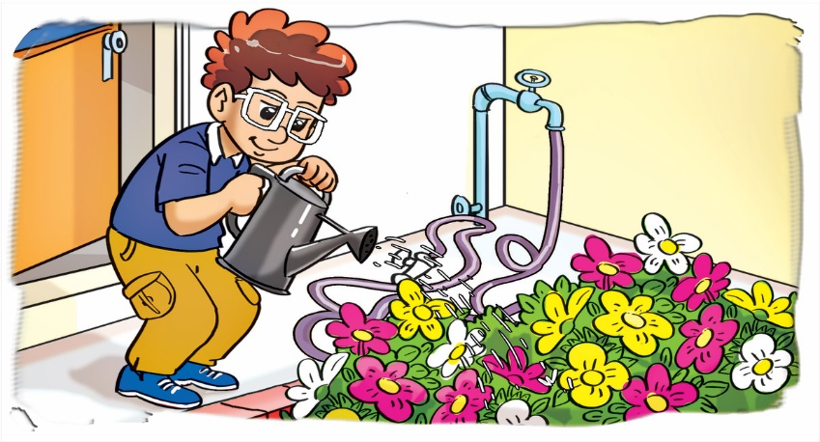
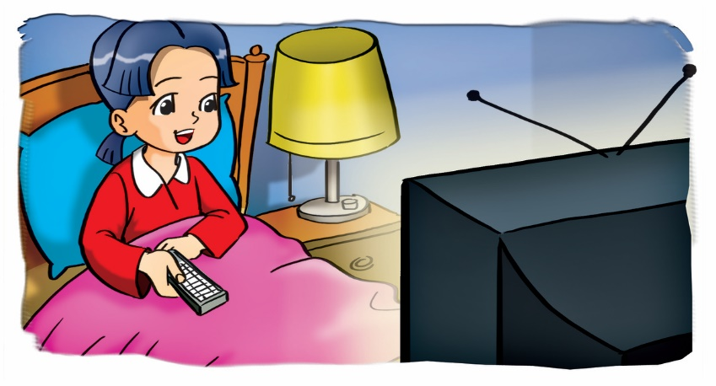
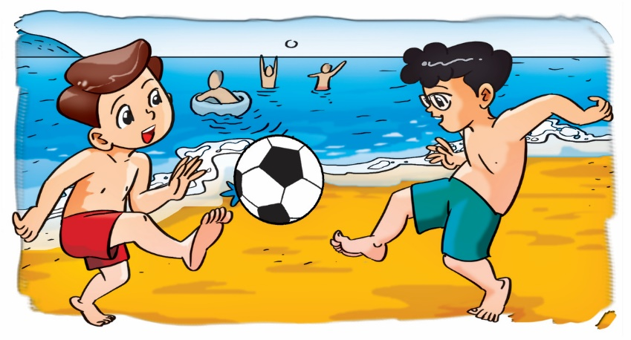
5. Look and write
1.
Mai: Where was Tom yesterday afternoon?
Tony: He was _____________.
Mai: What did he do?
Tony: He _________________.
Phong: Where was Mai yesterday evening?
Akiko: She was _______________.
Phong: What did she do?
Akiko: She ___________.
Linda: Where were Phong and Nam yesterday?
Quan: They were ____________.
Linda: What did they do?
Quan: They _______________.
in the garden
watered the flowers
2.
in the bedroom
watched TV
3.
on the beach
played football

Slide 22
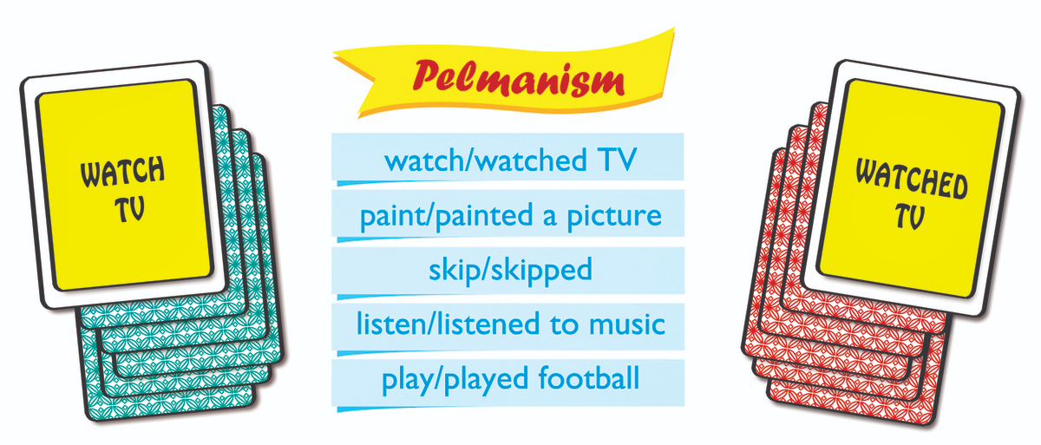
6. Let’s play

Slide 23



THANK YOU!
Welcome to join with me!
MsPham Powerpoint
Mspham

