Slide 1
Unit 9
What are they doing?
Lesson 2

Slide 2
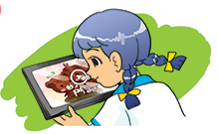

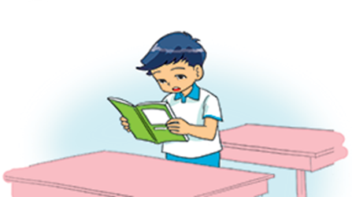
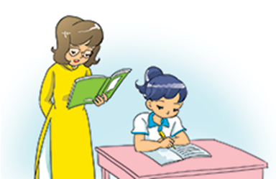
A. Vocabulary
V
V-ing
watch a video
watching a video
Xem video
listen to music
listening to music
Nghe nhạc
read a text
reading a text
Đọc đoạn văn
write a dictation
writing a dictation
Viết chính tả

Slide 3
VOCABULARY

Slide 4
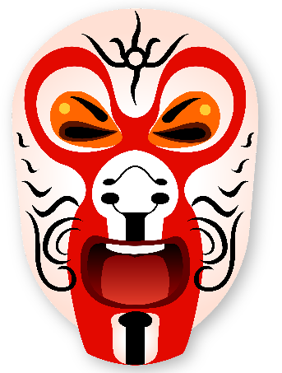


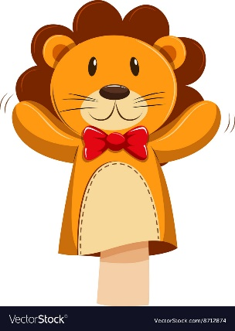
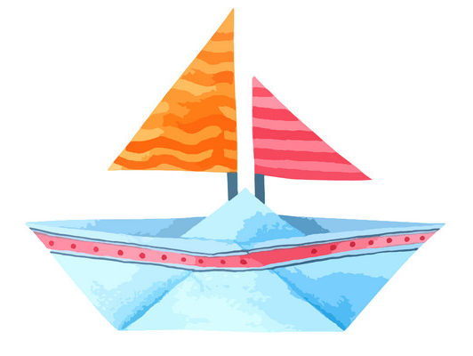
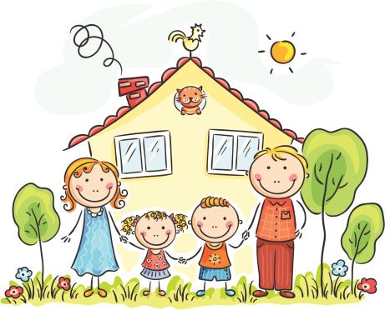

MsPham-0936082789
A. Vocabulary
paper
puppet
mask
kite
/ˈpeɪpər/
/ˈpʌpɪt/
/mɑːsk/
/kaɪt/
Giấy
Con rối
Mặt nạ
Diều
picture
boat
plane
/ˈpɪktʃər/
/bəʊt/
/pleɪn/
Bức tranh
Con thuyền
Máy bay

Slide 5
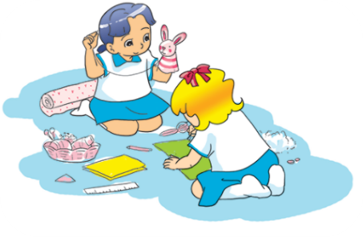
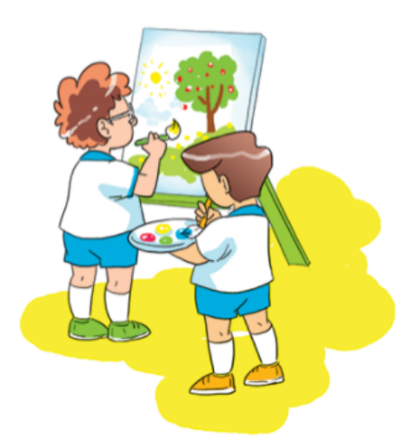
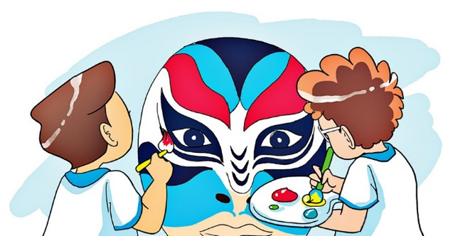
A. Vocabulary
V
V-ing
make
/meɪk/
making
Làm, tạo ra
draw
/drɔː/
drawing
Vẽ
paint
/peɪnt/
painting
Sơn, tô, vẽ

Slide 6
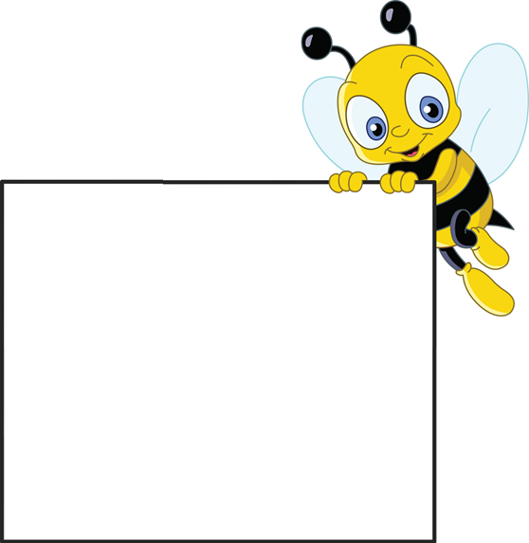

Tick the best answer
A
mask
B
puppet
C
kite

Slide 7
Tick the best answer
A
paper
B
plane
C
puppet

Slide 8
Tick the best answer
A
kite
B
plane
C
boat

Slide 9
Tick the best answer
A
puppet
B
paper
C
picture

Slide 10
Tick the best answer
A
plane
B
puppet
C
mask

Slide 11
Tick the best answer
A
boat
B
paper
C
mask

Slide 12
Tick the best answer
A
kite
B
puppet
C
picture

Slide 13
Tick the best answer
A
write
B
paint
C
read

Slide 14
Tick the best answer
A
make
B
puppet
C
take

Slide 15
Tick the best answer
A
make
B
draw
C
watch

Slide 16
MsPham-0936082789
A. Vocabulary
paper
puppet
mask
kite
/ˈpeɪpər/
/ˈpʌpɪt/
/mɑːsk/
/kaɪt/
Giấy
Con rối
Mặt nạ
Diều
picture
boat
plane
/ˈpɪktʃər/
/bəʊt/
/pleɪn/
Bức tranh
Con thuyền
Máy bay

Slide 17
GRAMMAR

Slide 18

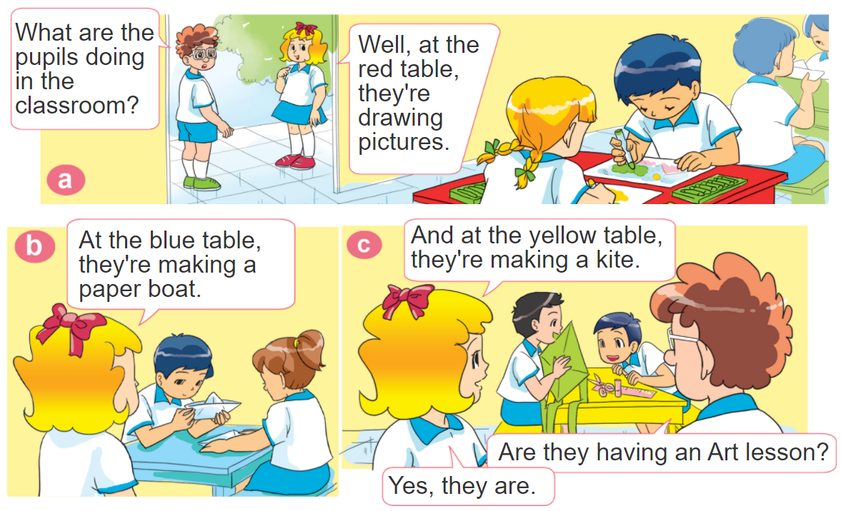
1. Look, listen and repeat.

Slide 19


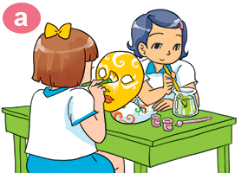
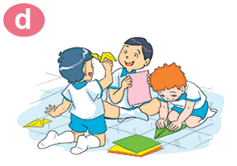
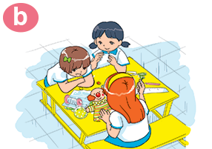
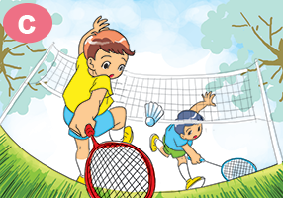
2. Point and say
What are they doing?
They’re _________.
making paper planes
painting
mask
making puppet
playing badminton

Slide 20


3. Let’s talk
He/she’s _________.
Where is he/she?
Where are they?
They’re _________.
What's he/she doing?
He/she’s ______.
What are they doing?
They’re _________.

Slide 21
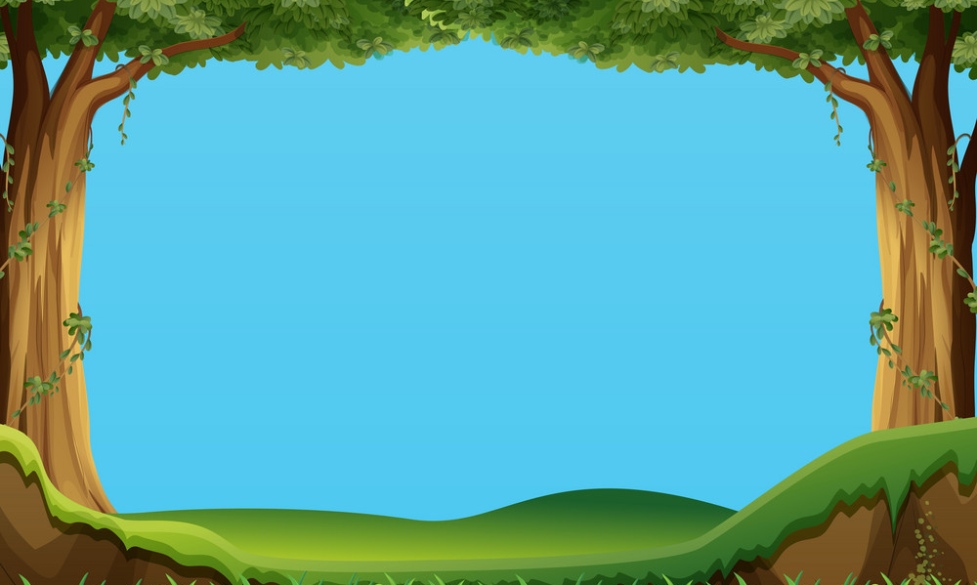




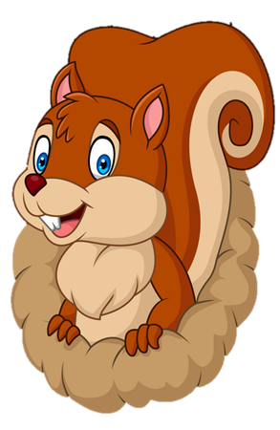
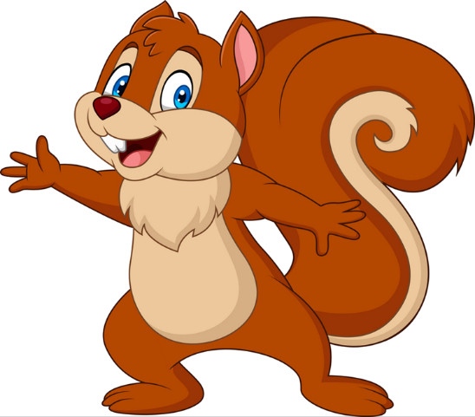
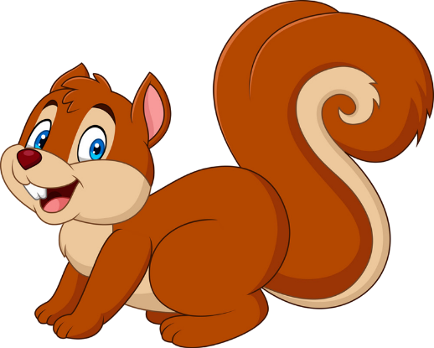
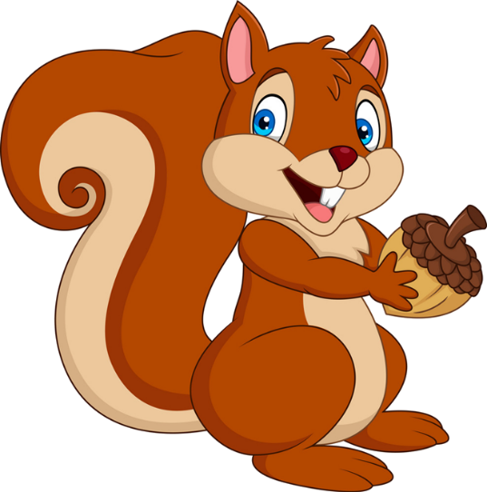


PLAY
NEXT
Brown squirrel
& acorn

Slide 22
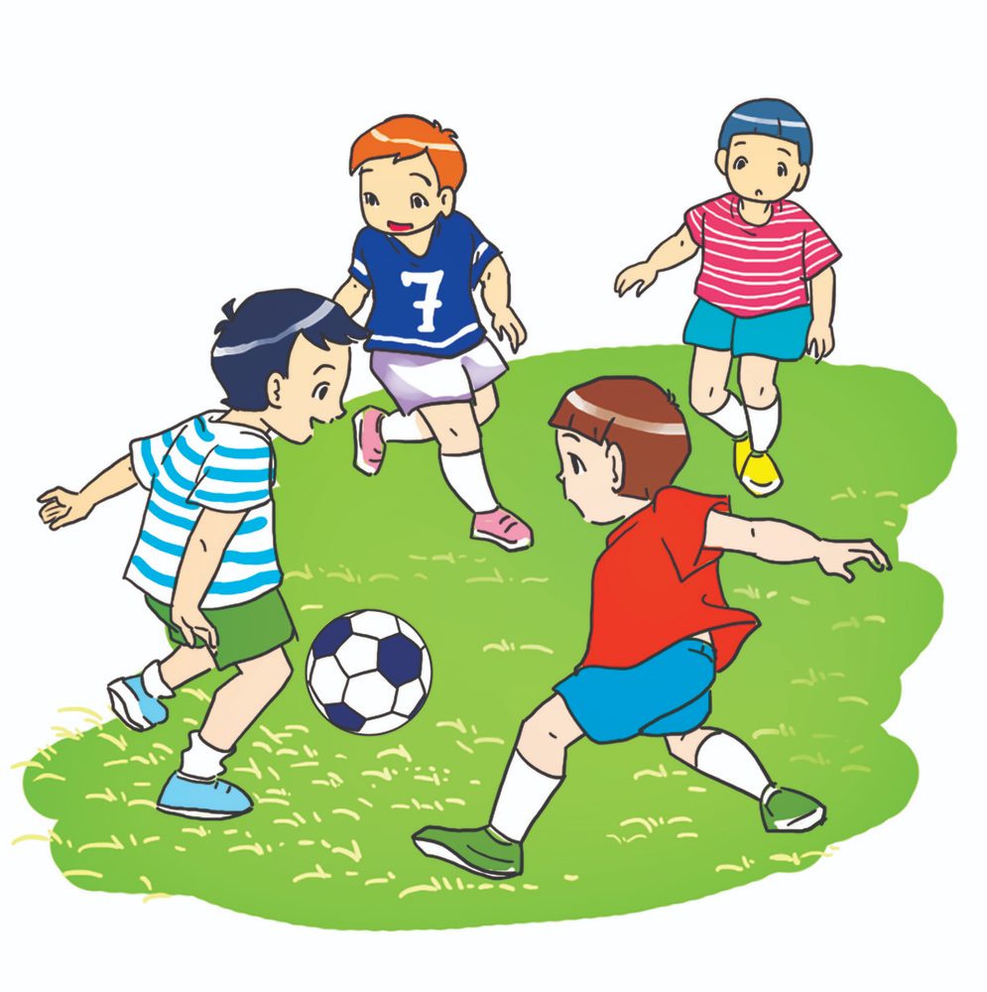


What are they doing?
They are playing football.
We are playing football.
farm
zoo

Slide 23
What are they doing?
They are painting masks.
They are painting pictures.
Next
farm
zoo

Slide 24
They are painting masks.
What are they doing?
Where are they doing?
Next
farm
zoo

Slide 25
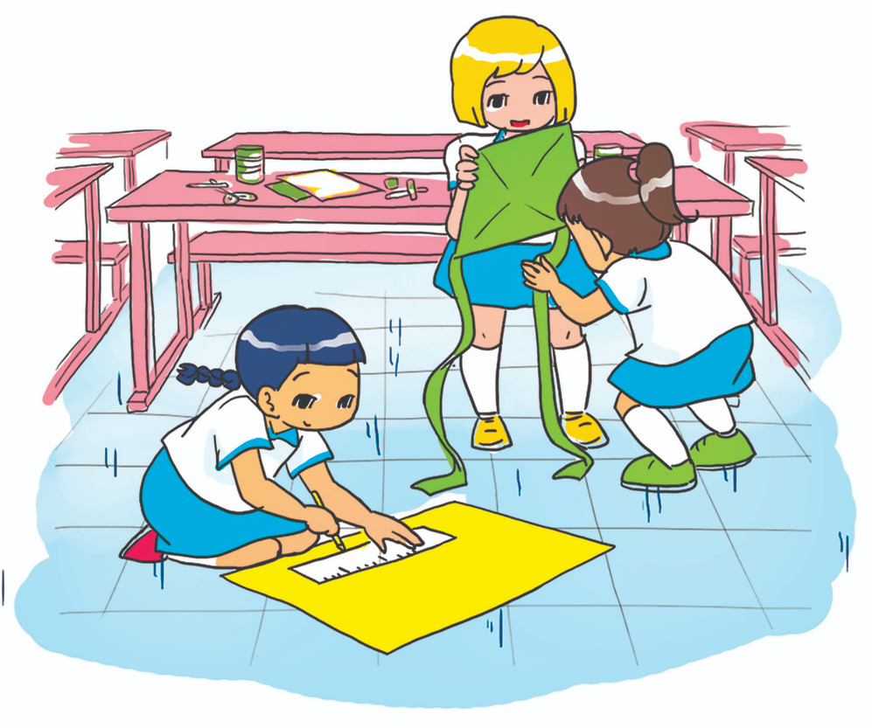
What are they doing?
They are making
paper kites.
She’s making
paper kites.
farm
zoo

Slide 26
What are they doing?
They are making
paper planes.
They are making
puppets.
farm
zoo

Slide 27
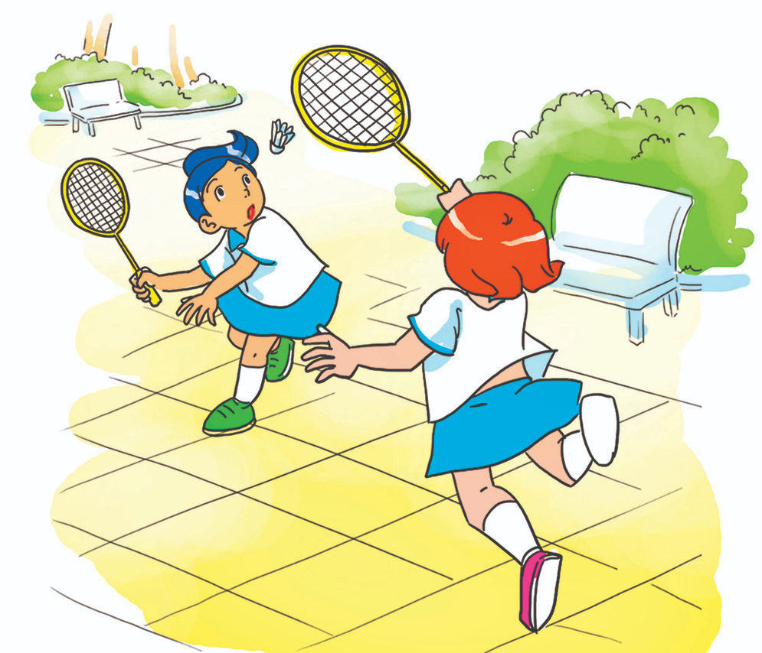
What are they doing?
They playing
badminton.
They are playing badminton.
farm
farm

Slide 28
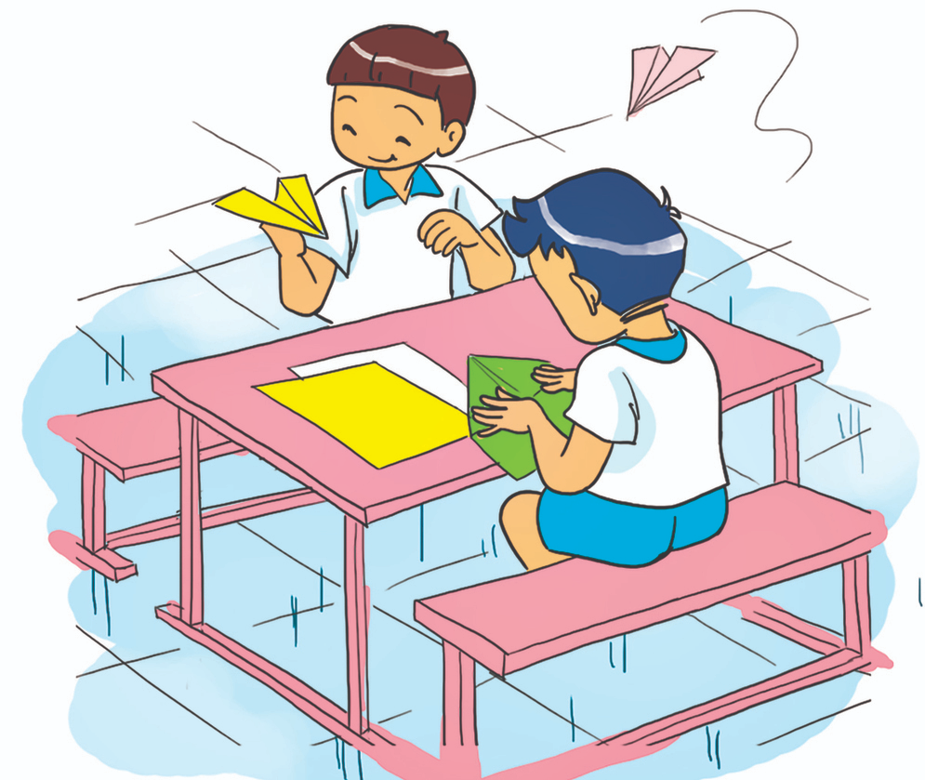
What are they doing?
They are make
paper planes.
They are making
paper planes.
farm
farm

Slide 29
They are making
paper planes.
What are you doing?
What are they doing?
farm
zoo

Slide 30


Good job!

Slide 31

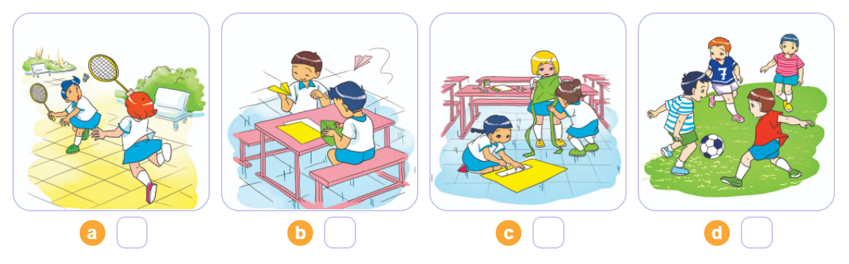
4. Listen and number
1
2
3
4
2
4
3
1

Slide 32
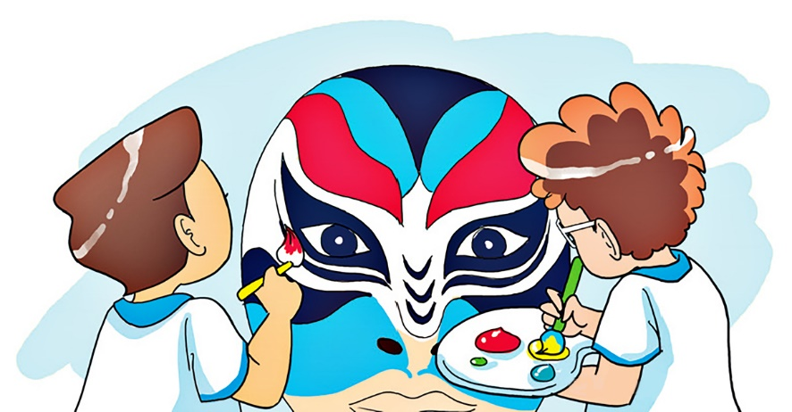
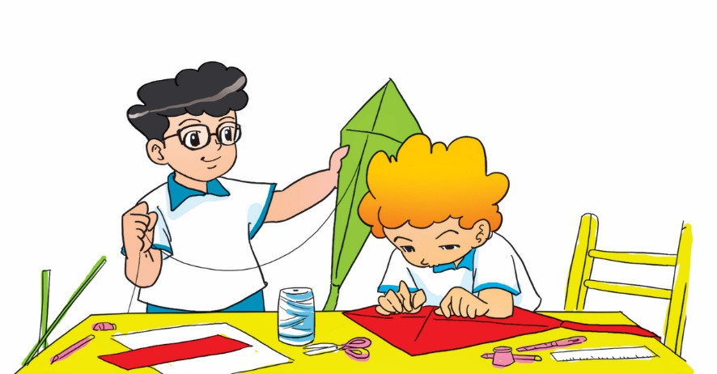
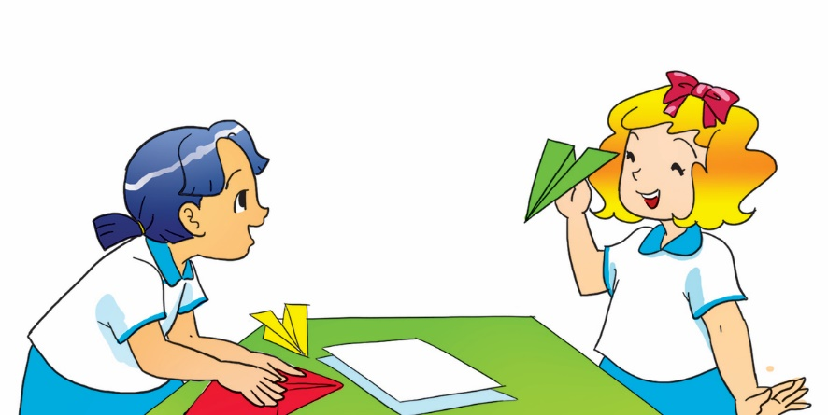
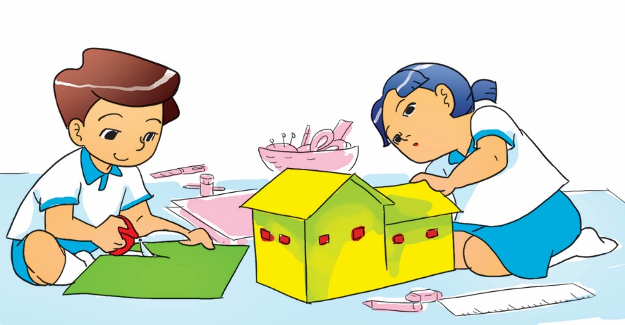
5. Look and write
1. What are Nam and Tom doing?
They are painting a mask. /
They're painting a mask.
2. What are Phong and Peter doing?
They are making kites /
They're making kites.
3. What are Mai and Linda doing?
They are making paper planes. /
They're making paper planes.
4. What are Mai and Nam doing?
They are making a paper house. /
They're making a paper house.

Slide 33
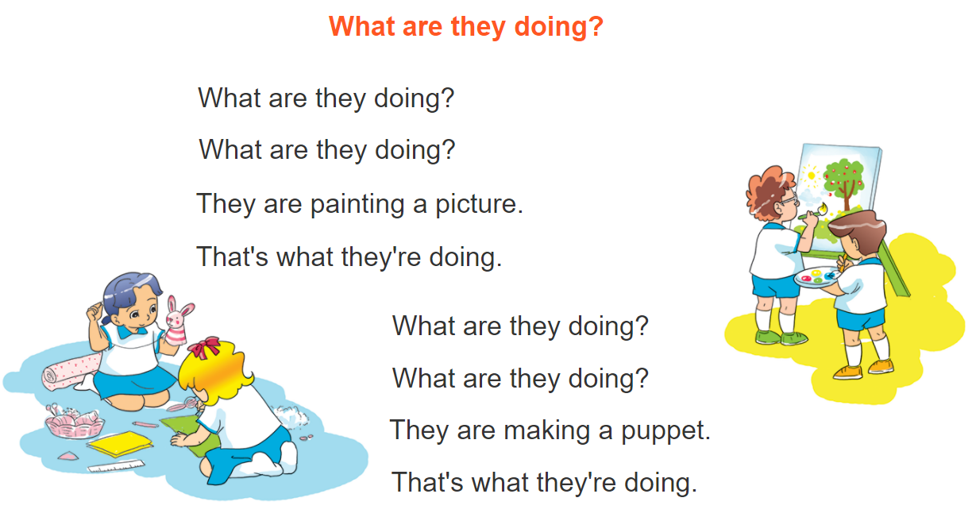



6. Let’s sing

Slide 34



THANK YOU!
Welcome to join with me!
MsPham Powerpoint
Mspham

