Slide 1
Unit 9
What are they doing?
Lesson 1

Slide 2




A. Vocabulary
V
V-ing
watch a video
watching a video
Xem video
listen to music
listening to music
Nghe nhạc
read a text
reading a text
Đọc đoạn văn
write a dictation
writing a dictation
Viết chính tả

Slide 3
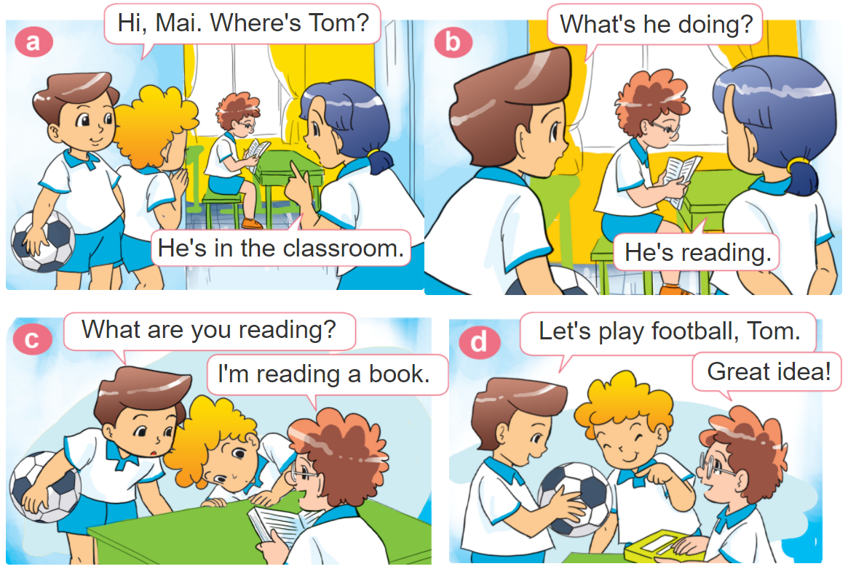

1. Look, listen and repeat.

Slide 4





2. Point and say
What's she / he doing?
She / he’s _________.
watching
a video
reading a text
listening to music
writing a dictation

Slide 5
Grammar
Hỏi và trả lời cô ấy/anh ấy đang làm gì:
What's she / he doing?
(Cô ấy / anh ấy đang làm gì?)
She / he’s _______.
+ V-ing
(Cô ấy / anh ấy đang _____)
Hỏi và trả lời BẠN đang làm gì:
What are you doing?
(Bạn đang làm gì?)
I’m _______.
+ V-ing
(Tôi đang _____)

Slide 6
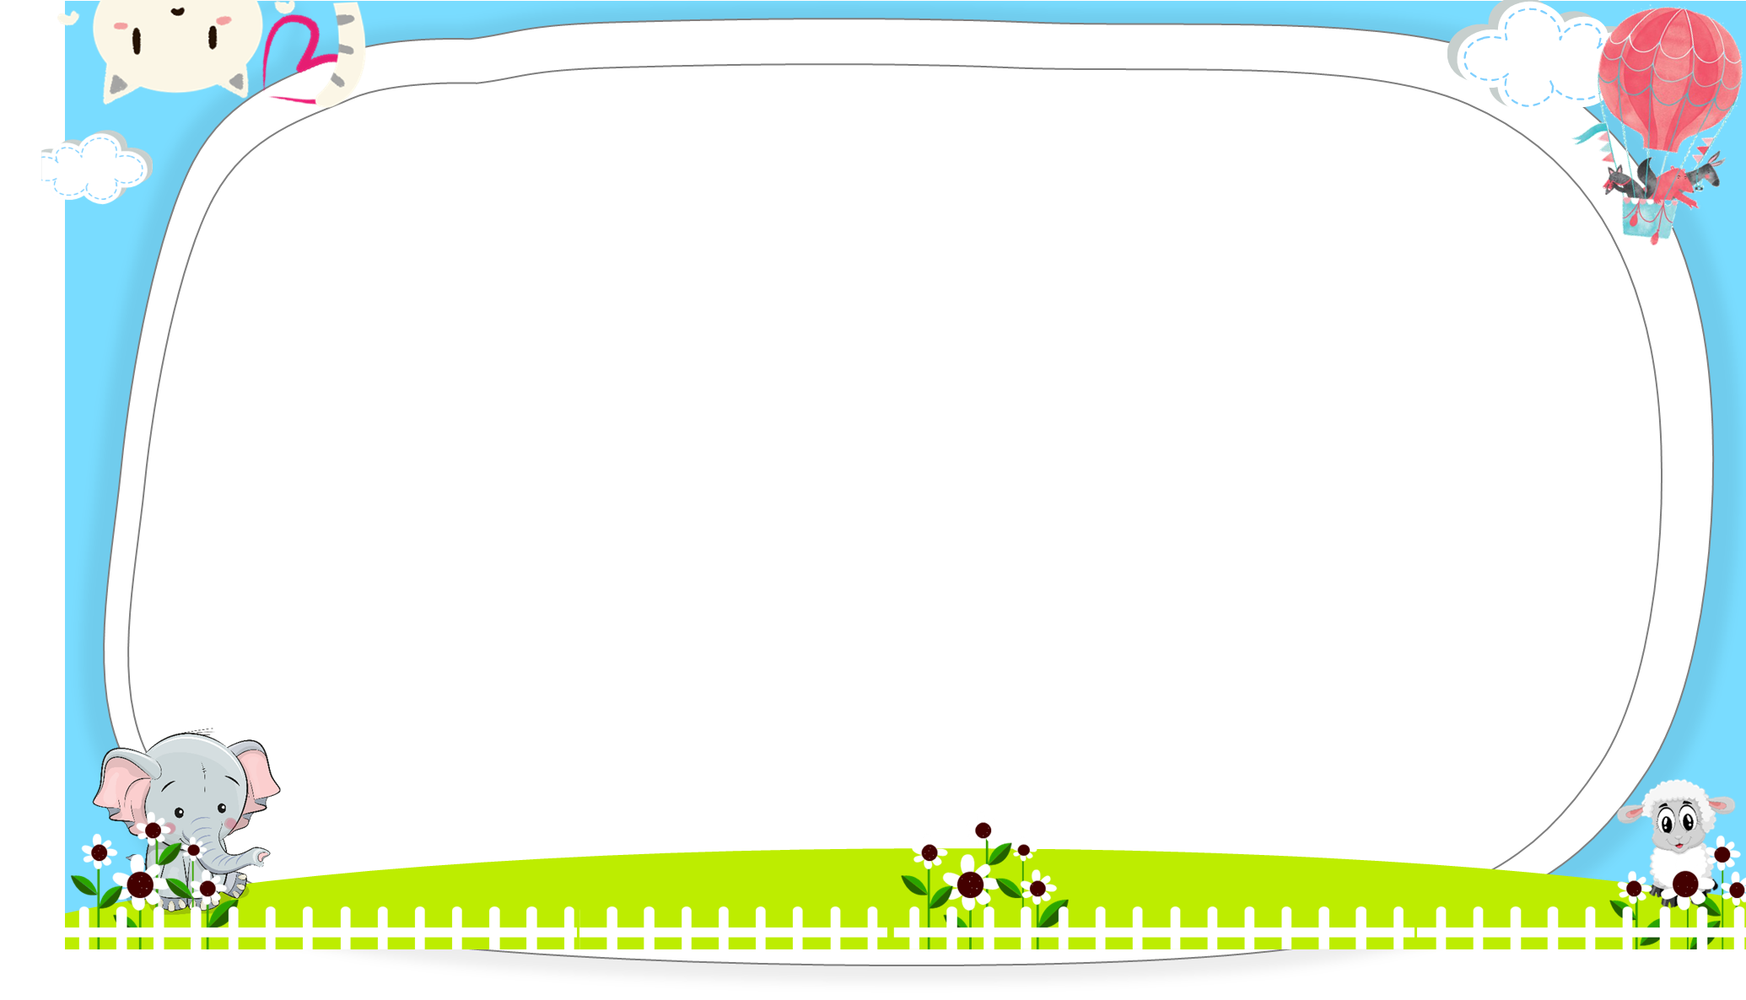




AND
GAME
PLAY

Slide 7



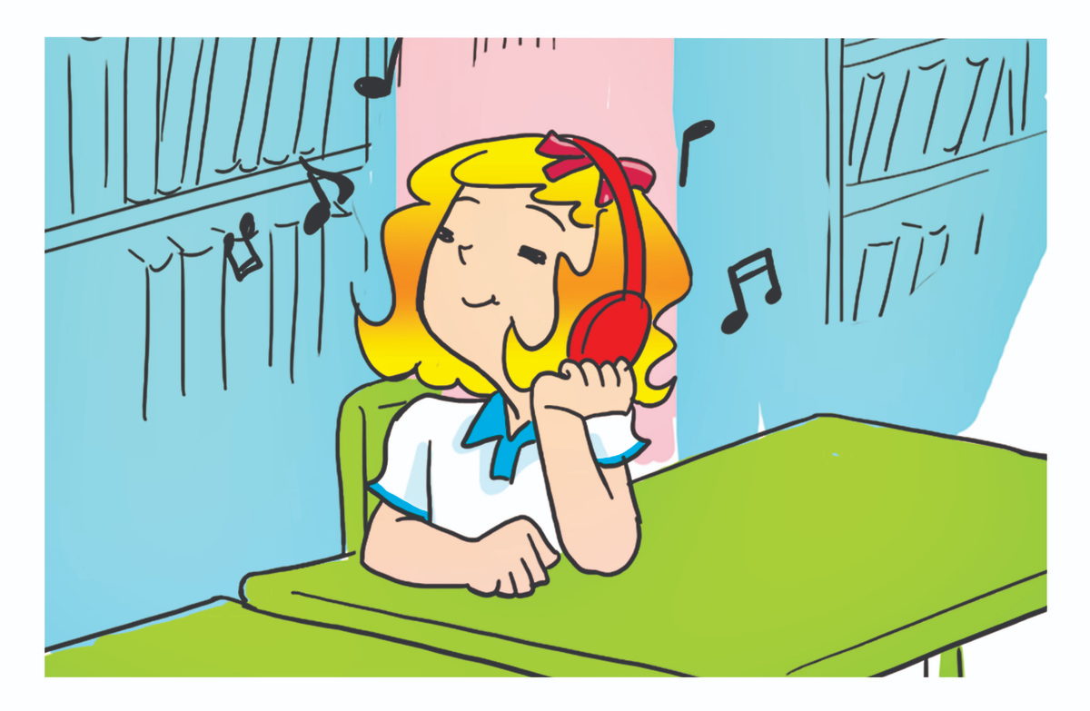
She
He
What's _______ doing?
______ is listening to music.
Next

Slide 8
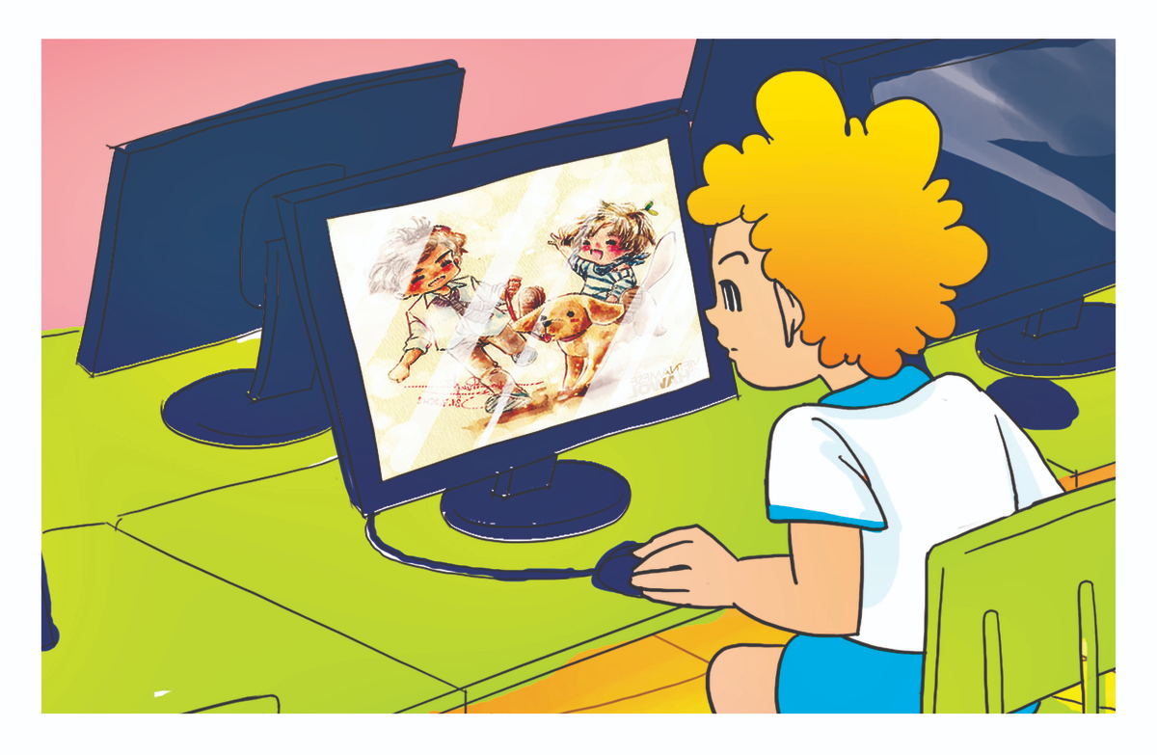
He
She
What's _______ doing?
______ is watching a video.
Next

Slide 9
He
She
What's _______ doing?
______ is listening to music.
Next

Slide 10
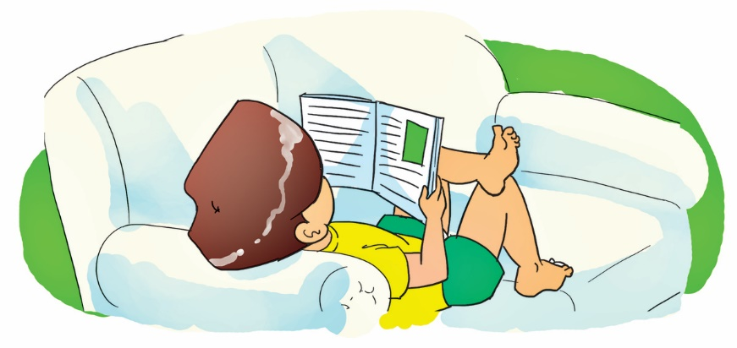
He
She
What's _______ doing?
______ is reading a text.
Next

Slide 11

She
He
What's _______ doing?
______ is writing a text.
Next

Slide 12
listen to music
listening to music
What's he doing?
He’s _________.
Next

Slide 13
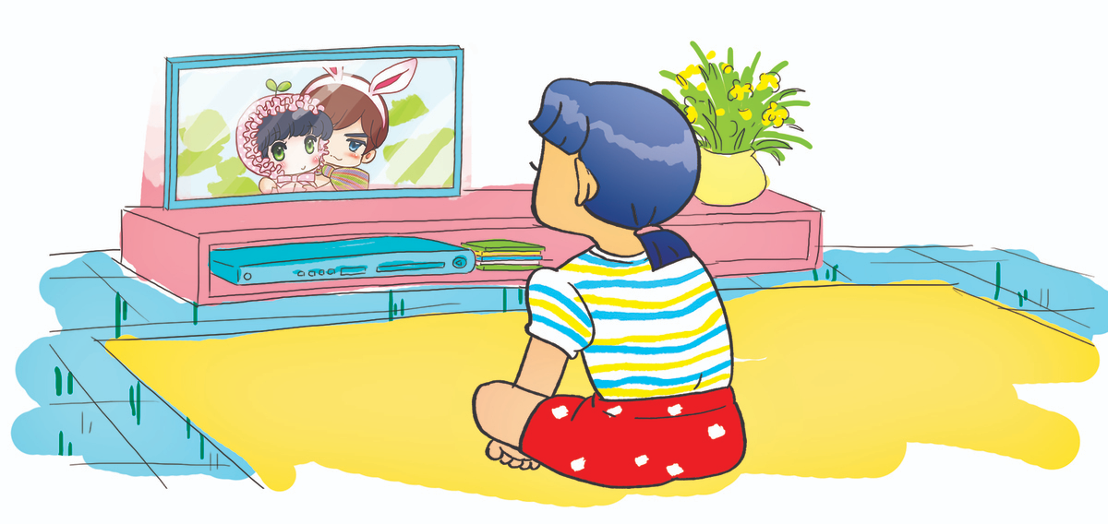
watching a video
listening to music
What's she doing?
She’s _________.
Next

Slide 14
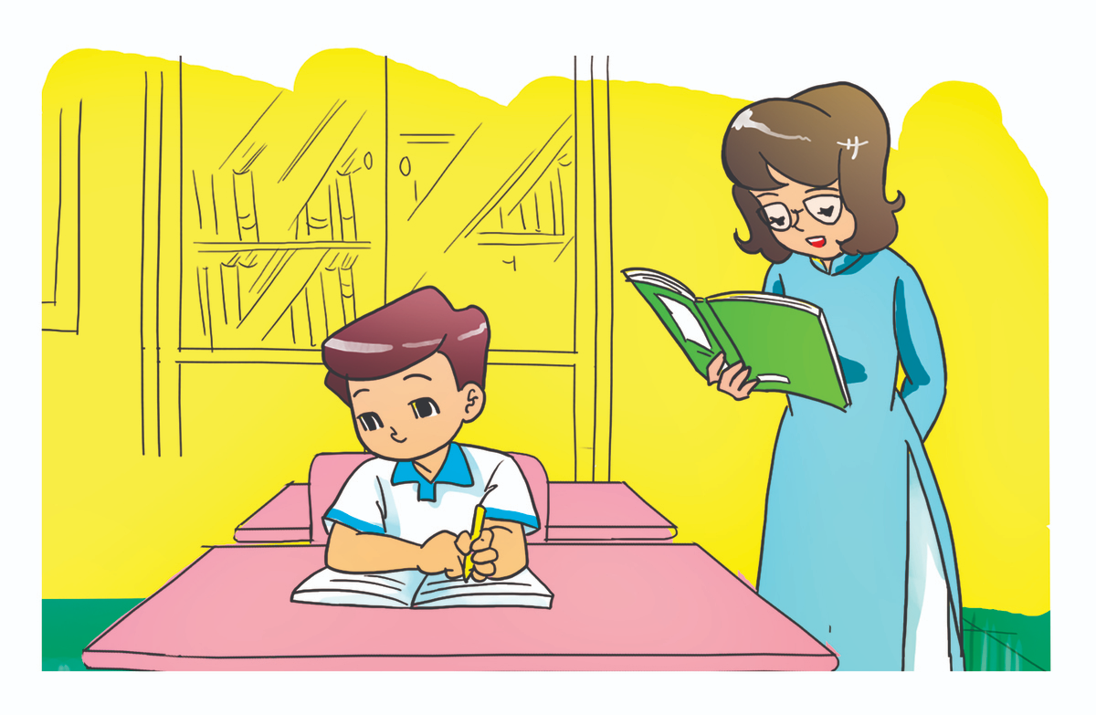
Writing a dictation
Reading a text
What's he doing?
He’s _________.
Next

Slide 15

listening
reading
What's she doing?
She’s _________.
Next

Slide 16

Next

Slide 17
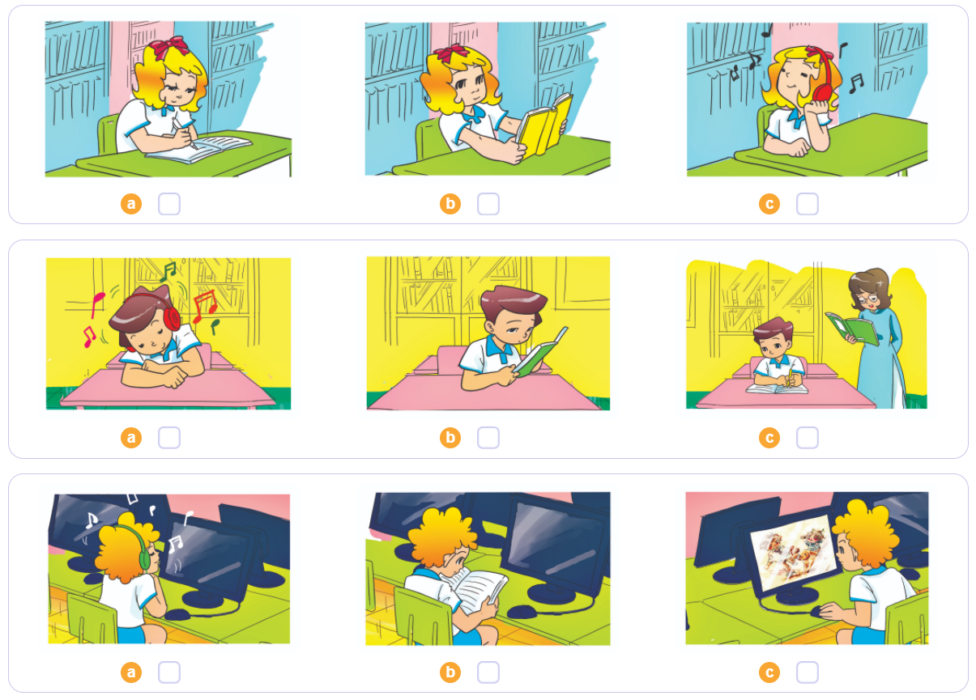


4. Listen and tick
1
2
3

Slide 18
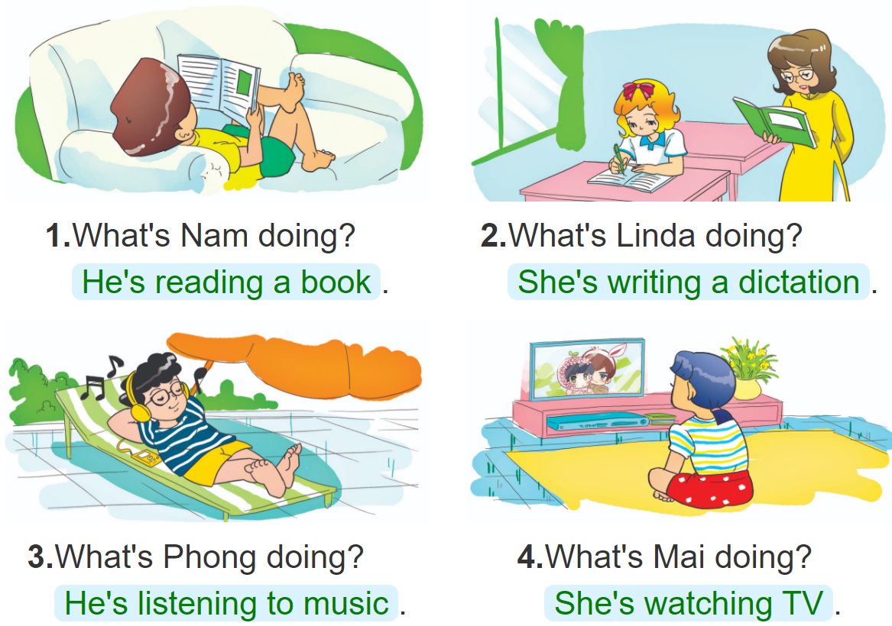
5. Look and write
________________________
____________________________
____________________________
_________________________

Slide 19
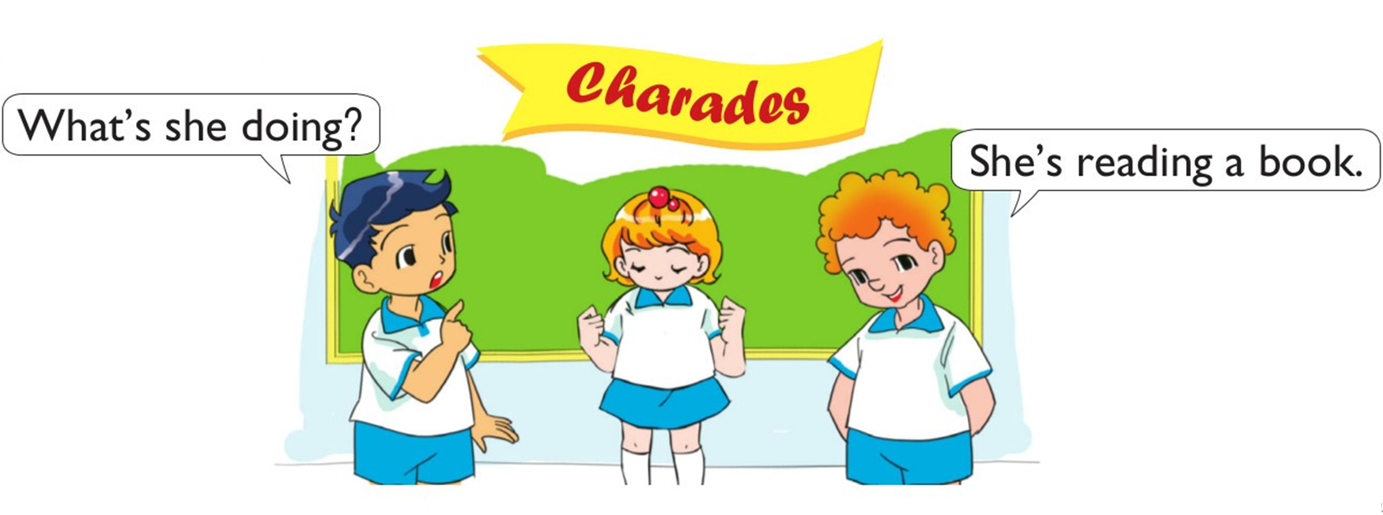
6. Let’s play

Slide 20



THANK YOU!
Welcome to join with me!
MsPham Powerpoint
Mspham

