Slide 1

Unit 8: Food
Lesson 4.1
Page 119

Slide 2
Lesson Outline
Warm-up
Vocabulary
Structure
Consolidation
Wrap-up

Slide 3
Objectives
By the end of this lesson, students will be able to…
Vocabulary: learn and practice knife, spoon, chopsticks, fork, noodles
Structure: learn and practice
We eat ____with a ____.
We often eat ____.
My favorite food is ____.

Slide 4

WARM UP

Slide 5

New words

Slide 6



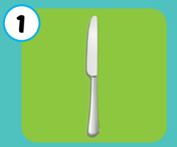
Giấu các icon audio
Click each picture to hear the sound.
knife
/naɪf/
Con dao

Slide 7
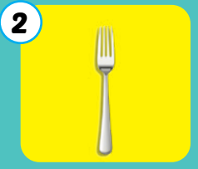
Giấu các icon audio
Click each picture to hear the sound.
fork
/fɔːrk/
Cái nĩa

Slide 8
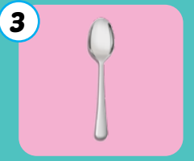
Giấu các icon audio
Click each picture to hear the sound.
spoon
/spuːn/
Cái thìa

Slide 9
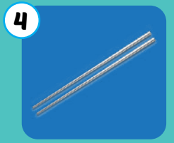
Giấu các icon audio
Click each picture to hear the sound.
chopsticks
/ˈtʃɑːpstɪks/
Đôi đũa

Slide 10
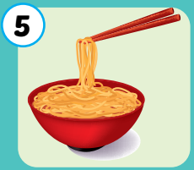
Giấu các icon audio
Click each picture to hear the sound.
noodles
/ˈnuːdlz/
mì, bún, phở

Slide 11
Giấu các icon audio
Click each picture to hear the sound.
knife
fork
spoon
chopsticks
noodles
/naɪf/
Con dao
/fɔːrk/
Cái nĩa
/spuːn/
Cái thìa
/ˈtʃɑːpstɪks/
Đôi đũa
/ˈnuːdlz/
Mì,bún, phở

Slide 12

Enjoy your day!

