Slide 1
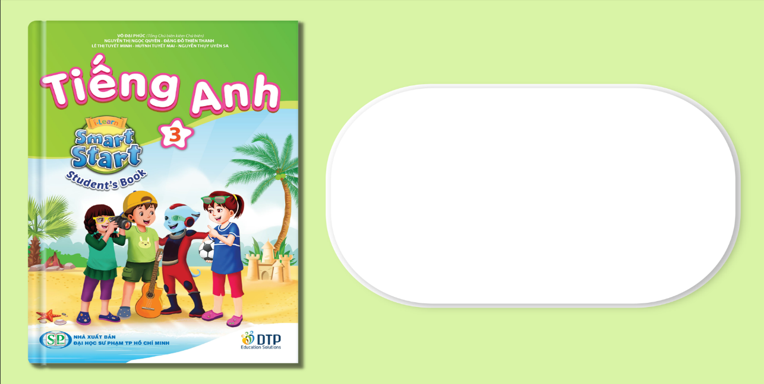
Unit 7: Toys
Lesson 2.1
Page 99

Slide 2
Lesson Outline
Warm-up
Vocabulary
Structure
Consolidation
Wrap-up

Slide 3
Objectives
By the end of this lesson, students will be able to…
Vocabulary: Pronounce and use the words related to the topic properly: card, block, dice, marble
Structure: Ask about the quantity of certain items that someone has by using:
How many marbles do you have?
I have five marbles.

Slide 4

WARM UP

Slide 5

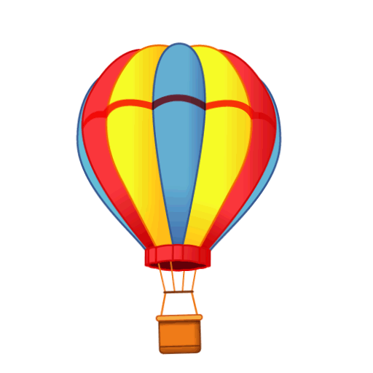
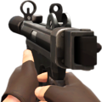
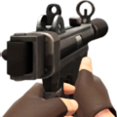

How many cards do you have?
I have_________cards.
three
five
four
three
Click on the right balloon

Slide 6

How many blocks do you have?
I have ________blocks.
two
two
six
four
Click on the right balloon

Slide 7

How many marbles do you have?
I have__________ marbles.
five
seven
six
five
Click on the right balloon

Slide 8

How many dice do you have?
I have_________dice.
seven
eight
nine
seven
Click on the right balloon

