Slide 1

Unit 4: HOME
Lesson 4.1 Review and practice
Page 64

Slide 2
Lesson Outline
Warm-up
Listening
Reading
Consolidation
Wrap-up

Slide 3
Objectives
By the end of this lesson, students will be able to review asking where people are, asking what people are doing, asking where things are and talking about their homes.

Slide 4

WARM UP

Slide 5

Workbook
p. 44

Slide 6
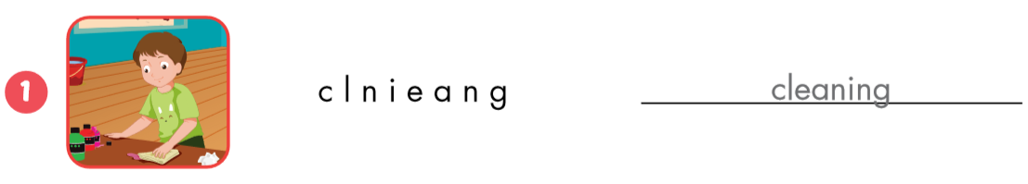

cleaning
bedroom

Slide 7
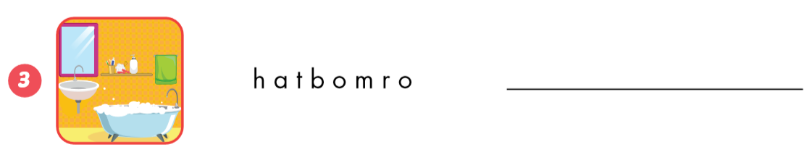
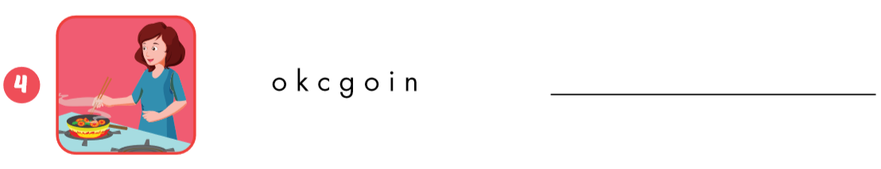
bathroom
cooking

Slide 8


mirror
sofa

Slide 9


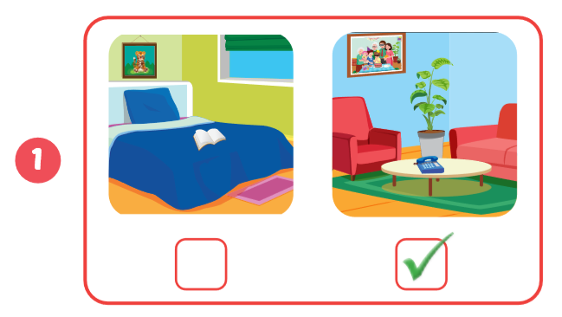
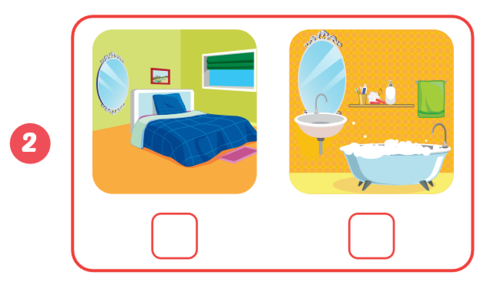


Slide 10
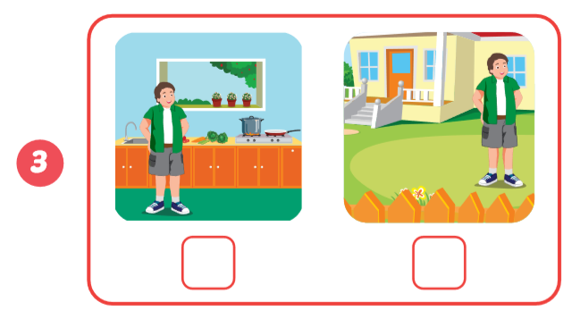


Slide 11

CONSOLIDATION

Slide 12
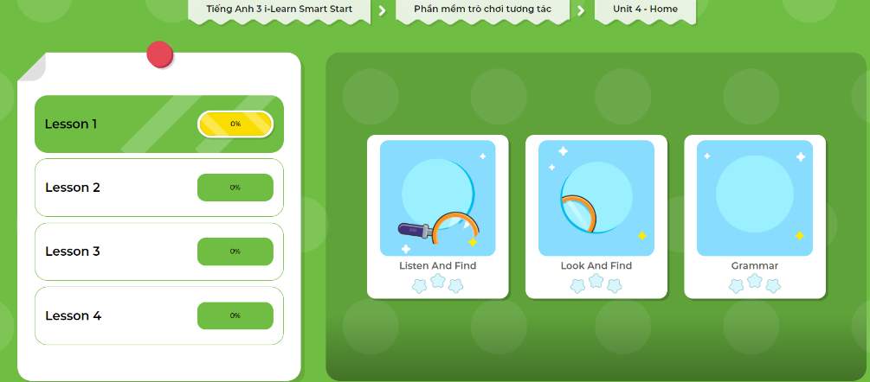
Extra Practice
DHA App
Let’s play!
Click here to play the game

Slide 13

WRAP-UP

Slide 14

Enjoy your day!

