Slide 1








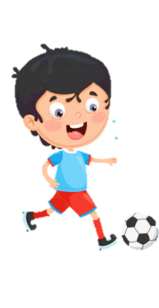



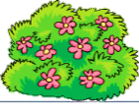





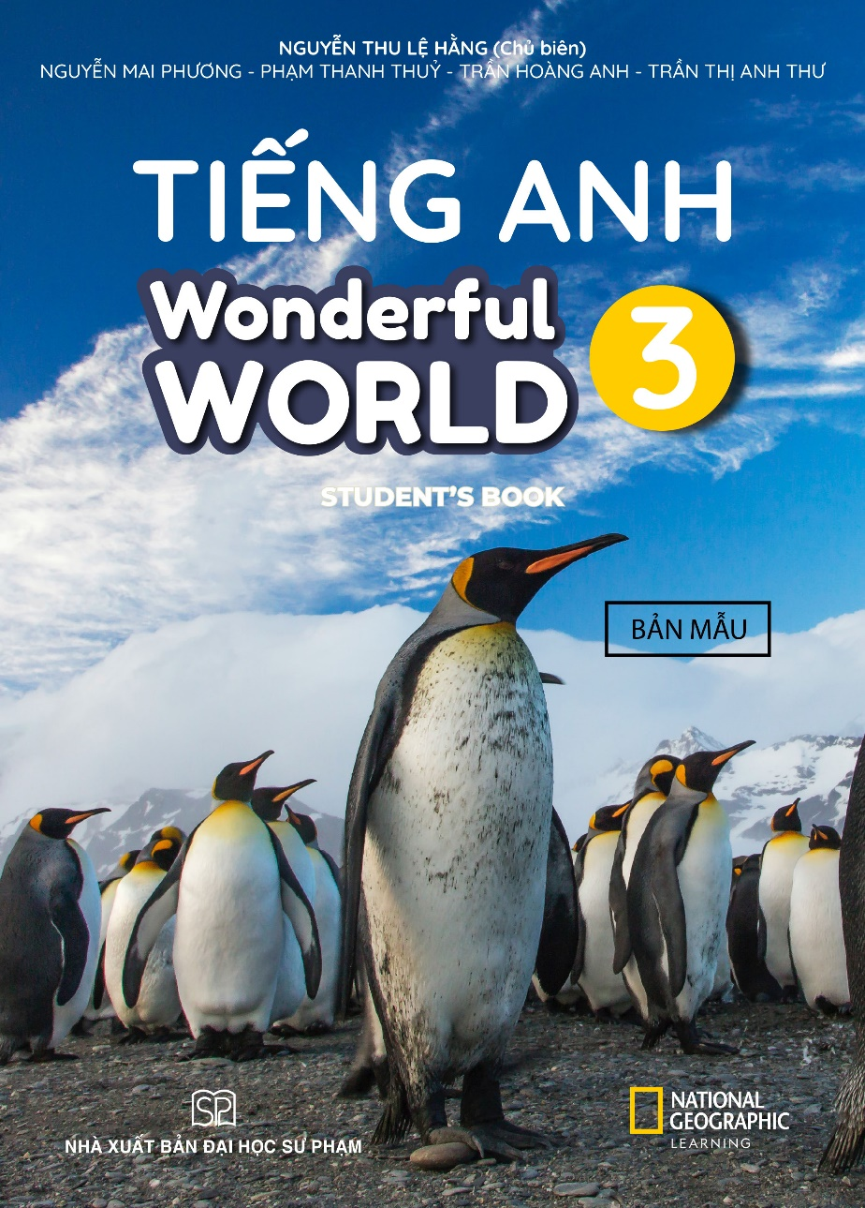



Slide 2

REVIEW 2
Part 2

Slide 3
Guessing game.
1. WARM UP

Slide 4
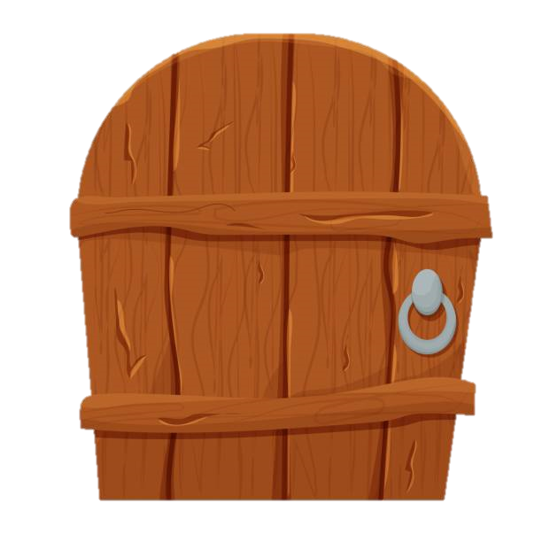


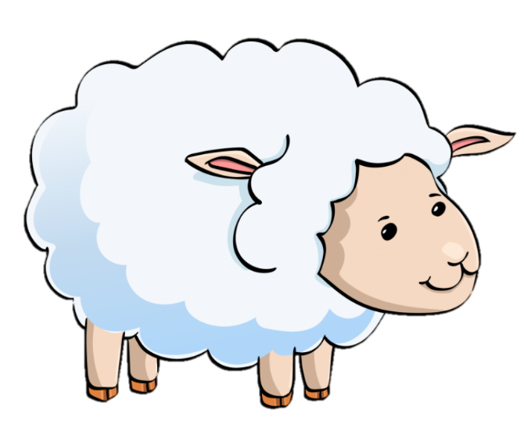
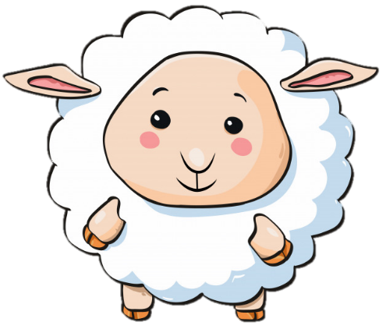
What’s this?
It’s an elephant.

Slide 5
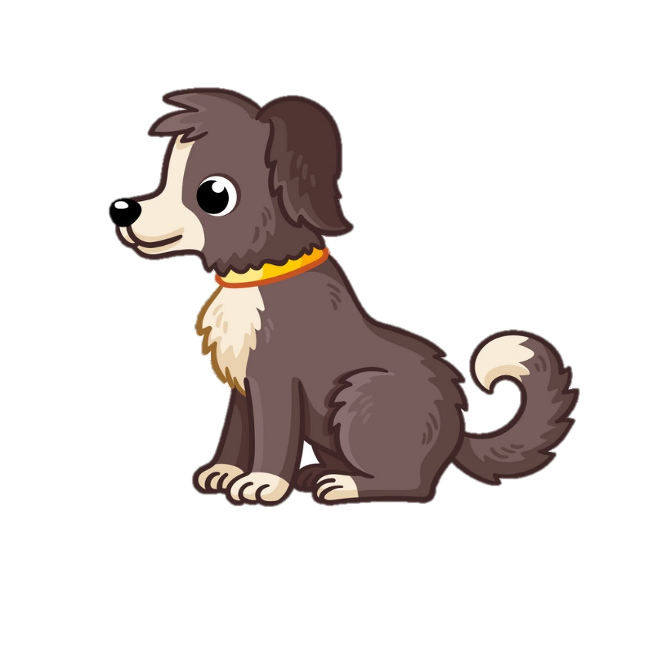

What’s this?
It’s a dog.

Slide 6
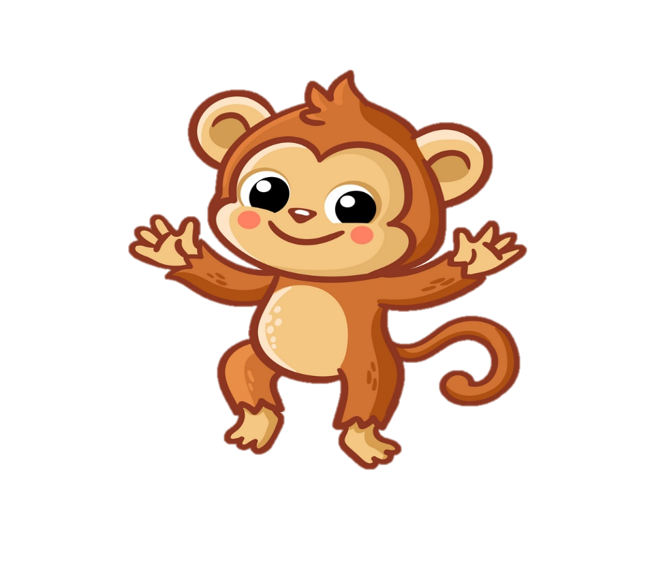

What’s this?
It’s a monkey.

Slide 7


What’s this?
It’s a fish.

Slide 8
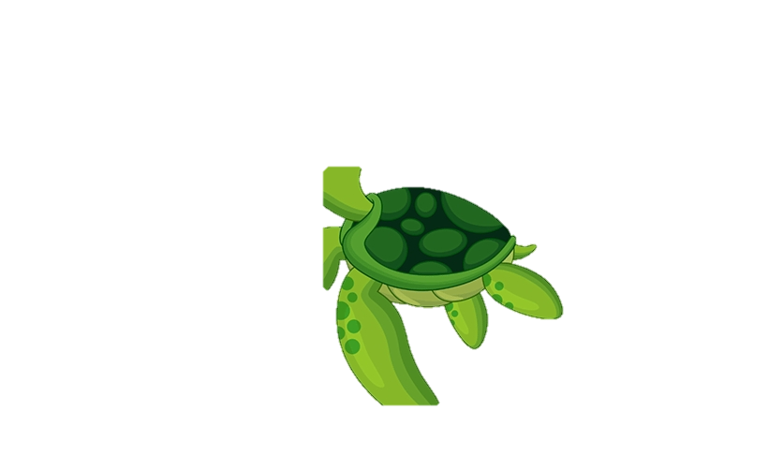
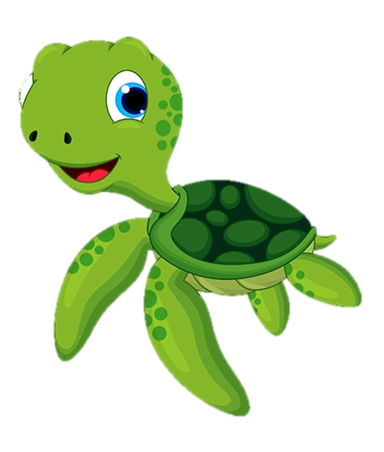
What’s this?
It’s a turtle.

Slide 9


What’s this?
It’s a whale.

Slide 10
2 REVIEW
Task 1 Match

Slide 11

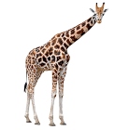



Match
Match
giraffe
shark
elephant
rabbit
lion
1
2
3
4
5

Slide 12
Task 2: Circle

Slide 13
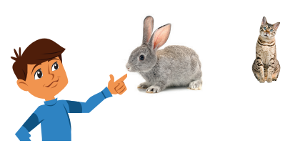
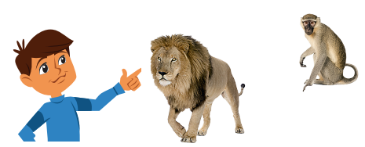
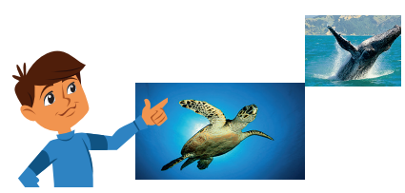
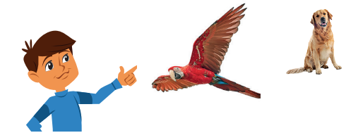
Circle
1 This/ That is a rabbit.
This/ That is a cat.
2 This/ That is a monkey.
This/ That is a lion.
3 This/ That is a whale.
This/ That is a turtle.
4 This/ That is a bird.
This/ That is a dog.

Slide 14
Task 3:
Write and say

Slide 15
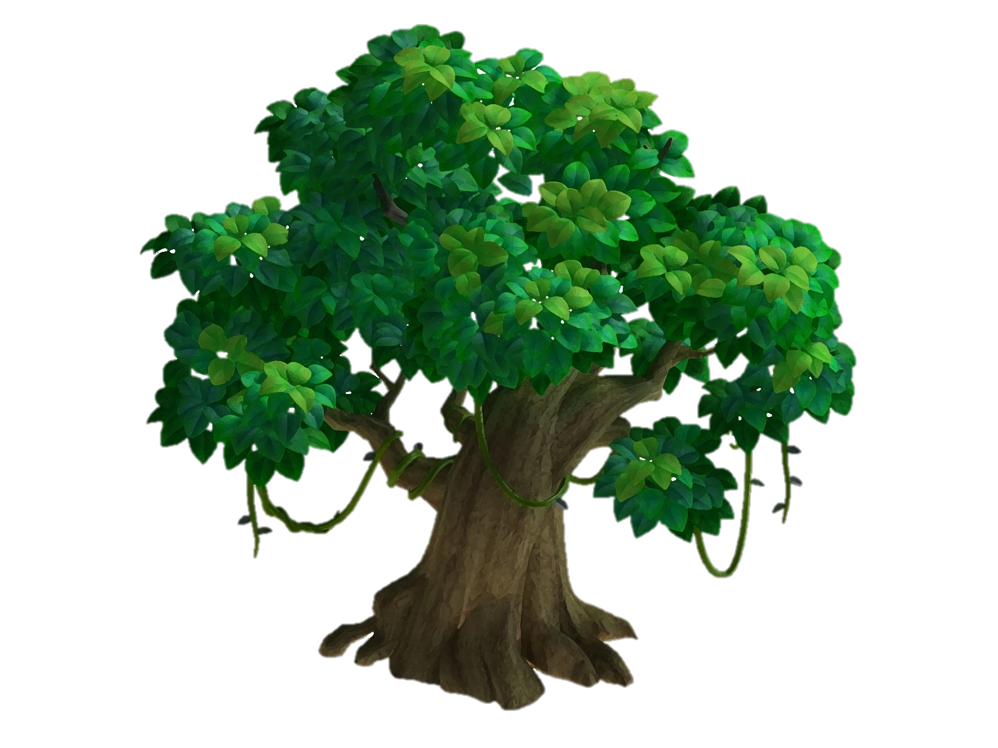


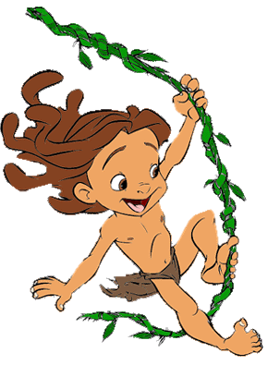
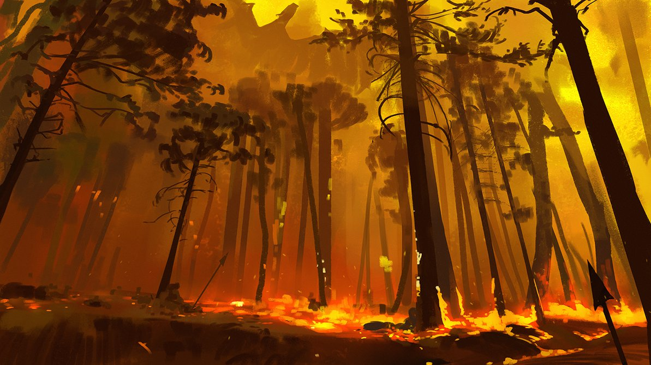




SAVE THE FOREST
Notes:
Bấm PLAY để có hiệu ứng âm thanh

Slide 16
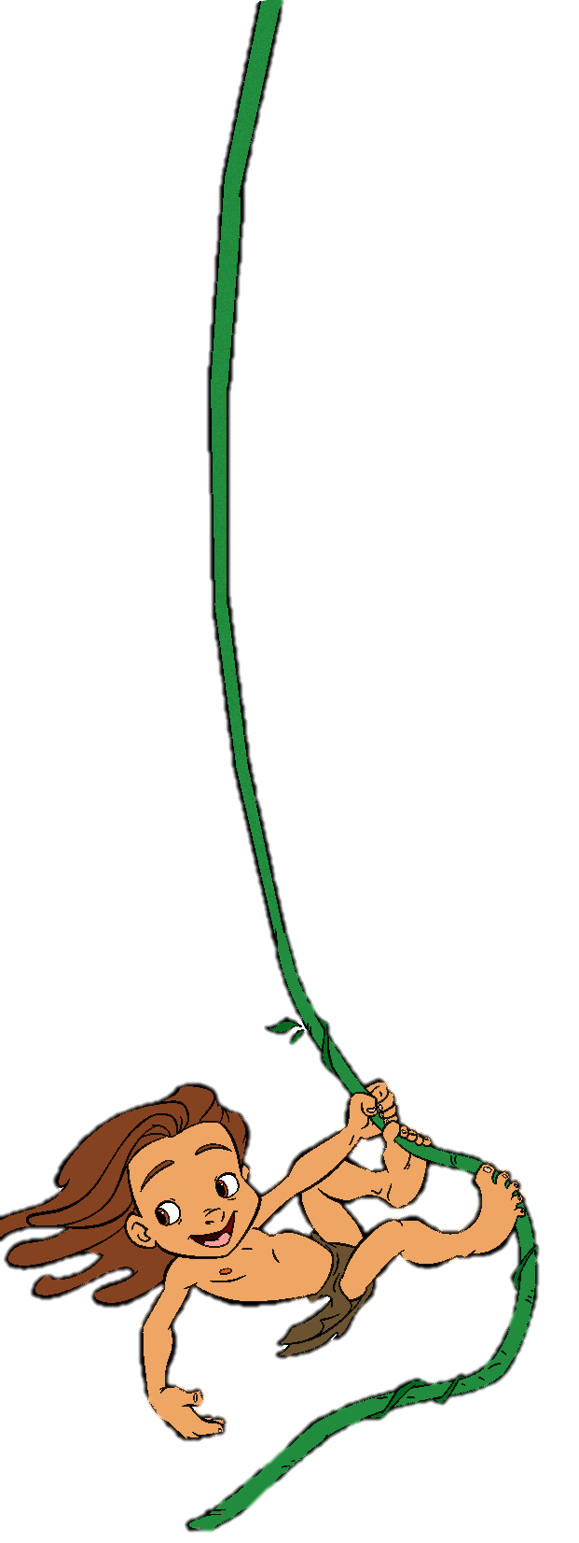

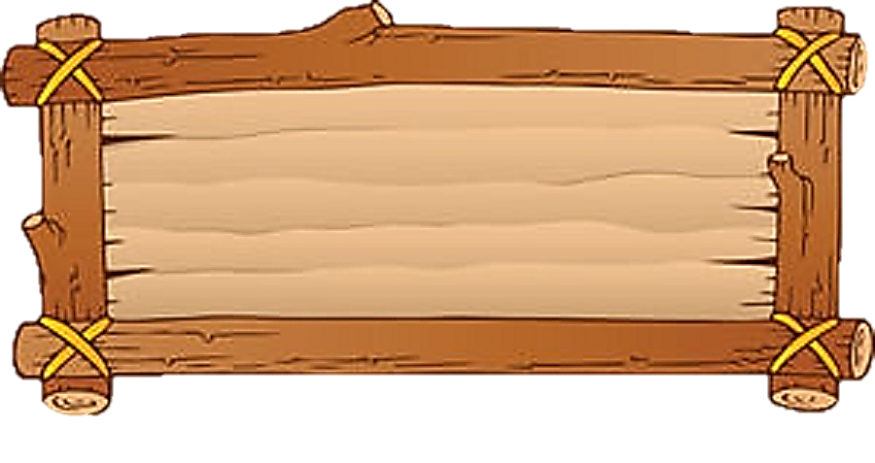

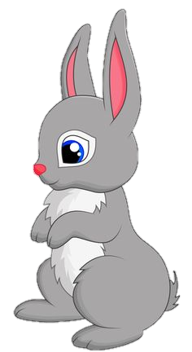
1___________ ?
It’s a rabbit.
What’s this?

Slide 17
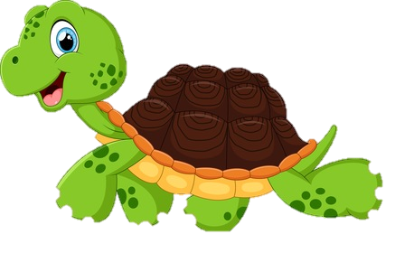
2 What are these? __________turtles.
They are turtles.

Slide 18

3 What’s that?
_________a shark.
It’s a shark.

Slide 19
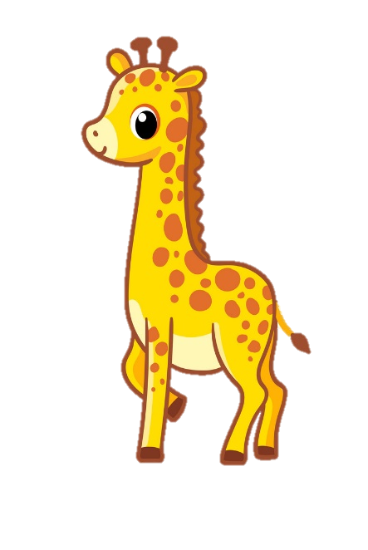
4 ________those?
They’re giraffes.
What are those?

Slide 20
Write and say.
What’s this
1 ____________? It’s a rabbit.
2 What are these? ________turtles.
3 What’s that? ____a shark.
4 ________ those? They’re giraffes.
They are
It’s
What are

Slide 21
3 EXTRA ACTIVITY
Making paper animals

Slide 22

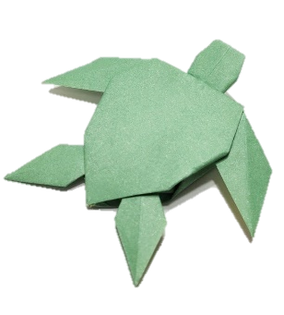
They’re turtles. They’re green.
They’re cool

Slide 23




Good bye.
See you again!

