Slide 1








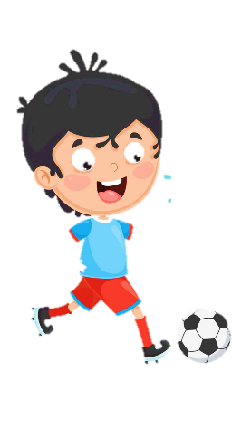












Notes:
Để nguyên trang bìa như này, chỉ thay đổi tên bài trong quá trình làm. Logo của sách Wonderful World

Slide 2







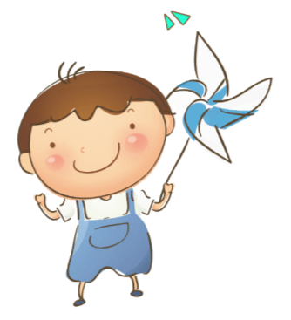
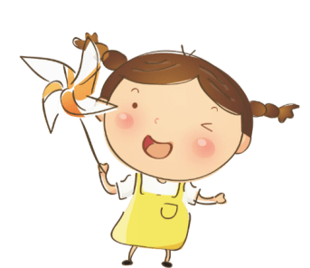

Slide 3






Warm up!

Slide 4




Movement Game: Hip hip hooray
Hands up!
Hands down!
Hip hip hooray
Go to Wonderful World!
Notes:
+ Hands up: raise 2 hands up
+ Hands down: Put to hands down
+ Hip hip hooray (2 times): smack 2 hands on hips then put hands to mouth when saying hooray (2 times)
+ Go to Wonderful World: join 2 hands and make waves then raise both hands up and wave.

Slide 5
Memorization
game

Slide 6

E L O L H
HELLO
Notes:
- Show flashcard of letters E L O L H to sts in 5 seconds.
- Ask sts to read the letters they have seen
- Ask if sts know what word in English built from 5 letter.
- Write on the board Hello and introduce the greeting lesson.

Slide 7

Presentation
Task 1: Listen and repeat

Slide 8
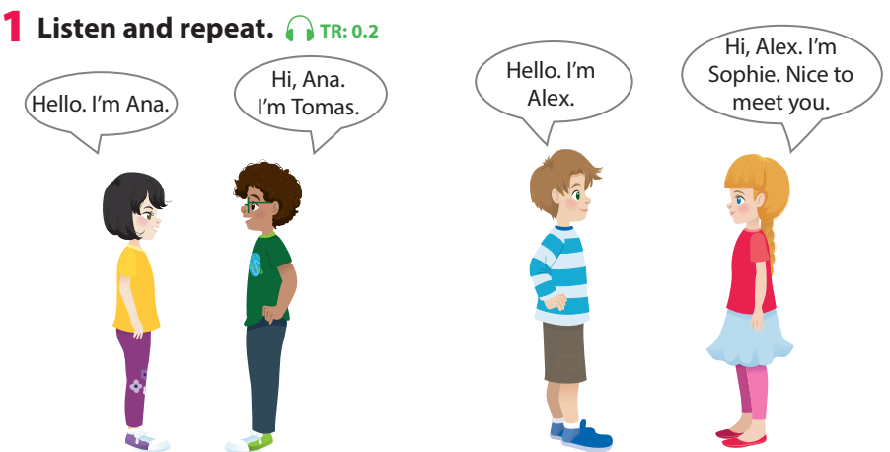
Notes:
Use flashcards to introduce the vocabulary and structure of lesson.
Say the words/sentences for sts to repeat in chorus.
Put the flashcards in different places around the room.
Say a word/sentence for sts to repeat then point.
Play the track 0.2, ask students to listen and repeat in chorus, group.

Slide 9


Notes:
Say a word/sentence for sts to repeat then point.

Slide 10




Notes:
Say a word/sentence for sts to repeat then point.

Slide 11

Practice
Task 2: Say

Slide 12
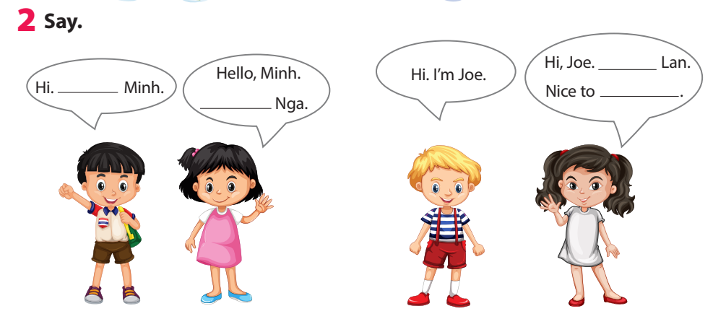
I’m
meet you
I’m
I’m
Notes:
Task 2: Say - Ask sts how many friends can they see and their names.
- Have sts look at the bubbles and ask them to complete (spoken).
- Have sts practice the dialogues in chorus, group, pairs.

Slide 13
Practice
Task 3: Let’s talk
Game: Pass the ball
Notes:
- Play some music. - Ask sts to pass the ball to the next person. - When the music stops the student with the ball stands up and say: “Hi/Hello, I’m…”

Slide 14
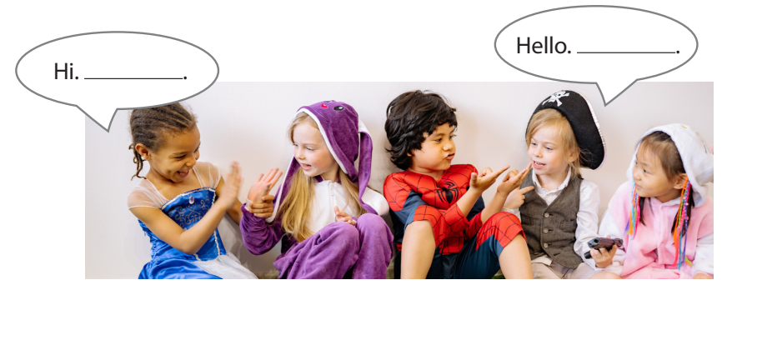

Task 3: Let’s talk
Game: Pass the ball
Notes:
- Play some music. - Ask sts to pass the ball to the next person. - When the music stops the student with the ball stands up and say: “Hi/Hello, I’m…”

Slide 15

Production
make a name tag
Notes:
- Play some music. - Ask sts to pass the ball to the next person. - When the music stops the student with the ball stands up and say: “Hi/Hello, I’m…”

Slide 16
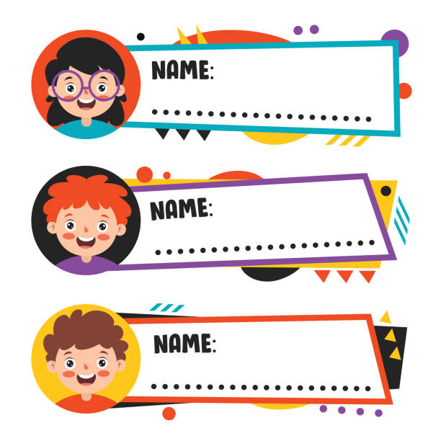
Linh – Cinderella
Long – super man
Nam – iron man
Notes:
- Ask Sts to choose a name that they like then make a name tag and decorate it, stick on chest.
- Have Sts to stand in 2 lines facing together.
- Ask sts of 2 lines shake hand and introduce their name, using
Hello/Hi. I’m…
Hello/Hi. I’m… Nice to meet you.
- When hearing hand clapping, sts in line 1 make a step to the left. They meet a new friend and practice the conversation again.

Slide 17


Hello/Hi. I’m…
Nice to meet you.
I’m Linh
Cinderella
Hello/Hi.
I’m Long - super man.
Notes:
- Ask Sts to choose a name that they like then make a name tag and decorate it, stick on chest.
- Have Sts to stand in 2 lines facing together.
- Ask sts of 2 lines shake hand and introduce their name, using
Hello/Hi. I’m…
Hello/Hi. I’m… Nice to meet you.
- When hearing hand clapping, sts in line 1 make a step to the left. They meet a new friend and practice the conversation again.

Slide 18

Assessment
Choose the correct answer!
Notes:
Play some music. - Ask sts to pass the ball to the next person. - When the music stops the student with the ball stands up and say: “Hi/Hello, I’m…”
Thiết kế hoạt động tương tác ở phần Assessment (nội dung câu hỏi ở slide 23, đáp án ở slide 24)

Slide 19

Choose the correct answer!
1. ……, I’m Nhung.
Hello B. I’m Tuan
2. Hi, ……….
A. Hello B. I’m Ana
3. I’m Thanh. …….
A. Hello, Thanh B. Nice to meet you
Notes:
Choose the correct answer
……, I’m Nhung.
A. Hello B. I’m Tuan
2. Hi, ……….
A. Hello B. I’m Ana
3. I’m Thanh. …….
A. Hello, Thanh B. Nice to meet you
- Check in pair then whole class.
- Say goodbye

Slide 20
Let’s check!
1. ……, I’m Nhung.
Hello B. I’m Tuan
2. Hi, ……….
A. Hello B. I’m Ana
3. I’m Thanh. …….
A. Hello, Thanh B. Nice to meet you
Notes:
Choose the correct answer
……, I’m Nhung.
A. Hello B. I’m Tuan
2. Hi, ……….
A. Hello B. I’m Ana
3. I’m Thanh. …….
A. Hello, Thanh B. Nice to meet you
- Check in pair then whole class.
- Say goodbye

Slide 21
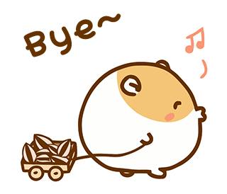
Goodbye!

