Slide 1








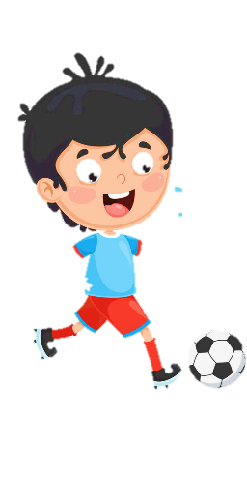











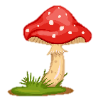

Slide 2
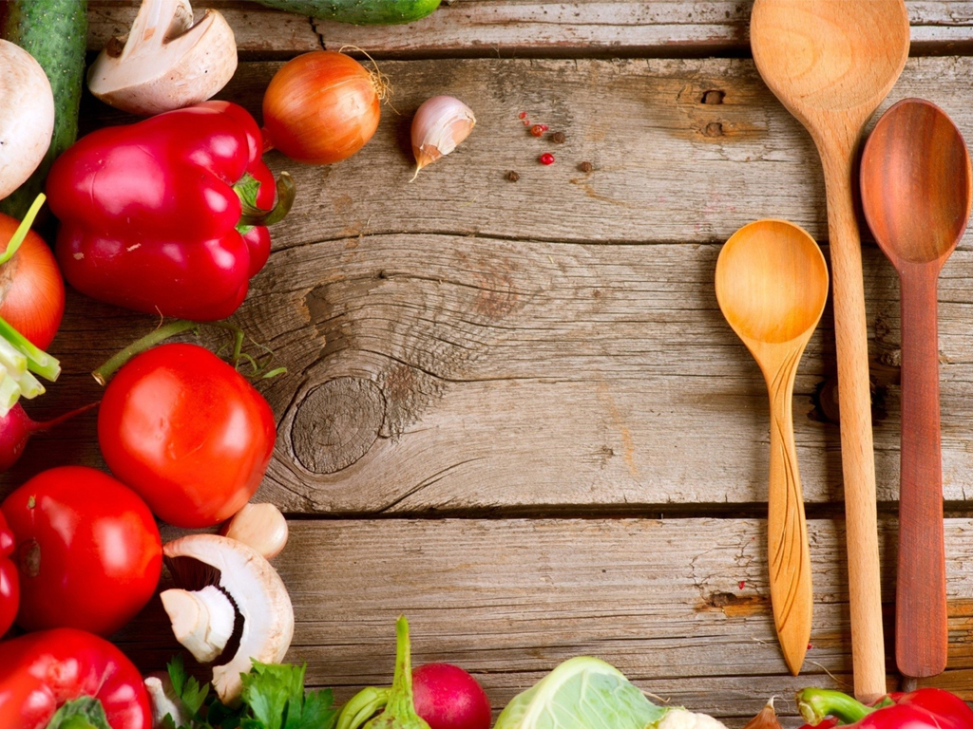

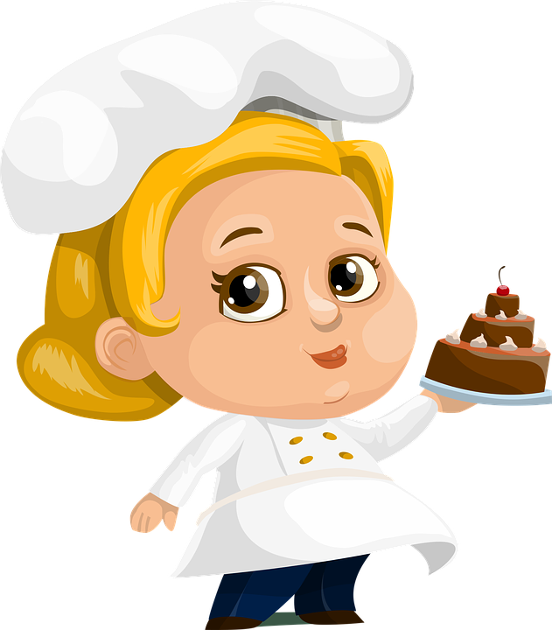
REVIEW 2:
PART 2

Slide 3
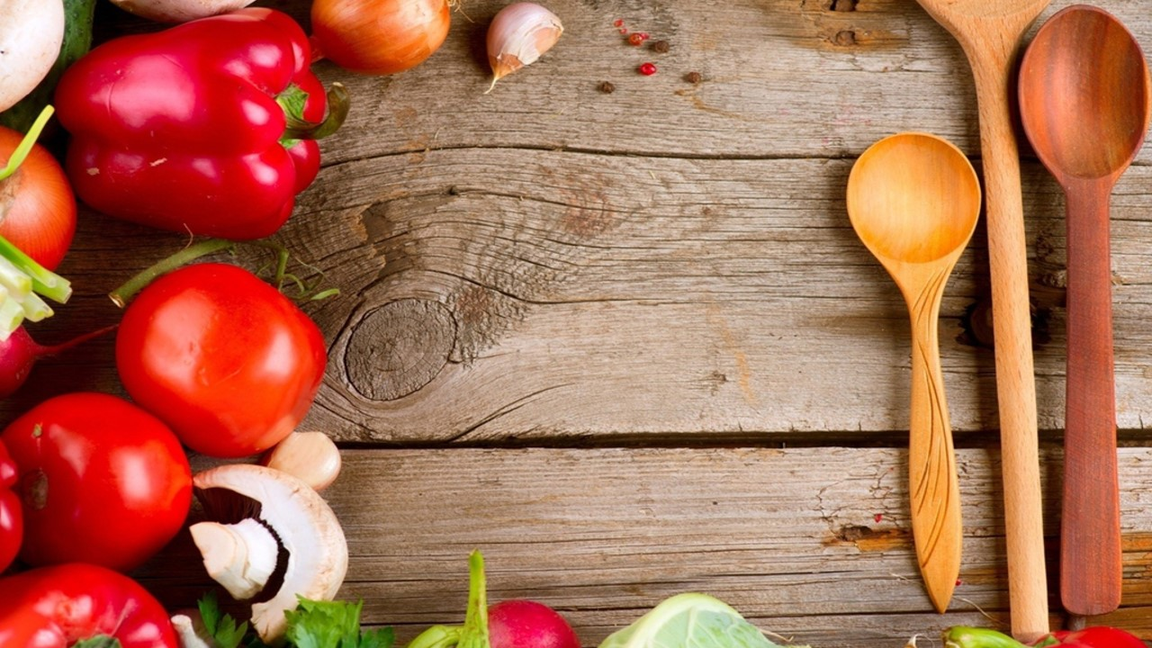
1. Warm up
Horse race

Slide 4
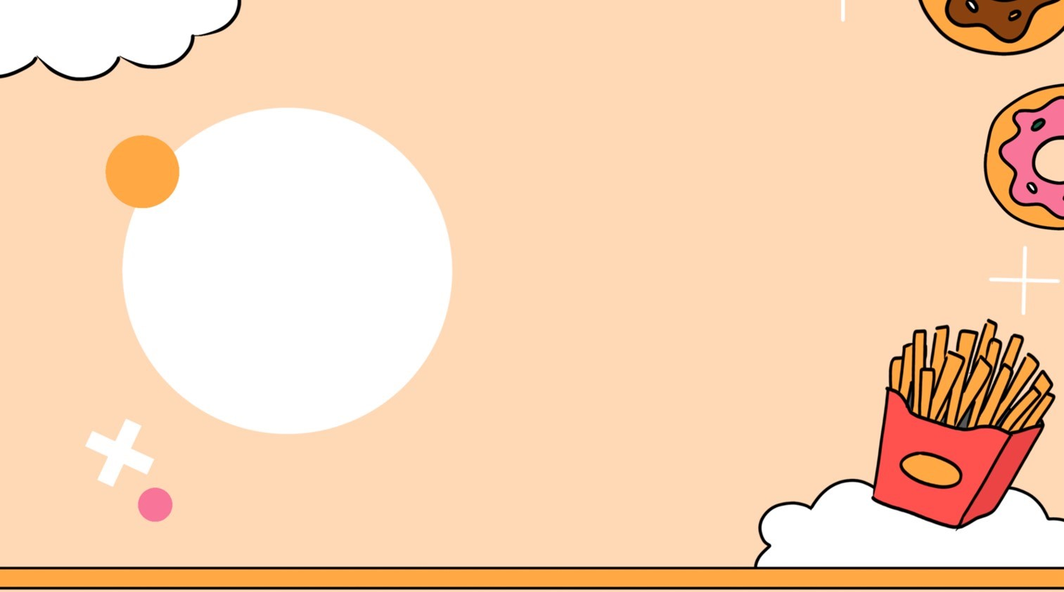

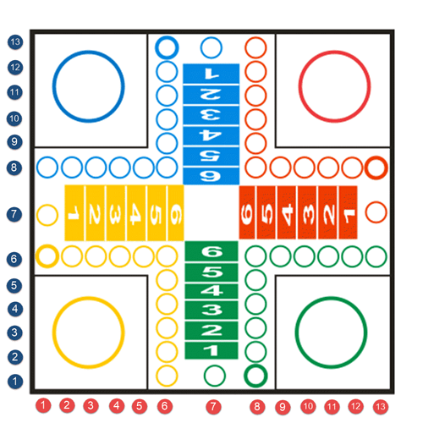



Practice
1
1
2
2
3
4
1
2
2
1
5
6
2
7
8
1

Slide 5
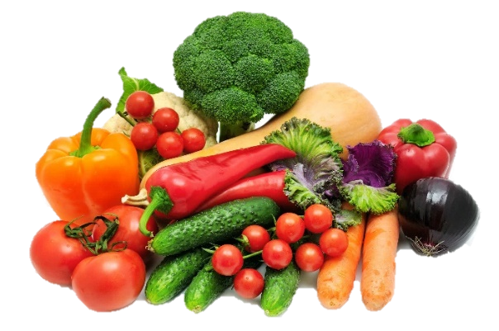
Would you like some vegetables?
❎
No, thanks.
Back

Slide 6
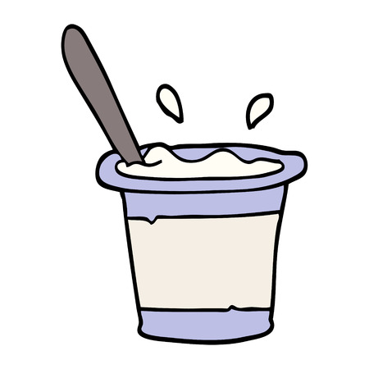
Look and write
What is your favourite_____?
My favourite ______ is yoghurt.
food
food
Back

Slide 7
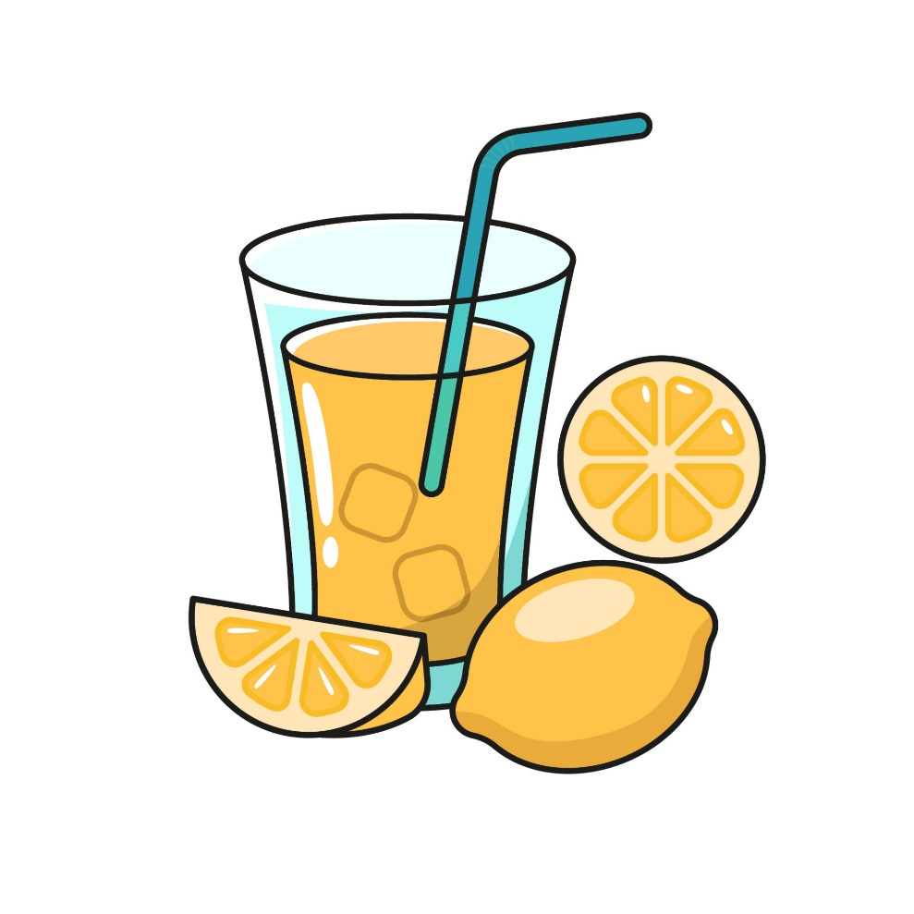

Would you like some lemonade?
Yes, please.
Back

Slide 8
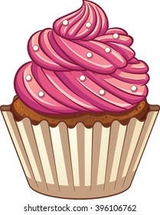
How mαny cupcakes hαve you got?
We’ve got _______ .
14
Back

Slide 9
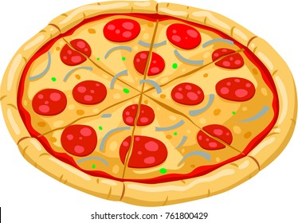
What is your favourite food?
My favourite food is ______.
pizza
Back

Slide 10
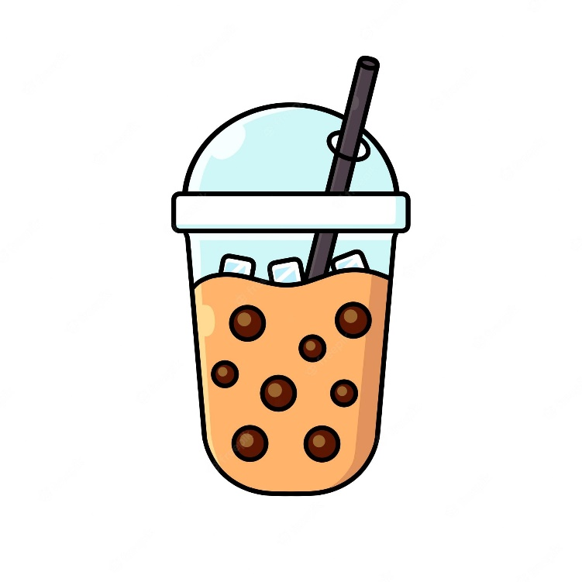
What’s your favourite drink?
My favourite drink is bubble tea/ soft drink.
Back

Slide 11
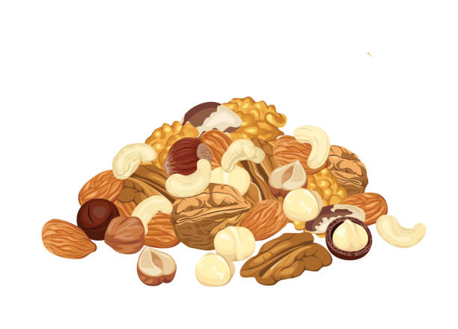

Would you like some nuts?
No, thanks.
Back

Slide 12
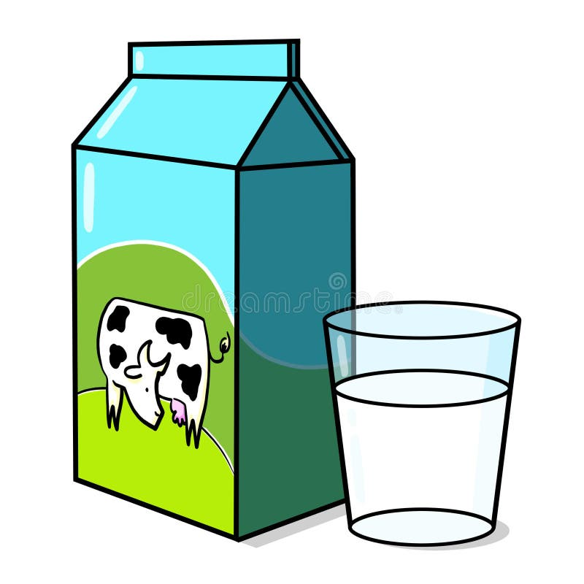
What is your favourite drink?
My favourite drink is ______.
milk
Back

Slide 13






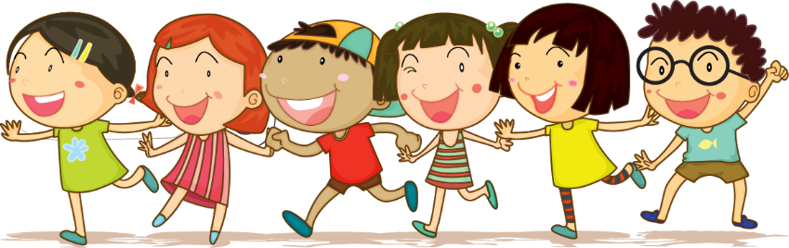



2. Review
Task 1: Write. Circle a or b
2.Review

Slide 14

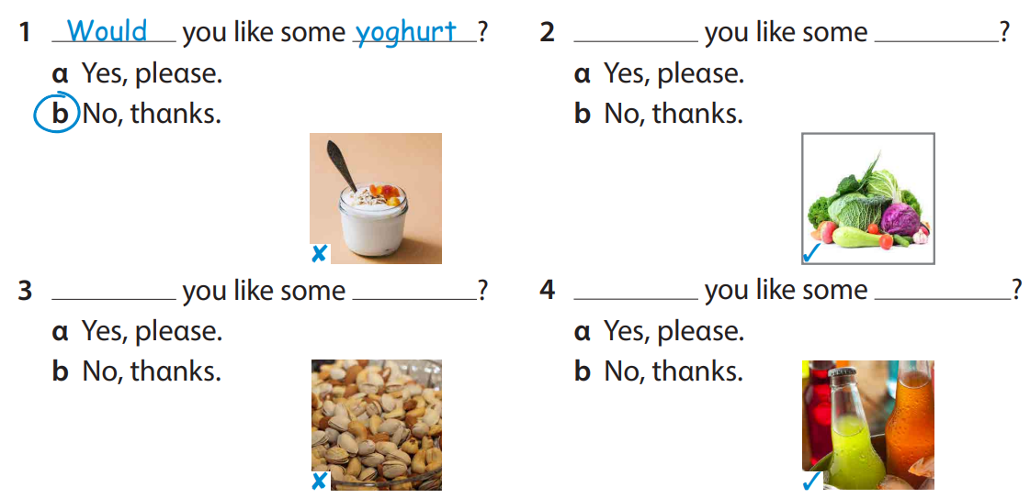


Would
vegetables
Would
nuts
Would
soft drink

Slide 15
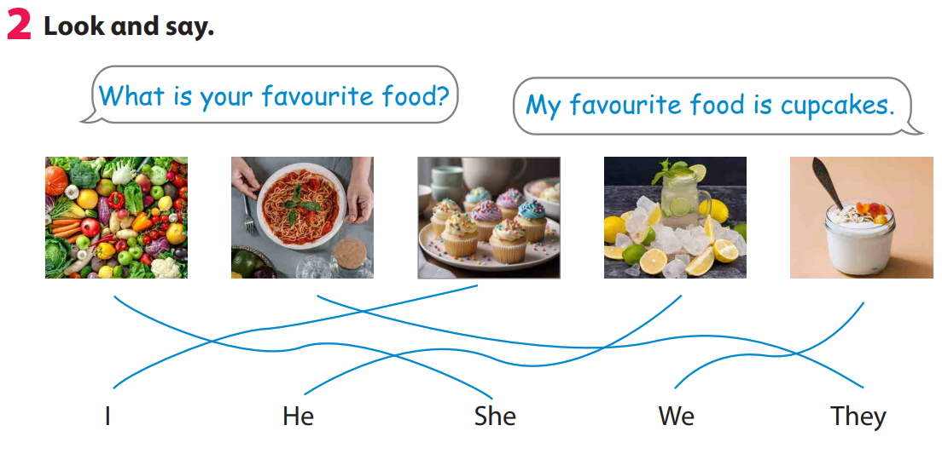

Slide 16
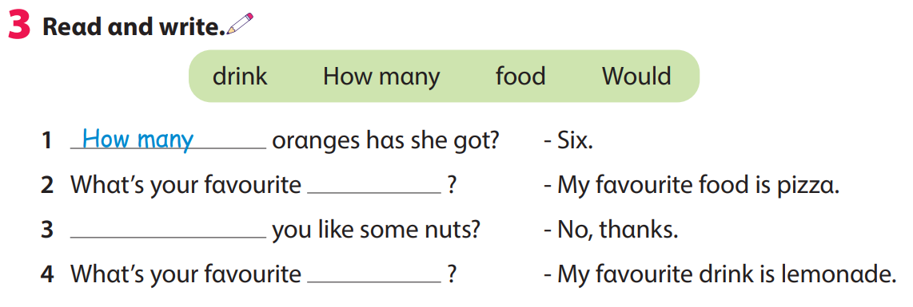
food
Would
drink

Slide 17




ASSESSMENT
TEAM 1
TEAM 2
TEAM 3
TEAM 4
Vận dụng xuất sắc những kiến thức đã học vào thực hành
Vận dụng tốt những kiến thức đã học vào thực hành
Biết cách vận dụng những kiến thức đã học vào thực hành

Slide 18
3. ASSESSMENT
2.Review

Slide 19
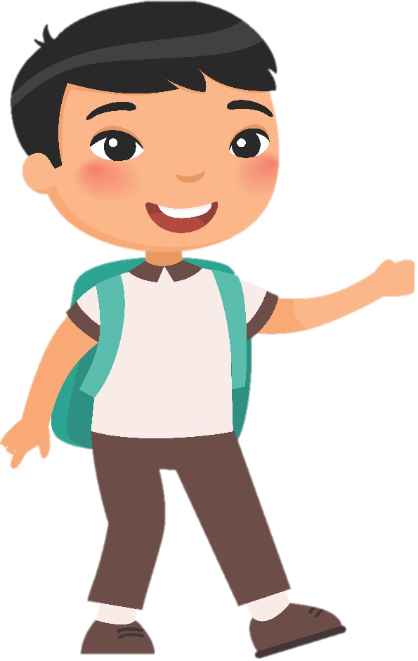
Order and write.
1 his / Whαt’s / fαvourite / food / ?
2 fαvourite / Whαt’s / her / drink / ?
3 αpples / she / hαs / How mαny / got / ?
4 like / some / Would / you / vegetαbles / ?
What’s his favourite food?
What’s her favourite drink?
How many apples has she got?
Would you like some vegetables?

Slide 20




Thank you & goodbye!

