Slide 1





















Review 1
Part 4
Notes:
Để nguyên trang bìa như này, chỉ thay đổi tên bài trong quá trình làm. Logo của sách Wonderful World

Slide 2







Warm up
Game: Who’s missing?
Notes:
- Show all the pictures of family members on the screen.
- Ask Ss to read.
- Ask them to close their eyes.
- Choose a student from each team and go to the board.
- Tell the rule and let children do a trial.
- Check children’s understanding. (If children can’t understand well, T can explain the rule in Vietnamese).
- T removes a family member and asks pupils to identify who is missing.
- The winner is who can say the correct member first.

Slide 3


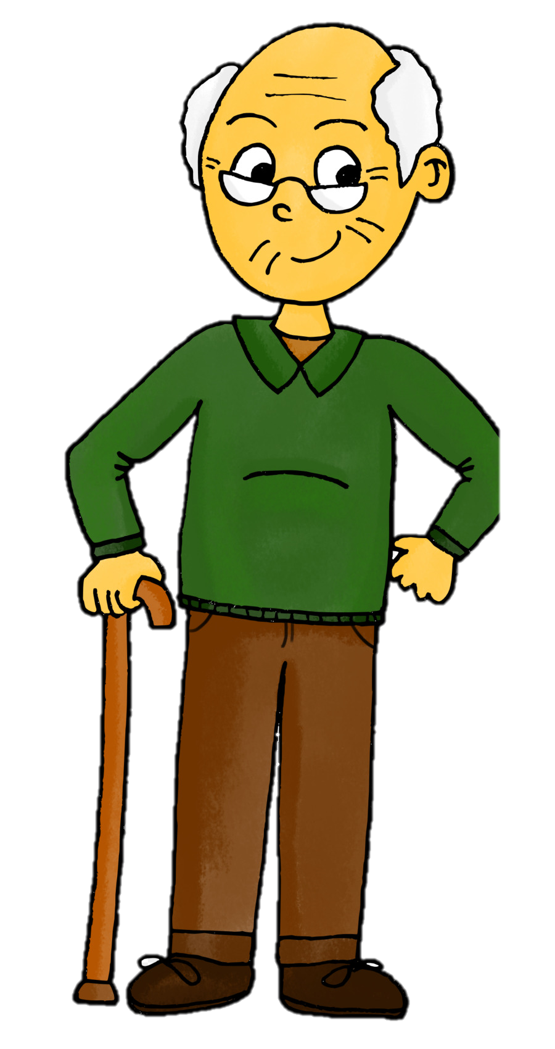
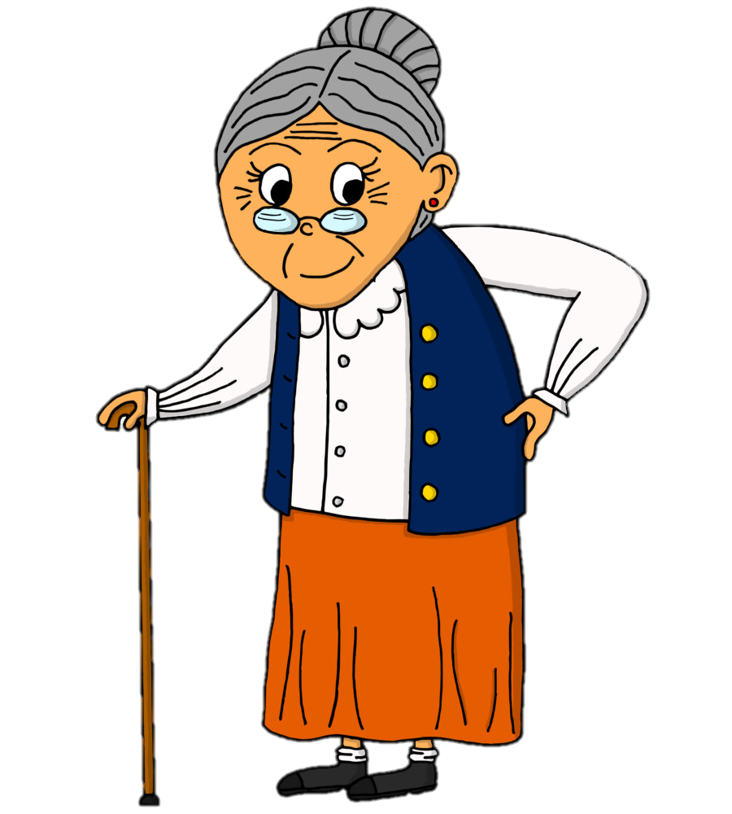

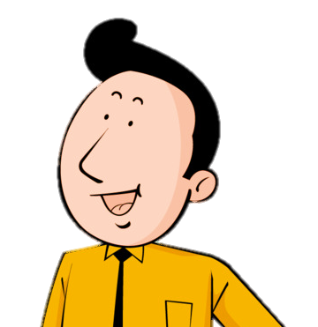
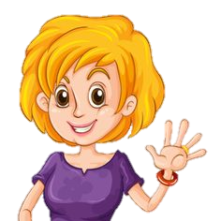
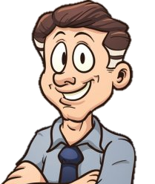
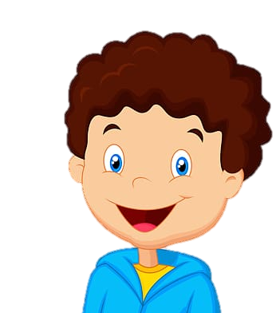
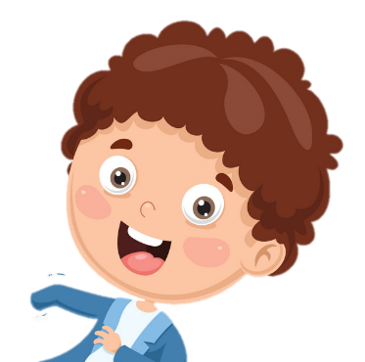
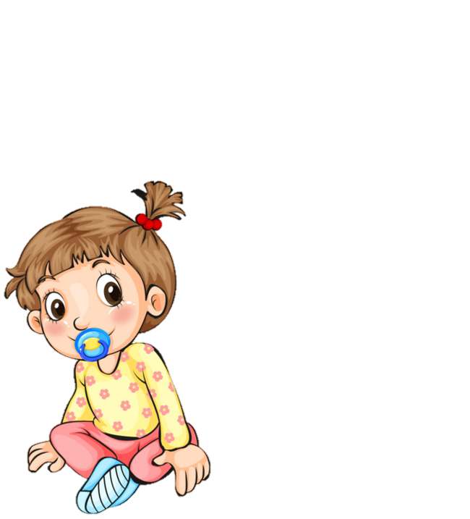
grandpa
grandma
mum
aunt
uncle
dad
brother
sister
cousin
Notes:
- Show all the pictures of family members on the screen.
- Ask Ss to read.
- Ask them to close their eyes.
- Choose a student from each team and go to the board.
- Tell the rule and let children do a trial.
- Check children’s understanding. (If children can’t understand well, T can explain the rule in Vietnamese).
- T removes a family member and asks pupils to identify who is missing.
- The winner is who can say the correct member first.

Slide 4
grandpa
grandma
dad
aunt
mum
uncle
brother
sister
cousin

Slide 5










2. Review

Slide 6

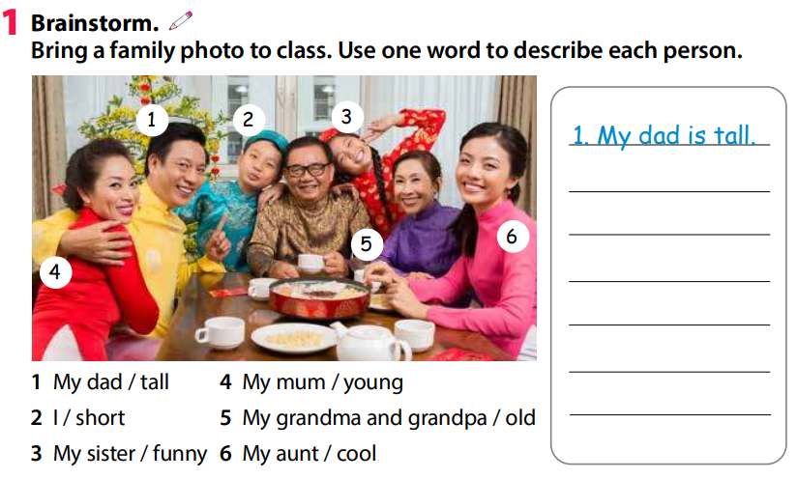
2 Presentation
2. I’m short.
3. My sister is funny.
4. My mum is young.
5. My grandma and grandpa are old.
6. My aunt is cool.

Slide 7

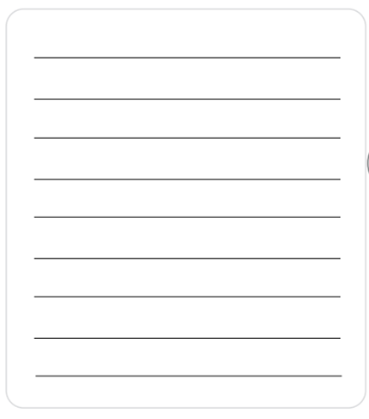
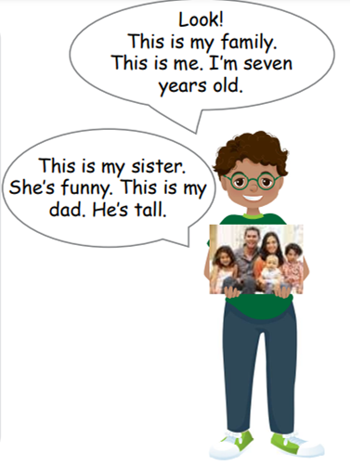
2 Write and talk about your family.
Write one sentence about each member of your family. Tell your class about it.

Slide 8
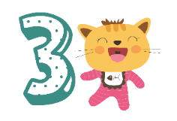
Extra Activity

Slide 9
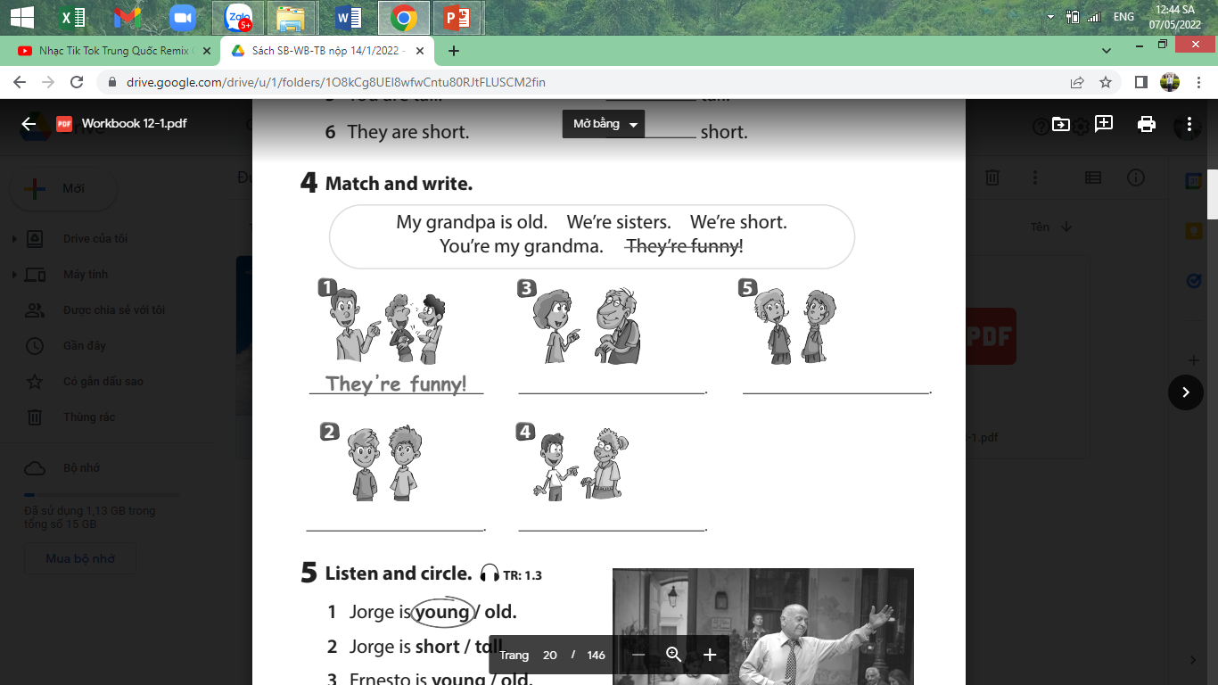
Task 1:Fill in the blank
My grandpa is old.
We’re sisters.
We’re short.
You’re my grandma.

Slide 10




Good bye.
See you again!

