Slide 2
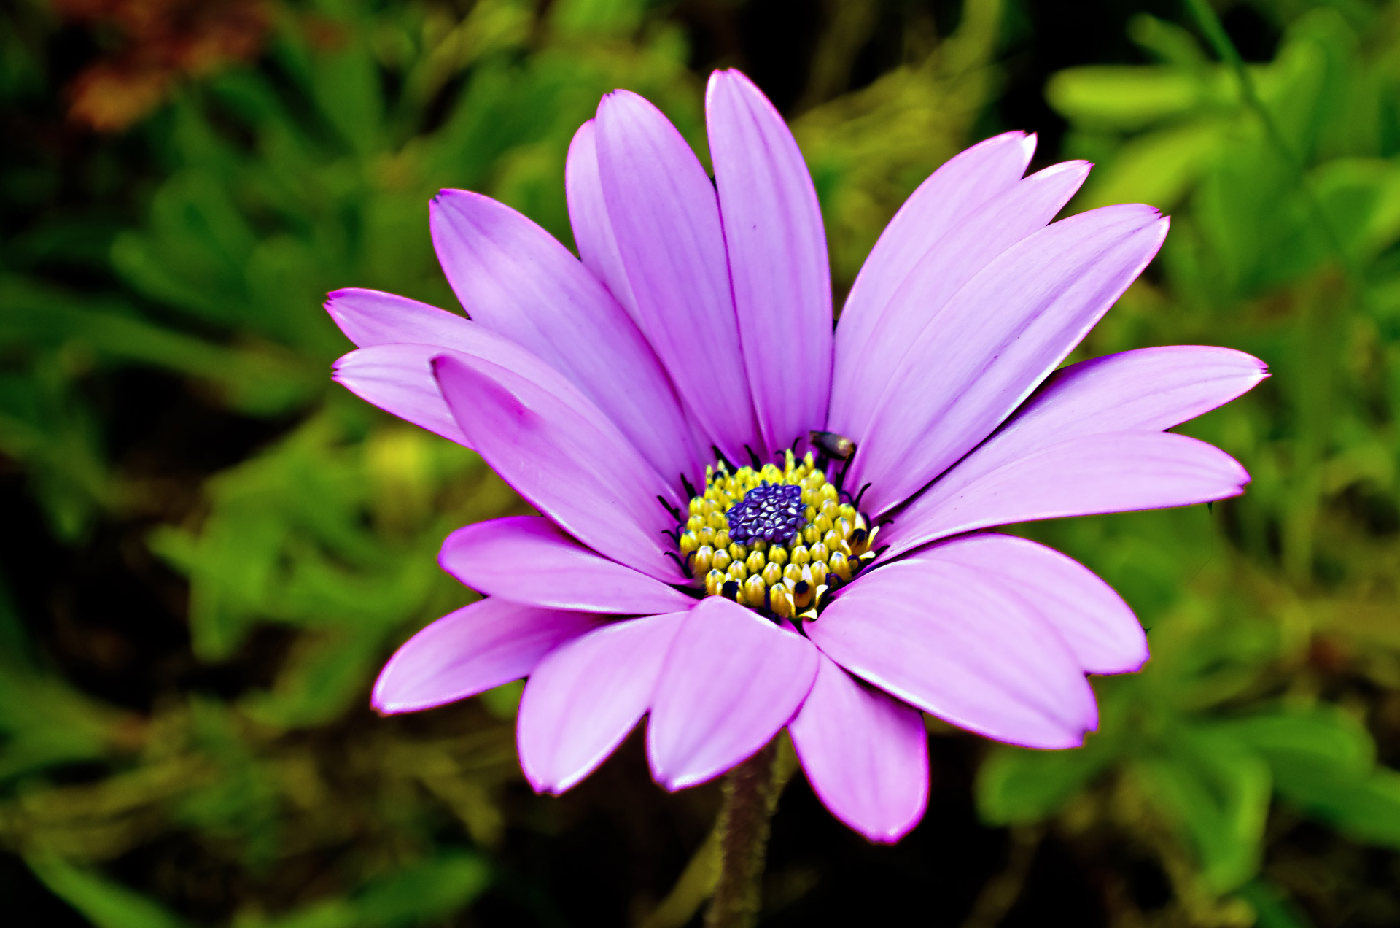
REVIEW 2
REVIEW 2
Skills

Slide 3

OBJECTIVES
By the end of the lesson, students will have revised the skills they have practiced in Units 4 – 6.

Slide 4

STYLES OF MUSIC
STYLES OF MUSIC

Slide 5


Slide 6
Reading

Slide 7
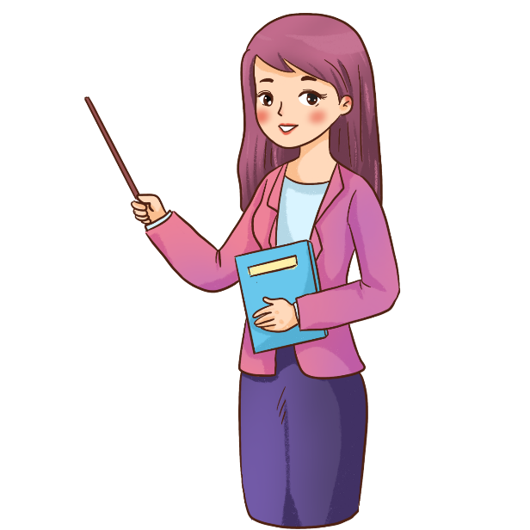
Ex1. Choose one appropriate option (A, B, C) to fill in each gap of the paragraph.

Slide 8
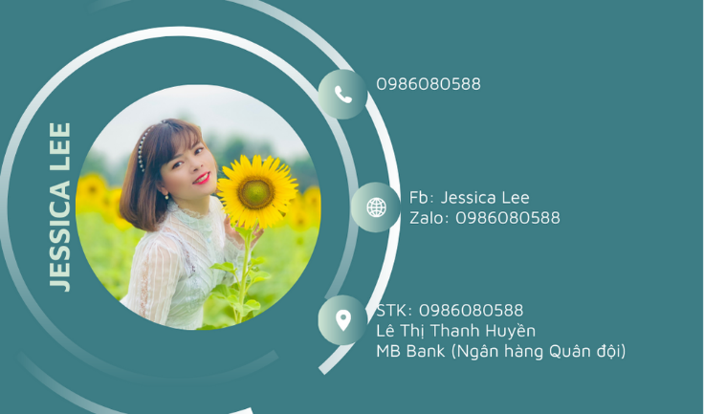


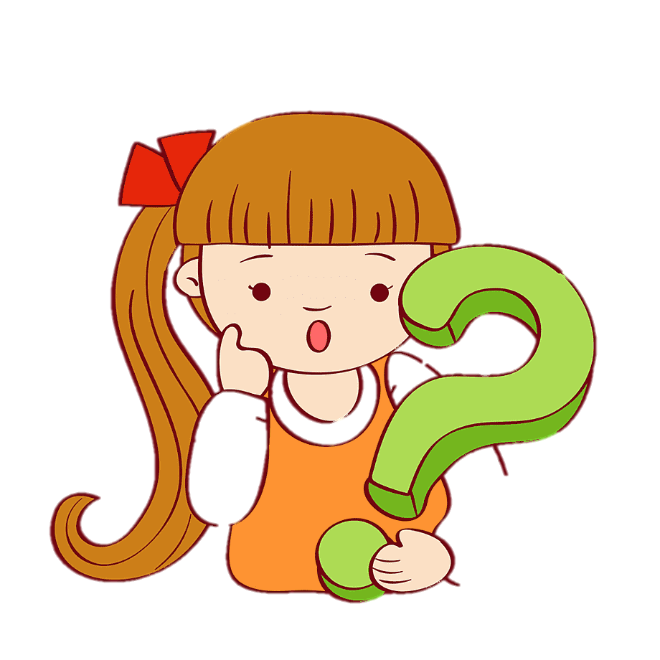
What kind of music do you enjoy? Some people like going to (1) ______ concerts or listening to an orchestra. The musicians wear very formal clothes, and the audience is silent until the end of the (2) ______. If you are a fan of rock music, you can dance to the music or sing some rock songs at football stadiums or in parks. (3) ______ music is often played at weddings and parties in many countries. Nowadays, we can (4) ______ to music in shops and lifts. Teenagers even listen to music when they (5) ______. Music is everywhere!

Slide 9

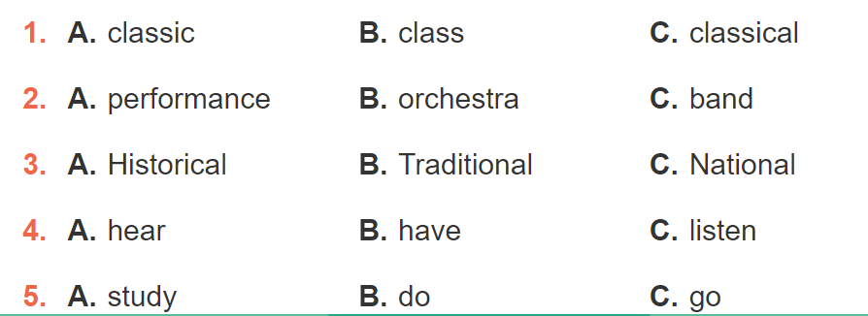

Slide 10
Speaking

Slide 11
Ex2. Work in pairs. Imagine you have just visited a lower secondary school. Ask and answer the questions, using the following suggestions.

Slide 12

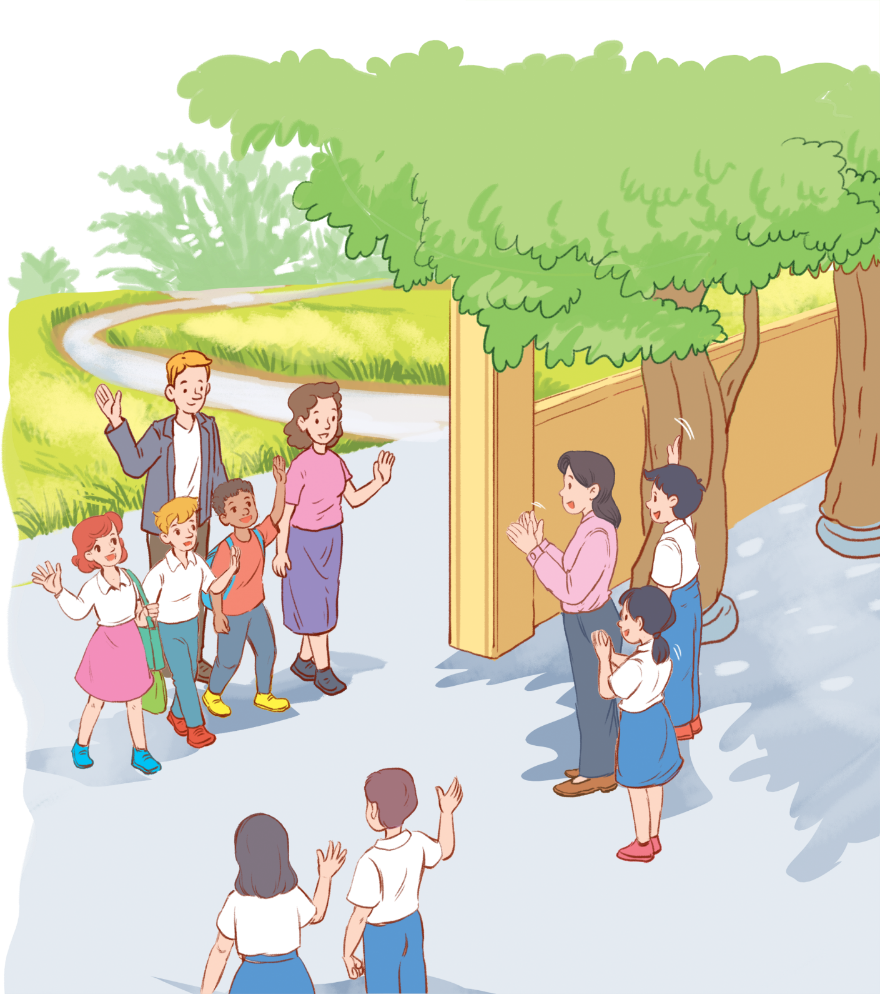
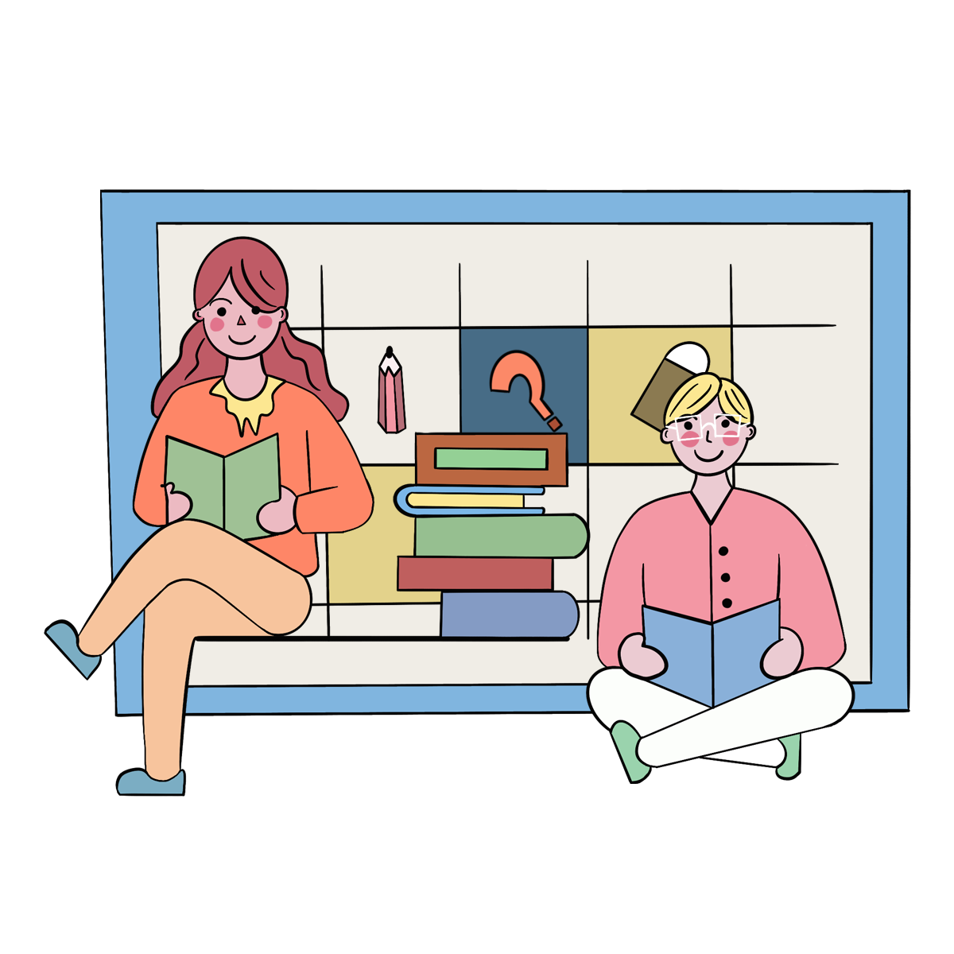
Work in pairs. Imagine you have just visited a lower secondary school. Ask and answer the questions, using the following suggestions.

Slide 13



Work in pairs. Imagine you have just visited a lower secondary school. Ask and answer the questions, using the following suggestions.
1. Where the school is.
2. How many teachers and students there are.
3. What school facilities are.
4. What school outdoor activities students do.

Slide 14
1. Where the school is.
My school is in District 1, the center of Ho Chi Minh city. The school offers young students quality education and one of the best views in town from its location.

Slide 15
2. How many teachers and students there are.
My school has four hundred students and thirty-two teachers.

Slide 16
3. What school facilities are.
There are a modern library, a swimming pool, 3 buildings, a lot of classrooms, a large cafeteria, a big schoolyard, a parking lot.

Slide 17
4. What school outdoor activities students do.
We plant trees in the garden. We also donate old books, old clothes for poor children.

Slide 18
Listening

Slide 19
Ex3. Listen to a man talking about his meal at a restaurant and tick (✓) the adjectives you hear.

Slide 20


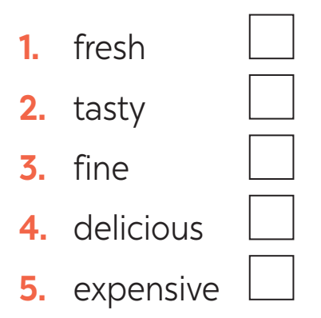



Slide 21
Ex4. Listen again and fill in each gap with ONE word.

Slide 22
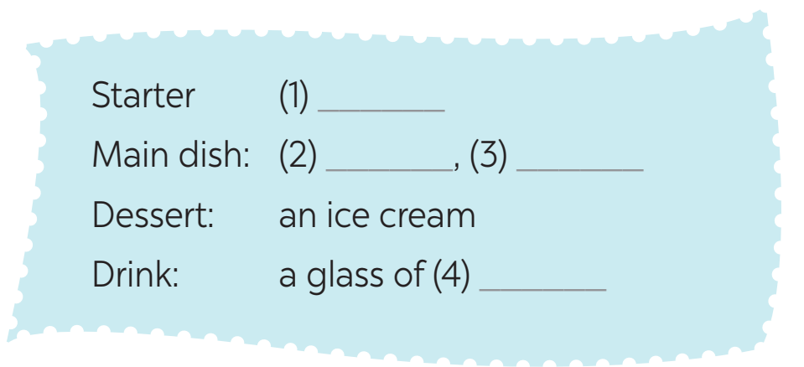
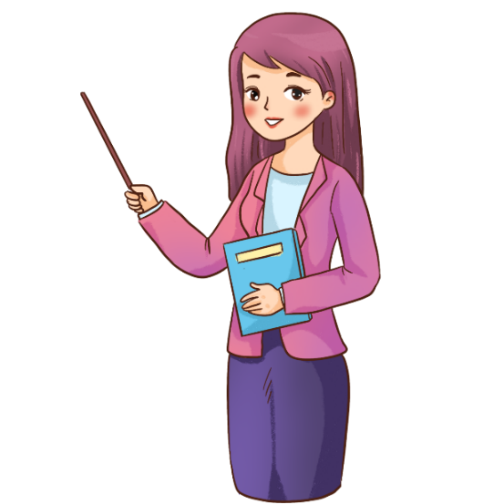
salad
fish
vegetables
juice

Slide 23
Writing

Slide 24
Ex5. Write a paragraph of about 60 words about a meal you had at a restaurant.

Slide 25

Last weekend, my parents and I had a meal at a small restaurant in the centre of town. For a starter, I ordered a plate of salad. The salad is prepared using different vegetables and fruits and then those are cut into pieces and mixed together with mustard. My family ordered fried chicken and shrimp for the main dish. It’s also my favourite dish in this restaurant. The food is very delicious. I have quite a sweet tooth so I always look forward to dessert. I ordered Tiramisu. My parent ordered 2 cups of coffee.

Slide 26
Unit 2
Consolidation

Slide 27
Reading
Speaking
Listening
Writing
UNITS
4-5-6

Slide 28

Homework
Prepare for Test for the first term

Slide 29



Slide 30

1. C
Some people like going to classical concerts or listening to an orchestra.
Giải thích:
classic (n): tác phẩm kinh điển class (n): lớp học classical (adj): cổ điển
Trước danh từ “concerts” (buổi hòa nhạc), ta sử dụng tính từ “classical” (cố điển).
2. A
The musicians wear very formal clothes, and the audience is silent until the end of the performance. :
performance (n): buổi biểu diễn orchestra (n): dàn hợp xướng band (n): ban nhạc
Sau giới từ “the” cần dùng danh từ hoặc tính từ, cả 3 đáp án đều là danh từ nhưng đáp án B, C không phù hợp với nghĩa của câu.
3. B
Traditional music is often played at weddings and parties in many countries.i thích:
historical (adj): liên quan đến lịch sử traditional (adj): truyền thống national (adj): thuộc về quốc gia
Đứng đầu câu cần 1 danh từ/ tính từ cả 3 đáp án đều là tính từ nhưng đáp án A, C không phù hợp với nghĩa của câu.
4. C
Nowadays, we can listen to music in shops and lifts.thích:
hear (v): lắng nghe listen (v): nghe have (v): có
Sau “can” cần một động từ, cả 3 đáp án đều là dộng từ nhưng đáp án A, B không phù hợp với nghĩa của câu.
5. A
Teenagers even listen to music when they study.

