Slide 2
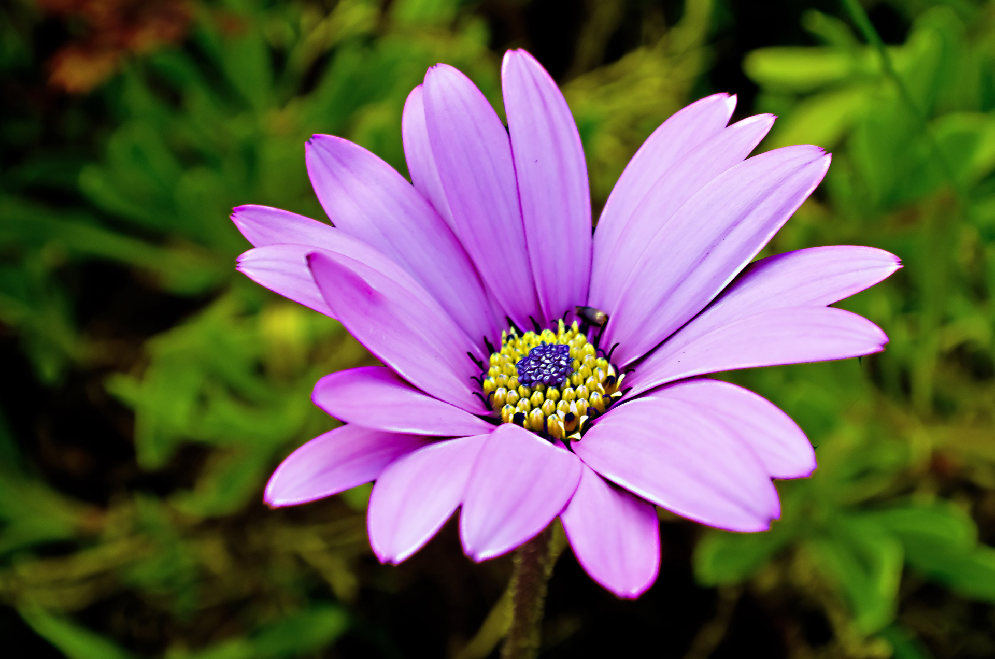
REVIEW 2
REVIEW 2
Language

Slide 3

OBJECTIVES
By the end of the lesson, students will have revised the language they have learnt in Units 4 – 6.

Slide 4

Find keyword?

Slide 5



music and arts

Slide 6
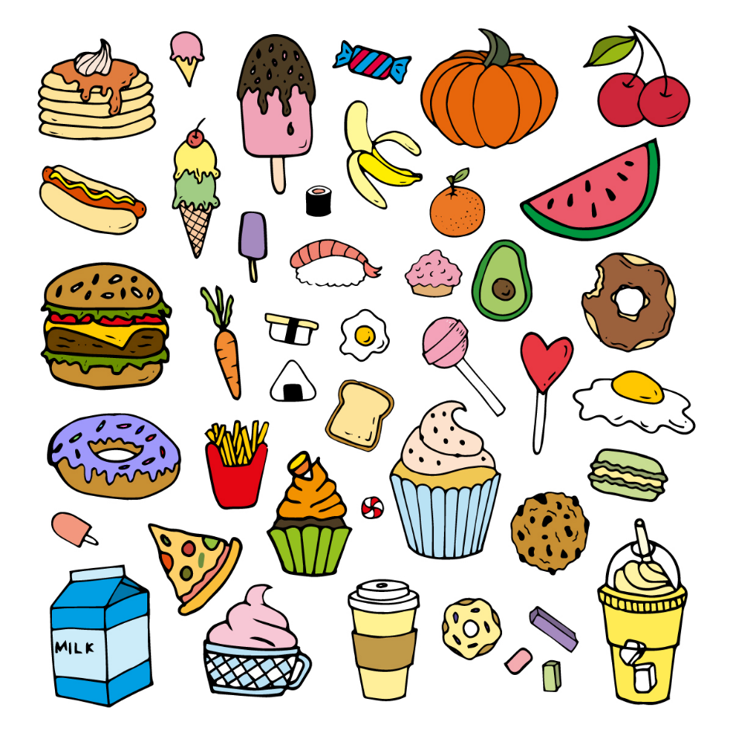

food and drink

Slide 7
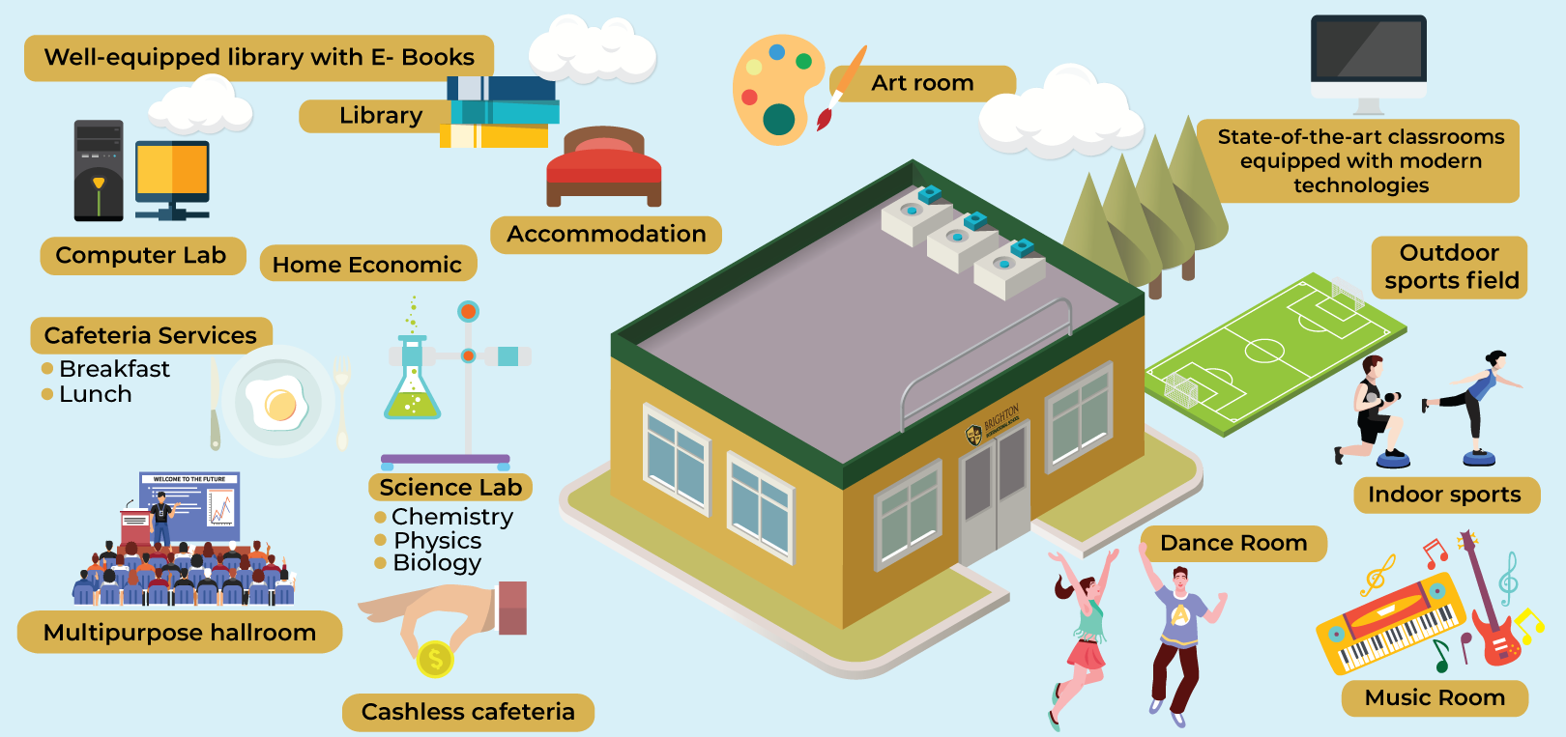
school facility

Slide 8
Pronunciation

Slide 9
Ex1. Circle the word in which the underlined part is pronounced differently. Listen, check, and repeat the words.

Slide 10

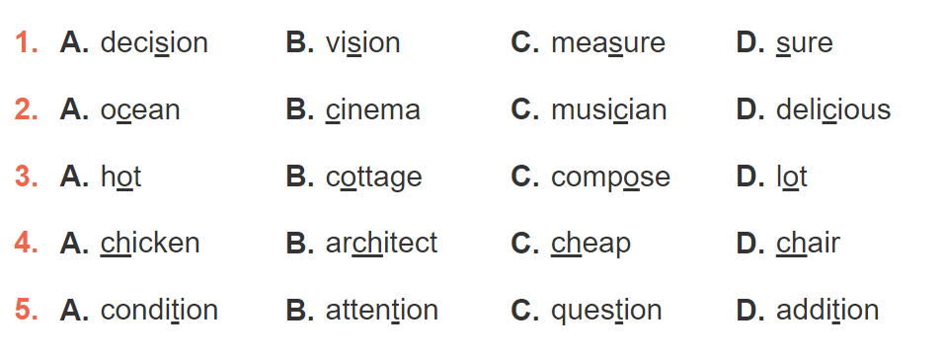



Slide 11
Vocabulary

Slide 12
Ex2. Match a word in A with a word or phrase in B. Then complete the sentences with the appropriate phrases.

Slide 13
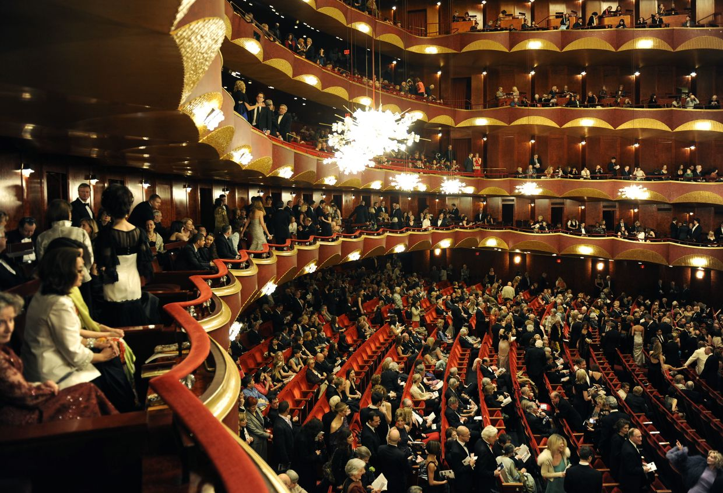
a classical concert

Slide 14
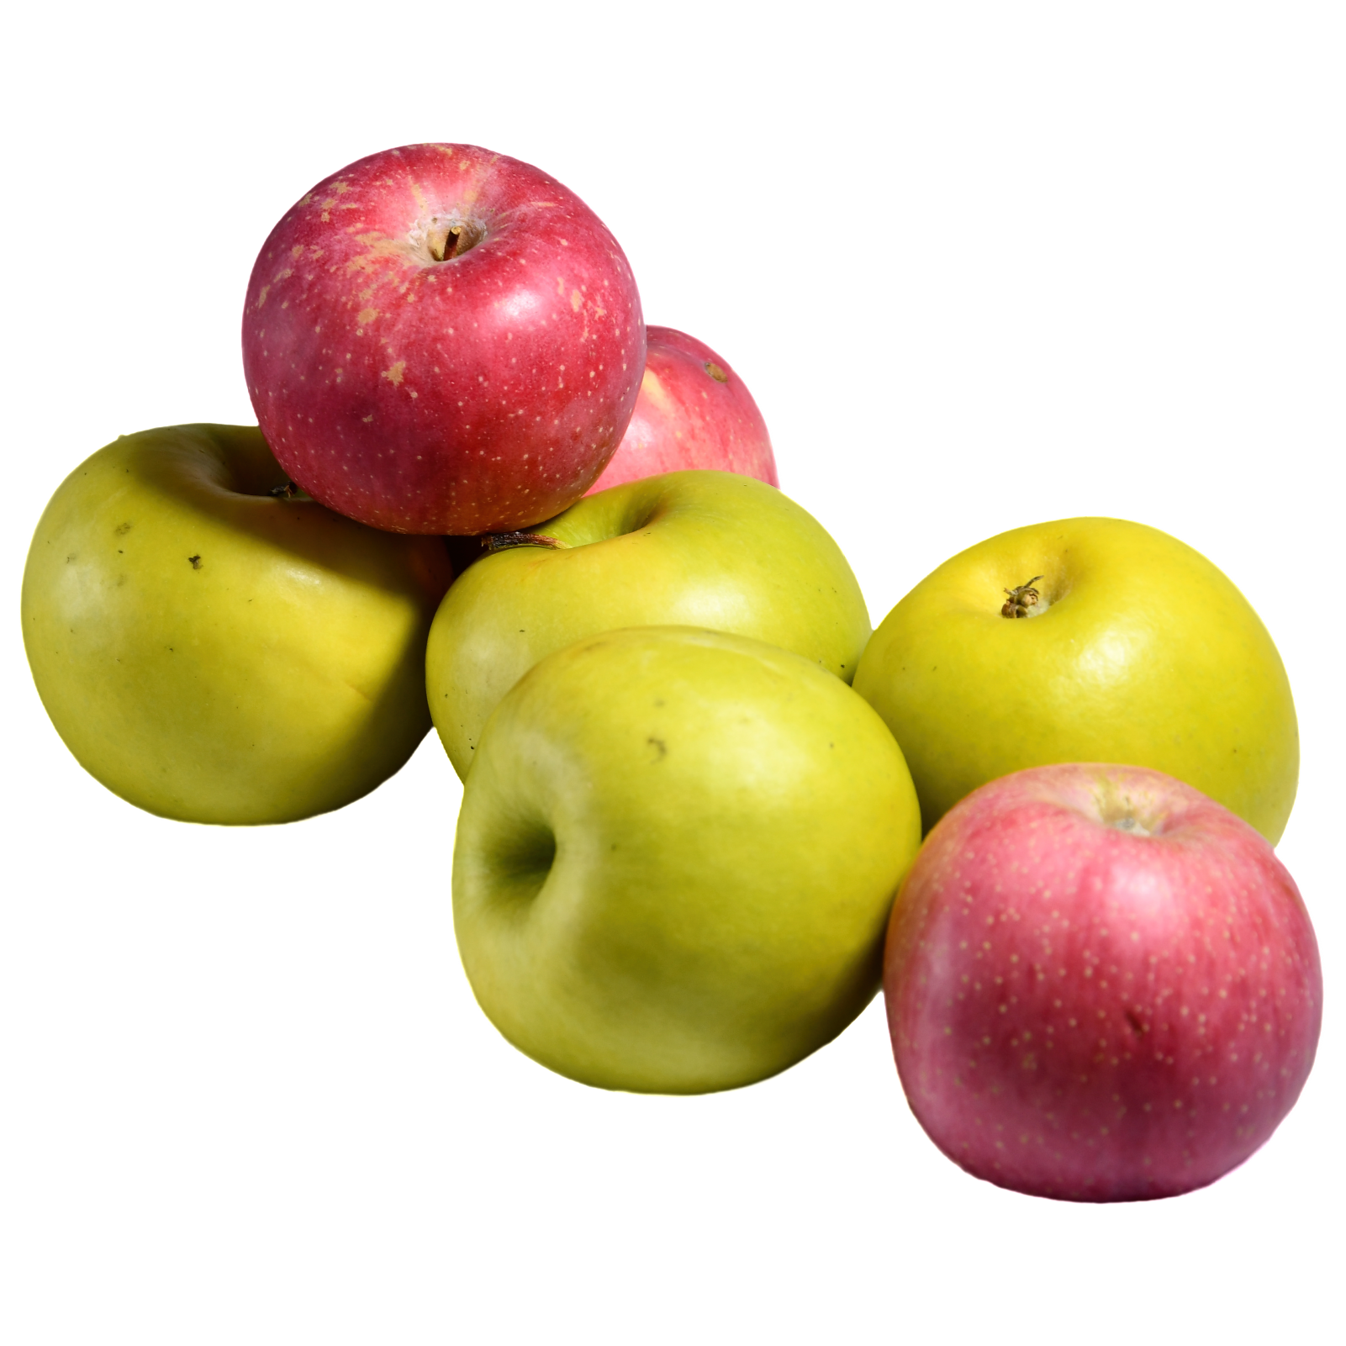
some apples

Slide 15

an entrance exam

Slide 16

the guitar

Slide 17
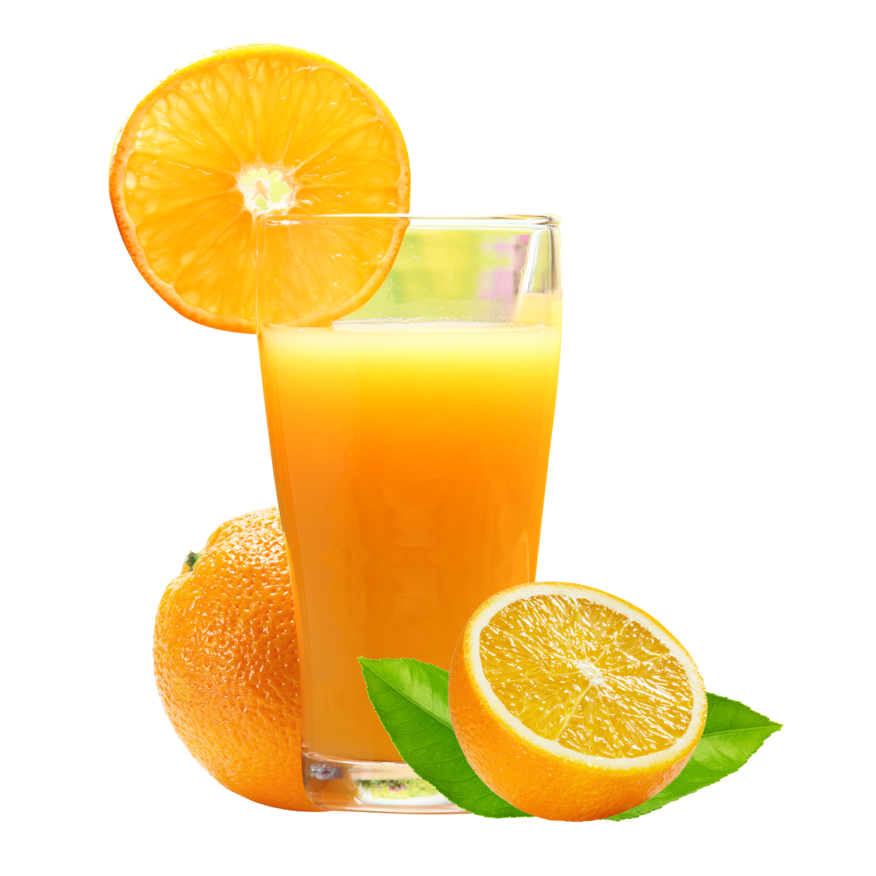
juice

Slide 18
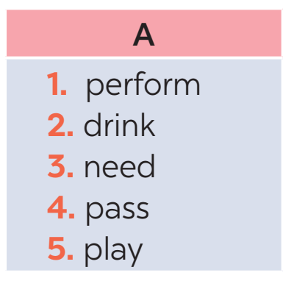
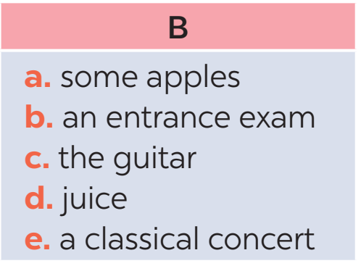

Slide 19
Ex3. Underline the correct word to complete the sentences.

Slide 20


1. Trinh Cong Son is one of Viet Nam’s greatest scientists / composers.
2. How many butter / apples do we need for an apple pie? 3. The musicians will perform their final portrait / concert next week. 4. Ha Noi Amsterdam School is for normal / gifted students. 5. Students have to take a(n) entrance / final exam to study at my school.

Slide 21
Grammar

Slide 22
Ex4. Complete the passages about camping. Use the words and phrases from the boxes.

Slide 23
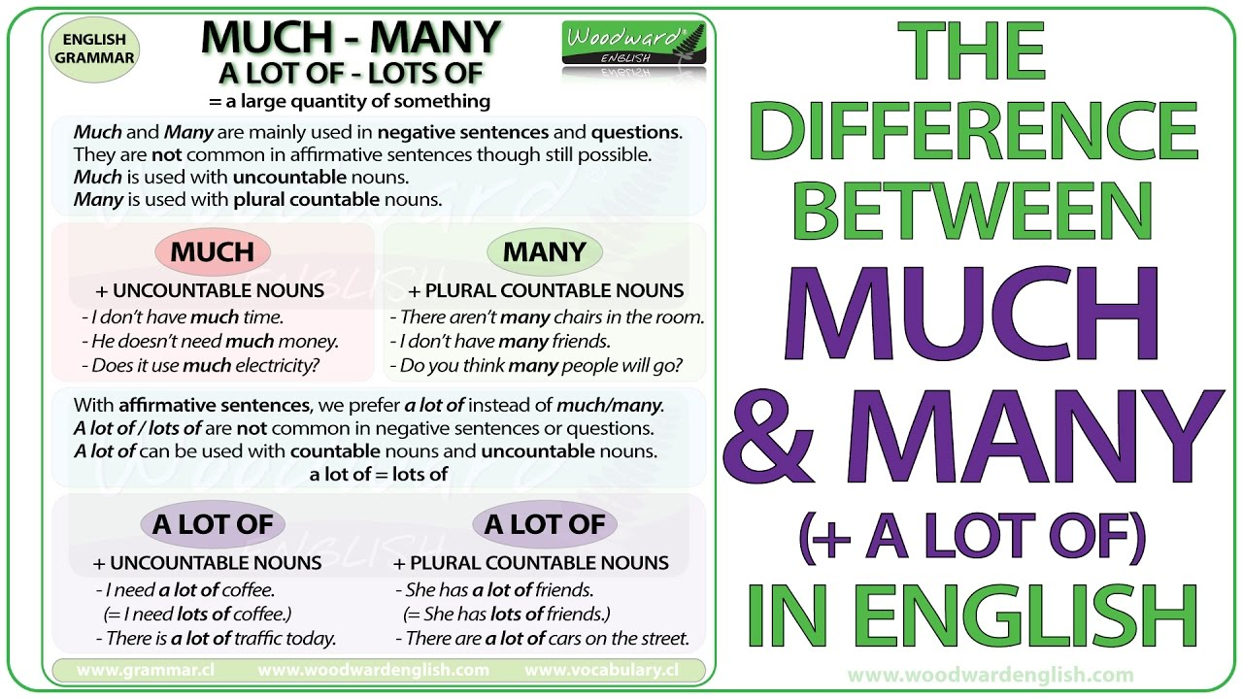

Slide 24
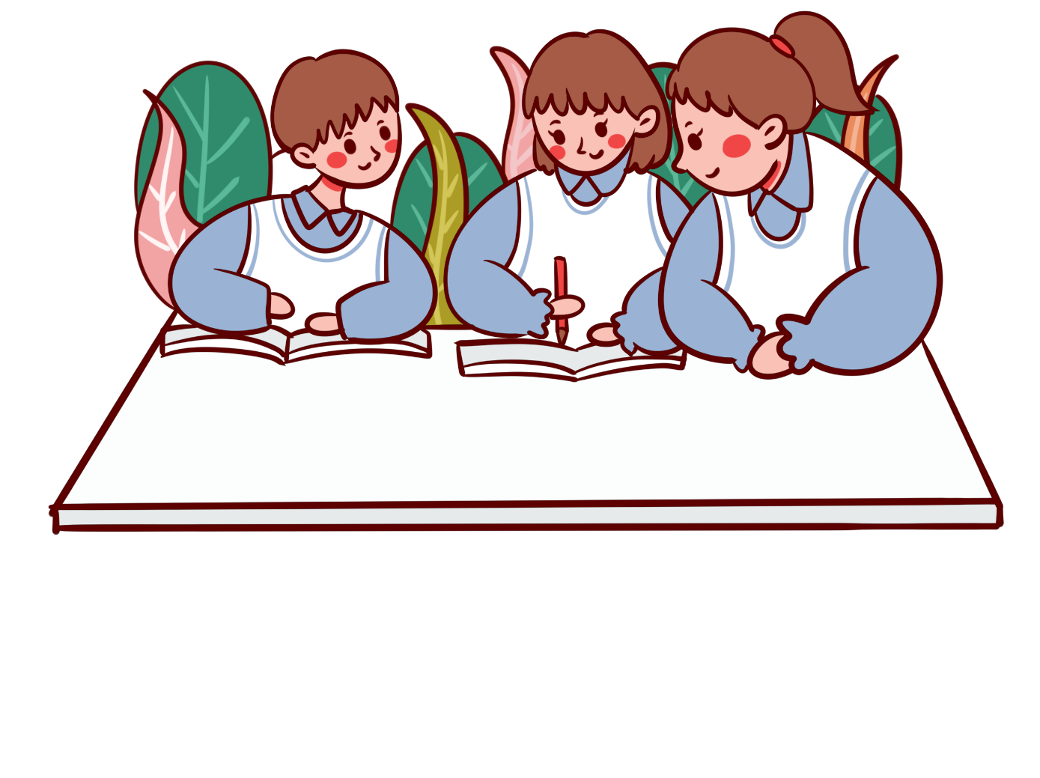
How much How many a lot of
Plan your meals in advance. How many sandwiches are you going to make? How many loaves of bread will you need? Do you plan to make popcorn? (1) _________ butter do you need? (2) _________ eggs will you buy? Do you need to buy (3) _________ drinks in advance?
How much
How many
a lot of

Slide 25
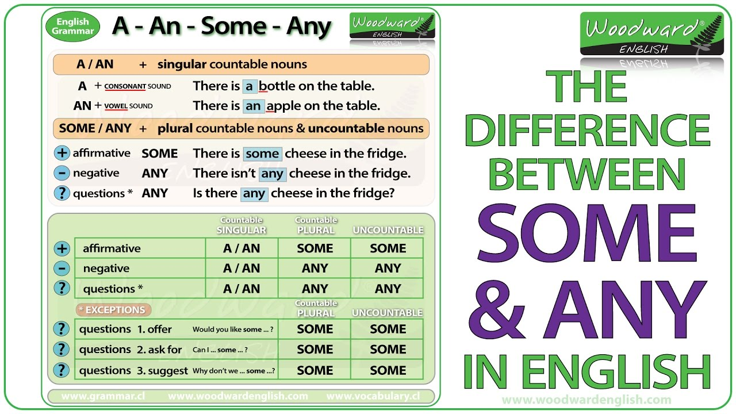

Slide 26
some much many
Making a fire is a skill. And it is easy to learn. You won’t need (4) ______ practice before you can make a campfire. Start with (5) ______ paper and leaves. Place the wood on top of these. Don’t use (6) ______ big pieces of wood. Just put two or three big pieces over the sticks and keep the rest for later.
much
some
many

Slide 27
Ex5. Complete the second sentence, using the words in brackets.

Slide 28
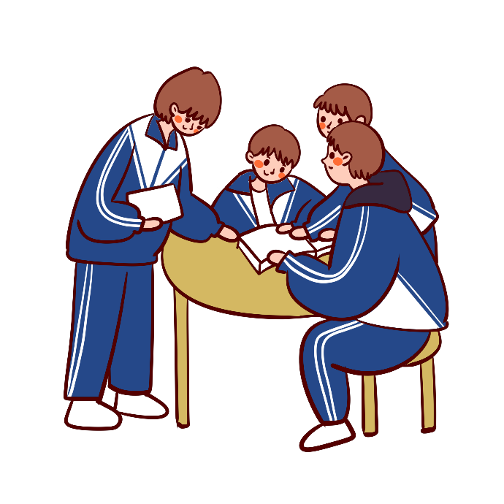
1. I think classical music is not as exciting as rock and roll. (more … than)
→ I think rock and roll _____________________________________________. 2. The poster in the gallery is the same as the one in my house. (different from)
→ The poster in the gallery __________________________________________. 3. A ticket to the theatre is cheaper than I expected. (not as … as)
→ A ticket to the theatre ____________________________________________. 4. The painting in the museum is not different from the painting in the gallery. (like) → The painting in the museum _______________________________________.
is more exciting than classical music
is not different from the one in my house
is not as expensive as I expected
is like the one in the gallery

Slide 29
Unit 2
Consolidation

Slide 30
Language
Pronunciation
Vocabulary
Grammar

Slide 31

Homework
Prepare for the next lesson:
Review 2 - Skills

Slide 32



