Slide 1

Welcome to our class today!
Class: 7A4
Teacher: Vũ Thị Hoài Thu
School: Nguyễn Bỉnh Khiêm Secondary school

Slide 2
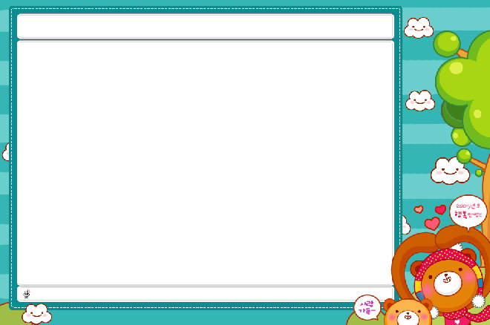

GAME: HIDDEN PICTURE
2 teams
Choose a number and answer the questions to open a part of the picture.
The words and parts of picture will show you the KEY WORD.
Which team guess the correct KEY WORD will be the winner.

Slide 3
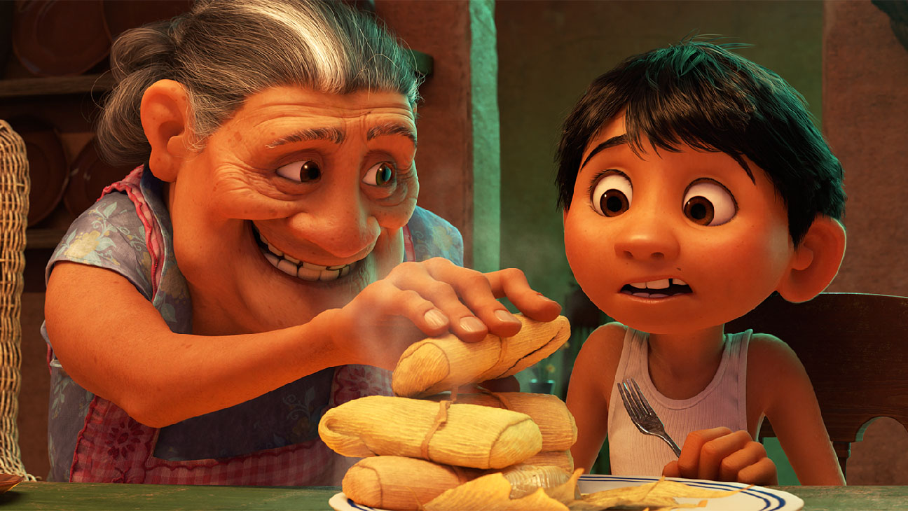
1
2
3
4
5
6
Film

Slide 4

Question 1
I like listening to...........in my free time.
My favourite song is “My heart will go on”
A. singer B. music
C. programme D. television

Slide 5
Question 2
What do you call the person who appears in the movie on TV?
A. MC B. weatherman
C. actor D. viewer

Slide 6
Question 3
I like the cartoon “Tom and Jerry”.
It’s very..................
A. interesting B. dangerous
C.boring D. careful

Slide 7
Question 4
Peter likes reading .......... “Cinderella” before bedtime every night.
A. play B. television
C.movie D. story

Slide 8
Question 5
The main......... “Elsa” in the animated film “Frozen” is very beautiful.
A. people B. music
C.character D. story

Slide 9
Question 6:
This is a piece of electrical equipment with a screen on which you can watch programmes with moving pictures and sounds. What is it?
A. TV B. light
C. radio D. camera

Slide 10

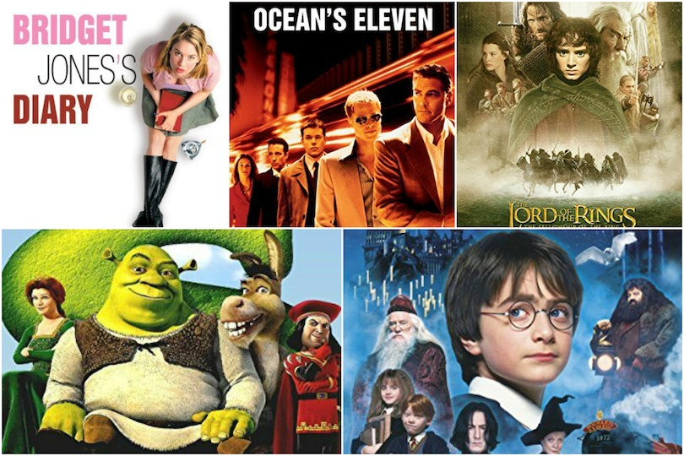
Do you often watch film?
What’s your favourite film?

Slide 11

Unit 8: Films Period 62: Getting started

Slide 12

Objectives
An overview about the topic “Films”
Lexical items related to the topic “Films”
+ Types of films
+ Adjectives describing films

Slide 13

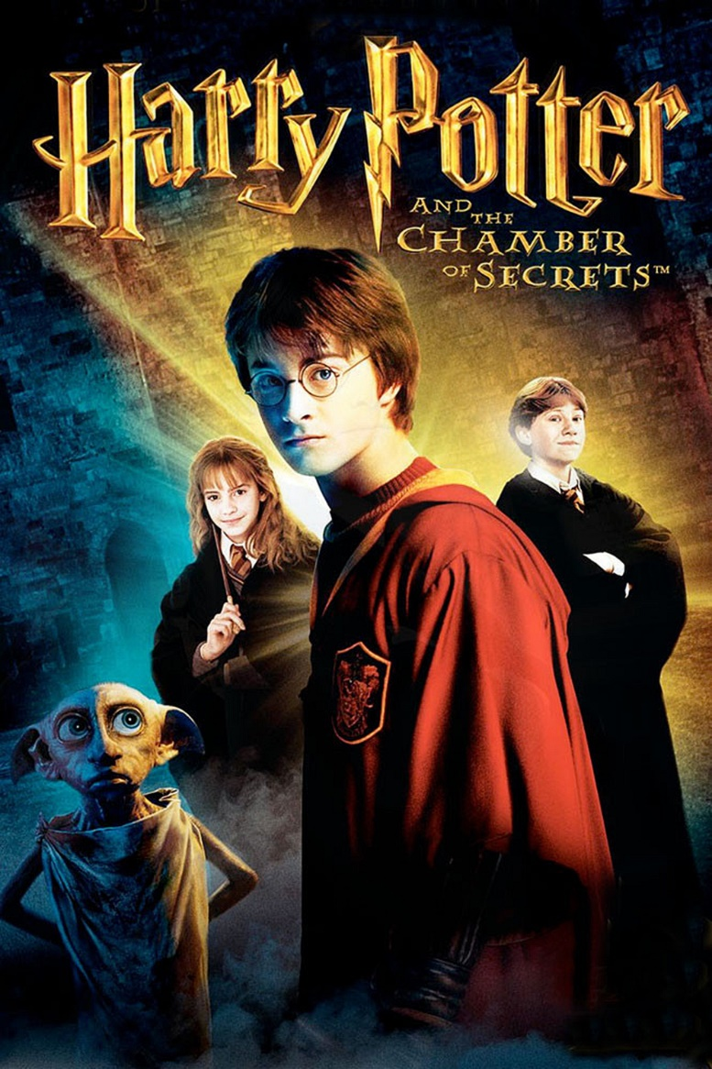

I. Vocabulary:
fantasy (n)
/ˈfæntəsi/
phim viễn tưởng

Slide 14
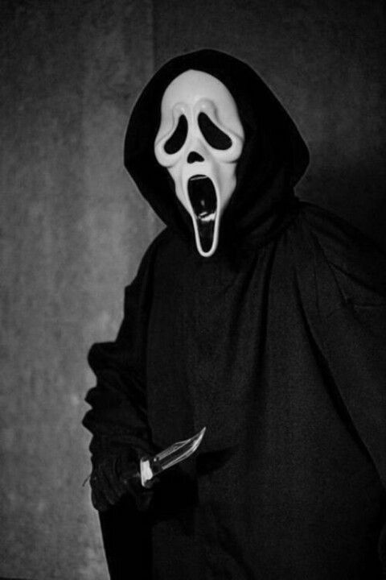
I. Vocabulary:
horror film (n)
/'hɒrə fɪlm/
phim kinh dị

Slide 15
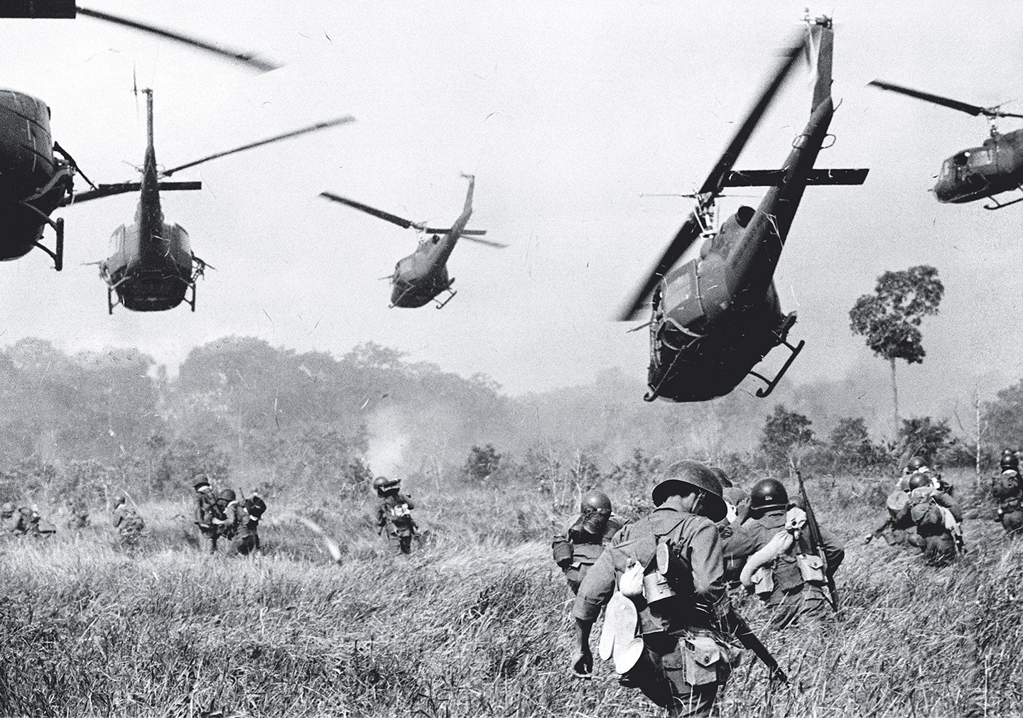
I. Vocabulary:
documentary (n)
/ˌdɒkjuˈmentri/
phim tài liệu

Slide 16
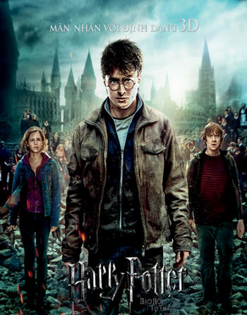
I. Vocabulary:
star (v)
/stɑːr/
đóng vai chính
To have one of the main parts in a film, play, etc.

Slide 17
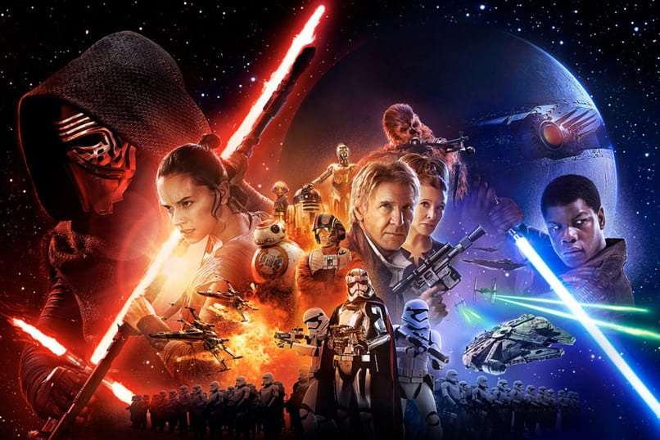
I. Vocabulary:
science fiction (n)
/ˈsaɪəns ˈfɪkʃən/
khoa học viễn tưởng

Slide 18

I. Vocabulary:
review (n)
/rɪˈvjuː/
bình luận
A report in a newspaper, magazine, or programme that gives an opinion about a new book, film, etc.

Slide 19

II. Practice:
1
Listen and read

Slide 20

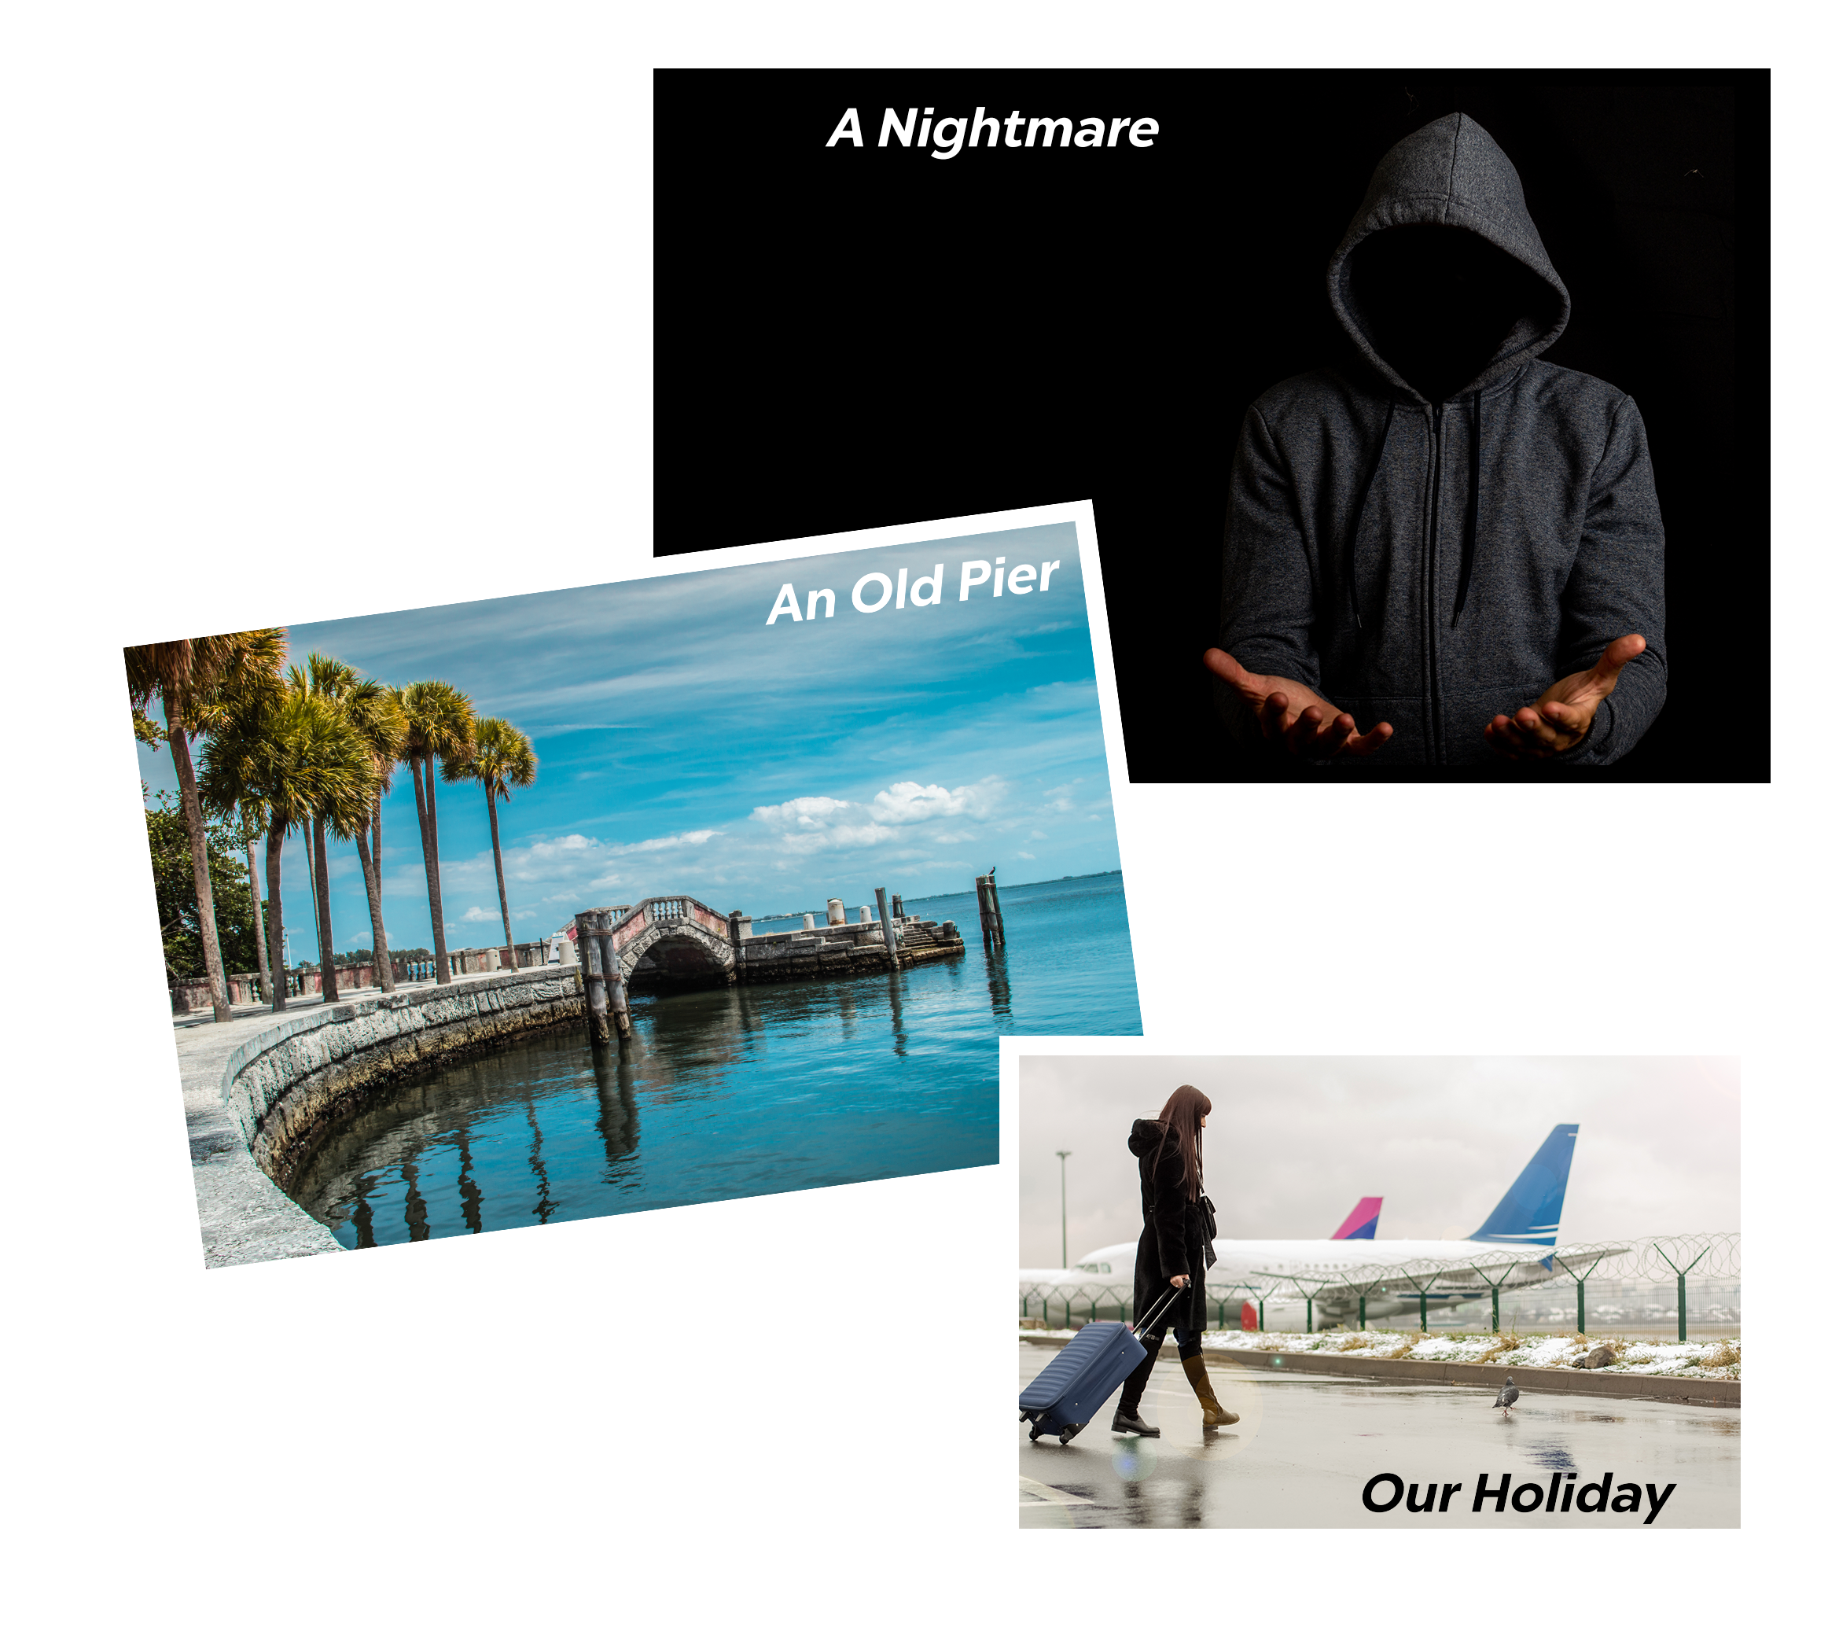
What are they talking about?
What types of films would they like to see?

Slide 21
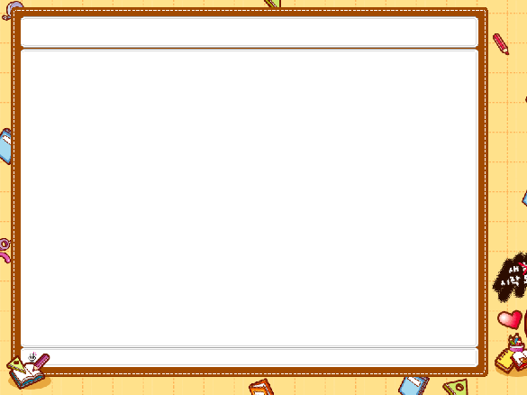
1
Listen and read.
Mark: Let's go to the cinema tonight!
Mi: Good idea! What shall we see?
Mark: A Nightmare is on at Sao Mai Cinema tonight.
Mi: Is it a fantasy?
Mark: No, it's a horror film.
Mi: That's too scary for me. Look! An Old Pier is on at Town Cinema. It's a documentary.
Mark: I don't really like documentaries. They're often boring. What about Our Holiday?
Mi: What kind of film is it?
Mark: It's a comedy.
Mi: And who stars in it?
Mark: Kate Harrison and Lily Collins.
Mi: Um, they're pretty good. What's it about?
Mark: It's about two women living in different countries and they decide to exchange houses.
Mi: What are the reviews like?
Mark: Well, although a few people say it's a bit silly, most say it's funny and interesting.

Slide 22
II. Practice:
2
Read the conversation again and choose the correct answer to each question.

Slide 23

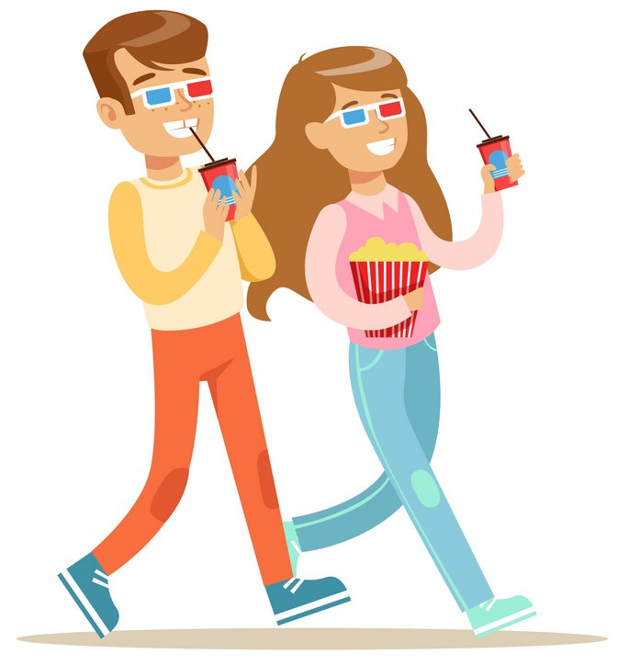
2
Read the conversation again and choose the correct answer to each question.
1. What does Mark suggest doing tonight? a. Watching a TV show. b. Watching a film. c. Staying at home.
Mark: Let’s go to the cinema tonight! Hoa: Good idea! What shall we see?

Slide 24
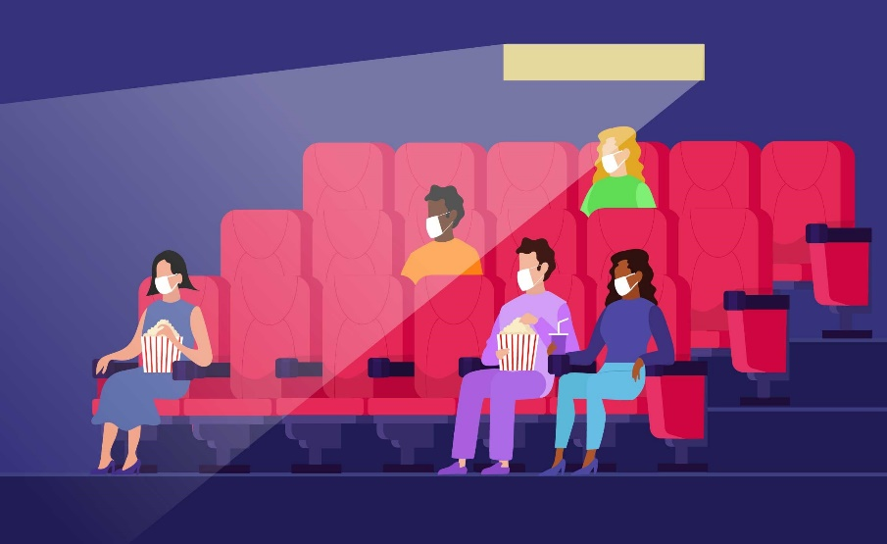
2
Read the conversation again and choose the correct answer to each question.
2. Why doesn’t Mark want to see An Old Pier? a. He doesn’t like that type of film. b. It’s not on at a convenient time. c. He saw it last week.
Hoa: That’s too frightening for me. Look! An Old Pier is on at the Town Cinema. It’s a documentary. Mark: I don’t really like documentaries. They’re often boring. What about Our Holiday?

Slide 25

2
Read the conversation again and choose the correct answer to each question.
3. The word “reviews” in the conversation mostly means ______. a. people’s opinions about the film b. interesting scenes in the film c. what people don’t like about the film
Mi: What are the reviews like?
Mark: Well, although a few people say it's a bit silly, most say it's funny and interesting.

Slide 26
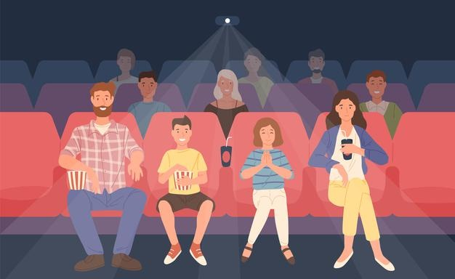
2
Read the conversation again and choose the correct answer to each question.
4. What do people think of Our Holiday? a. Everyone likes it. b. No one likes it. c. Most people like it.
Hoa: What are the reviews like? Mark: Well, although a few people say it’s a bit silly, most say it’s funny and interesting.

Slide 27
II. Practice:
3
Choose the correct word or phrase to complete each of
the following sentences.

Slide 28

3
Choose the correct word or phrase to complete each of the following sentences.
1. A film that tries to make the audience laugh is a (comedy / documentary).
2.A film that is based only on imagination, not on real facts, is a (comedy / fantasy).
3.A film that shows real life events or stories is a (documentary / horror film).
4.A film that is set in the future, often about science, is a (cartoon / science fiction film).
5. A film in which strange and frightening things happen is a
(horror film / comedy).

Slide 29




5 questions- 2 teams
2 students stand back to the board.
When teacher shows the word, one student explain.
Who raises the hand faster and has the correct answer can choose their present (their points).

Slide 30

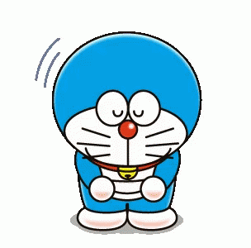
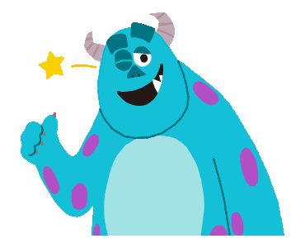
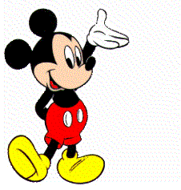

1
2
3
4
5

Slide 31
fantasy
1
A film that is based only on imagination, not on real facts

Slide 32
comedy
2
A film that tries to make the audience laugh.

Slide 33
science fiction film
3
A film that is set in the future, often about science

Slide 34
horror film
4
A film in which strange and frightening things happen

Slide 35
documentary
5
A film that shows real life events or stories

Slide 36
3
Choose the correct word or phrase to complete each of the following sentences.
1. A film that tries to make the audience laugh is a (comedy / documentary).
2.A film that is based only on imagination, not on real facts, is a (comedy / fantasy).
3.A film that shows real life events or stories is a (documentary / horror film).
4.A film that is set in the future, often about science, is a (cartoon / science fiction film).
5. A film in which strange and frightening things happen is a
(horror film / comedy).

Slide 37
II. Practice:
4
Complete the following sentences with the words in the box.

Slide 38
4
Complete the following sentences with the words in the box.
funny
interesting
frightening
moving
boring
1. Going to the hospital can be _________________ for a child. 2. The film was so _______________ that the audience couldn’t stop laughing. 3. Many people cried when they saw the _______________ scenes of the film. 4. The film last night was so _______________ that we fell asleep. 5. This book is ________________. I got a lot of useful information from it.

Slide 39




AGENT

Slide 40



Going to the hospital can be __________ for a child.
frightening
GOOD JOB!
funny
interesting
moving
frightening
1/5

Slide 41
The film was so ________ that the audience couldn’t stop laughing.
funny
GOOD JOB!
interesting
moving
funny
boring
2/5

Slide 42

Many people cried when they saw the ________ scenes of the film.
moving
GOOD JOB!
frightening
moving
funny
boring
3/5

Slide 43

The film last night was
so ________ that we fell asleep.
boring
GOOD JOB!
boring
interesting
funny
frightening
4/5

Slide 44
This book is ________. I got a lot of useful information from it.
interesting
GOOD JOB!
moving
funny
boring
interesting
5/5

Slide 45
III. Production:
5
Work in pairs. Ask and answer about a type of film. Use some of the adjectives in Task 4.

Slide 46


5
Work in pairs. Ask and answer about a type of film. Use some of the adjectives in Task 4.
Example: A: Do you like documentaries? B: No, I don’t. A: Why not? B: I think they’re boring.

Slide 47
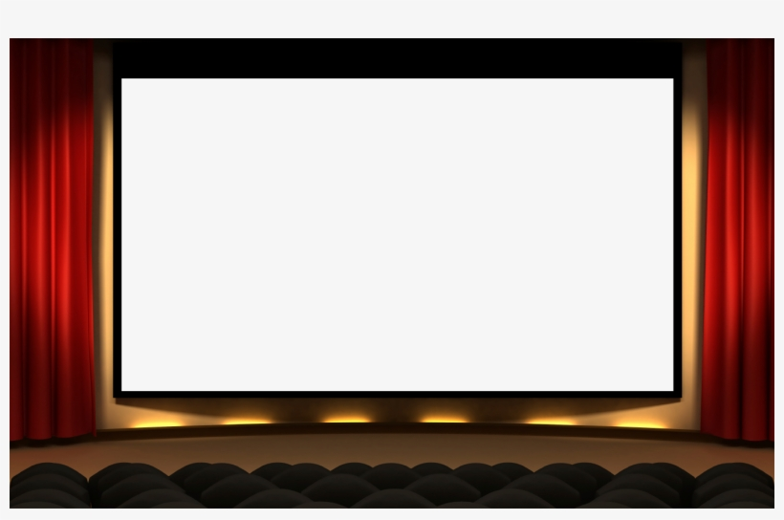

Wrap-up
FILMS
Topic of the unit
Vocabulary
Adjectives describing films
Types of films
comedy, documentary, fantasy, cartoon, horror film, science fiction film
funny, boring, frightening, moving, interesting

Slide 48

IV. HOMEWORK
Write new words 2 lines and learn them by heart.
Do exercises 1,2 in Workbook
(p. 60-61).
Prepare Unit 8- A closer look 1.

Slide 49
