Slide 1


Slide 2



Unit
8
FILMS
LESSON 2: A CLOSER LOOK 1
Adjectives to describe films
Vocabulary
/ɪə/ and /eə/
Pronunciation
Unit
HOBBIES

Slide 3

OBJECTIVES
By the end of the lesson, students will be able to:
use the lexical items related to the topic “Films”
correctly pronounce words that contain the sounds: /ɪə/ and /eə/

Slide 4
LESSON 2: A CLOSER LOOK 1
WARM-UP
Who is faster?: Film posters
Task 1: Work in pairs and match the adjectives with the definitions.
Task 2: Complete the following sentences, using the adjectives in 1.
Task 3: Reporter – Film Critic.
VOCABULARY
PRONUNCIATION
Task 4: Listen and repeat. Practice pronouncing.
Task 5: Listen and practice the sentences.
Game: Broken telephone
CONSOLIDATION
Wrap-up
Homework

Slide 5
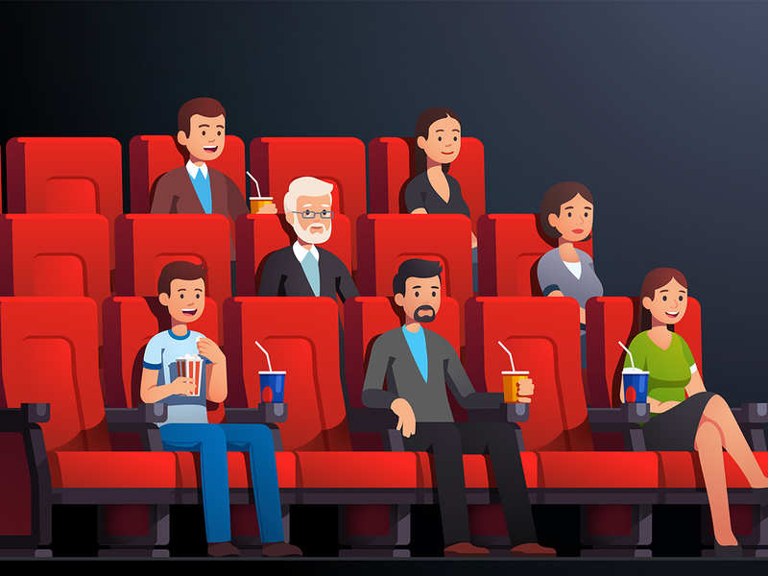
LESSON 2: A CLOSER LOOK 1
WARM-UP
Who is faster?: Film posters
Aims of the stage:
To review on types of films, recall students’ vocabulary on adjectives to describe film.

Slide 6



WARM-UP
cartoon
animation
animated film
action film
comedy

Slide 7


WARM-UP
horror film
western film

Slide 8

LESSON 2: A CLOSER LOOK 1
WARM-UP
Who is faster?: Film posters
Vocabulary
Task 1: Work in pairs and match the adjectives with the definitions.
Task 2: Complete the following sentences, using the adjectives in 1.
Task 3: Reporter – Film Critic.
VOCABULARY
Aims of the stage:
To introduce the new words

Slide 9

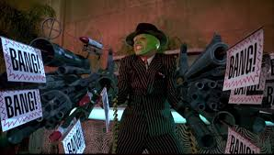
VOCABULARY
violent (adj)
/'vaiələnt/
hung dữ; bạo lực, mãnh liệt

Slide 10
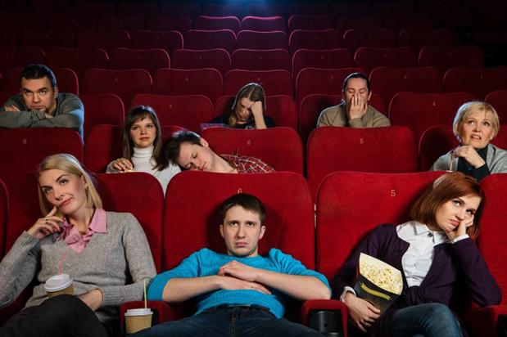
VOCABULARY
dull (adj)
/dʌl/
buồn tẻ, chán, đơn điệu

Slide 11

VOCABULARY
confusing (adj)
/kən'fju:ziŋ/
khó hiểu, gây bối rối

Slide 12
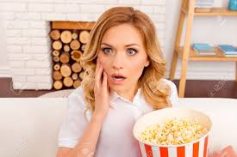
VOCABULARY
shocking (adj)
/'∫ɒkiŋ/
gây choáng váng, làm sửng sốt

Slide 13
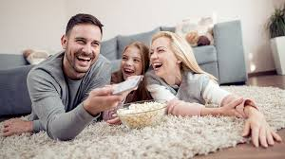
VOCABULARY
enjoyable (adj)
/in'dʒɔiəbl/
thú vị, thích thú

Slide 14
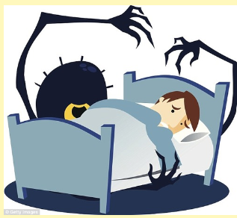
VOCABULARY
nightmare (N)
/ˈnaɪtmeə(r)/
ác mộng

Slide 15
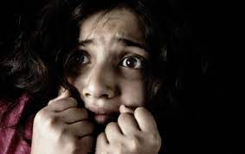
VOCABULARY
fear (N)
/fɪə(r)/
nỗi sợ hãi

Slide 16

VOCABULARY
pier (N)
/pɪə(r)/
cầu tàu

Slide 17
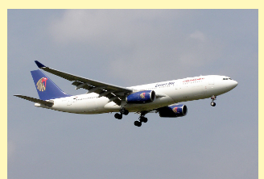
VOCABULARY
aeroplane (N)
/'eərəplein/
máy bay, phi cơ
* airplane

Slide 18
VOCABULARY
find sb/ sth + adj
thấy ai/ cái gì như thế nào
E.g: I find the cartoon “Tom and Jerry” interesting.

Slide 19
LESSON 2: A CLOSER LOOK 1
WARM-UP
Who is faster?: Film posters
Vocabulary
Task 1: Work in pairs and match the adjectives with the definitions.
Task 2: Complete the following sentences, using the adjectives in 1.
Task 3: Reporter – Film Critic.
VOCABULARY
https://wordwall.net/resource/27241481/english-7-unit-8-alc1-exercise-1

Slide 20
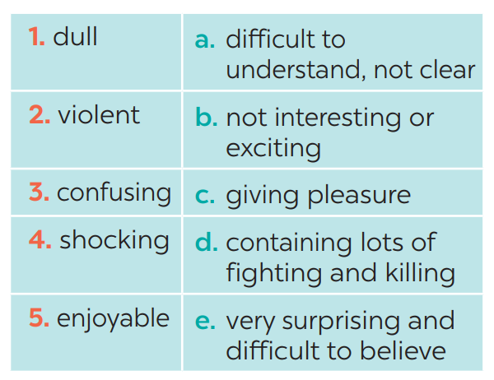
VOCABULARY
1
Match the following adjectives with their meanings.
1. b
2. d
3. a
4. e
5. c
Notes:
Wordwall game:https://wordwall.net/resource/27241481/english-7-unit-8-alc1-exercise-1

Slide 21
VOCABULARY
2
1
Complete the following sentences, using the adjectives in
1. I found the film A Polluted Planet hard to believe. It’s a very _________ documentary. 2. The film was so _________ that we almost fell asleep. 3. I think you will enjoy Our Holiday. It’s quite _________ . 4. There were too many fights in the film. It was too _________ . 5. I didn’t really understand the film. It was very _________ .
shocking
dull
enjoyable
violent
confusing

Slide 22
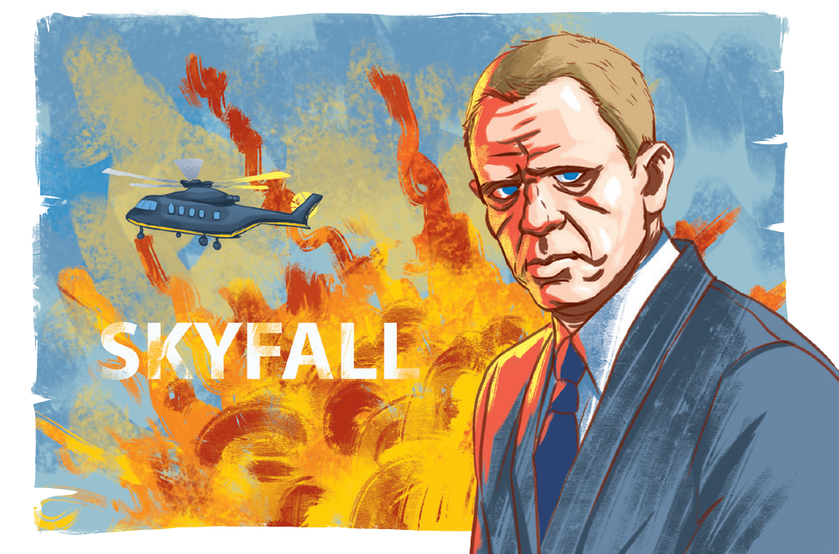
VOCABULARY
3
Work in pairs. Ask and answer questions about a film you saw recently.
Example: A: What film did you see recently? B: Skyfall. A: What do you think of it? B: It’s too violent.

Slide 23
LESSON 2: A CLOSER LOOK 1
WARM-UP
Who is faster?: Film posters
Vocabulary
Task 1: Work in pairs and match the adjectives with the definitions.
Task 2: Complete the following sentences, using the adjectives in 1.
Task 3: Reporter – Film Critic.
VOCABULARY
PRONUNCIATION
Pronunciation
Task 4: Listen and repeat. Practice pronouncing.
Task 5: Listen and practice the sentences.
Game: Broken telephone

Slide 24

PRONUNCIATION
/ɪə/ and /eə/
Aims of the stage:
To let students listen and notice the targeted sounds in individual words.
To let students practice pronouncing the targeted sounds in sentences.

Slide 25


PRONUNCIATION
Listen and repeat the following words. Pay attention to the underlined parts.
chair
here
Can you recognize the sounds in the underlined parts?
chair
here
/eə/
/ɪə/

Slide 26
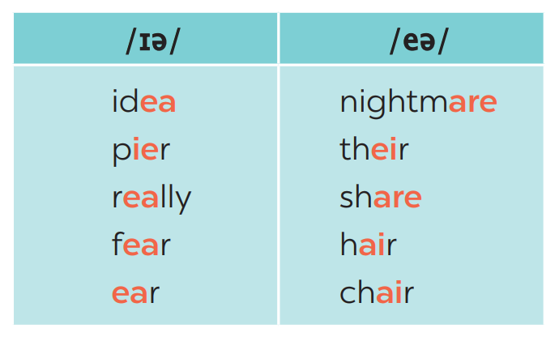
PRONUNCIATION
4
Listen and repeat the words. Pay attention to the sounds /ɪə/ and /eə/.

Slide 27

PRONUNCIATION
5
Listen and repeat, paying attention to the underlined words.
Game: Broken telephone
/ɪə/ and /eə/
1. Is there a cinema near here? 2. There’s a chair under the stairs. 3. Put your earphones near here. 4. I don’t care about your idea. 5. Our aeroplane is up there, in the air.

Slide 28
LESSON 2: A CLOSER LOOK 1
WARM-UP
Who is faster?: Film posters
Vocabulary
Task 1: Work in pairs and match the adjectives with the definitions.
Task 2: Complete the following sentences, using the adjectives in 1.
Task 3: Reporter – Film Critic.
VOCABULARY
PRONUNCIATION
Pronunciation
Task 4: Listen and repeat. Practice pronouncing.
Task 5: Listen and practice the sentences.
Game: Broken telephone
CONSOLIDATION
Wrap-up
Homework

Slide 29
CONSOLIDATION
1
WRAP-UP
Adjectives to describe films
Vocabulary
/ɪə/ and /eə/
Pronunciation

Slide 30

CONSOLIDATION
2
HOMEWORK
- Write new words 2 lines and learn by heart.
- Do exercises in Workbook. (A-1,2; B-2,3)
- Prepare Unit 8- A closer look 2.

Slide 31

Website: sachmem.vn
Fanpage: facebook.com/sachmem.vn/

