Slide 1


Slide 2



Unit
10
ENERGY SOURCES
LESSON 2: A CLOSER LOOK 1
VOCABULARY
PRONUNCIATION
Unit
HOBBIES

Slide 3

OBJECTIVES
By the end of the lesson, students will be able to gain:
- vocabulary about sources of energy.
- pronunciation: Stress in three-syllable words

Slide 4
LESSON 2: A CLOSER LOOK 1
WARM-UP
Game: Crossword
Task 1: Match the types of energy with the energy sources.
Task 2: Write the phrases to label the pictures
Task 3: Complete the sentences.
VOCABULARY
Task 4: Listen and repeat. Pay attention to the stressed syllables in the words.
Task 5: Listen and repeat, paying attention to the underlined
words.
PRONUNCIATION
CONSOLIDATION
Wrap-up
Homework

Slide 5
LESSON 2: A CLOSER LOOK 1
WARM-UP
Game: Crossword
Aims of the stage:
To activate students’ prior knowledge and vocabulary related to the topic, the targeted vocabulary, and its pronunciation

Slide 6
WARM-UP: CROSS WORDS
ENERGY
1
S
S
U
N
1
2
C
O
A
L
O
2
O
L
3
I
L
3
W
A
B
L
E
4
R
E
N
E
A
4
R
A
S
5
N
A
T
U
R
A
L
G
5
Notes:
Click the numbers to shows the 5 words in 5 rows. Click the star to show the secret word.

Slide 7
VOCABULARY
1. The star that shines in the sky during the day and gives the earth heat and light. What’s it?
=> sun

Slide 8

VOCABULARY
2. What’s it?
=> coal

Slide 9
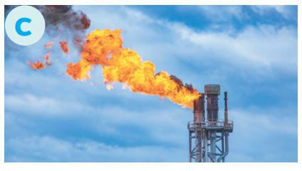
VOCABULARY
3. What’s it?
=> oil

Slide 10
VOCABULARY
4. This adjective means “can be replaced without the risk of using it all up”
=> renewable

Slide 11
VOCABULARY
5. Gas that is found under the ground or the sea and that is used as a fuel. What’s it?
=> natural gas

Slide 12

LESSON 2: A CLOSER LOOK 1
WARM-UP
Game: Crossword
Task 1: Match the types of energy with the energy sources.
Task 2: Write the phrases to label the pictures.
Task 3: Complete the sentences.
VOCABULARY
Aims of the stage:
To visually introduce some nouns related to the topic

Slide 13

VOCABULARY
solar energy (n. phr.)
/ˈsəʊlə(r) ˈenədʒi/
năng lượng mặt trời

Slide 14

VOCABULARY
hydro energy (n. phr.)
/ˈhaɪdrəʊ ˈenədʒi/
năng lượng nước

Slide 15

VOCABULARY
nuclear energy (n)
/njuːklɪər ˈenədʒi/
năng lượng hạt nhân

Slide 16
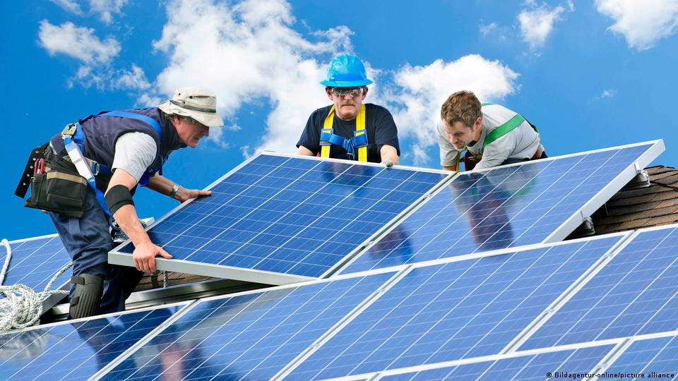
VOCABULARY
solar panel (n)
/ˈsəʊlə(r) ˈpænl/
tấm năng lượng mặt trời

Slide 17
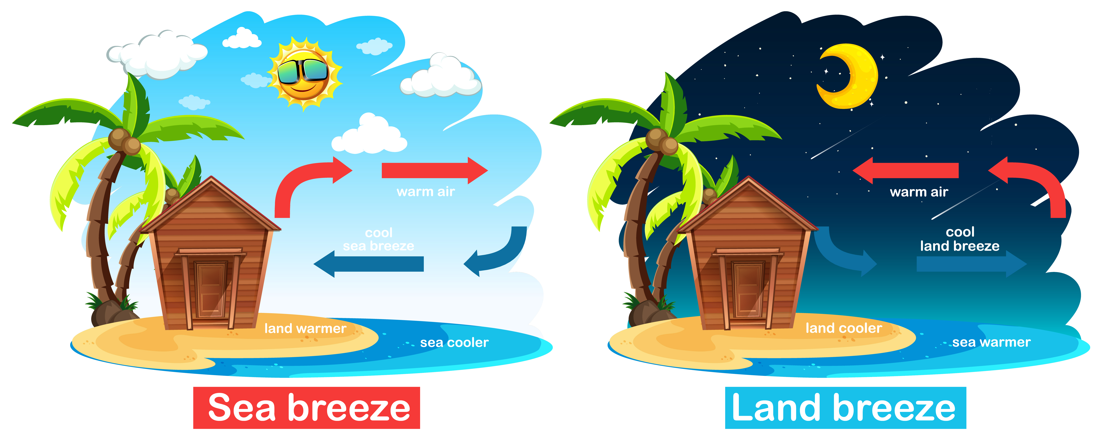
VOCABULARY
breeze (n)
/briːz/
làn gió nhẹ

Slide 18
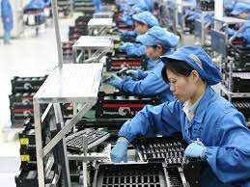
VOCABULARY
produce (v)
/prəˈdjuːs/
sản xuất

Slide 19
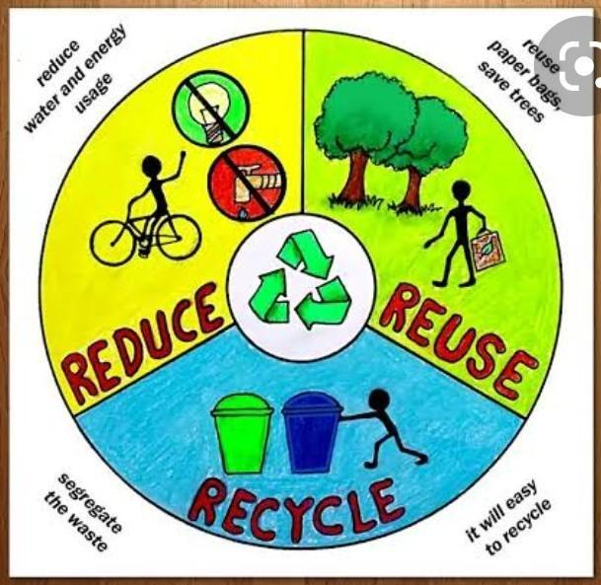
VOCABULARY
reduce (v)
/rɪˈdjuːs/
giảm

Slide 20

VOCABULARY
look for (ph.v)
tìm kiếm

Slide 21
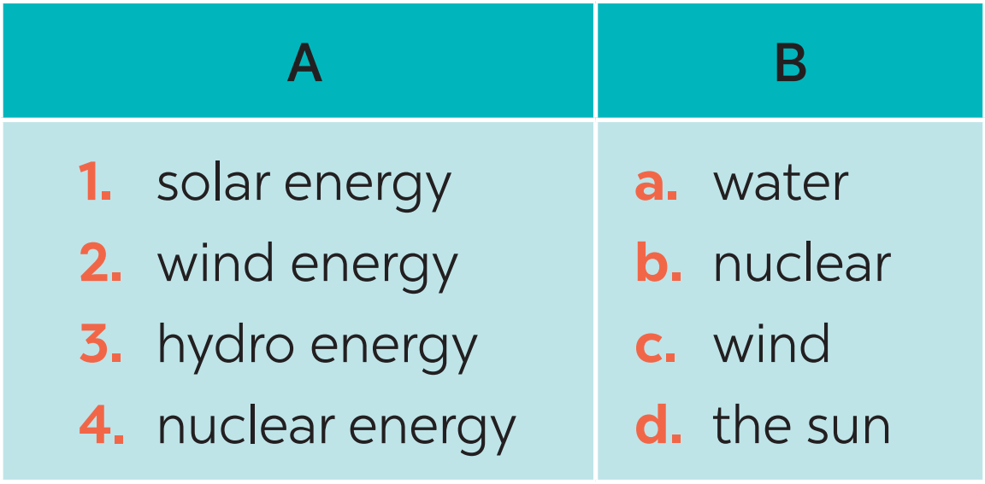
VOCABULARY
1
Match the types of energy in A with the energy sources in B.
1. d
2. c
3. a
4. b

Slide 22
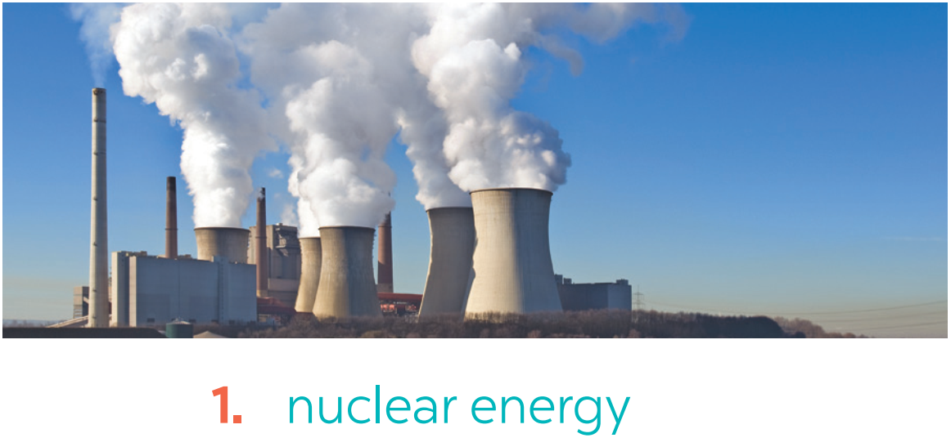
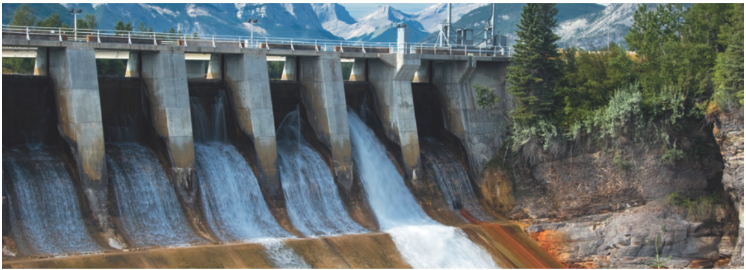
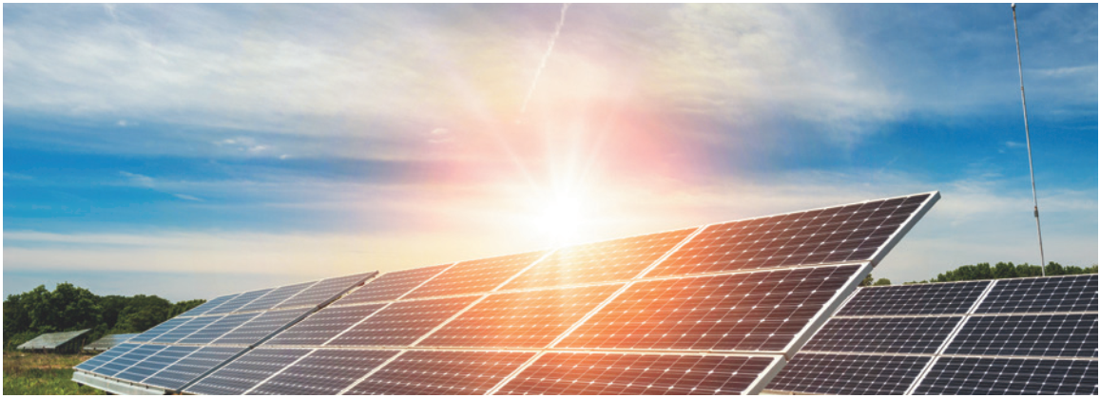
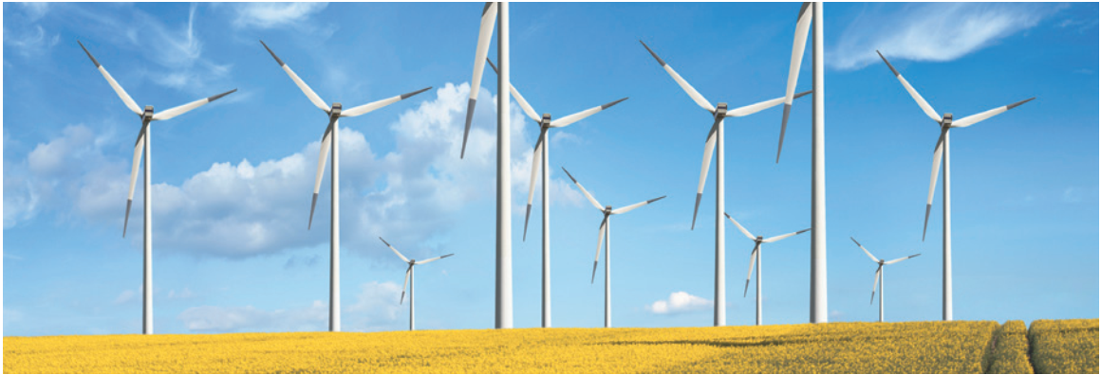
VOCABULARY
2
Write the phrases to label the pictures.
hydro energy
2. ________________
solar energy
wind energy
3. ________________
4. ________________

Slide 23
VOCABULARY
3
Complete the sentences with the words and phrases from 1 or 2.
1. A good place to change ______ to energy is near the sea because of the sea breezes.
2. They are putting solar panels on the roof of our building to produce ____________.
3. When energy comes from ______, we call it hydro energy.
4. They are reducing the use of _____________ because it is not safe to produce.
wind
solar energy
water
nuclear energy

Slide 24
LESSON 2: A CLOSER LOOK 1
WARM-UP
Game: Crossword
Task 1: Match the types of energy with the energy sources.
Task 2: Write the phrases to label the pictures.
Task 3: Complete the sentences.
VOCABULARY
Task 4: Listen and repeat. Pay attention to the stressed syllables in the words.
Task 5: Listen and repeat, paying attention to the underlined
words.
PRONUNCIATION

Slide 25

PRONUNCIATION
4
Listen and repeat. Pay attention to the sressed syllables in the words.
4
STRESS IN THREE-SYLLABLE WORDS
'energy re'cycle
'dangerous ex'pensive
'easily po'lluting
'government re'sources

Slide 26
PRONUNCIATION
5
Listen and repeat, paying attention to the stressed syllables in the underlined words.
1. Nuclear 'energy is 'dangerous and ex'pensive.
2. We should ride a bike when 'travelling short 'distances.
3. The word “re'cycle” has three 'syllables.
4. Burning coal is po'lluting our environment.
5. Our 'government is looking for new sources of 'energy to replace gas.

Slide 27
LESSON 2: A CLOSER LOOK 1
WARM-UP
Game: Crossword
Task 1: Match the types of energy with the energy sources.
Task 2: Write the phrases to label the pictures.
Task 3: Complete the sentences.
VOCABULARY
Task 4: Listen and repeat. Pay attention to the stressed syllables in the words.
Task 5: Listen and repeat, paying attention to the underlined
words.
PRONUNCIATION
CONSOLIDATION
Wrap-up
Homework

Slide 28
CONSOLIDATION
1
WRAP-UP
VOCABULARY
PRONUNCIATION

Slide 29

CONSOLIDATION
2
HOMEWORK
Write new words 2 lines and learn by heart
Do exercises in the workbook. (A-1,2; B-2)
Prepare the next lesson: A closer look 2

Slide 30

Website: sachmem.vn
Fanpage: facebook.com/sachmem.vn/

