Slide 1
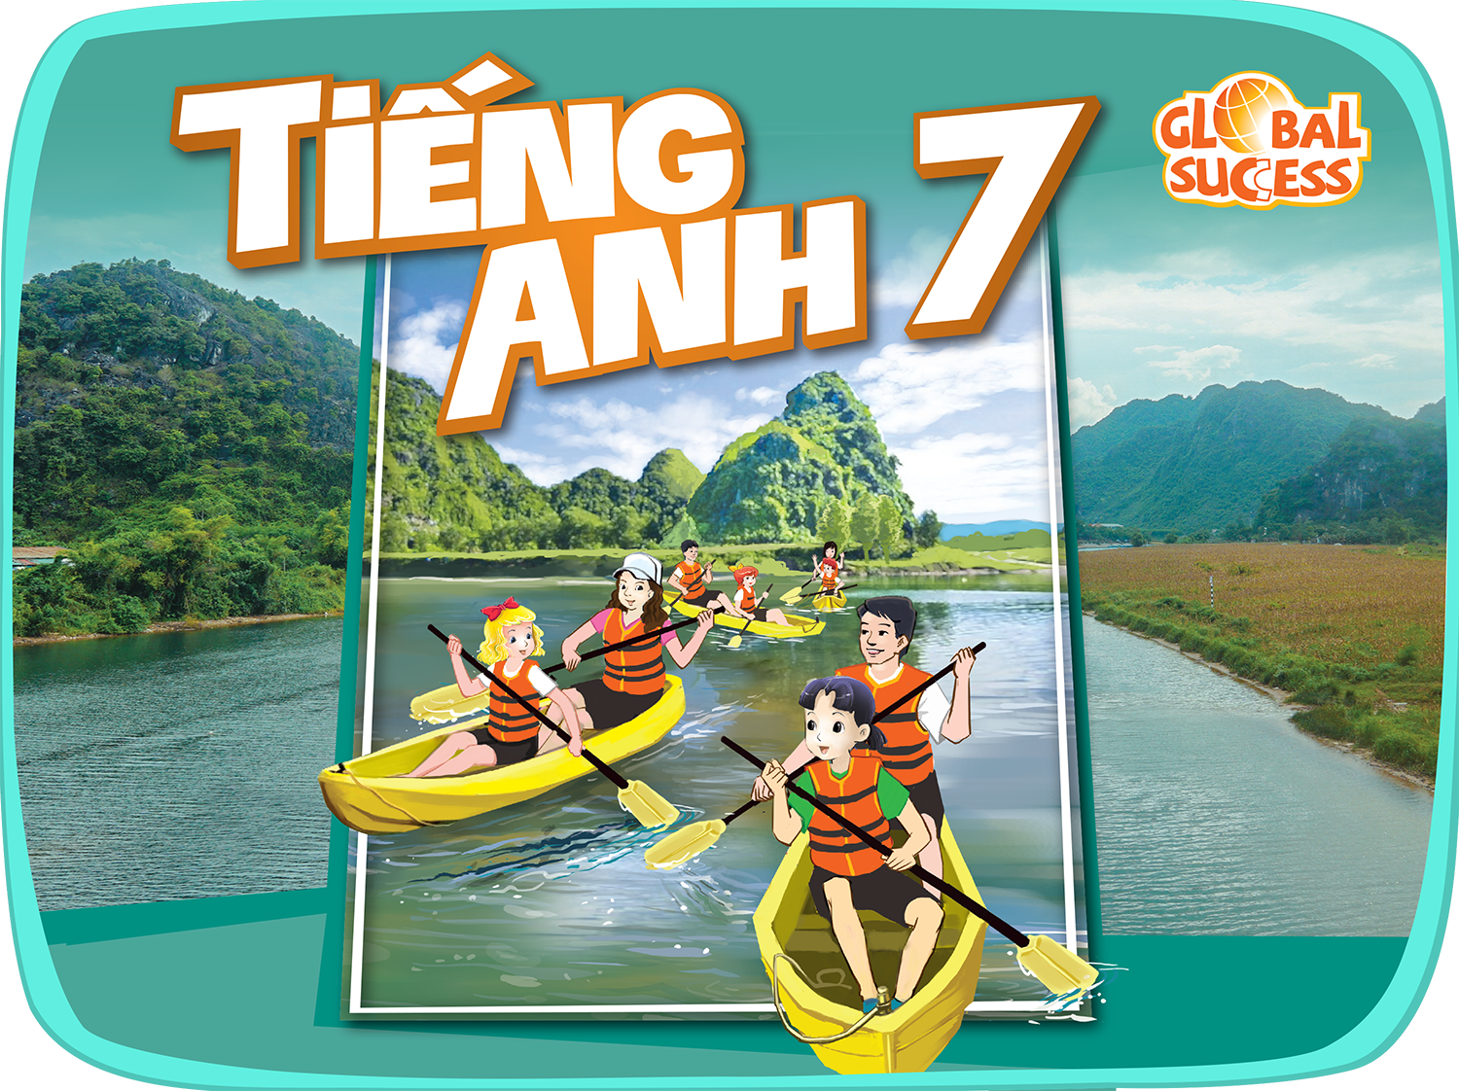

Slide 2



Unit
9
FESTIVALS AROUND THE WORLD
LESSON 5: SKILLS 1
Unit
HOBBIES

Slide 3

OBJECTIVES
By the end of this lesson, Ss will be able to gain:
1. Knowledge:
- develop reading skill about an unusual festival
- develop speaking skill: talking about a festival they enjoy
2. Core competence:
- develop communication skills and creativity
- be collaborative and supportive in pair work and teamwork
- develop presentation skill
- actively join in class activities
3. Personal qualities
- develop self-study skills

Slide 4
LESSON 5: SKILLS 1
WARM-UP
Game: Who is faster?
Task 1: Work in pairs. Look at the pictures. Which events do you think happen at the Twins Day Festival?
Task 2: Match each word from the email in 1 with its meaning.
Task 3: Read the email again. Complete each sentence with no more than TWO words.
READING
Task 4: Match the questions and answer about a festival someone joined.
Task 5: Work in pairs. Ask and answer about a festival you and your friend joined, using the questions in 4 as cues. Tell the class about the festival your partner joined.
SPEAKING
CONSOLIDATION
Wrap-up
Homework

Slide 5
LESSON 5: SKILLS 1
WARM-UP
Game: Who is faster?
Stage aims:
to introduce the topic of reading.
to enhance students’ skills of cooperating with team mates

Slide 6
WARM-UP: WHO IS FASTER?
Mid-Autumn Festival
It is the symbol of the moon, prosperity and family reunion.

Slide 7
WARM-UP: WHO IS FASTER?
Halloween
It is the symbol of bad luck.

Slide 8
WARM-UP: WHO IS FASTER?
Cannes Film Festival
It is the symbol of the winner’s prize.

Slide 9
WARM-UP: WHO IS FASTER?
Easter
It is the symbol of a new life because it has a lot of babies.

Slide 10
LESSON 5: SKILLS 1
WARM-UP
Game: Who is faster?
Task 1: Work in pairs. Look at the pictures. Which events do you think happen at the Twins Day Festival?
Task 2: Match each word from the email in 1 with its meaning.
Task 3: Read the email again. Complete each sentence with no more than TWO words.
READING

Slide 11
VOCABULARY
gathering (n)
/ˈɡæð.ər.ɪŋ/
cuộc hội họp

Slide 12
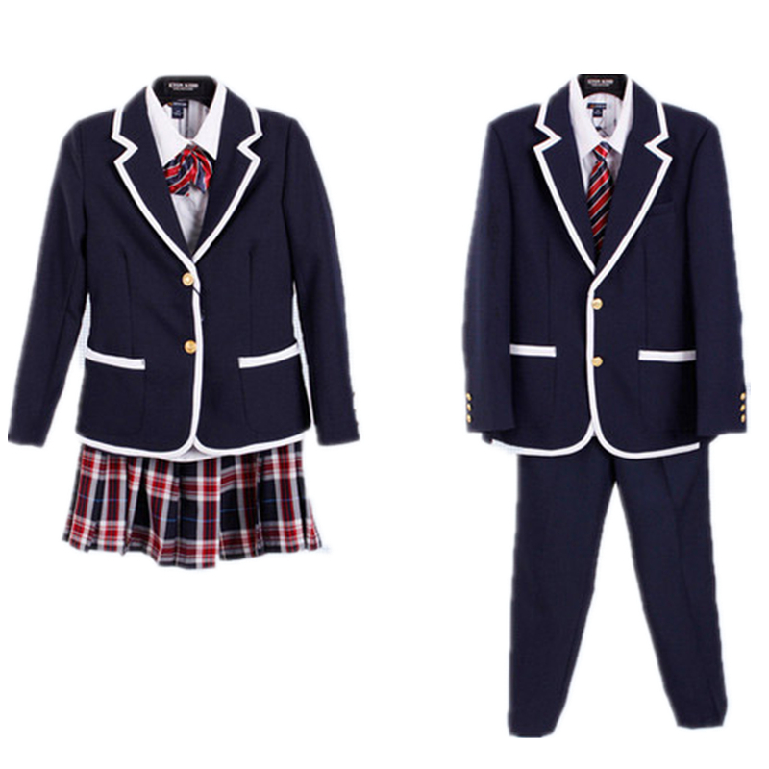
VOCABULARY
uniform (n)
/ˈjuːnɪfɔːm/
đồng phục

Slide 13
VOCABULARY
feature (v)
/ˈfiːtʃər/
trình diễn đặc biệt

Slide 14
VOCABULARY
performance (n)
/pəˈfɔːməns/
màn biểu diễn

Slide 15
READING
1
Work in pairs. Look at the pictures. Which events do you think happen
at the Twins Day Festival?

Slide 16
1
Now quickly read the email below and check your answers.

Slide 17
VOCABULARY
2
Match each word from the email in 1 with its meaning.
1. gathering | a. two children born to the same mother at the same time
2. featured | b. meeting
3. twins | c. the act of entertaining other people by singing, dancing, and playing music, etc.
4. performance | d. showed something as the most important part
1. b
2. d
3. a
4. c

Slide 18
READING
3
Read the email again. Complete each sentence with no more than TWO words.
People hold the festival in Twinsburg on the ____________ every August.
There are twins from many ____________.
In the Double Take Parade, twins in uniforms _____________.
Mark enjoyed the ____________ by the Korean twins the most.
Mark and his twin sister ran in the ____________.
In his opinion, the festival was very ____________.
first weekend
countries
walked together
performance
Fun Run
exciting

Slide 19
LESSON 5: SKILLS 1
WARM-UP
Game: Who is faster?
Task 1: Work in pairs. Look at the pictures. Which events do you think happen at the Twins Day Festival?
Task 2: Match each word from the email in 1 with its meaning.
Task 3: Read the email again. Complete each sentence with no more than TWO words.
READING
Task 4: Match the questions and answer about a festival someone joined.
Task 5: Work in pairs. Ask and answer about a festival you and your friend joined, using the questions in 4 as cues. Tell the class about the festival your partner joined.
SPEAKING

Slide 20
SPEAKING
4
Match the questions and answers about a festival someone joined.
1
1. What festival did you join? | a. Yes, very much because there was a lot to do.
2. Where and when did you join it? | b. I joined the festival in Phu Yen last March.
3. Why do people celebrate it? | c. I watched people play drums, sing traditional songs, and dance. I also played traditional games with the children there.
4. What did you do there? | d. I joined the Hoi Mua Festival.
5. Did you like the festival? Why or why not? | e. They celebrate it to thank the Rice God and pray for a better new crop.
1. d
2. b
3. e
4. c
5. a

Slide 21
SPEAKING
5
Work in pairs. Ask and answer about a festival you and your friend joined, using the questions in 4 as cues. Tell the class about the festival your partner joined.
1. What festival did you join?
2. Where and when did you join it?
3. Why do people celebrate it?
4. What did you do there?
5. Did you like the festival? Why or why not?

Slide 22
LESSON 5: SKILLS 1
WARM-UP
Game: Who is faster?
Task 1: Work in pairs. Look at the pictures. Which events do you think happen at the Twins Day Festival?
Task 2: Match each word from the email in 1 with its meaning.
Task 3: Read the email again. Complete each sentence with no more than TWO words.
READING
Task 4: Match the questions and answer about a festival someone joined.
Task 5: Work in pairs. Ask and answer about a festival you and your friend joined, using the questions in 4 as cues. Tell the class about the festival your partner joined.
SPEAKING
CONSOLIDATION
Wrap-up
Homework

Slide 23
CONSOLIDATION
1
WRAP-UP
In this lesson, we have learnt to:
read for specific information about an unusual festival
talk about a festival you enjoy

Slide 24
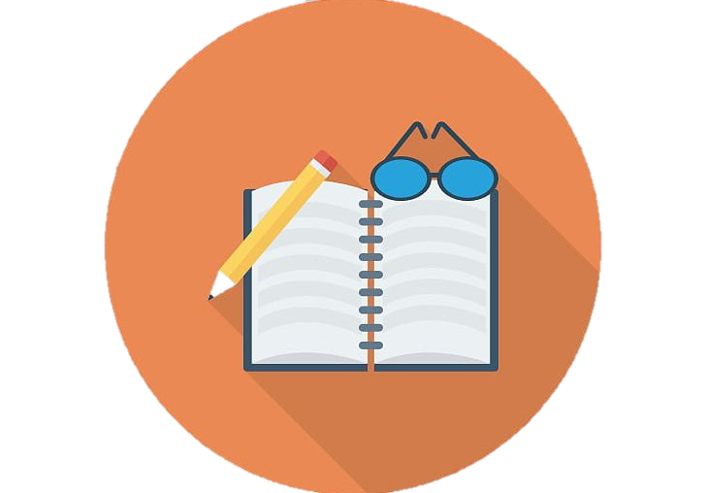
CONSOLIDATION
2
HOMEWORK
Write new words 2 lines and learn by heart.
Do exercises in the Workbook (C1,2; D1)
Prepare for Unit 9- Skills 2.

Slide 25
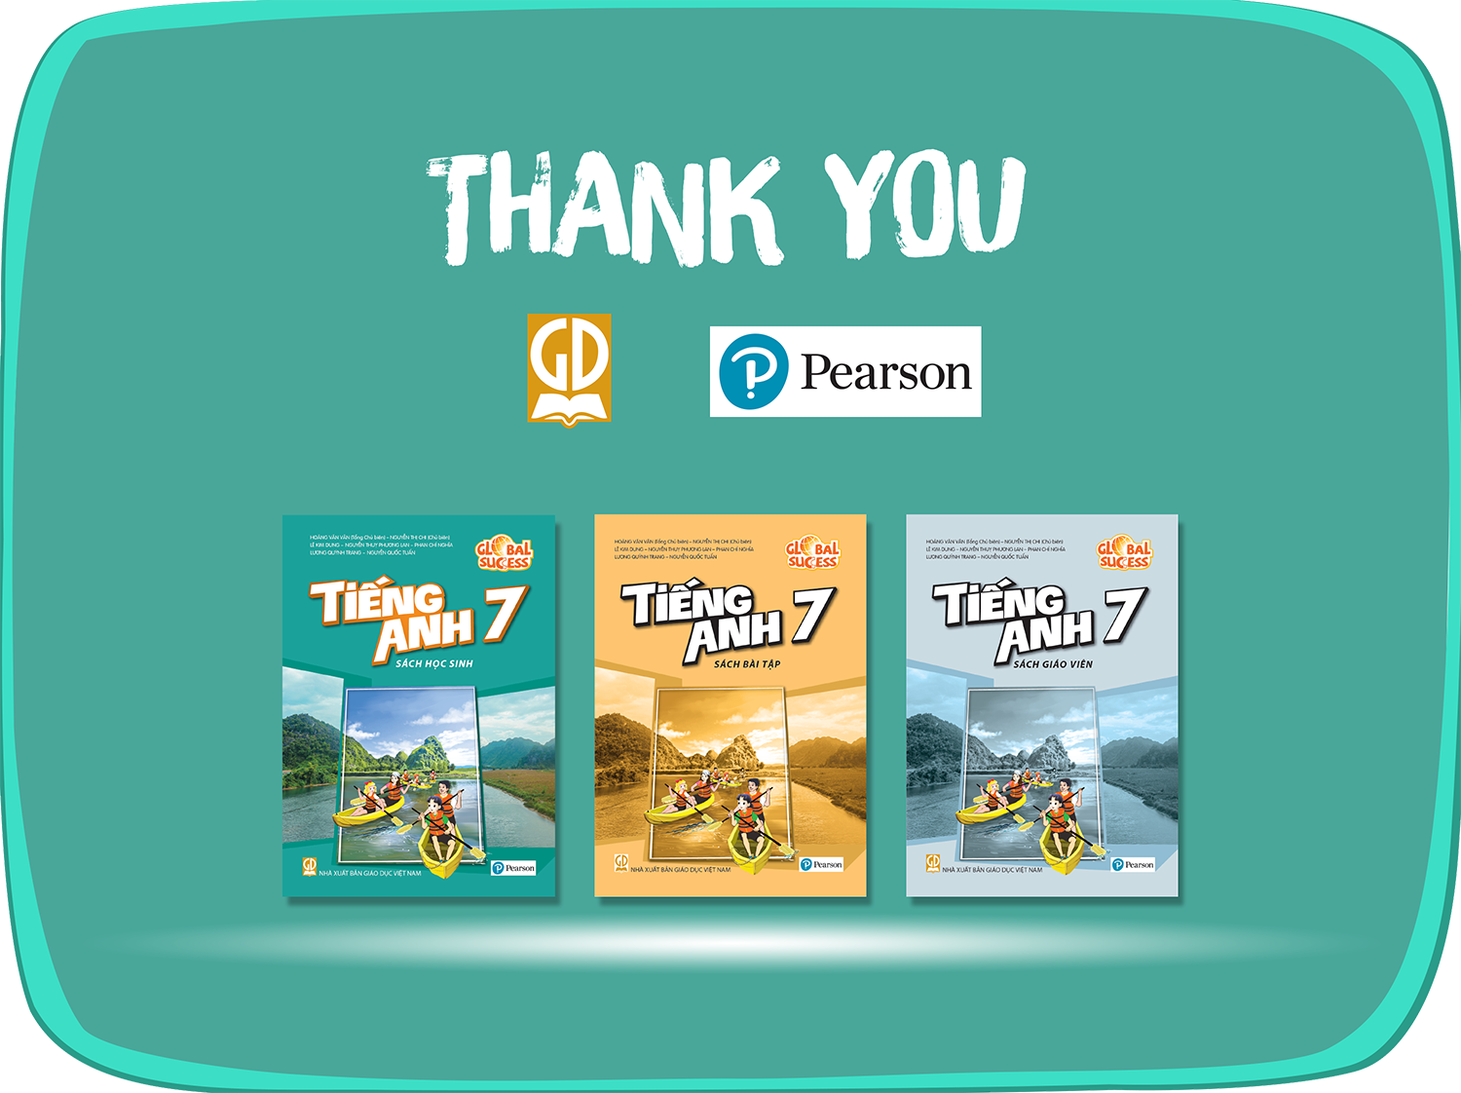
Website: sachmem.vn
Fanpage: facebook.com/sachmem.vn/

