Slide 2
Unit 11 ( Con’t)
Lesson 4: COMMUNICATION

Slide 3
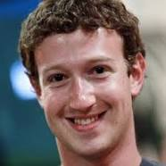

Mark Zuckerberg
( 1984)
James Watt
( 1736- 1819)

Slide 4
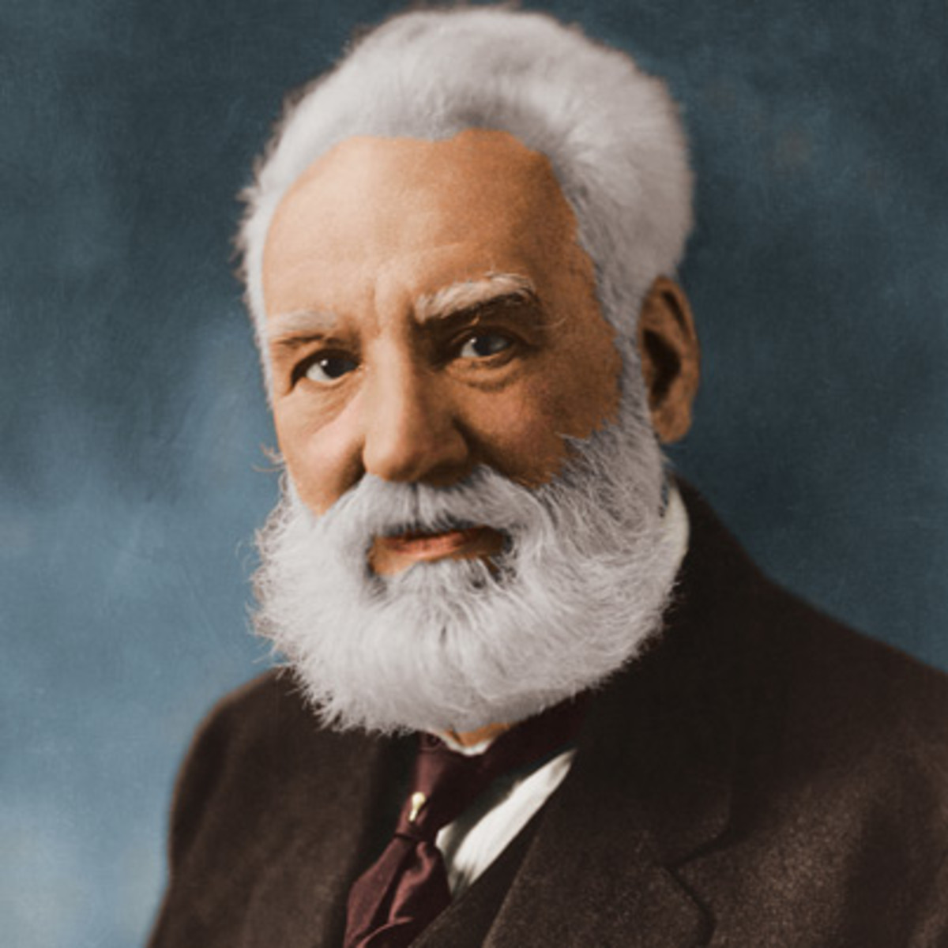
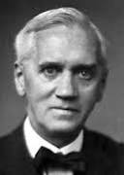
Alexander Graham Bell
( 1847-1922)
Sir Alexander Fleming
( 1881- 1955)

Slide 5
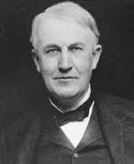
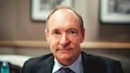
Thomas Edinson
( 1847- 1931)
Tim Berners- Lee
( 1955)

Slide 6
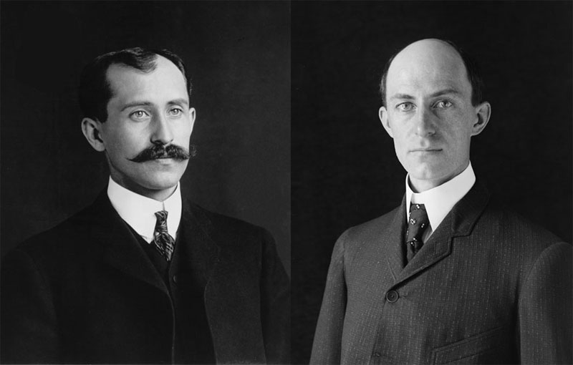
The Wright brothers
( 1871, 1948 / 1867,1912)

Slide 7
1. Match the inventors in A with their inventions in B:
A
Thomas Edison
2. Sir Alexander Fleming
3. Alexander Graham Bell
4. The Wright brothers
5. James Watt
6. Mark Zuckerberg
7. Tim Berners- Lee
B
a. the steam engine
b. Facebook
c. the light bulb
d. penicilline
e. the Internet
f. the telephone
g. the airplane

Slide 8
2/ 53 Which invention is more useful?
Ex: A: The invention of the airplane is very important because it has changed the way people travel and transport goods around the world.
B: You are right. But I think the invention of penicillin is more useful because it has saved lots of lives……
C: ……………

Slide 9
3a. Ha had an interesting dream last night in which she met and interviewed Alexander Graham Bell, the inventor of the telephone:
Ha: When and where were you born?
Bell: I was born in 1847 in Scotland.
Ha: And did you go to school in Scotland?
Bell: Yes, I went to the Royal High School.
Ha: What subject did you like best?
Bell: I always liked sciences, especially biology
Ha: Did you go to university?
Bell: Yes, I went to Edinburgh University, and then to the University of London.
…………

Slide 10
b. Two days later, Ha told her friend what Alexander bell said. Now report what ha told her friend, using reported speech
Ex: Alexander Bell said that he had gone to the Royal High School.

Slide 11
4/ 53 Work in pairs. One of you is a reporter, and the other is Tim Berners- Lee. Role- play, using the information
Tim Berners- Lee:
Bristish computer scientist, inventor of the Internet
. Born 8 June 1955- London
. 1973- 1976 : Oxford University
. 1978 : joined company called D.G. Nash
. 1900 : built first Web Browser
. 6 August 1991 : first website put online

