Slide 1


TRƯỜNG THCS LONG BIÊN
BÀI GIẢNG ĐIỆN TỬ MÔN TIẾNG ANH 7
UNIT 11. TRAVELLING IN THE FUTURE
GV: Lê Hà Chi
Tổ Ngoại ngữ - Năng khiếu

Slide 2
OBJECTIVES By the end of the lesson, students will be able to use:
Future simple
POSSETIVE PRONOUNS
+ To talk about future activities
+ To make predictions
to demonstrate ownership

Slide 3
01
The future simple

Slide 4

How will we travel in 2050?!
1. How will we go to school in 2050?
2. What transportation will we probably use to travel oversea?
3. Which will transportation run on, fossil fuels or renewable energy? Why?
Notes:
- Discuss in group in 3 minutes and write down the answers
- T write onto the board 2 answer onto the board
Suggested answers:
1. We will go to school by skytrain/bamboo-copter/hyperloop
2. We will probably use the teleporter to travel oversea
3. Renewable energy because fossil fuels will run out/ burning fossil fuels can cause pollution

Slide 5
How will we travel in 2050?!
Suggested answers:
1. We will go to school by bamboo-copter.
2. We will probably use the teleporter to travel oversea
3. Renewable energy because fossil fuels will run out
Notes:
- Discuss in group in 3 minutes and write down the answers
- T write onto the board 2 answer onto the board
Suggested answers:
1. We will go to school by skytrain/bamboo-copter/hyperloop
2. We will probably use the teleporter to travel oversea
3. Renewable energy because fossil fuels will run out/ burning fossil fuels can cause pollution

Slide 6
What tense did we use in our answers?
→ Future simple tense
1
2
→ to talk about future actions
→ to make prediction
When do we use this tense?
Fossil fuels will run out
We will go to school by bamboo-copter.
→ NOT 100% SURE
Notes:
After 2 questions, Draw Ss attention to these sentences and ask:
- What tense are they in?
- Are we 100% sure about these ideas?
=> We use Future tense to talk about future activities and to make predictions.

Slide 7
STRUCTURE
+
S + will + V
-
S + will not (won’t) + V
?
Will + S + V ?

Slide 8
Signal
1. Adverbs of time
Tomorrow
Next week/ month/ year/ day/ Sunday …
Someday
In + period of time: in 3 months, in 4 minutes
2. Some verbs
Think
Promise
Predict
Think/ believe/ suppose
3. Some adverbs
Perhaps
Probably
Maybe

Slide 9
Ex 1. Complete the sentence with will or won’t (p117)
won’t
1. Petrol-powered cars are not eco- friendly, so they ……… be popular.
2. We ……… travel by teleporter soon because it is faster.
3. Rich people ……… choose to travel to other planets for their holidays.
4. People ……… take holidays in crowded places as in the past.
5. Bullet trains ……… soon become a popular means of transport in Viet Nam because they are green and safe.
will
will
won’t
will
Notes:
These sentences are

Slide 10
Ex 2. Rearrange the words and phrases to make sentences. (P117)
1. driverless cars / we / will have / in 2030 /.
___________________________________
2. cars / cities / won’t allow / in 2050 /.
___________________________________
3. electric cars / will / popular / be /?
___________________________________
4. we / use / will / buses / soon / solar-powered /.
_______________________________________
5. have / enough parking places / we / will / in ten years /?
_______________________________________________
We will have driverless cars in 2030.
Cities won’t allow cars in 2050.
Will electric cars be popular?
We will use solar-powered buses soon.
Will we have enough parking places in ten years?
Notes:
These sentences are

Slide 11


Mistery box
Work in 4 teams
Each box has a question and a score
Take turn to choose the box then raise hands to answer the questions.
The team with most points wins

Slide 12
Mistery box
1
2
3
4
5

Slide 13
10
Alice: Do you think travelling by teleporter will become possible soon? Tom: Yes. I hear that it (1.take) _____ very little time to travel from one country to another.
Will take

Slide 14
30
Alice: Right. And we (2. not have)
__________ to wait at the airport.
Won’t have

Slide 15
35
Tom: _____ we (3. have) ____
to learn to drive it ?
Will we have

Slide 16
20
Alice: No. We (4. not drive)
_______ it. It makes us disappear then appear in another place in just seconds.
Won’t drive

Slide 17
15
Tom: How wonderful! There (5. not be) __________ traffic jams any more, right?
Won’t be

Slide 18

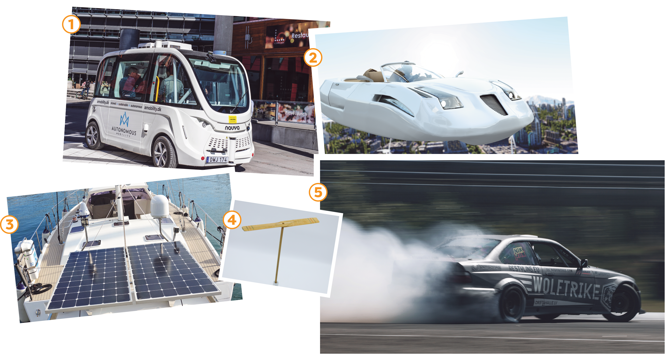
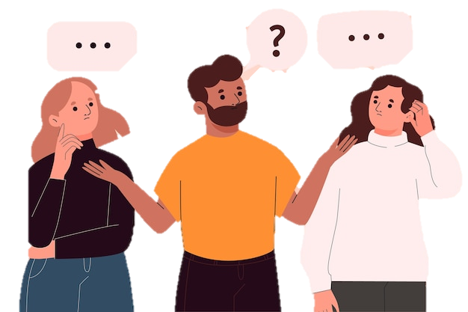
5. Look at the pictures and tell your partner if you will / won’t travel by these means of transport. Give reason(s) (P118)
Example: A: I will travel by flying car because it is very fast. B: I won’t travel by car in another 20 years because it pollutes the air.
Notes:
ask the students to name the transports - example – practise

Slide 19
02
Possessive pronouns

Slide 20


LISTEN AND FILL IN THE BLANK
we
pronoun
Do you remember, ____ were sittin', there by the water? You put _____ arm around me for the first time You made a rebel of a careless ____ careful daughter You are the best thing, that's ever been _____.
Possessive
adjective
your
man's
mine
Possessive Pronoun

Slide 21
Let’s complete this table
Personal pronouns | Possessive adjectives | Possessive pronouns
I
You
We
They
He
She
It

Slide 22
Let’s complete this table
Personal pronouns | Possessive adjectives | Possessive pronouns
I | my | mine
You | your | yours
We | our | ours
They | their | theirs
He | his | his
She | her | hers
It | its | its

Slide 23
5. Replace the underlined phrases with possessive pronouns (P118)
1. My motorbike runs on electricity. How about their motorbikes?
____________
2. Your bicycle is blue and my bicycle is red. ____________
3. My dream is to travel to the moon. His dream is different__________
4. My bus was late. Your bus was on time. ____________
5. His car is a flying car. Our car is an electric one. ____________
theirs
mine
His
Yours
Ours

Slide 24

Notes:
Game: (Optional) https://wordwall.net/resource/43088388/mr-rowans-possessive-pronouns-whack-a-mole
Allow student to touch the slide show and the teacher will hit the mouse => the team with the most point wins

Slide 25
Let’s recap!
What have you learnt today?
Use present simple, possessive adjectives
✓
Use present simple, possessive pronouns
Use present simple, pronouns

Slide 26
Choose the correct answer
1
I think she _____ lose her voice because she talks too loud.
C. Will
A. won’t
B. Shall not
2
Perhaps we ______ (travel) by bamboo-copter in 2050.
A. traveled
B. will travel
C. travel
His hair is curly, but ________ is traight.
3
A. my
B. her
C. yours

