Slide 1


TRƯỜNG THCS LONG BIÊN
BÀI GIẢNG ĐIỆN TỬ MÔN TIẾNG ANH 7
UNIT 10. ENERGY SOURCES
GV: Lê Hà Chi
Tổ Ngoại ngữ - Năng khiếu

Slide 2
Unit 10
Energy Sources
Lesson 2. A closer look 1

Slide 3



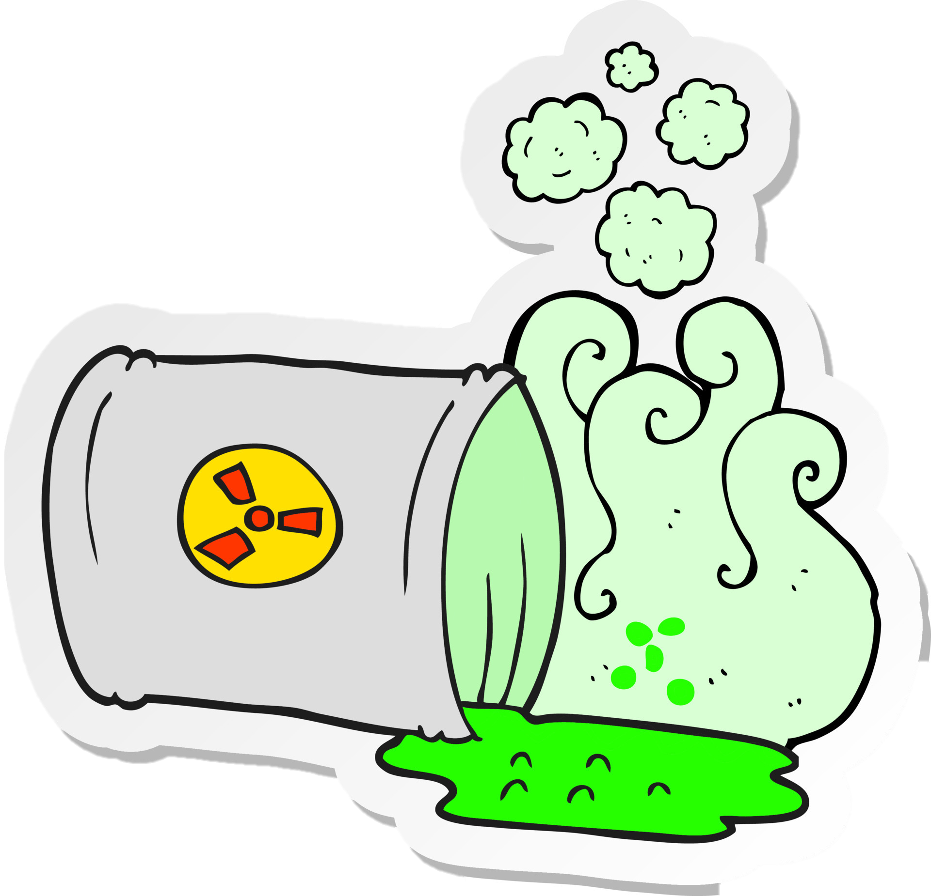
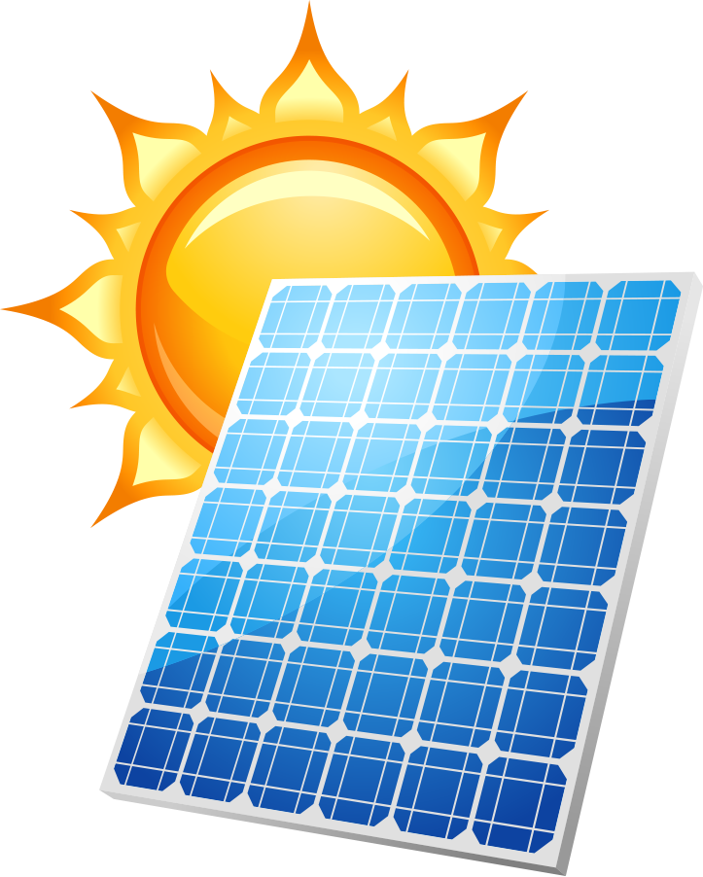
BRAINSTORMING
WIND
WATER
SUN
NUCLEAR
SOLAR PANEL

Slide 4
OBJECTIVES
By the end of the lesson, students will be able to:
VOCABULARY | Name the energy sources and types of energy
PRONUNCIATION | Pronounce the correct stress in three-syllable words

Slide 5
VOCABULARY

Slide 6
Ex 1. (p 106) Match the types of energy in A with the energy sources in B.
A B
1. Solar energy
solar energy – the sun
a. water
2. Wind energy
wind energy – wind
b. nuclear
3. Hydro energy
hydro energy – water
c. wind
4. Nuclear energy
nuclear energy – nuclear
d. the sun

Slide 7
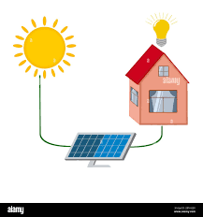
I. VOCABULARY
Solar energy
/ˌsəʊlər ˈenədʒi/

Slide 8
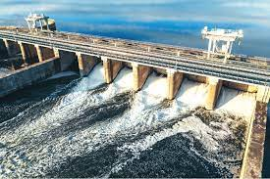
I. VOCABULARY
Hydro energy
/ˈhaɪdrəʊ ˈenədʒi/

Slide 9
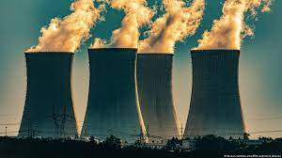
I. VOCABULARY
Nuclear energy
/ˈnjuːkliə(r)ˈenədʒi/

Slide 10

VOCABULARY
Listen and repeat the words.
New words | Meaning
solar energy | Năng lượng mặt trời
hydro energy | Năng lượng nước
nuclear energy | Năng lượng hạt nhân

Slide 11
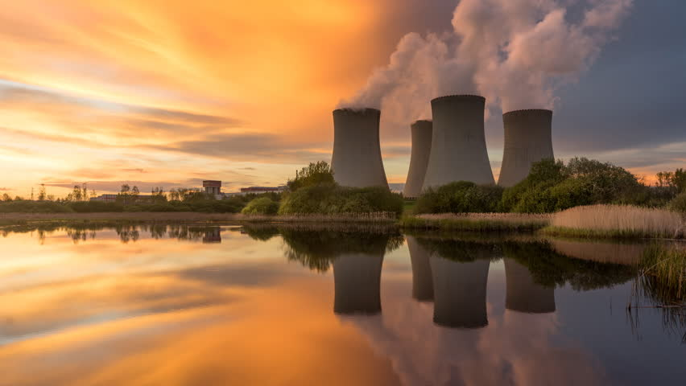
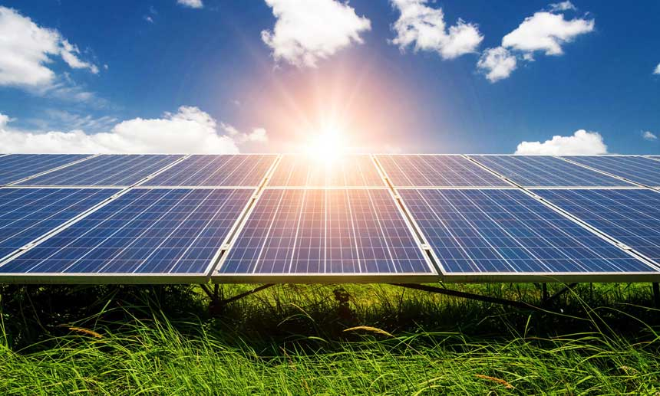
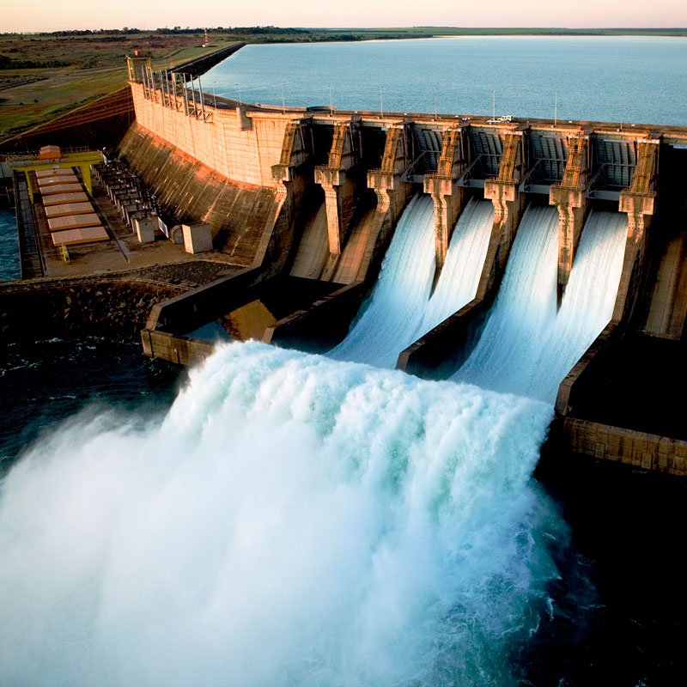
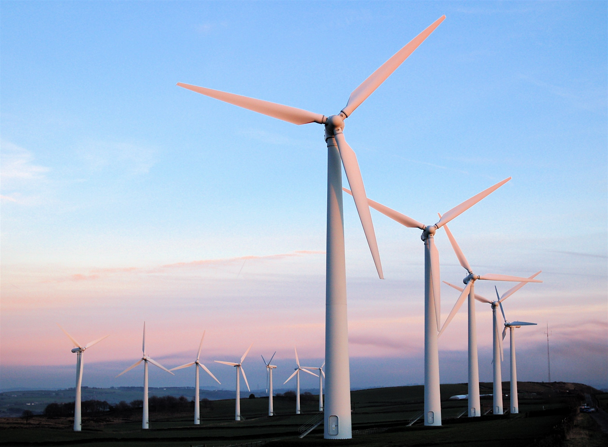
Ex 2. (106) Write the phrases to label the pictures.
Solar energy
Wind energy
Hydro energy
Nuclear energy
1
3
2
4

Slide 12
Ex 3. (p 106) Work in pairs. Complete the sentences with the words and phrases from 1 or 2.
01
02
03
04
A good place to change ________ to energy is near the sea because of the sea breezes.
wind
They are putting solar panels on the roof of our building to produce ______________.
solar energy
When energy comes from __________, we call it hydro energy.
water
They are reducing the use of_______________ because it is not safe to produce.
nuclear energy

Slide 13
PRONUNCIATION
Stress in three-syllable words

Slide 14
Watch the video and answer the questions:
1. Write 2 words with first-stressed syllable
2. Write 2 words with second-stressed syllable
3. Does the stress change when the words have “re-” “-es” “-ing” “-ly”?
=> Most 3-syllable words are stressed on the 1st or 2nd syllable.
Notes:
Stress in 3-syllable words
*
1. 2. 3.
II. Practice

Slide 15
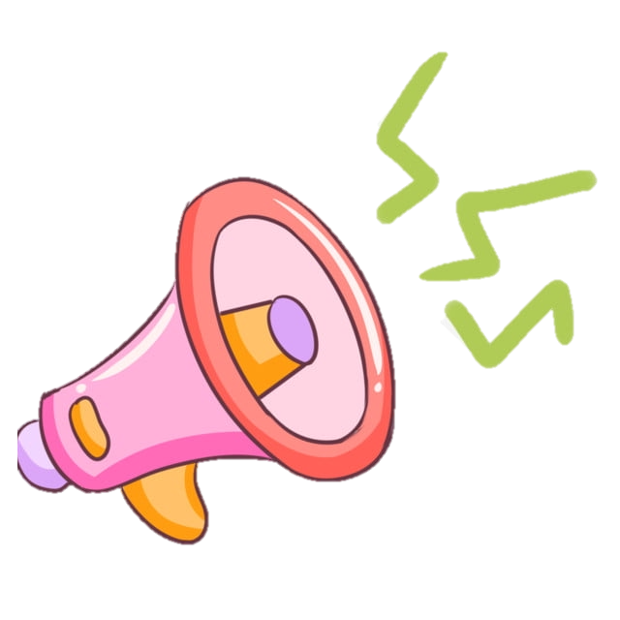
Ex 4. (p 106) Listen and repeat. Pay attention to the stressed syllables in the words.
'energy
'dangerous
'easily
'government
re'cycle
ex'pensive
po'lluting
re'sources

Slide 16


PRONUNCIATION GAME
Listen to the word and decide the stress of it.
Stress: 1st
Stress: 2nd
Sit down
Stand up

Slide 17

PRONUNCIATION GAME
 | WORD | PRONUNCIATION
WORD 1 | electric | /ɪˈlektrɪk/
WORD 2 | different | /ˈdɪfrənt/
WORD 3 | renewable | /rɪˈnjuːəbl/
WORD 4 | replace | /rɪˈpleɪs/
WORD 5 | expensive | /ɪkˈspensɪv/

Slide 18

Ex 5. (p 106) Listen and repeat, paying attention to the stressed syllables in the underlined words. Work in pairs.
1 | Nuclear 'energy is 'dangerous and ex'pensive.
2 | We should ride a bike when 'travelling short 'distances.
3 | The word "re'cycle" has three 'syllables.
4 | Burning coal is po'lluting our environment.
5 | Our 'government is looking for new sources of 'energy to replace gas.

Slide 19

Wrap-up

Slide 20
Homework
- Do exercise 1,\ 2 page 40 workbook.
- Learn by heart the new words.
- Prepare A closer look 2

