Slide 1


TRƯỜNG THCS LONG BIÊN
BÀI GIẢNG ĐIỆN TỬ MÔN TIẾNG ANH 7
UNIT 9. FESTIVALS AROUND THE WORLD
GV: Lê Hà Chi
Tổ Ngoại ngữ - Năng khiếu

Slide 2
Photo flash
remember and write
all the festivals

Slide 3
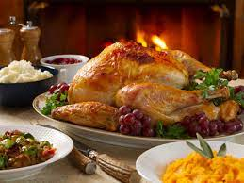
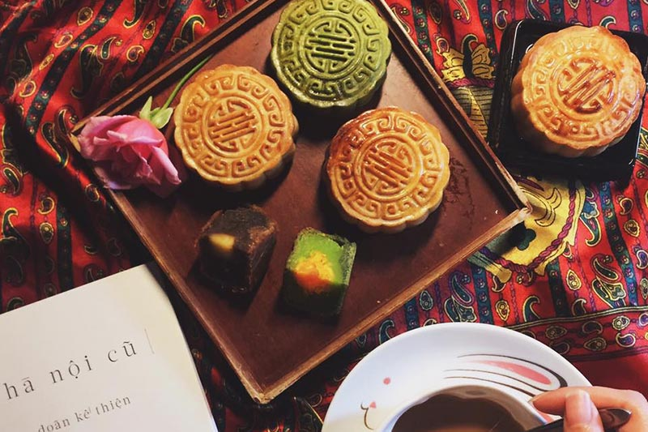
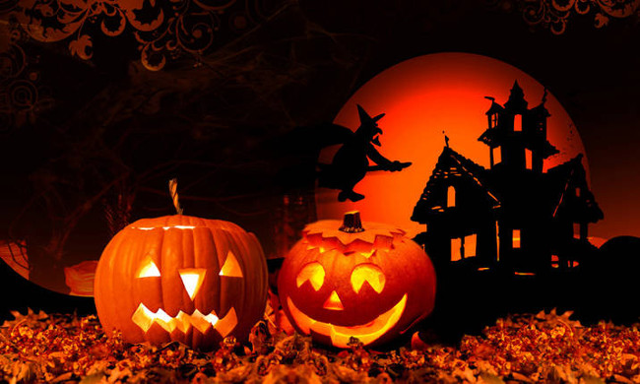

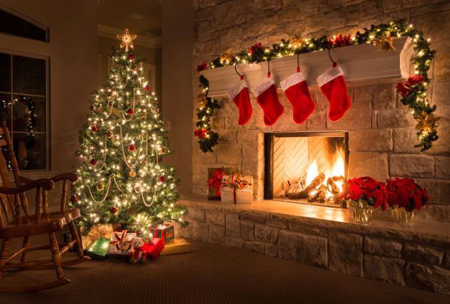
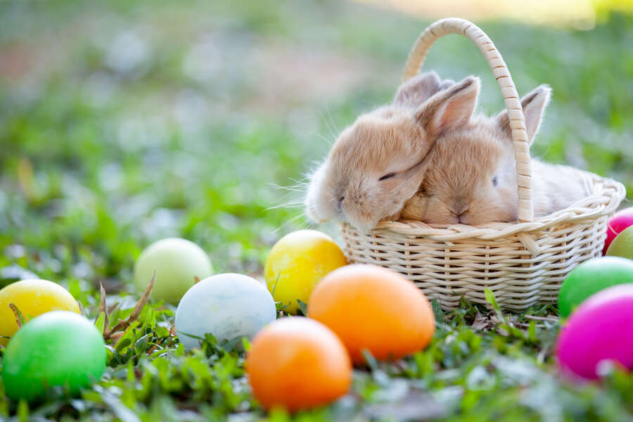

Show all
Fast
Medium
Slow
Hide all
Notes:
Do you know all the names of the festivals? That’s what we learn today, some festivals around the world, and we will check afterwards.

Slide 4
UNIT 9
Festivals around the world
Lesson 2: A closer look 2

Slide 5
Objectives
At the end of this lesson, students will be able to:
use the lexical items related to the topic festivals around the world.
pronounce and distinguish stress in
two-syllable words.
Notes:
-
-
- Pronounce and distinguish stress in two-syllable words.

Slide 6
01
Vocabulary

Slide 7

Check your answer
Easter
/ˈiːstə(r)/

Slide 8
Check your answer
Mid-autumn
festival
/mɪd- ˈɔːtəm ˈfestɪvl/

Slide 9
Check your answer
Christmas
/ˈkrɪsməs/

Slide 10
Check your answer
Thanksgiving
/ˌθæŋksˈɡɪvɪŋ/

Slide 11
Check your answer
Halloween
/ˌhæləʊˈiːn/

Slide 12
Ex 1 (pg.94) Write under each picture a festival name from the box.
1. Halloween
4. Cannes Film festival
2. Christmas
5. Easter
3. Mid-Autumn festival
6. Thanksgiving

Slide 13
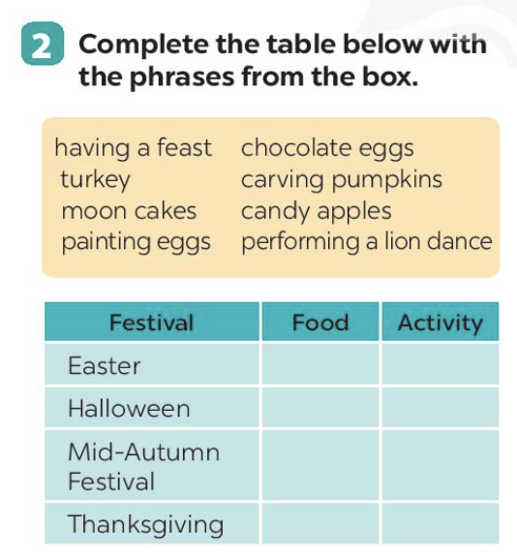
Ex 2 (pg.94) Complete the table below with the phrases from the box.
1. having a feast | 2. chocolate eggs | 3. turkey | 4. carving pumpkins
5. mooncakes | 6. candy apples | 7. painting eggs | 8. performing a lion dance
9. worshipping the Moon | 10. play trick or treat | 11. play Easter bingo | 12. potatoes
Festival | Food | Activity
Easter
Halloween
Mid-Autumn Festival
Thanksgiving
Notes:
Now you’re going to get to know more about the food and activities of each festival. Đề bài. Work in groups of 5-6. Write the words in the table. Let’s check: gọi trả lời: Easter: 1- 5.
Your friends have some more quizzes for you. Let’s guess the festival.

Slide 14
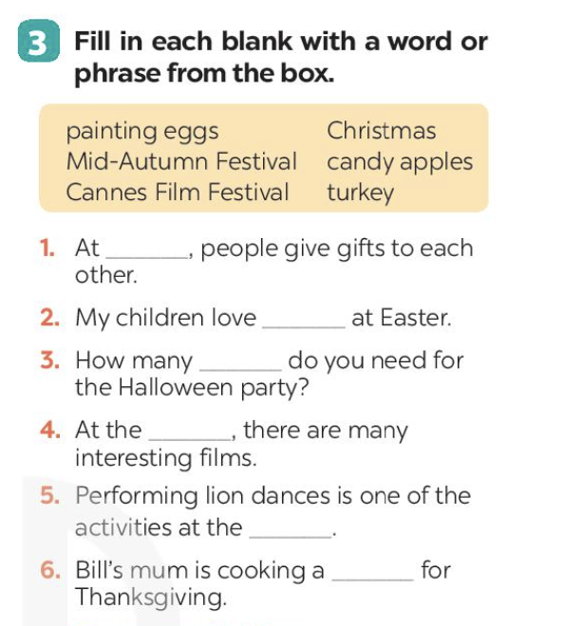
Ex 3 (pg.94) Fill in each blank with a word or phrase from the box.
painting eggs | Christmas | Mid-autumn festival
candy apples | Cannes film festival | turkey
1. At _________, people give gifts to each other.
2. My children love _________ at Easter.
3. How many _________do you need for the Halloween party?
4. At the _________, there are many interesting films.
5. Performing lion dances is one of the activities at the_________.
6. Bill's mum is cooking a _________ for Thanksgiving.

Slide 15
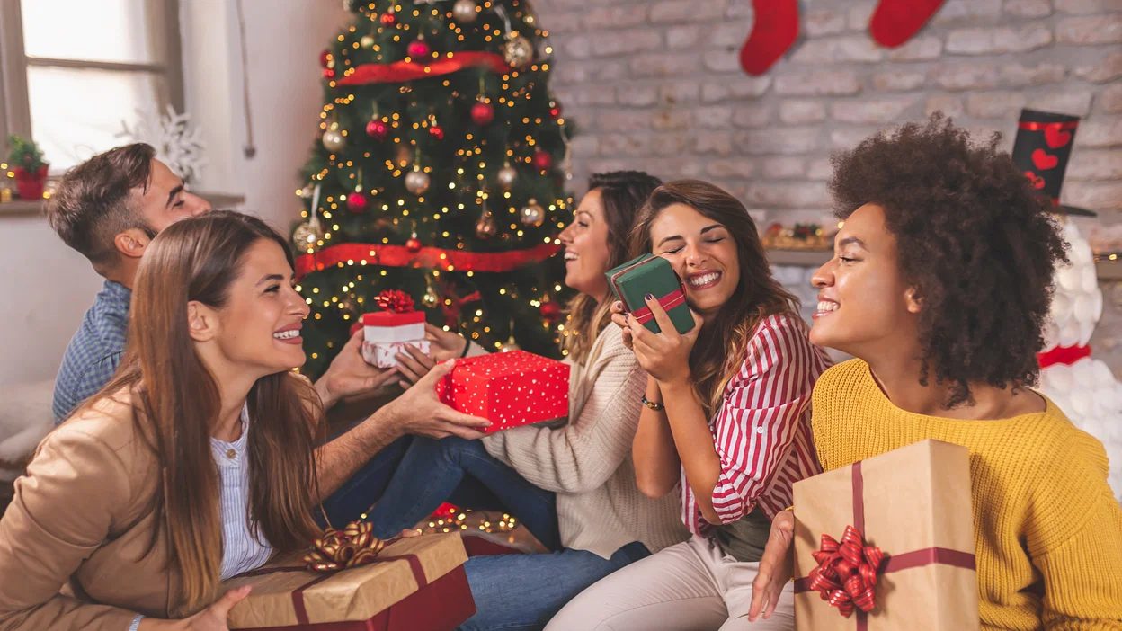
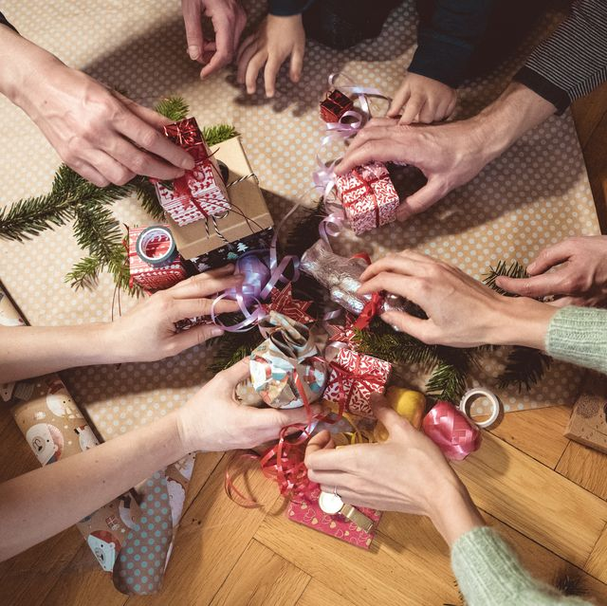
Ex 3 (pg.94) Fill in each blank with a word or frase from the box.
painting eggs | Christmas | Mid-autumn festival
candy apples | Cannes film festival | turkey
Christmas
1. At _______________, people give gifts to each other.

Slide 16
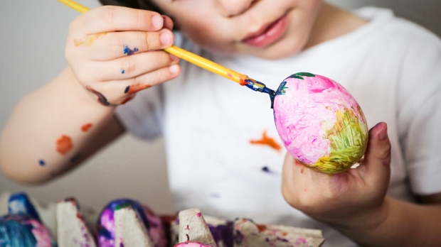
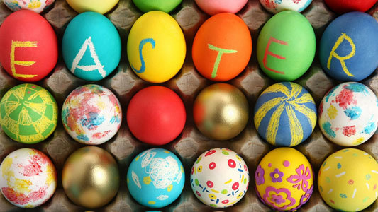
Ex 3 (pg.94) Fill in each blank with a word or frase from the box.
painting eggs | Christmas | Mid-autumn festival
candy apples | Cannes film festival | turkey
painting eggs
2. My children love ______________ at Easter.

Slide 17
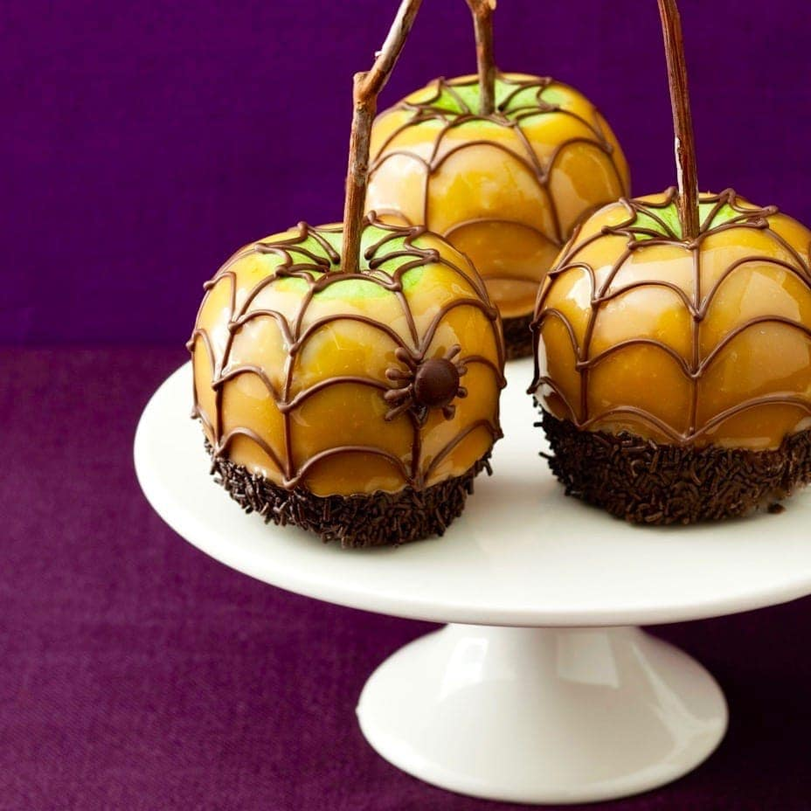
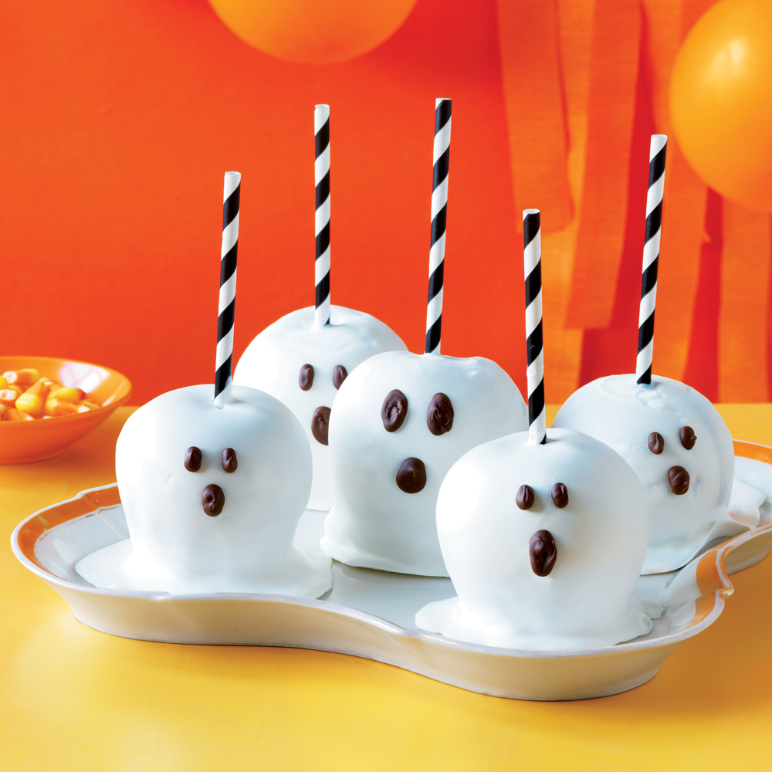
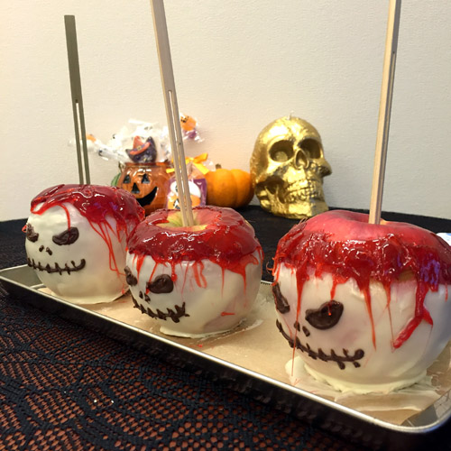
Ex 3 (pg.94) Fill in each blank with a word or frase from the box.
painting eggs | Christmas | Mid-autumn festival
candy apples | Cannes film festival | turkey
3. How many ________________do you need for the Halloween party?
candy apples

Slide 18


Ex 3 (pg.94) Fill in each blank with a word or frase from the box.
painting eggs | Christmas | Mid-autumn festival
candy apples | Cannes film festival | turkey
4. At the ______________, there are many interesting films.
Cannes film festival

Slide 19
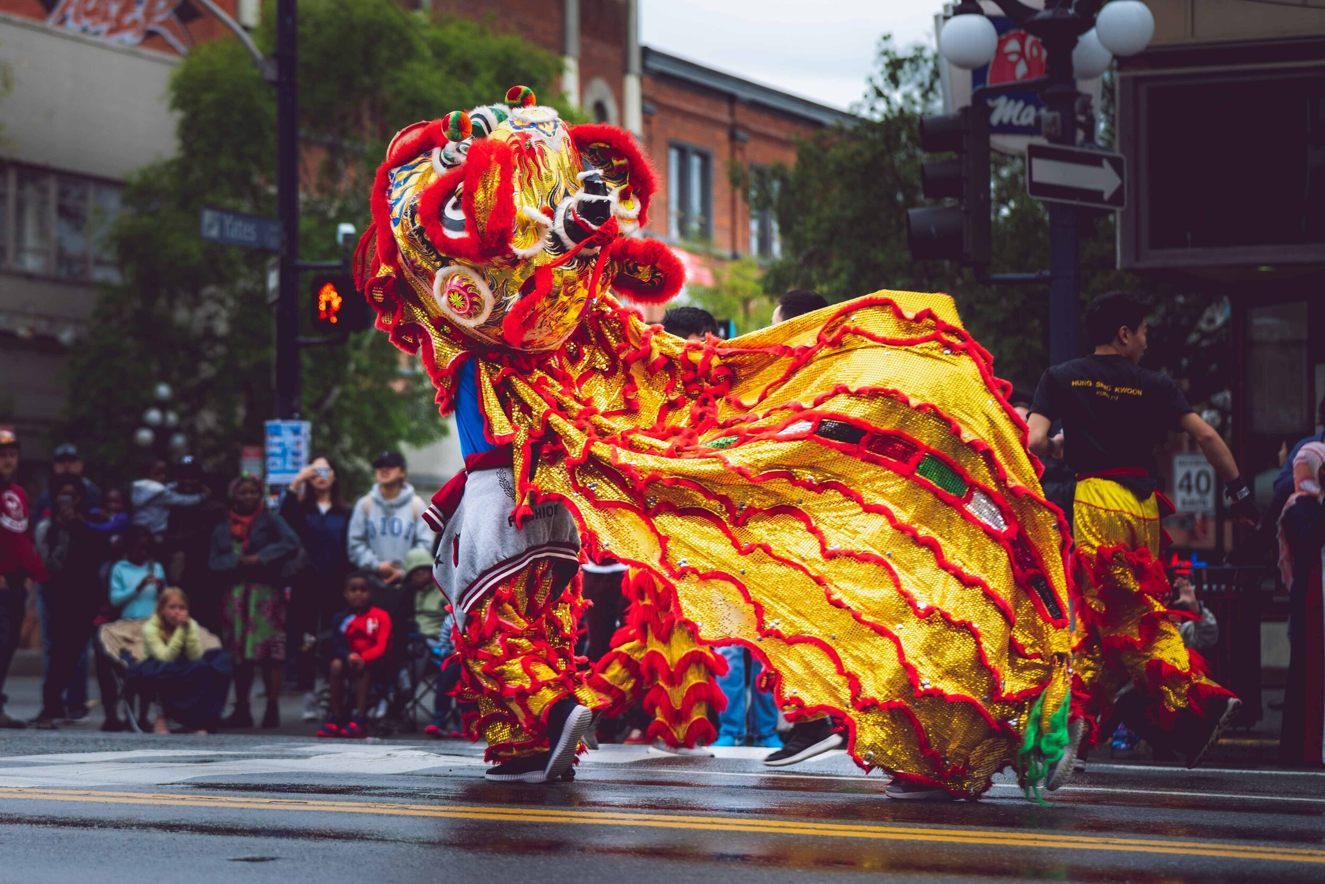
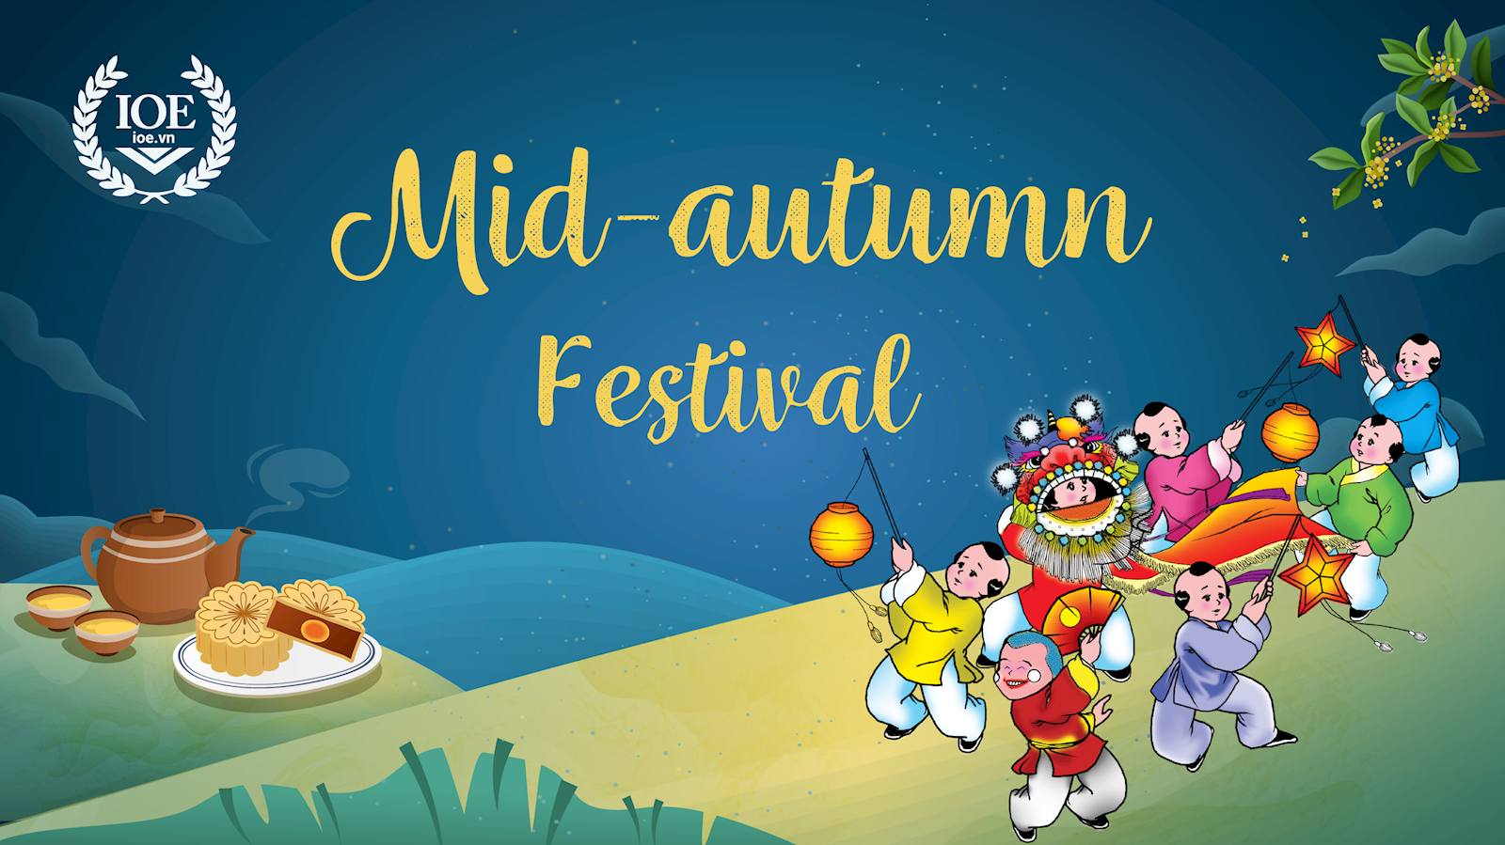
Ex 3 (pg.94) Fill in each blank with a word or frase from the box.
painting eggs | Christmas | Mid-autumn festival
candy apples | Cannes film festival | turkey
5. Performing lion dances is one of the activities at the _____________________.
Mid-autumn festival

Slide 20
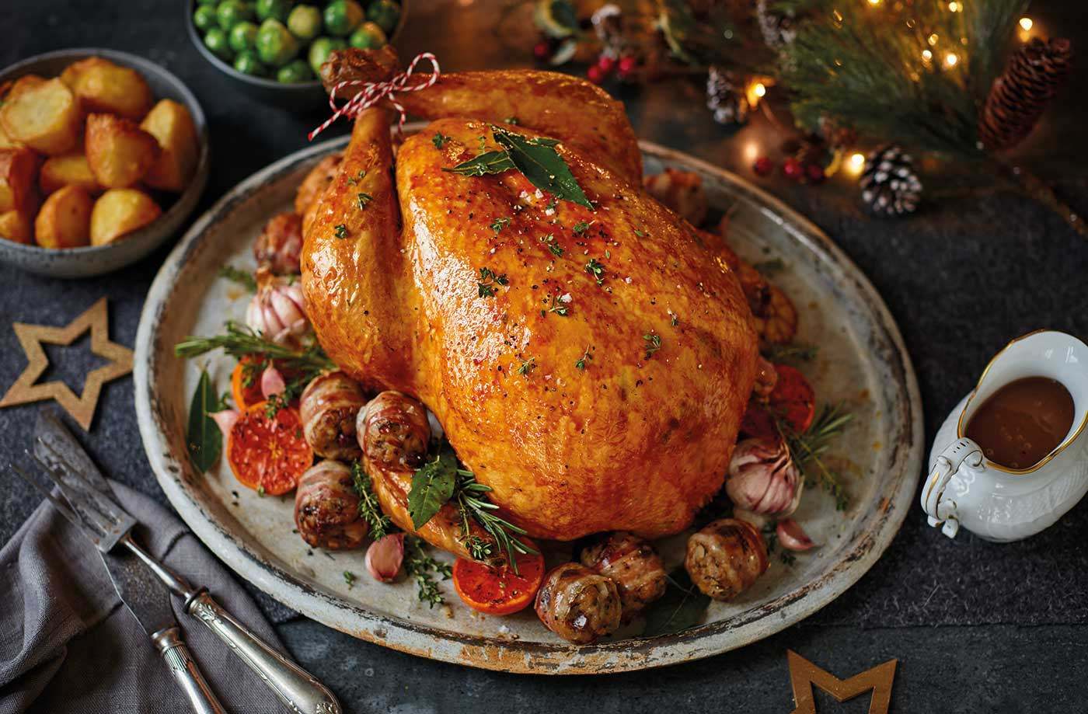
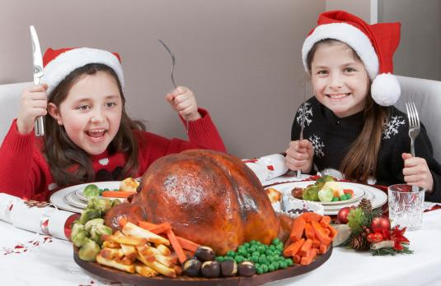
Ex 3 (pg.94) Fill in each blank with a word or frase from the box.
painting eggs | Christmas | Mid-autumn festival
candy apples | Cannes film festival | turkey
turkey
6. Bill's mum is cooking a _________ for Thanksgiving.

Slide 21
02
Pronunciation

Slide 22
Do you know anything about stress and syllable?
Watch the video and write 2 rules about stress

Slide 23
Stress in two-syllable words
are usually stressed on
the first syllable
Nouns and adjectives
Verbs
are usually stressed on the second syllable

Slide 24
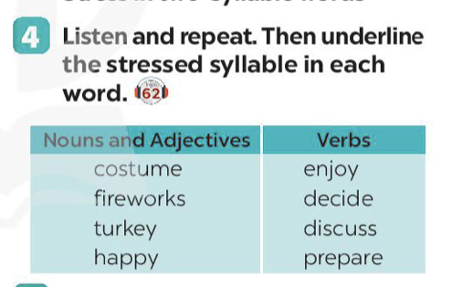
Ex 4 (pg.94) Listen and repeat.
Nouns and Adjectives | Verbs
costume | enjoy
fireworks | decide
turkey | discuss
happy | prepare

Slide 25
RECAP
1
Odd one out
A. chocolalate eggs B. moon cakes
C. carving pumpkins D. turkey
2
Fill in the blanks
Nouns and adjectives are usually stressed on the ________ syllable and verbs are stressed on the ________ syllable.
first
second

Slide 26
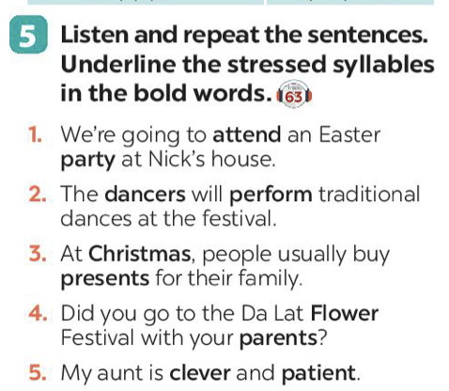
Ex 5 (pg.94) Listen and repeat the sentences. Underline the stressed syllables in the bold words.
1. We’re going to attend an Easter party at Nick’s house.
2. The dancers will perform traditional dances at the festival.
3. At Christmas, people usually buy presents for their family.
4. Did you go to the Da Lat Flower Festival with your parents?
5. My aunt is clever and patient.
/əˈtend/
/ˈpɑːti/
/ˈdɑːnsə/
/ pəˈfɔːm/
/ˈkrɪsməs /
/ˈprezənt /
/ˈflaʊə/
/ˈpeərənt /
/ˈklevə /
/ˈpeɪʃənt /

Slide 27
Ex 2 (pg.94) Complete the table below with the phrases from the box.
having a feast | chocolate eggs | turkey | carving pumpkins
mooncakes | candy apples | painting eggs | performing a lion dance
Festival | Food | Activity
Easter
Halloween
Mid-Autumn Festival
Thanksgiving
chocolate eggs
painting eggs
candy apples
carving pumpkins
performing
a lion dance
moon cakes
turkey
having a feast
Notes:
Thêm hình ảnh, cho 4 hs lên diễn + vẽ

Slide 28
Stress in two-syllable words
are usually stressed on
the first syllable
Nouns and adjectives
Except for:
advice machine
mistake hotel
alone amazed
/ədˈvaɪs/
/məˈʃiːn/
/mɪˈsteɪk/
/həʊˈtel/
/əˈləʊn/
/əˈmeɪzd/

Slide 29
Stress in two-syllable words
Verbs
are usually stressed on the second syllable
Except for:
offer happen
listen visit
travel manage
/ˈɒfə/
/ˈhæpən /
/ ˈlɪsən/
/ ˈvɪzɪt/
/ˈtrævəl /
/ˈmænɪdʒ /
Notes:
Watch the video and write 2 rules

Slide 30
Ex 4 (pg.94) Underline the stressed syllable in each word.
Nouns and Adjectives | Verbs
costume | enjoy
fireworks | decide
turkey | discuss
happy | prepare

