Slide 1


TRƯỜNG THCS LONG BIÊN
BÀI GIẢNG ĐIỆN TỬ MÔN TIẾNG ANH 7
UNIT 8. FILMS
GV: Lê Hà Chi
Tổ Ngoại ngữ - Năng khiếu

Slide 2
OBJECTIVES
Vocabulary
Grammar
Project
After this lesson, students will be able to
1
review the types of film and the adjectives to describe a film
2
review how to use connectors although/ though and however
3
apply what they have learnt into practice through a project

Slide 3
I. VOCABULARY
1. Types of films
2. Adjectives to describe films

Slide 4
II. GRAMMAR
Although/ However

Slide 5

Vocabulary
01
Types of films
Adjectives to describe films

Slide 6
1. Match the types of film in column A with their descriptions in column B.
A
B
1. science fiction film
a. This type of film makes you laugh.
2. comedy
b. This type of film has supernatural events.
3. horror film
c. This type of film gives us useful information about animals, science or technology.
4. documentary
d. This type of film is about life in the future, robots, and space travel.
5. fantasy
e. This is a frightening type of film.
Notes:
1. science fiction film
2. comedy
3. horror film
4. documentary
5. fantasy
a. This type of film makes you laugh.
b. This type of film has supernatural events.
c. This type of film gives us useful information about animals, science or technology.
d. This type of film is about life in the future, robots, and space travel.
e. This is a frightening type of film.

Slide 7

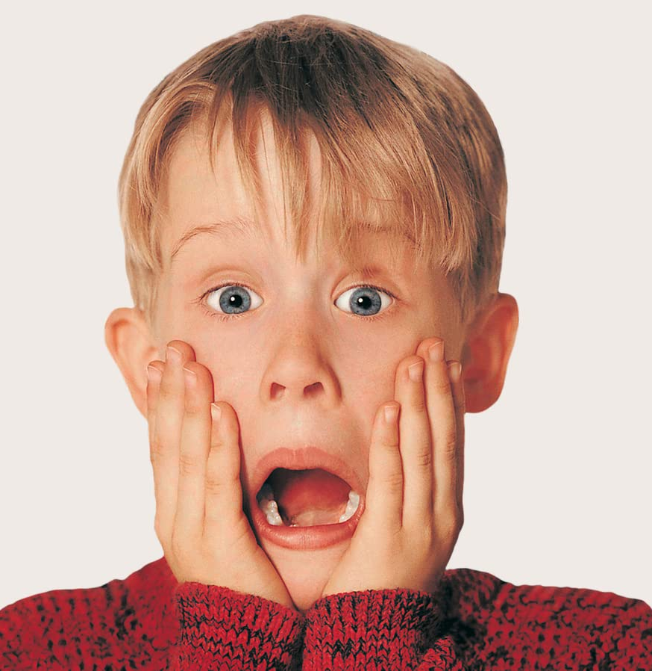
2. Work in group. Each group gives as many examples as possible for a type of film.
comedy
fantasy
horror
science-fiction film
documentary

Slide 8
2. Choose the correct answer A, B and C to complete each sentence.
1. The film was long and ___________ . Many people went home before it ended.
A. funny B. shocking C. dull
2. The film is too ___________ with a lot of fighting and killing scenes.
A. funny B. violent C. interesting
3. A ___________ story often makes us feel afraid.
A. moving B. interesting C. frightening
4. The news was ___________. I couldn’t believe it.
A. shocking B. funny C. confusing
5. ___________ films often make us cry.
A. Amusing B. Moving C. Funny
6. The road signs were ___________ and we soon got lost.
A. confusing B. shocking C. interesting

Slide 9

Grammar
03
connectors
although/ though and however

Slide 10
2. Choose the correct answer A, B and C to complete each sentence.
A
B
1. Although he arrived late,
a. people still buy them.
2. The film received good reviews
b. However, the number of people going to cinemas is increasing.
3. Though popcorn and other snacks in the cinema are very expensive,
c. I don't want to stay home tonight.
4. Cinema tickets are expensive.
d. he left the cinema early.
5. Although I don't really like to go to the cinema,
e. However, only a few people saw it.

Slide 11

Project
04
Your favorite film

Slide 12
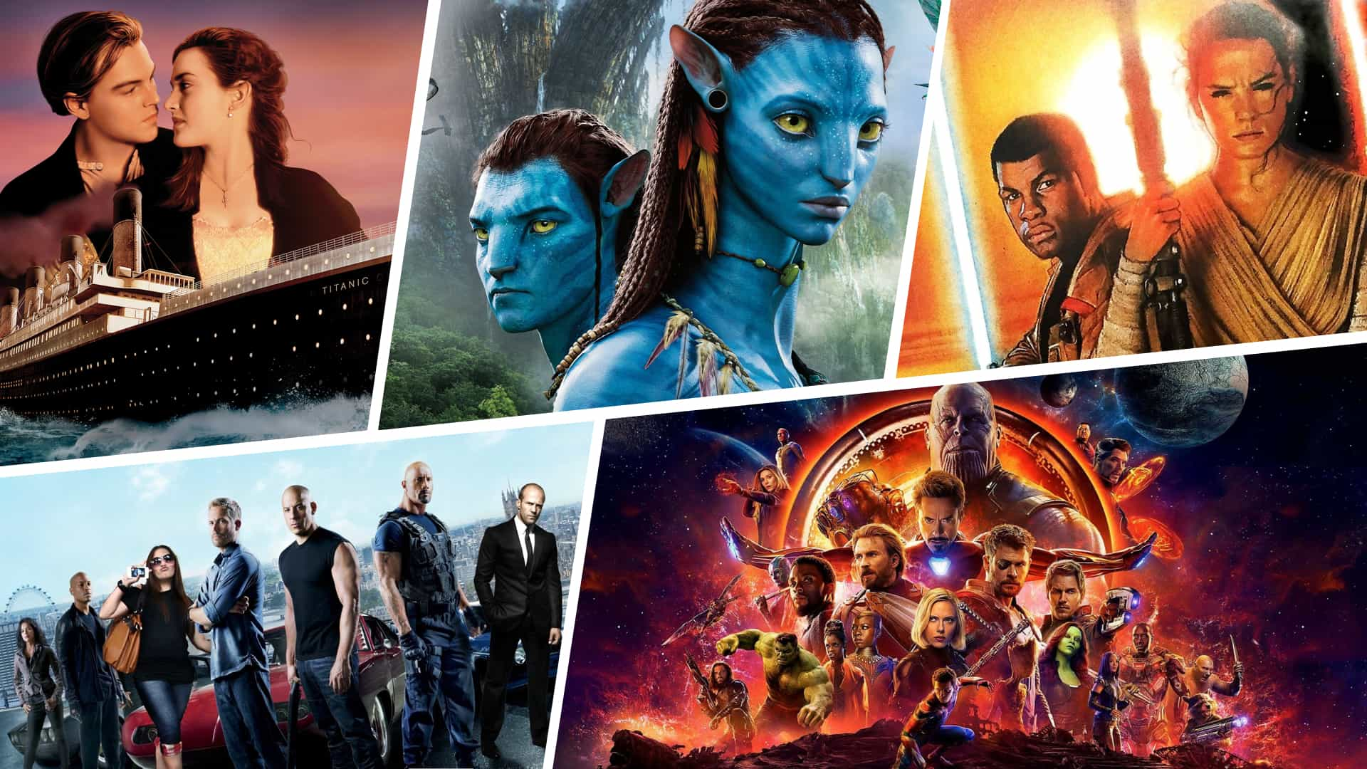
What’s your favorite movie?

Slide 13
Design a poster
(main-aim)
Write about favorite films (sub-aim)
Present your products
(sub-aim)

Slide 14
What can you talk about a favorite film?

Slide 15
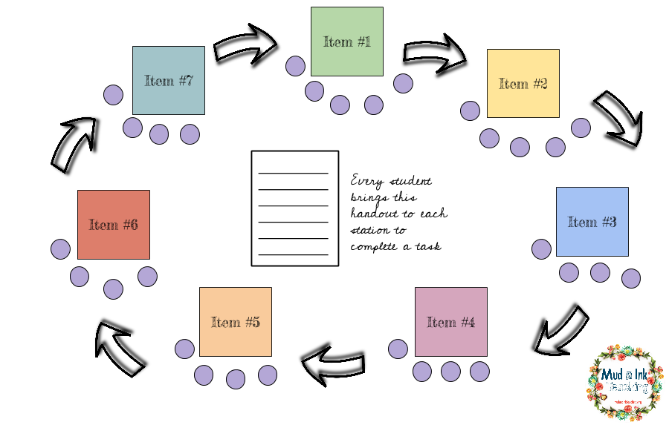
Posters exhibition
Presenters
- Stand up, take your poster
- Move to the other group
- Present your travel guide
The others
Look at your friend’s travel guide, listen
Do you like it? Why?

Slide 16
Let’s talk about your favorite movie!

Slide 17


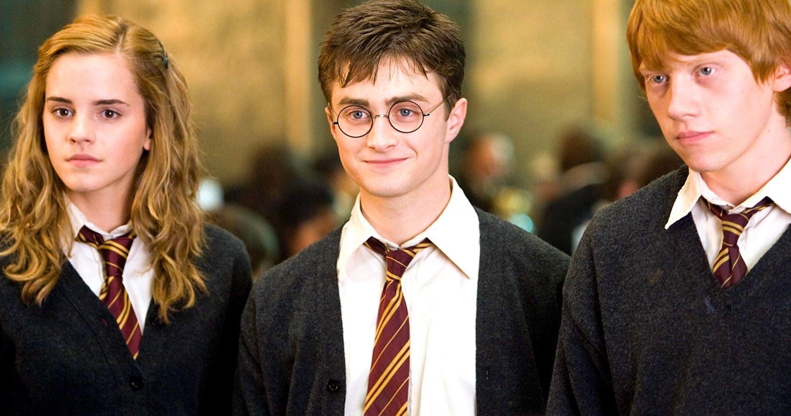

Name of the film
- It’s a fantasy film series.
- It’s directed by David Heyman
- Daniel Radcliffe, Rupert Grint, and Emma Watson star as the three leading characters: Harry Potter, Ron Weasley, and Hermione Granger
- The film tells the story of Harry Potter, a powerful wizard. He studies at Hogwarts try to fight the bad things happening around him.
- It’s a must-see for teens because the story is gripping and the acting is excellent. The music is also amazing.
- You can see them on many websites or Netflix.
type of film
its director
main actors / actresses
a short summary
pictures, photos about the film
reviews
showtime and cinema
Notes:
- name of the film
- type of film
- its director and main actors / actresses
- a short summary
- your overall opinion about the film
- the showtime and cinema
- pictures or photos to illustrate the film

Slide 18
Work in groups of 6.

Slide 19
 | Good (4) | Normal (3) | Need improvement (2) | Bad (1)
1. Preparation
2. Eye contact
3. Volume
4. Style

Slide 20

In group, listen and answer.
Group’s name:
Leader:
Writer(s):
Decorator(s):
Presenter(s):
Discuss the steps to make a poster:
(YOUR PLAN)

Slide 21
Steps to make a poster about favorite film
Step 1: Choose a favorite film
Step 2: Write the headings
Step 3: Write content
- name of the film
- type of film
- its director and main actors / actresses
- a short summary
- your overall opinion about the film
- the showtime and cinema
- pictures or photos to illustrate the film
Step 4: Decorate your poster

Slide 22
WRAP UP
Vocabulary
Grammar
Project
In this lesson, students have
1
reviewed the types of film and the adjectives to describe a film
2
reviewed how to use connectors although/ thought and however
3
applied what they have learnt into practice through a project

Slide 23
Thanks for your attention!
Please keep this slide for attribution

