Slide 1
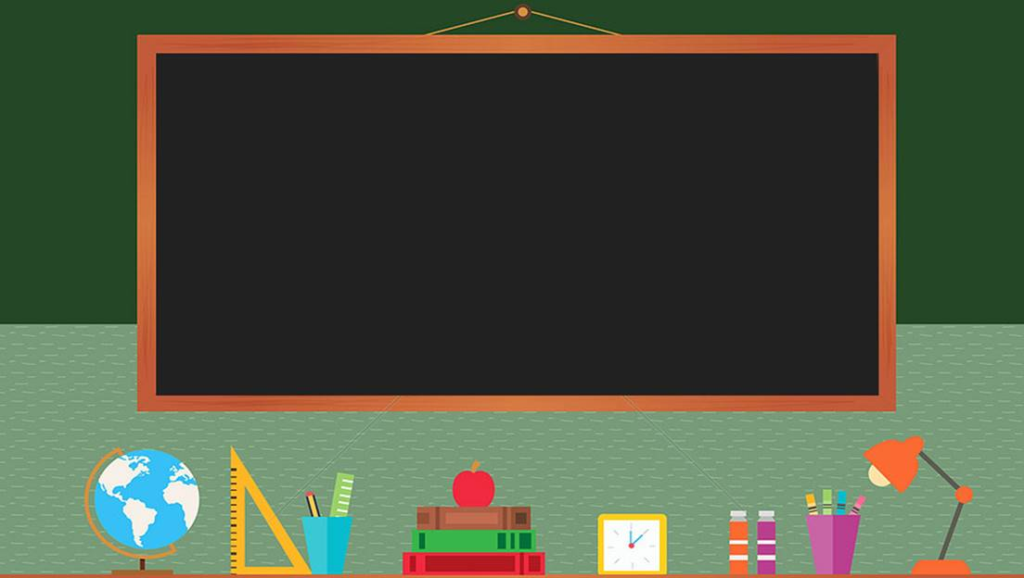

TRƯỜNG THCS LONG BIÊN
BÀI GIẢNG TIẾNG ANH 7
UNIT 7: SKILLS 2
GV: Nguyễn Thu Hằng
Tổ Ngoại Ngữ- Năng Khiếu

Slide 2
Unit 7. Traffic
Lesson 6. Skills 2

Slide 3
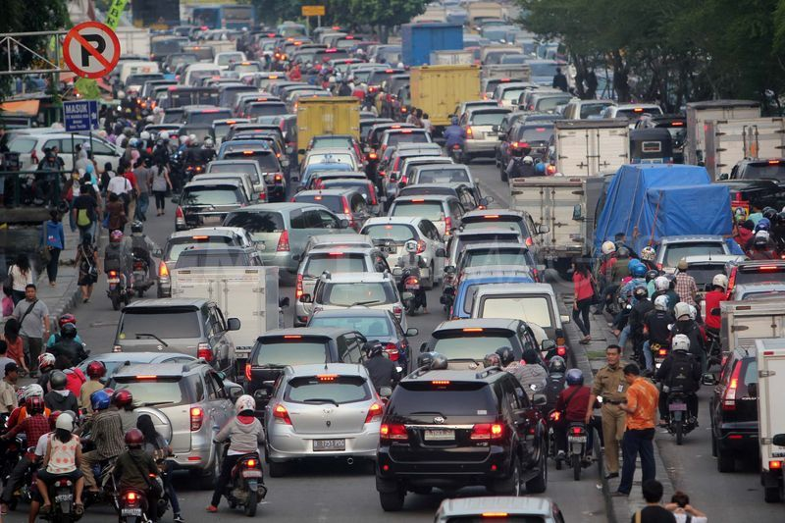
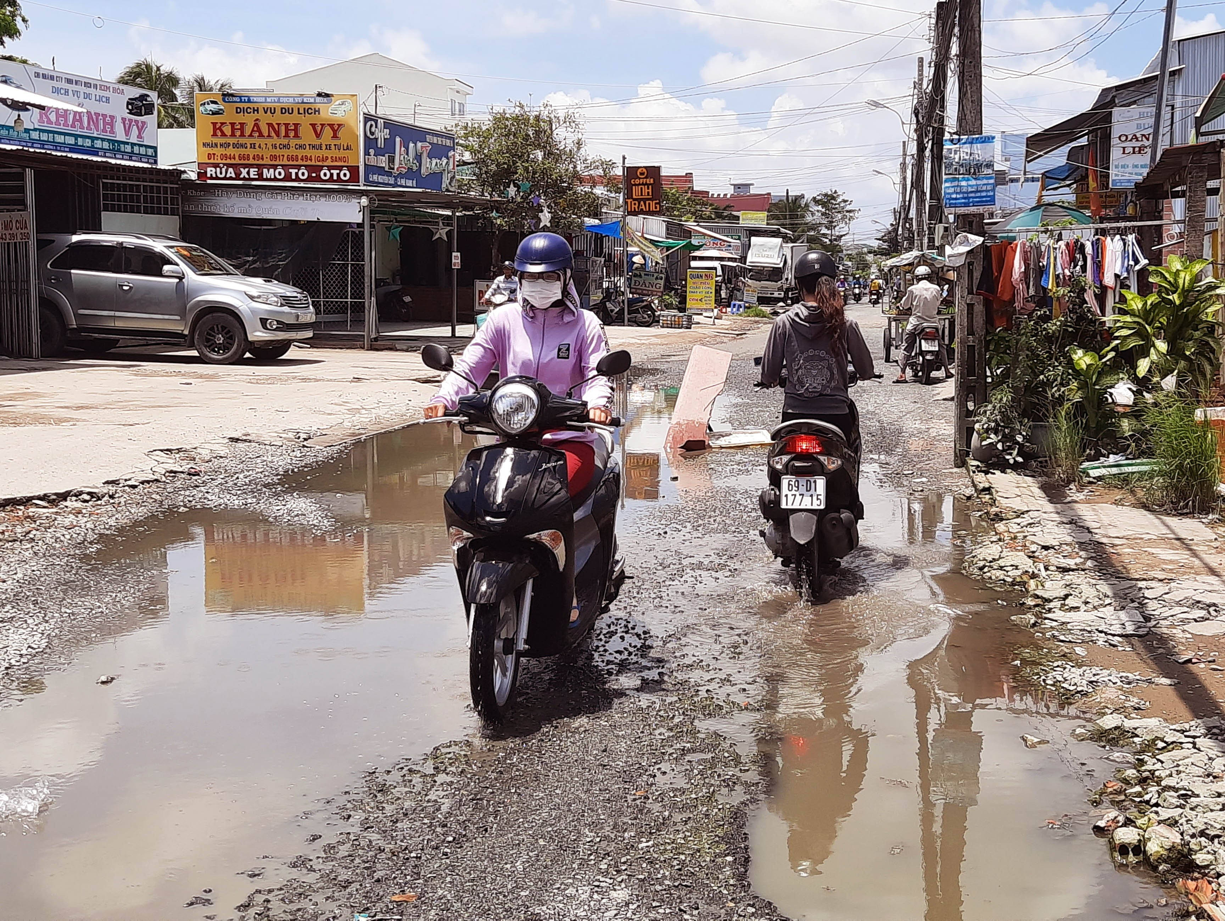
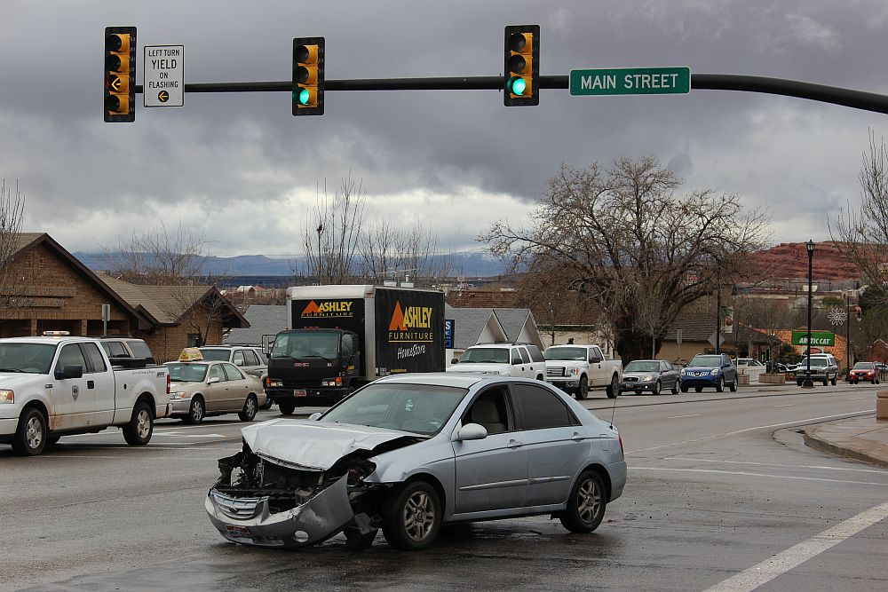
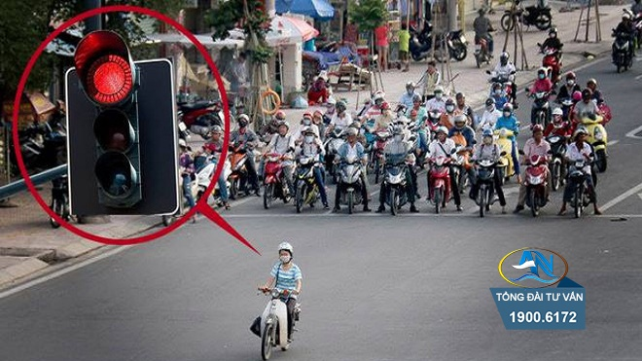
What are the topic today?
Traffic problems
What are they?
_oa_ p_oble_
Tra_ _ic
_ ms
Cr_sh
Pa_ _ a red lig_ _

Slide 4
Objectives
1
Listening
2
Writing
By the end of the lesson, students will be able to:
- use the lexical items related to the topic Traffic.
- listen for main ideas and specific information about traffic problems in Mumbai.
- write about traffic problems in your area.

Slide 5
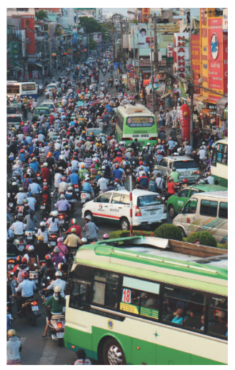
Ex 1. (p 79) Look at the picture and answer these questions.
What can you see in this picture?
What is special
about it?

Slide 6


The talk is about______.
Ex 2. (p 79) Listen to the recording and choose the correct answer A, B, or C.
Traffic in big cities
The population increase in Mumbai
The traffic problems in Mumbai
The traffic problems in Mumbai
Big cities around the world have traffic problems. Mumbai in India is one of them.
Notes:
Bấm vào hình loa để nghe bài

Slide 7
Ex 3. (p 79) Listen again and write ONE word or number in each gap.
Ex 3. (p 79) Underline the keywords.
1. Traffic _______ happen nearly every day in Mumbai.
1. Traffic _______ happen nearly every day in Mumbai.
2. One reason for the traffic _______ is the increase of the population.
2. One reason for the traffic _______ is the increase of the population.
3. Mumbai has nearly _______ million people.
3. Mumbai has nearly _______ million people.
4. The _______ in Mumbai are narrow.
4. The _______ in Mumbai are narrow.
5. Many road users do not _______ the traffic rules.
5. Many road users do not _______ the traffic rules.
Notes:
Bấm vào hình loa để nghe bài

Slide 8
1
jams
Traffic _______ happen nearly every day in Mumbai.
Traffic jams happen nearly every day, so drivers have to spend a lot of time on the road.
Notes:
Click vào ngôi loa để nghe đúng ý

Slide 9
2. One reason for the traffic _______ is the increase of the population.
jams
There are several reasons for traffic jams in this city. One reason is its increase in population.
Notes:
Click vào ngôi loa để nghe đúng ý

Slide 10
3. Mumbai has nearly _______ million people.
20
With nearly 20 million, Mumbai has too many people on the road.
Notes:
Click vào ngôi loa để nghe đúng ý

Slide 11
roads
4. The _______ in Mumbai are narrow.
Another reason is that the roads in Mumbai are narrow.
Notes:
Click vào ngôi loa để nghe đúng ý

Slide 12
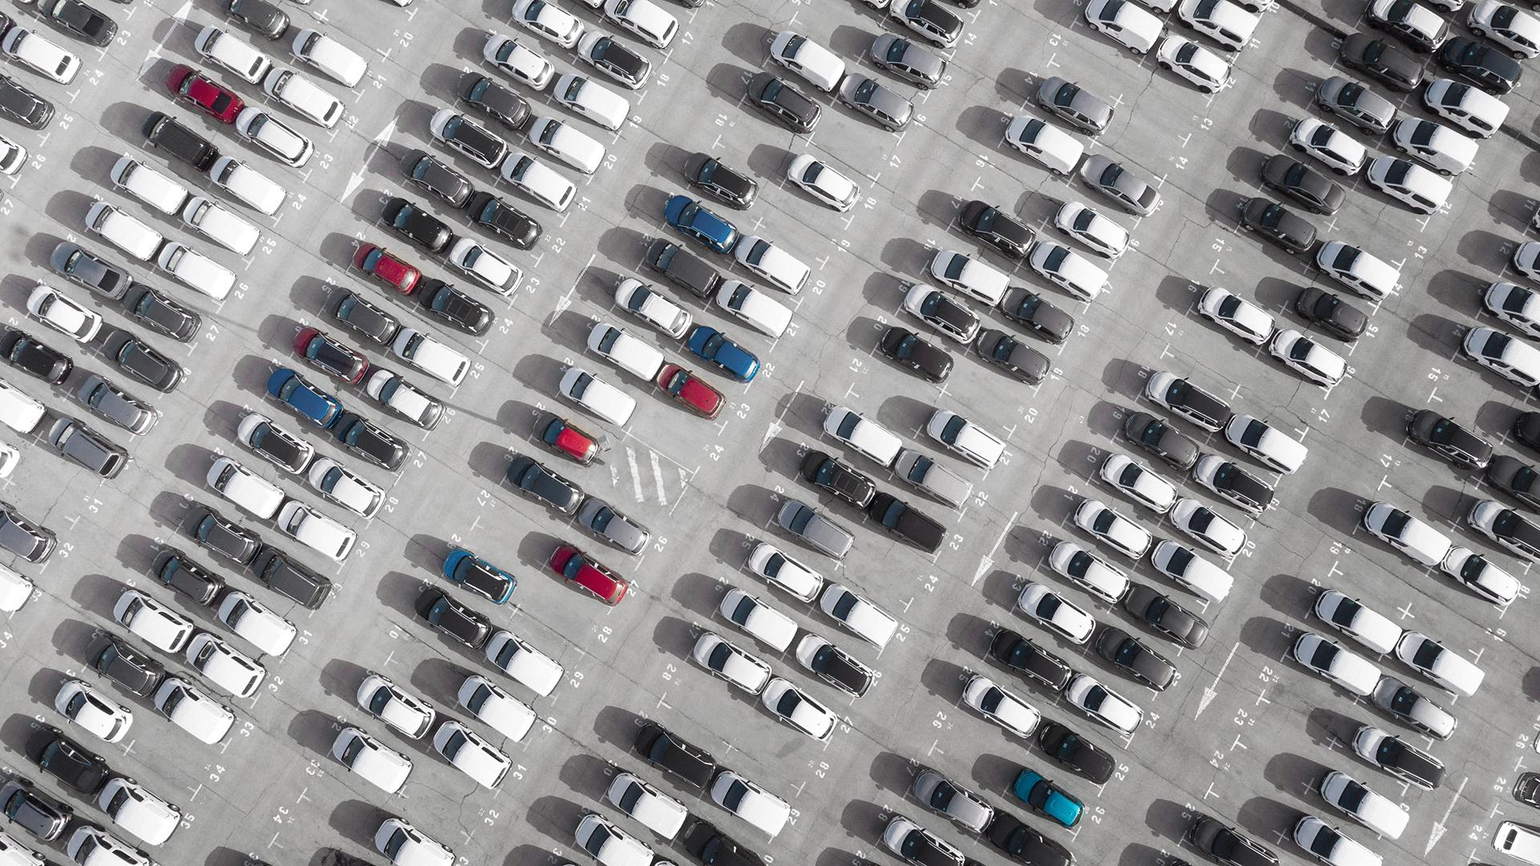
5. Many road users do not _______ the traffic rules.
obey
Also, many road users do not obey the traffic rules. As a result, this problem is getting worse and worse.
Notes:
Click vào ngôi loa để nghe đúng ý

Slide 13
Writing
What are the traffic problems in your city?

Slide 14
Ex 4. (p 79) Tick the traffic problems in big cities in Viet Nam.
Too many vehicles on the road.
Narrow and bumpy roads.
Some people not obeying traffic rules.
Young children riding their bikes dangerously.
Wild animals running across the road.

Slide 15

Our team
Ex 5. (p 79) Write a paragraph of about 70 words about the traffic problems in your town/city.
Introduction: (1 -2 sentence)
Problem 1:
Problem 2:
Problem 3:
Conclusion: reason or suggestion
Notes:
Draw the template on the board. Should include at least 3 problems.
For each problem, is …..enough? Write the supporting ideas. (Luận điểm– dẫn chứng, lí lẽ) => Đặt câu hỏi Why?/ Kết quả dẫn đến…/ ví dụ.

Slide 16
1. What is one of the traffic problems in your city?
2. Where should you cross the street?
3. Should on drive after drinking alcohol? why or why not?
4. What must you do before you turn left or right while riding a bike?
5. Should you wear a helmet when you ride a motorbike? why or why not?
Ex 5. (p 79) Write a paragraph of about 70 words about the traffic problems in your town/city.
Sample:
I have lived in Hanoi for many years, so I can see that the traffic here is usually so crowded, especially during rush hours. Some traffic problems have risen recently and drawn a lot of the public's attention. Firstly, there are too many vehicles on the road. There are many cars, buses, taxis and trucks on the high roads. Besides, the narrow and bumpy road can cause many accidents. On top of that, some people do not obey traffic rules. All of those careless actions can cause accidents. To avoid them, I think we should use public transportation instead of private cars to reduce the number of vehicles. What's more, it is a good idea to educate all people to follow the traffic rules and youngsters to know how to drive carefully and safely.

Slide 17
Swap and check
 | Yes | No
Have problems
Have reason or suggestion
Have correct spelling
All sentences have verbs

Slide 18

WRAP UP
What have we learnt today?
listen for main ideas and specific information about traffic problems in the world.
write about traffic problems in town/city.
talk about traffic problems in the world.
use the lexical items related to the topic Traffic.

Slide 19
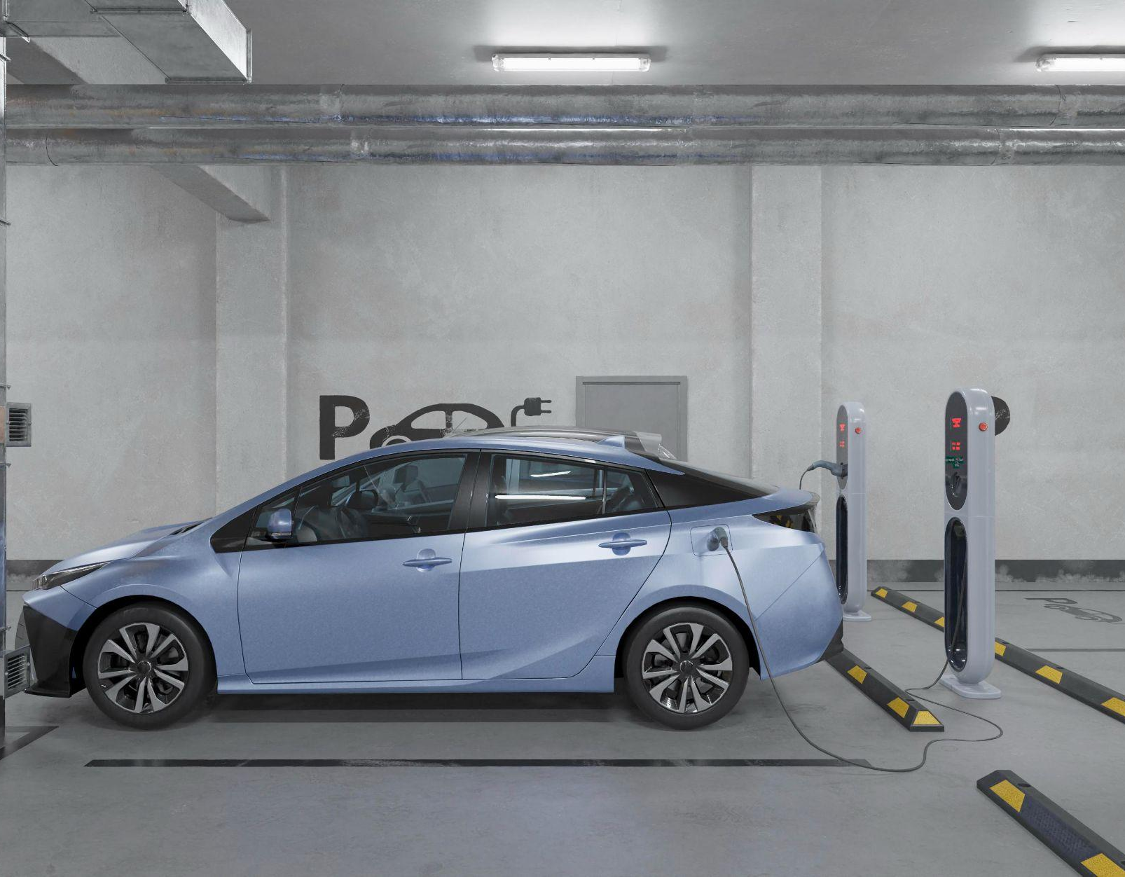
Thank you!

