Slide 1


TRƯỜNG THCS LONG BIÊN
BÀI GIẢNG ĐIỆN TỬ MÔN TIẾNG ANH 8
Tiết 1
UNIT 1: LEISURE TIME
Lesson 1: Getting started
GV: Đoàn Thị Lê
Tổ Ngoại Ngữ - Năng khiếu

Slide 2

WARM-UP
Watch a video and name leisure activities in the video in groups of 4/5 students?
LEISURE ACTIVITIES

Slide 3
UNIT 1: LEISURE TIME
Lesson 1:
Getting started

Slide 4
OBJECTIVES OF THE LESSON
01
02
03
Identify some leisure activities.
Study some new words related to the topic “Leisure time”.
Use the vocabulary to describe leisure time.

Slide 5
New words

Slide 6


New words:
DIY (n)
(do-it-yourself)
/ˌdiːaɪˈwaɪ/
tự tay làm

Slide 7

New words:
knitting kit (n)
/ˈnɪtɪŋ kɪt/
bộ dụng cụ đan len

Slide 8
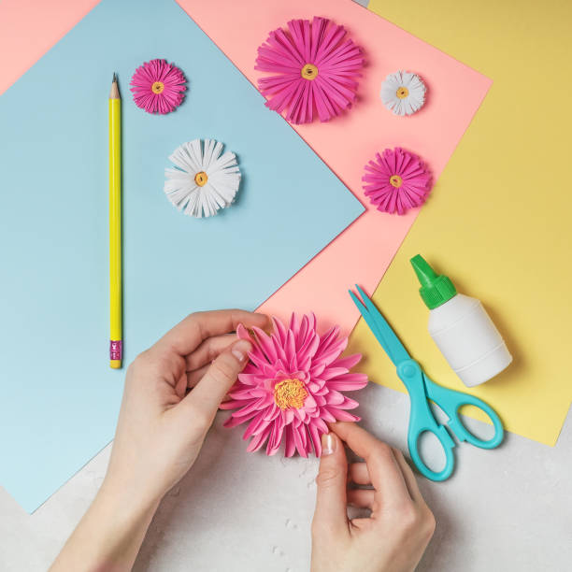
New words:
make paper flowers (v.phr)
/meɪk 'peɪpər 'flaʊərz/
làm hoa giấy

Slide 9
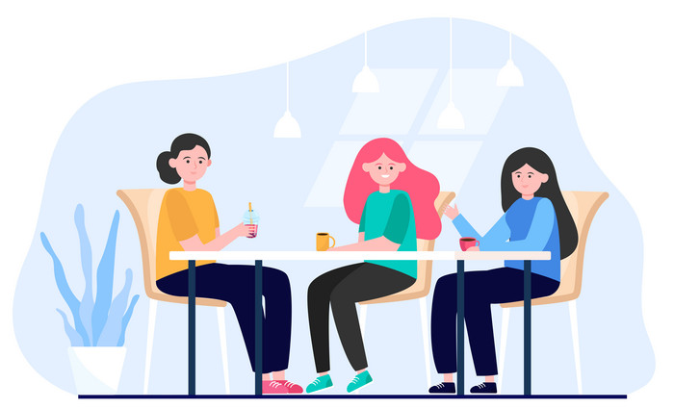
New words:
hang out (v)
/hæŋ aʊt/
đi chơi

Slide 10
Check the new words
New words | Pronunciation | Meaning
1. DIY (n) | /ˌdiːaɪˈwaɪ/ | tự tay làm
2. knitting kit (n) | /ˈnɪtɪŋ kɪt/ | bộ dung cụ đan len
3. dollhouse (n) | /ˈdɒlˌhaʊs/ | nhà búp bê
4. make paper flowers (v.phr) | /meɪk 'peɪpər 'flaʊərz/ | làm hoa giấy
5. hang out (v) | /hæŋ aʊt/ | đi chơi

Slide 11
PRACTICE

Slide 12
1
Listen and read
Tom: Hi, Trang. Surprised to see you. What brings you here?
Trang: Oh, hello Tom. I’m looking for a knitting kit.
Tom: A knitting kit? I didn’t know you like knitting.
Trang: Actually, I’m keen on many DIY activities. In my leisure time, I love
knitting, building dollhouses, and making paper flowers.
Tom: I see. So, you like spending time on your own.
Trang: Yes. What do you do in your free time?
Tom: I’m a bit different. I usually hang out with my friends. We go to the
cinema, go cycling, or play sport in the park.
Trang: You love spending free time with other people, don’t you?
Tom: That’s right. By the way, would you like to go to the cinema with me and
Mark this Sunday? There’s a new comedy at New World Cinema.
Trang: Yes, I’d love to. Can I ask Mai to join us?
Tom: Sure. Let’s meet outside the cinema at 9 a.m.

Slide 13
2
Read the conversation again and complete the sentences.
Trang is looking for a ____________.
She likes doing DIY in her ____________.
Tom loves spending his free time with ____________.
Tom and his friends usually _________ together.
Tom, Mark, Trang, and Mai are going to see a comedy this _______.
knitting kit
leisure time
other people
hang out
Sunday

Slide 14
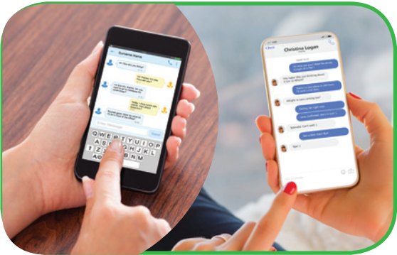
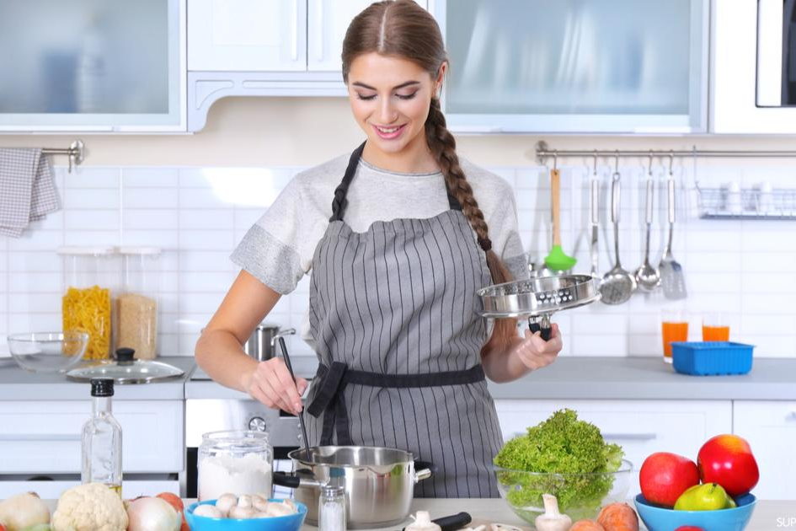
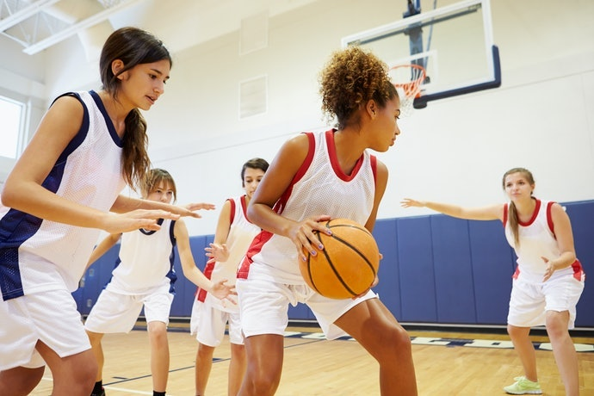
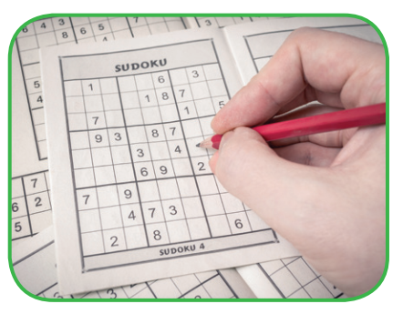
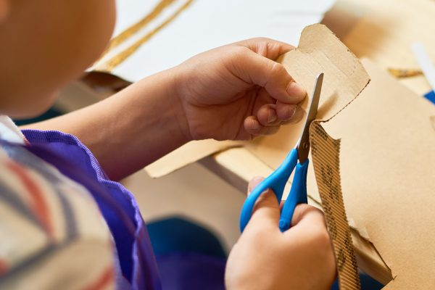

3
Work in pairs. Write the activities from the box under the correct pictures.
doing DIY
doing puzzles
surfing the net
cooking
playing sport
messaging friends

Slide 15
4
Work in pairs. Read the word and phrases, and guess which activities in 3 are described.
improve memory, a mental exercise
save money, increase creativity
improve physical health, make friends
keep in touch, be relaxed
learn something about IT, computer skills
doing puzzles
doing DIY
playing sport
messaging friends
surfing the net

Slide 16
GROUP – WORK
In group of 4/5 students to make a conservation about leisure time.

Slide 17

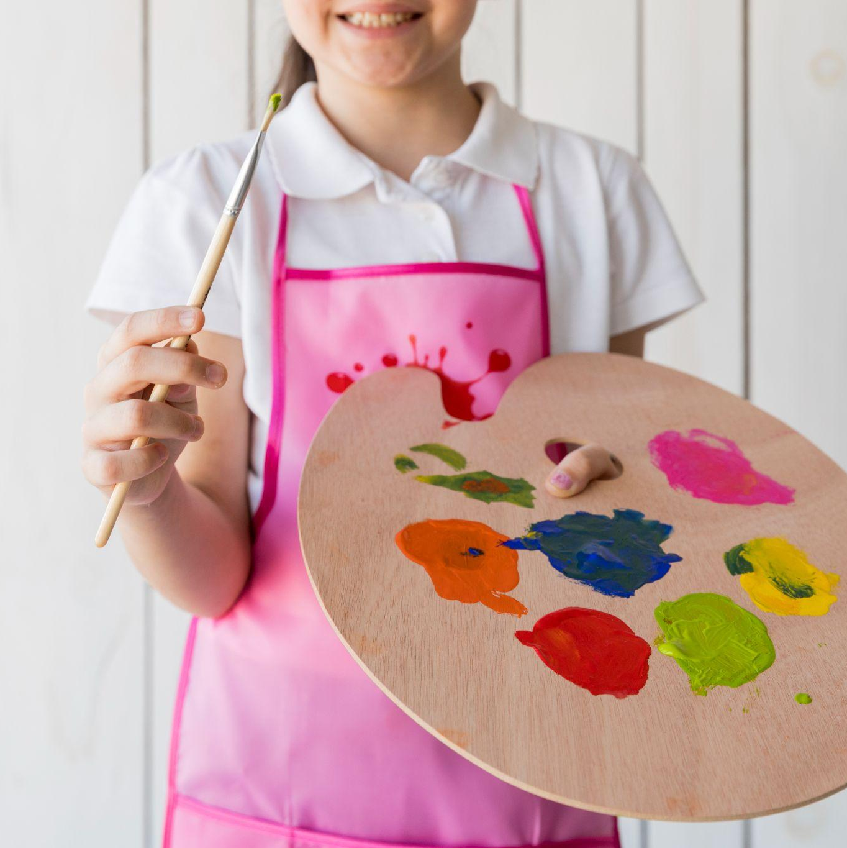
WRAP - UP
What have we learnt in this lesson?
identify the topic of the unit
use lexical items related to leisure activities
identify the language features that are covered in the unit

Slide 18
HOME WORK
Name a list of cheap expensive, easy and difficult leisure activities.
Do exercises in the workbook.
Prepare for the Project of Unit 1.

Slide 19
THANKS for attending the lesson!

Slide 20
