Slide 1

Unit 1: HEALTH
CLIL - Lesson 2
Page 74

Slide 2
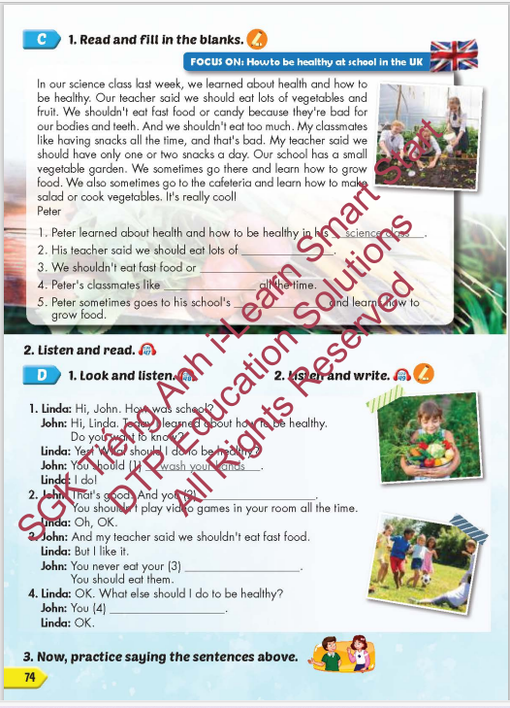
Lesson Outline
Warm-up
Reading
Listening
Speaking
Consolidation
Wrap-up

Slide 3
Objectives
By the end of this lesson, students will be able to review the target language and familiarize themselves with aspect how to be healthy at school in the UK and practice reading comprehension.
Vocabulary: do exercise, eat fast food, eat vegetables, wash your hands, play outside, eat too much.
Structure: What should I do to be healthy?
You should do exercise.
You shouldn't eat fast food.

Slide 4

WARM UP

Slide 5
Listen and choose. Then say.

Slide 6

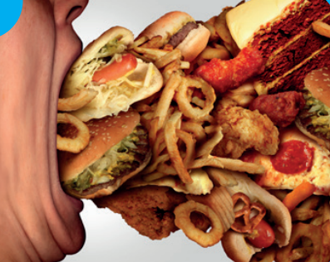
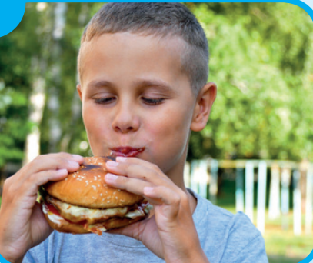


Listen and choose
A
B
C

Slide 7
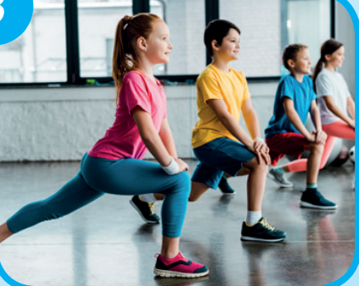
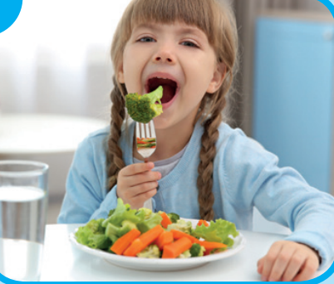
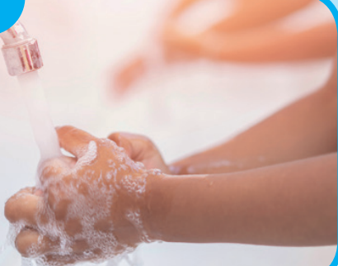
Listen and choose
A
B
C

Slide 8
Listen and choose
A
B
C

Slide 9
Listen and choose
A
C
A
B
B

Slide 10

It’s time to learn …

Slide 11

Lead-in

Slide 12

WHAT COUNTRY IS IT?
It’s the UK
The UK is known as the United Kingdom (UK).
The capital and largest city of the United Kingdom is London.

Slide 13
Practice

Slide 14

Reading

Slide 15

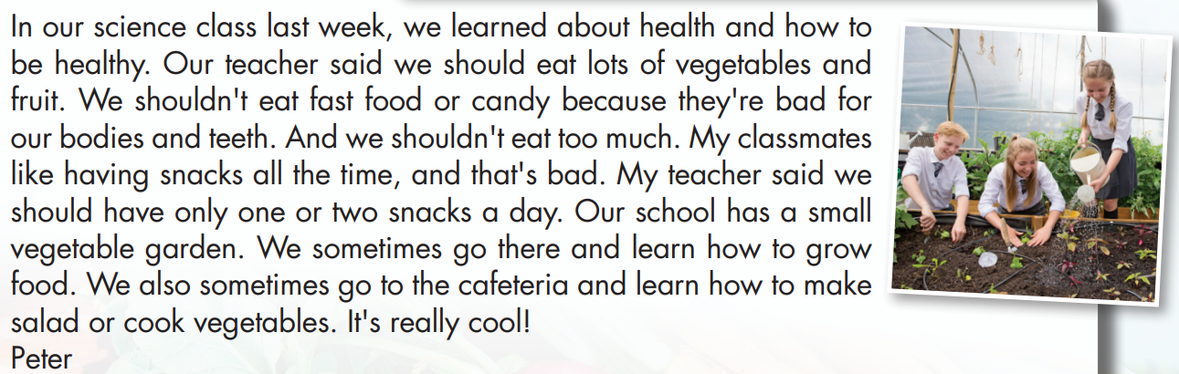

Slide 16
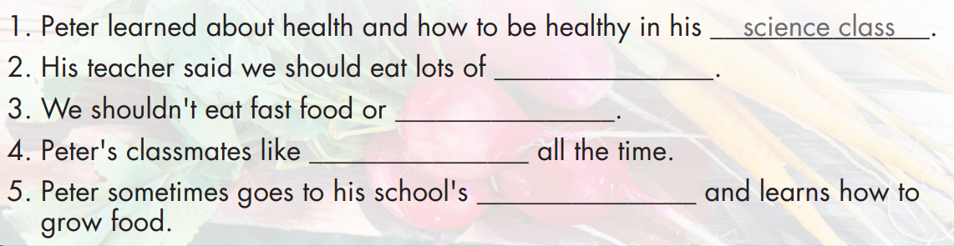
vegetables and fruit
candy
having snacks
vegetable garden

Slide 18
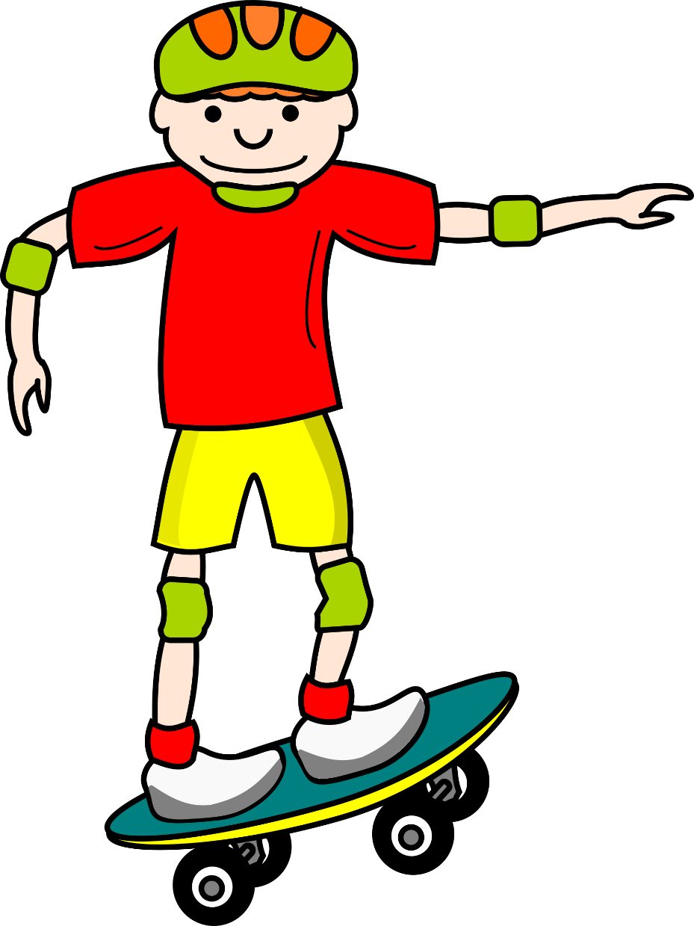
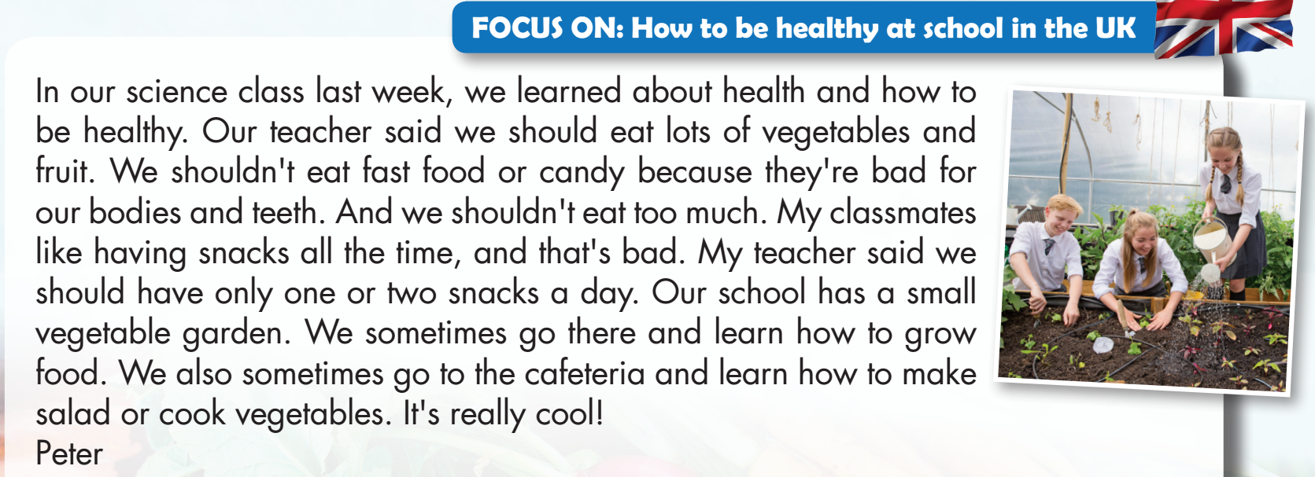
WHERE IS MY SKATEBOARD?
START

Slide 19
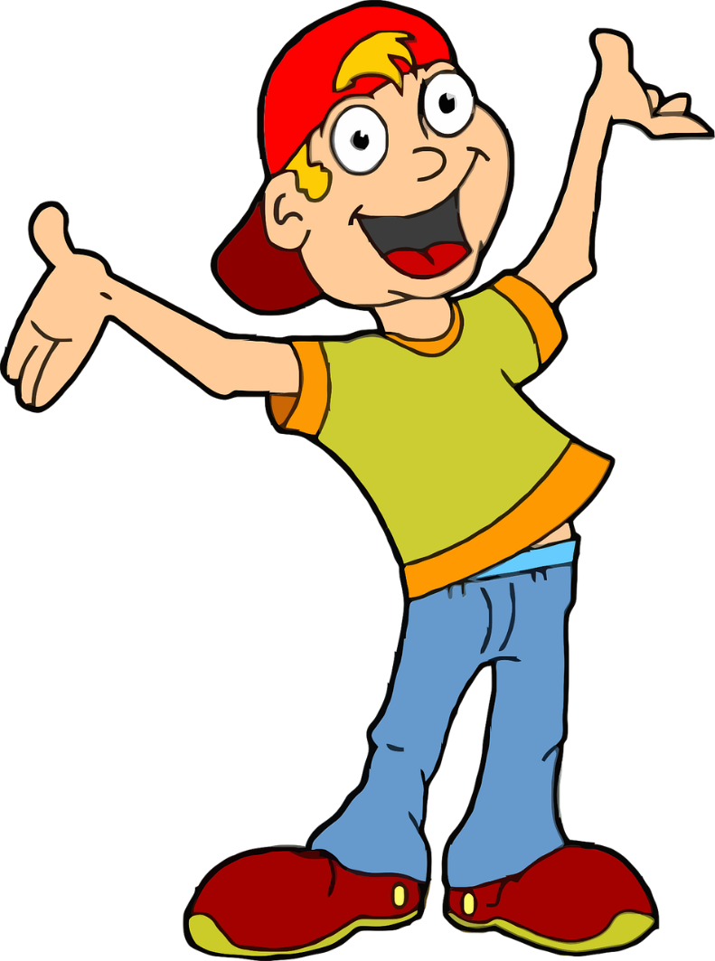

His teacher said we should eat lots of snacks.
TRUE
FALSE

