Slide 1

Unit 5: HEALTH
Lesson 3.1
Page 70

Slide 2
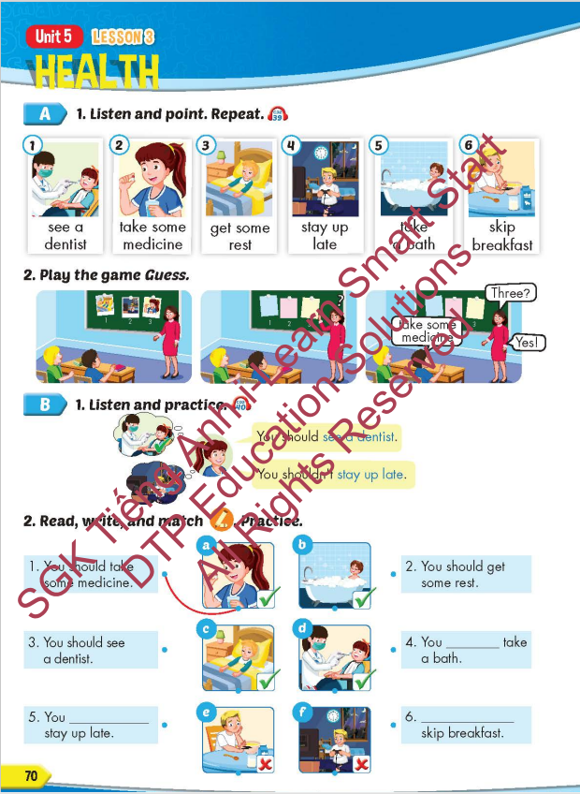
Lesson Outline
Warm-up
Vocabulary
Structure
Consolidation
Wrap-up

Slide 3
Objectives
By the end of this lesson, students will be able to give advice about health problems.
Vocabulary: see a dentist, take some medicine, get some rest, stay up late, take a bath, skip breakfast.
Structure: You should see a dentist.
You shouldn't stay up late

Slide 4

WARM UP

Slide 5




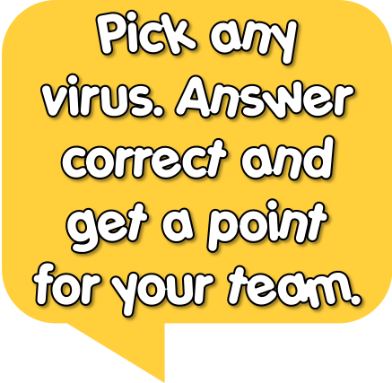





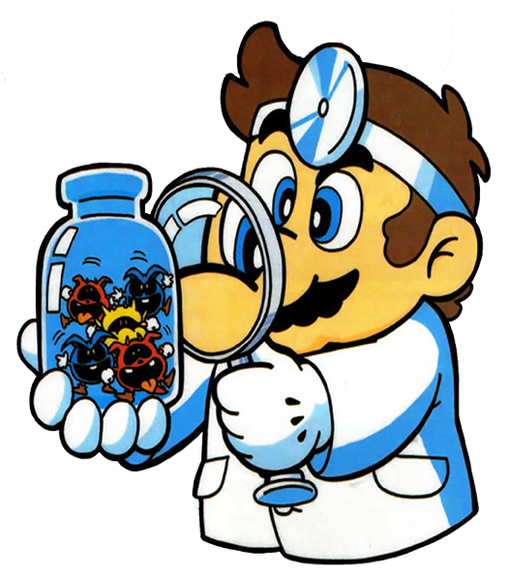
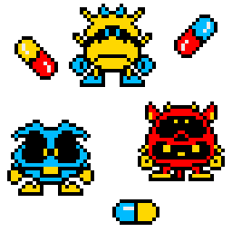





1
2
3
4
Welcome to my clinic!
5
8
7
6

Slide 6
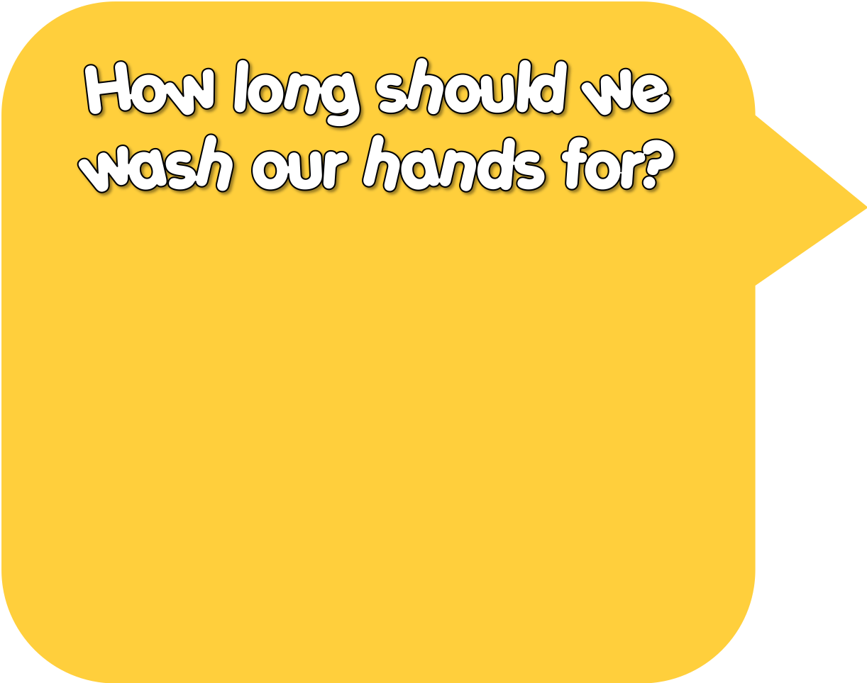

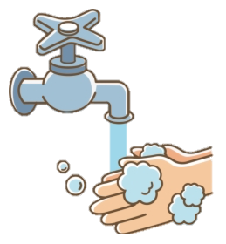



1-2 sec
3-10 sec
20-30 sec

Slide 7
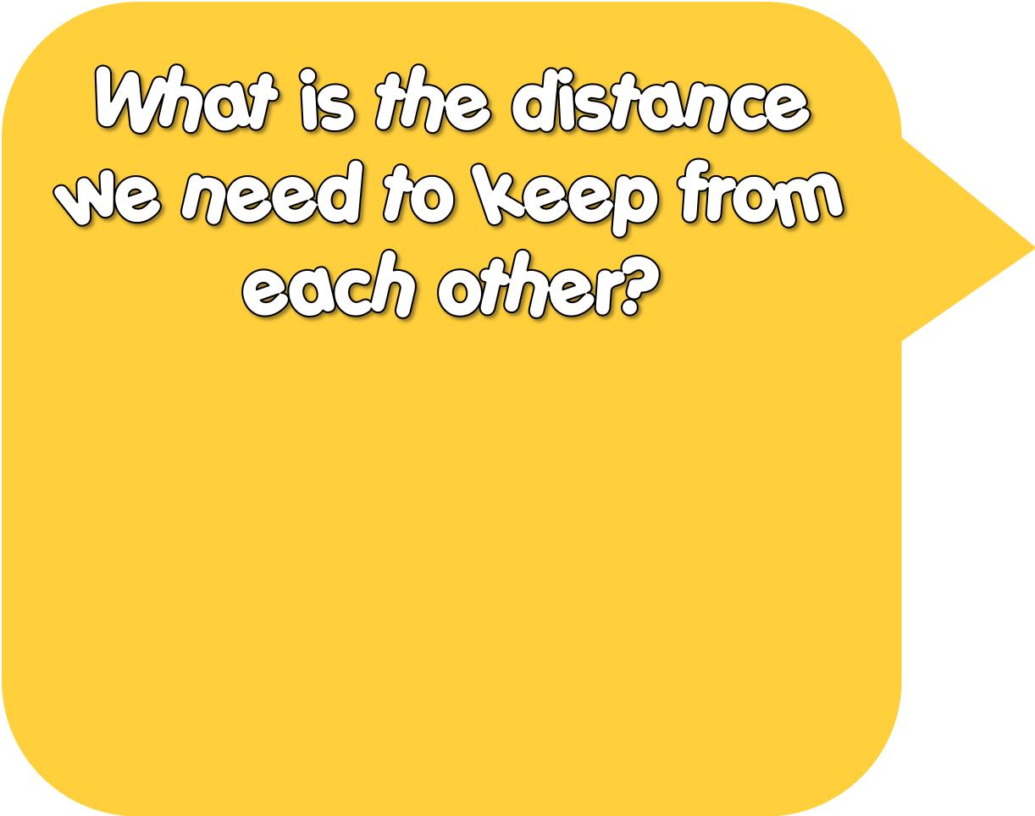
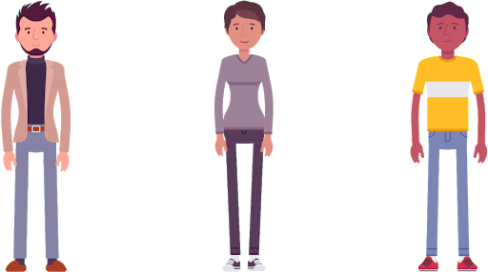
2 m
3 m
100 m

Slide 8
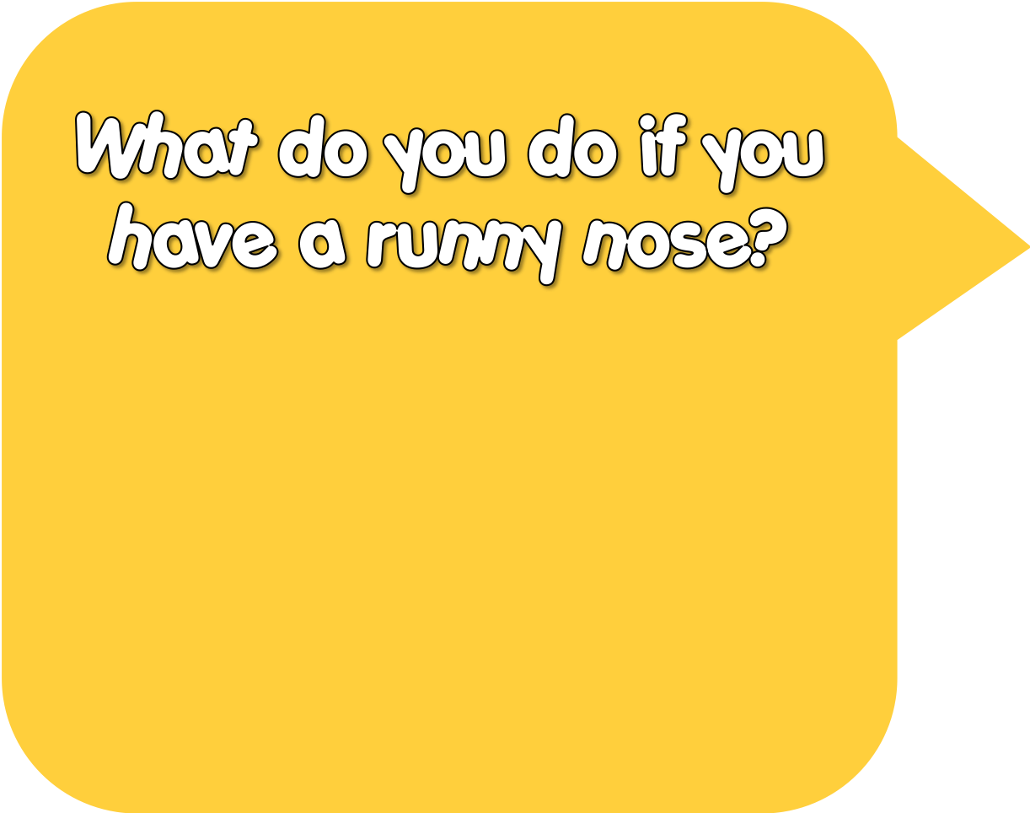

Lick it
Use a tissue
Nothing

Slide 9
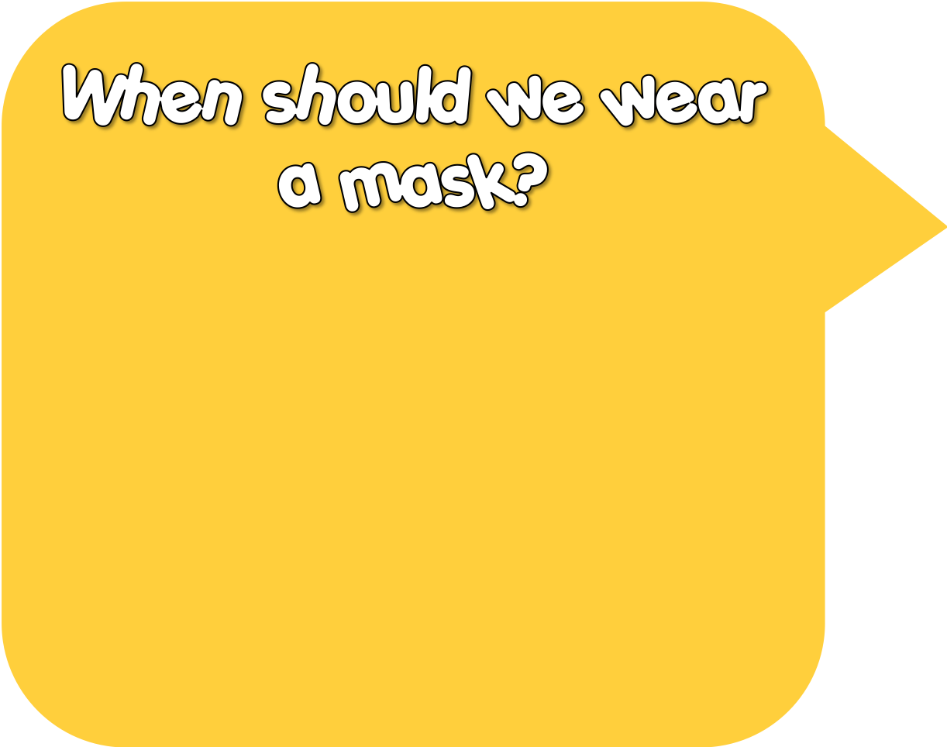
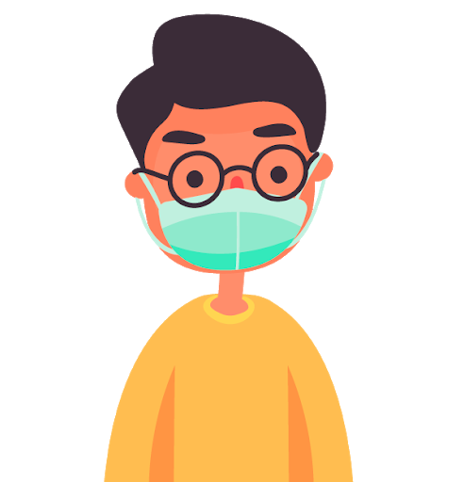
Outside
Eating
Swimming

Slide 10

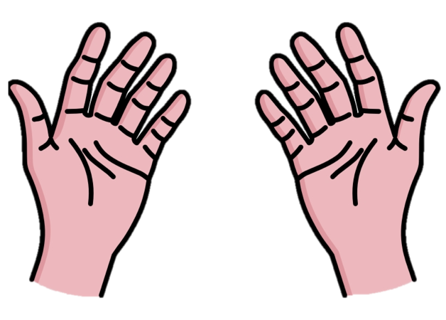
Soap
Coffee
Butter

Slide 11

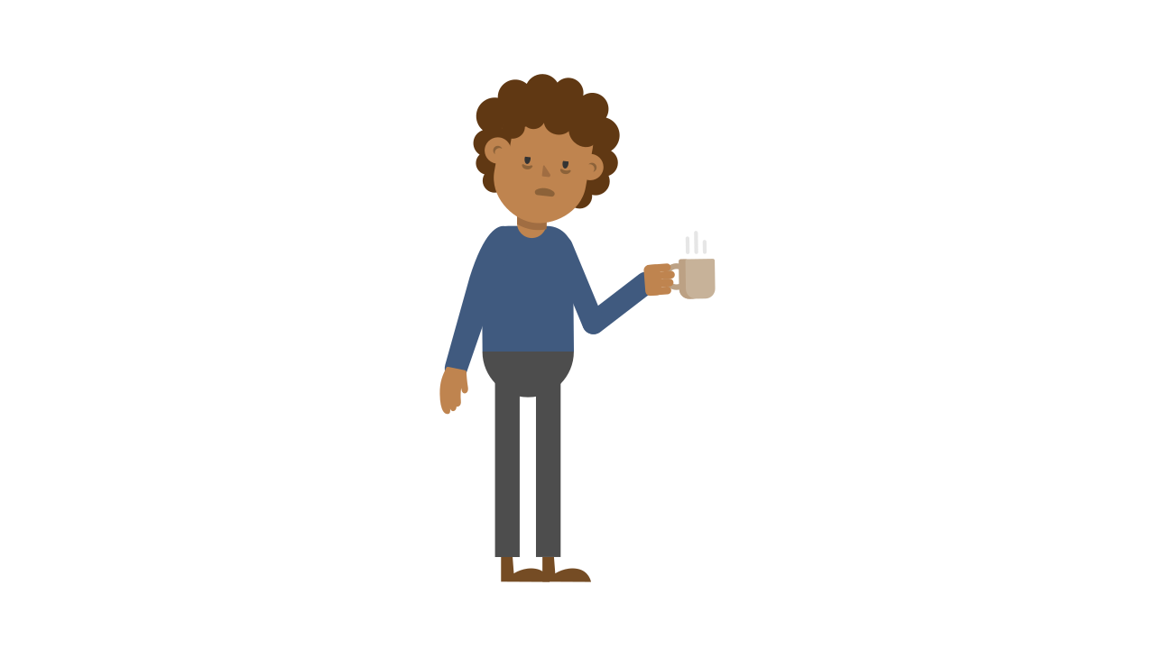
Yes
No
Maybe

Slide 12

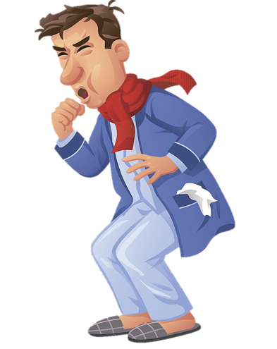
Eyes
Nose
Mouth

Slide 13


Cover your eyes
Use the toilet
Use your elbow

Slide 14

It’s time to learn …

Slide 15

New words
see a dentist, take some medicine, get some rest, stay up late, take a bath, skip breakfast

Slide 16

Presentation

