Slide 1

Unit 4: Travel
Lesson 3.3
Page 56

Slide 2
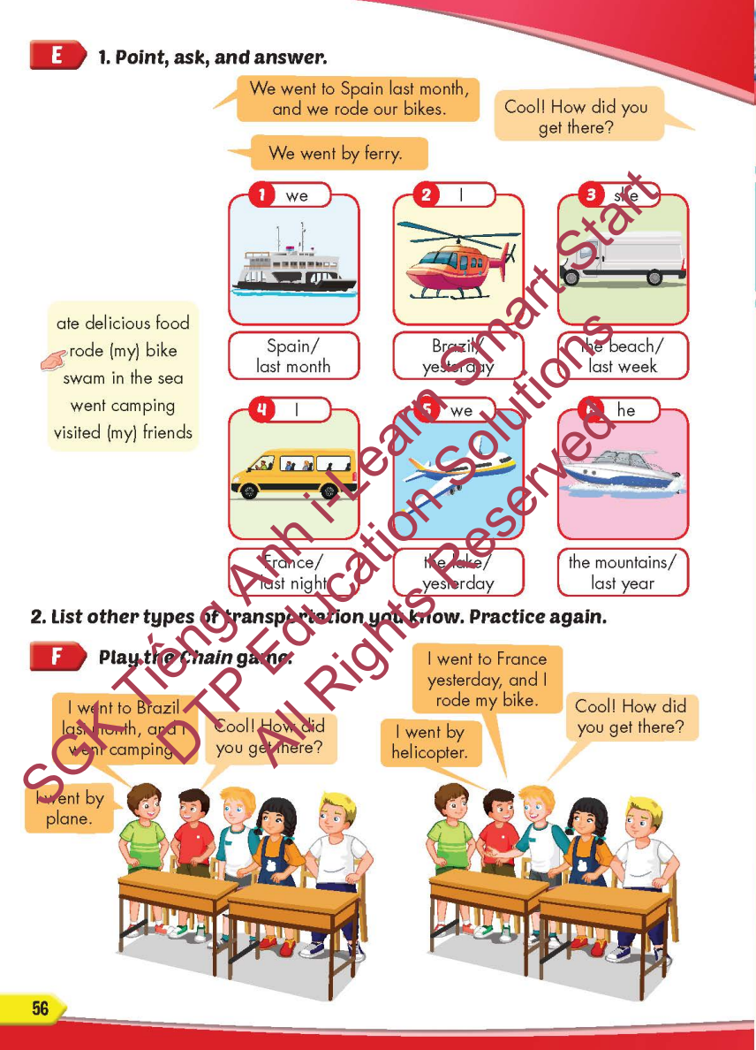
Lesson Outline
Warm-up
Practice
Speaking
Consolidation
Wrap-up

Slide 3
Objectives
By the end of this lesson, students will be able to…
Vocabulary: Pronounce and use the words related to the topic properly: ferry, minibus, plane, helicopter, van, speedboat
Structure: How did you get there? - We went by helicopter.

Slide 4

WARM-UP

Slide 5



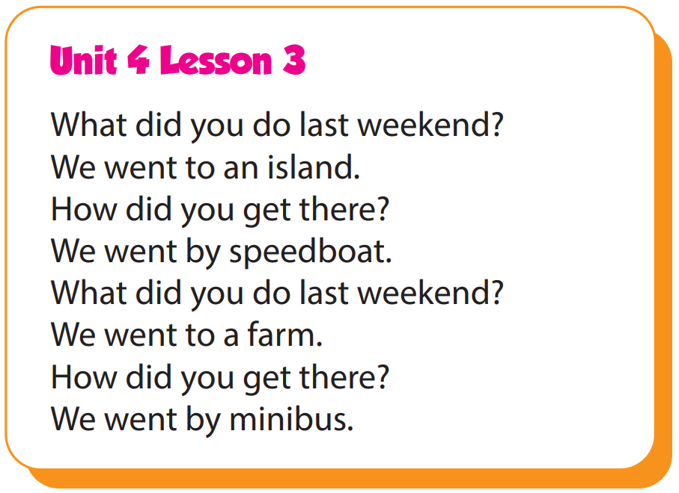

Slide 6

It’s time to learn …

Slide 7

Practice

Slide 8

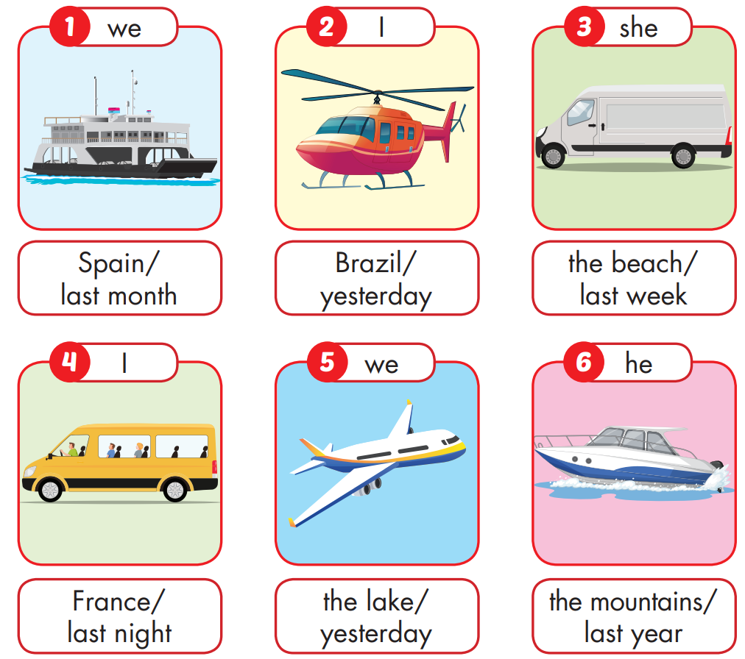
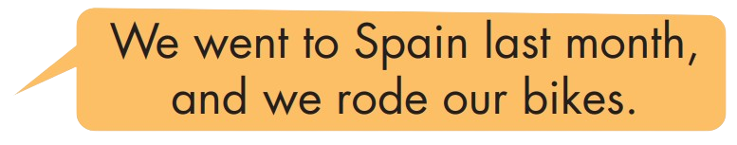
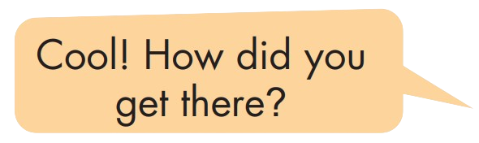

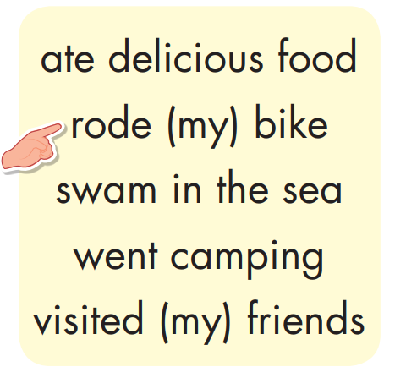

Slide 9
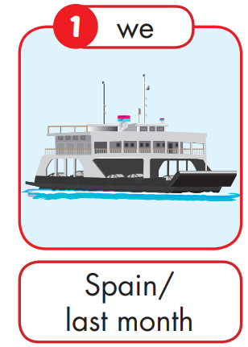

We went to Spain last month,
and we rode our bikes.
We went by ferry.
Cool! How did you get there?

Slide 10
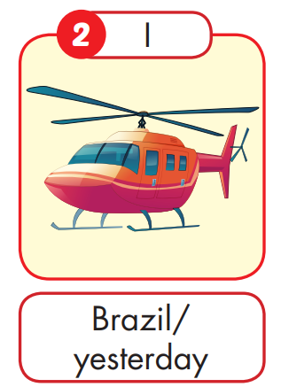
I went to Brazil yesterday,
and I vistited my friends.
I went by helicopter.
Cool! How did you get there?

Slide 11
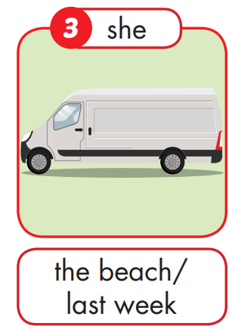
She went to the beach last week,
and she swam in the sea.
She went by van.
Cool! How did she get there?

Slide 12
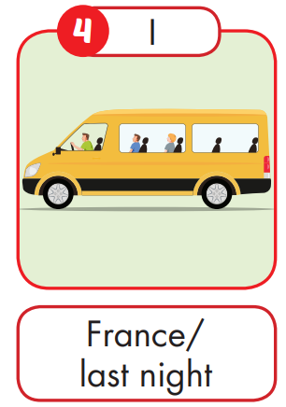
I went to France last night,
and I went camping.
I went by minibus.
Cool! How did you get there?

Slide 13
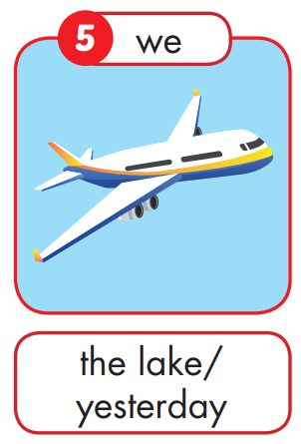
We went to the lake yesterday,
and we went camping.
We went by plane.
Cool! How did you get there?

Slide 14
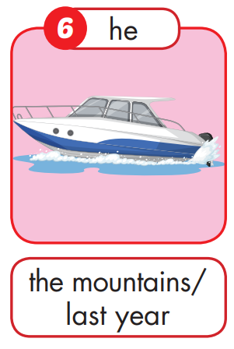
He went to the mountains,
and He ate delicious food.
He went by speedboat.
Cool! How did he get there?

