Slide 1

Unit 4: Travel
Lesson 3.2
Page 55

Slide 2
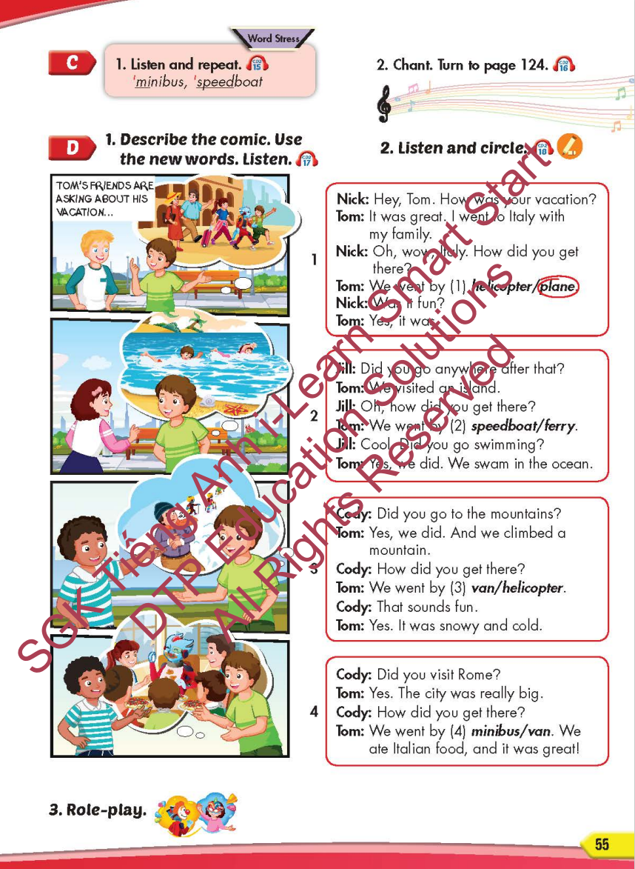
Lesson Outline
Warm-up
Listening
Consolidation
Wrap-up

Slide 3
Objectives
By the end of this lesson, students will be able to…
Word stress: 'minibus, 'speedboat
Structure: How did you get there? - We went by helicopter.

Slide 4

WARM-UP

Slide 5
CHECK-UP

Slide 6

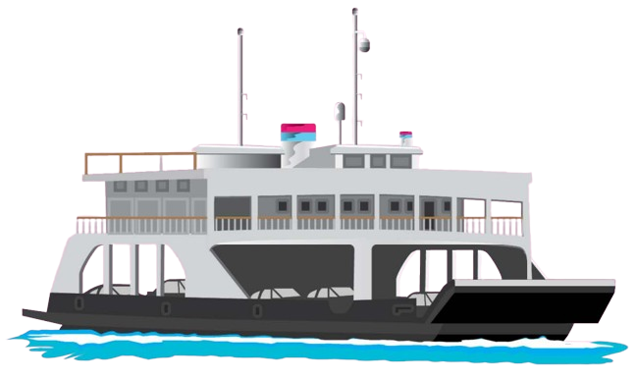
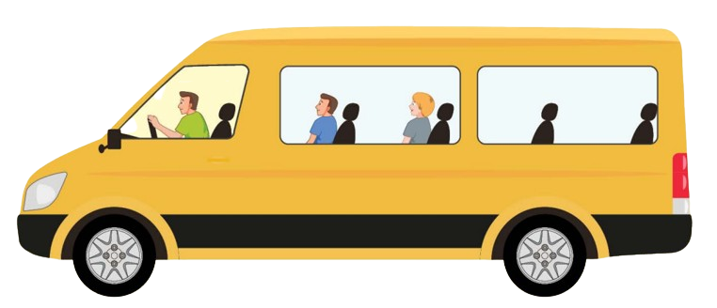




Listen and choose
A
B

Slide 7
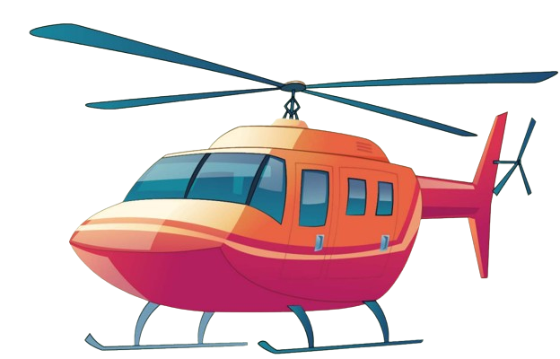
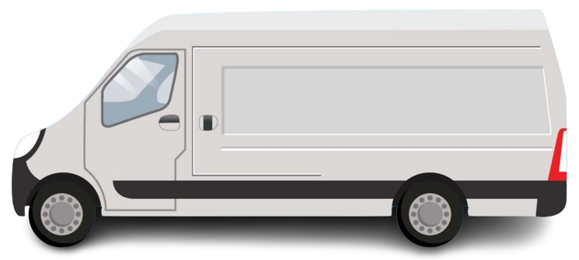
Listen and choose
A
B

Slide 8
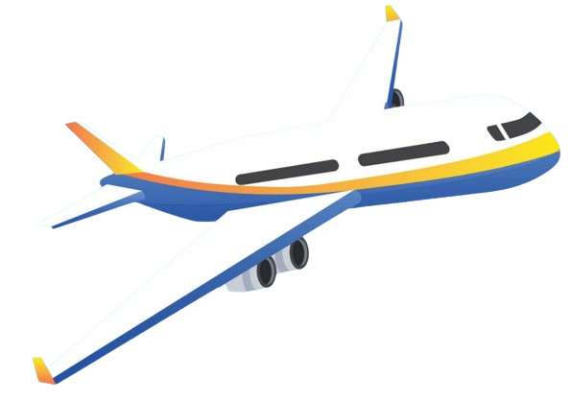
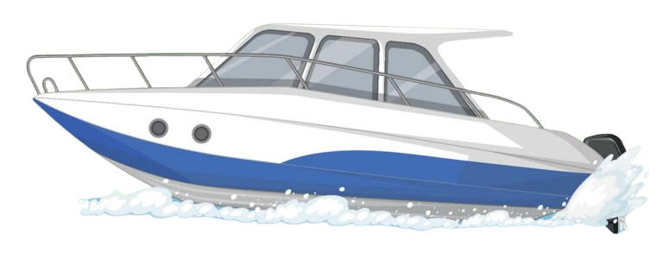
Listen and choose
A
B

Slide 9
Listen and choose
A
B

Slide 10
Listen and choose
A
B

Slide 11
Listen and choose
A
B

Slide 12

It’s time to learn …

Slide 13

Word stress
'minibus, 'speedboat

Slide 14

Listening

Slide 15
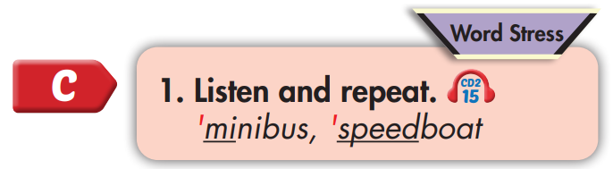
'minibus
'speedboat

Slide 16
Practice

Slide 17



Slide 18
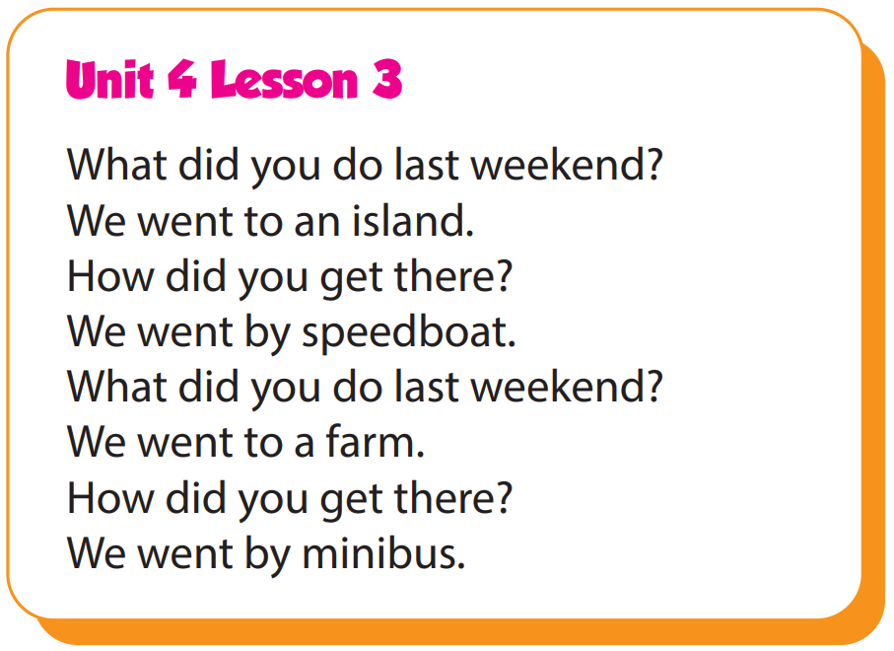

Slide 19
Structure
How did you get there?
- We went by helicopter.

Slide 20

Speaking

Slide 21
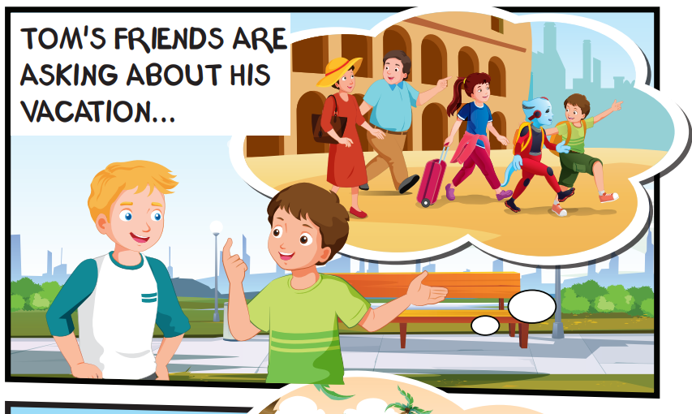
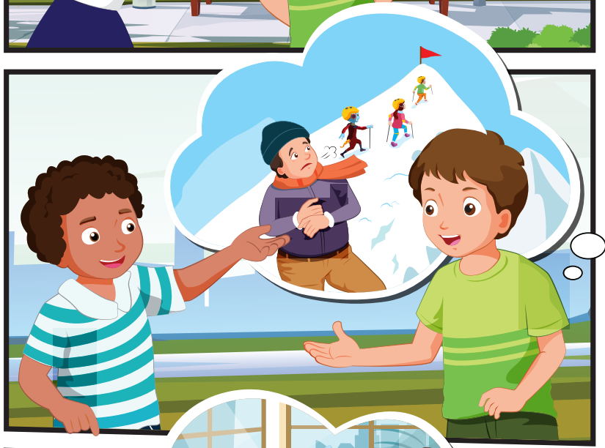
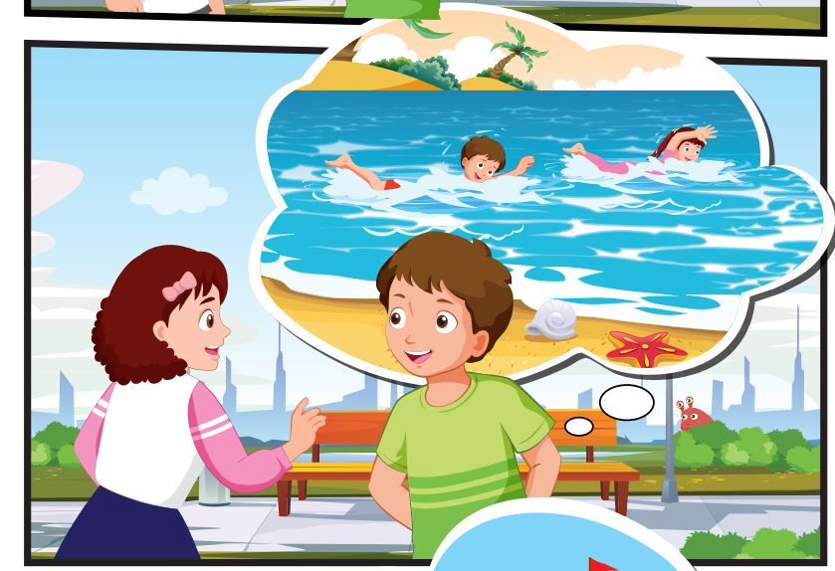
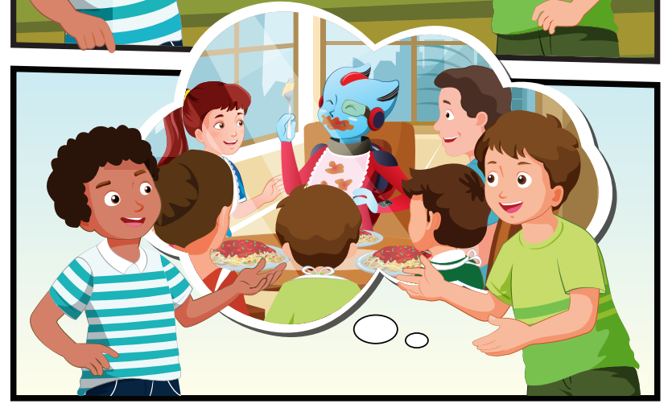
Who can you see?
Tom and his family, Alfie, Nick, Jill, Cody

Slide 22
Where are they?
Tom, Nick, Jill, and Cody are outside

Slide 23
What are they talking about?
Tom's vacation

Slide 24

Listening

