Slide 1

Unit 4: Travel
Lesson 1.3
Page 50

Slide 2
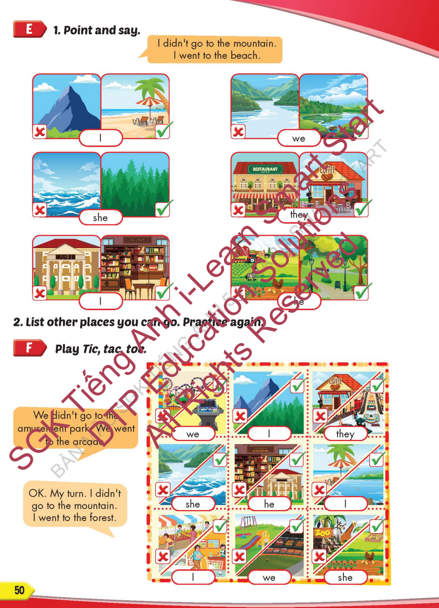
Lesson Outline
Warm-up
Practice
Speaking
Consolidation
Wrap-up

Slide 3
Objectives
By the end of this lesson, students will be able to…
Vocabulary: Pronounce and use the words related to the topic properly: mountain, lake, river, beach, ocean, forestYear (Tết), Christmas, Teachers' Day, Children's Day.
Structure: I didn't go to the river. I went to the beach.

Slide 4

WARM-UP

Slide 5

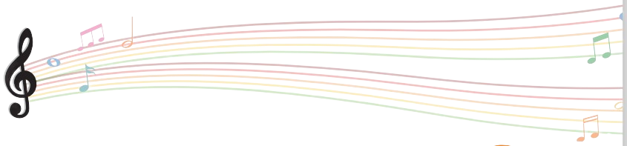

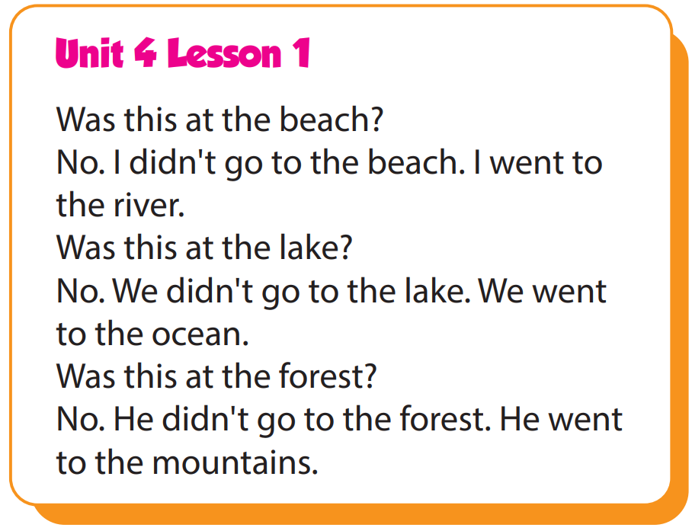

Slide 6

It’s time to learn …

Slide 7

Practice

Slide 8

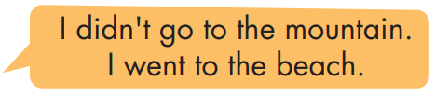
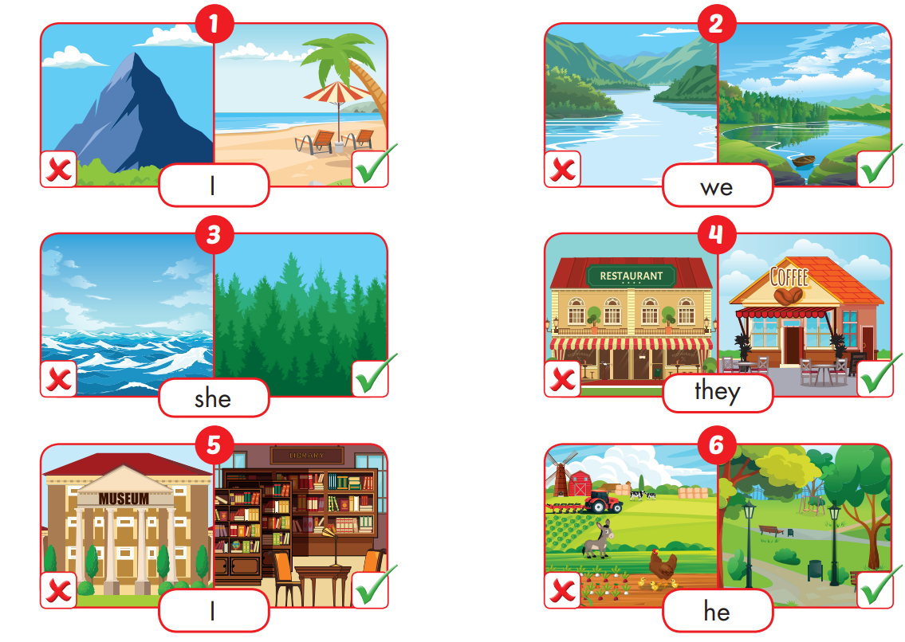

Slide 9
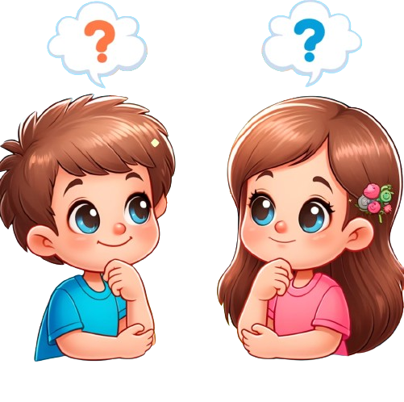
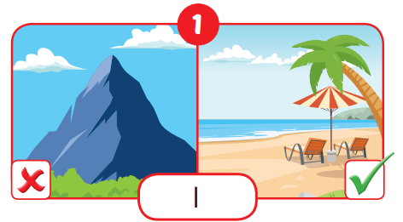
I didn't go to the moutain.
I went to the beach.

Slide 10
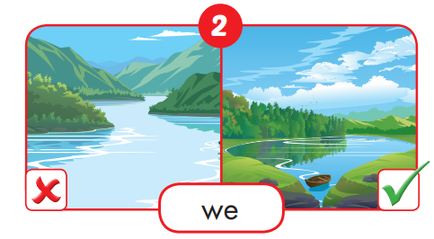
We didn't go to the river.
We went to the lake.

Slide 11
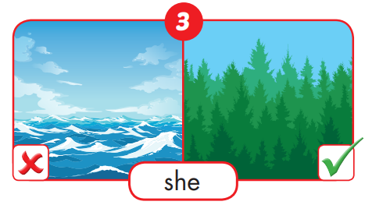
She didn't go to the ocean.
She went to the forest.

Slide 12
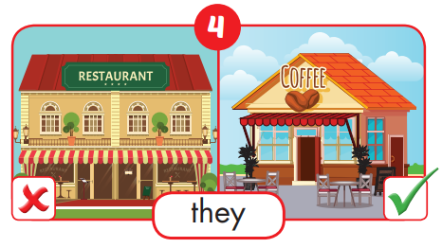
They didn't go to the restaurant.
They went to the coffee.

Slide 13
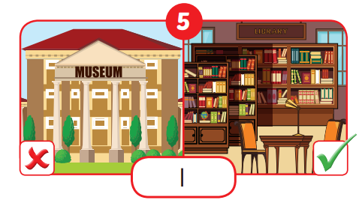
I didn't go to the museum.
I went to the library.

Slide 14
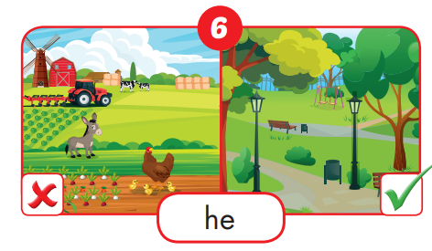
He didn't go to the farm.
He went to the park.

