Slide 1

Unit 4: Travel
Lesson 1.2
Page 49

Slide 2
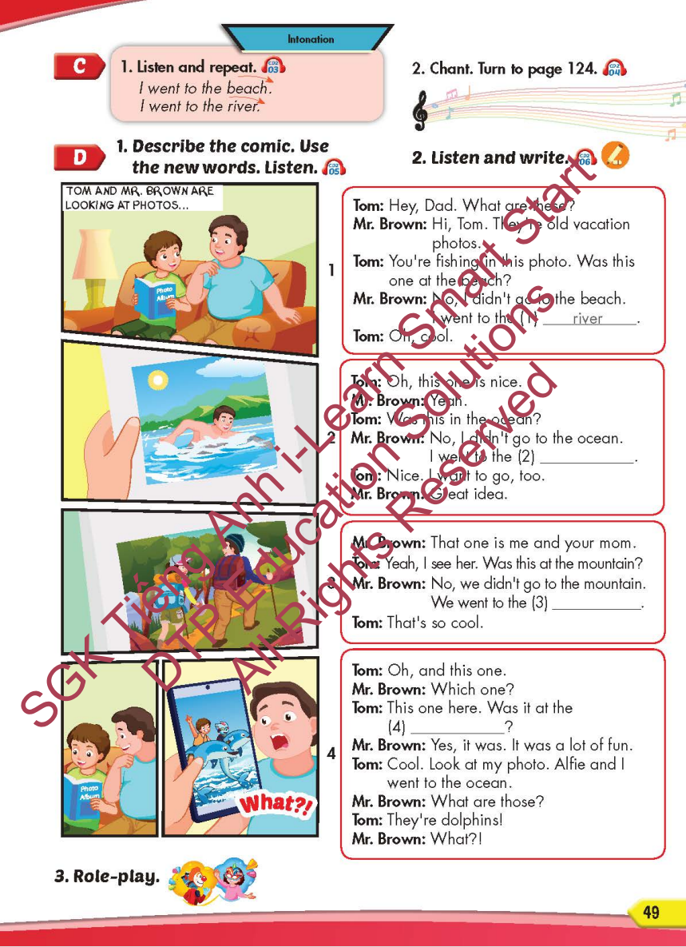
Lesson Outline
Warm-up
Listening
Consolidation
Wrap-up

Slide 3
Objectives
By the end of this lesson, students will be able to…
Itonation: Falling intonation.
Structure: I didn't go to the river. I went to the beach.

Slide 4
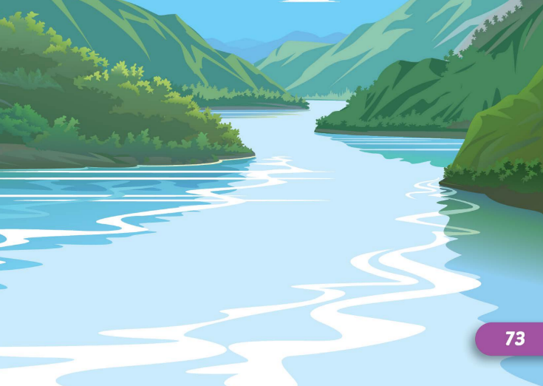

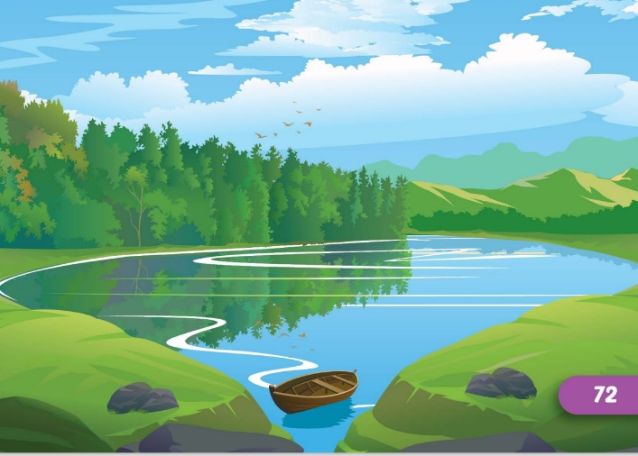
Look and say which is missing?
START
CHECK

Slide 5


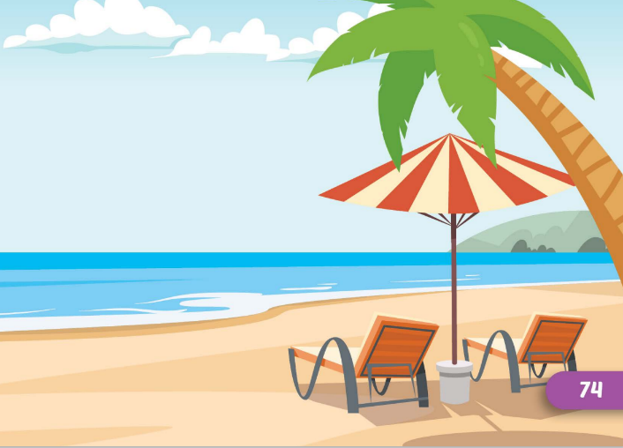
Look and say which is missing?
START
CHECK

Slide 6


Look and say which is missing?
START
CHECK

Slide 7


Look and say which is missing?
START
CHECK

Slide 8
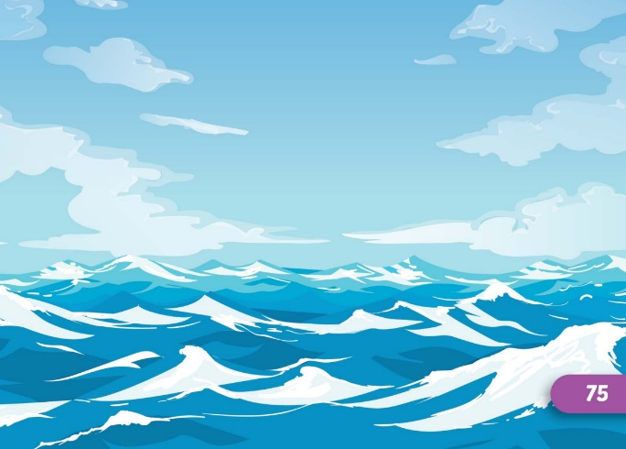


Look and say which is missing?
START
CHECK

Slide 9
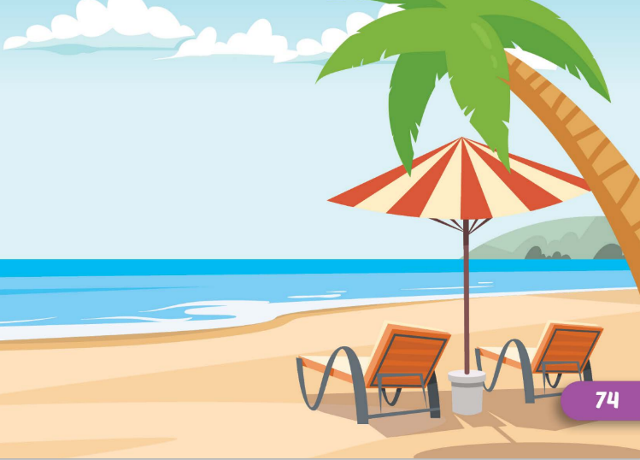


Look and say which is missing?
START
CHECK

Slide 10

Listening

Slide 11
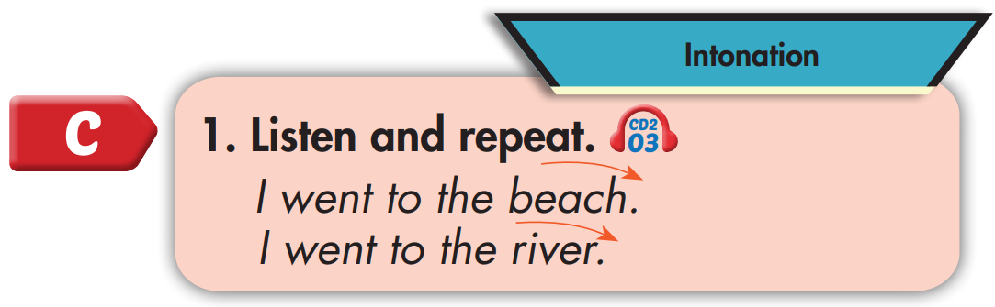

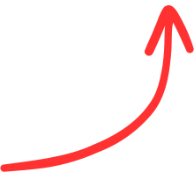
I went to the beach.
I went to the river.

Slide 12
Practice

Slide 13



Slide 14
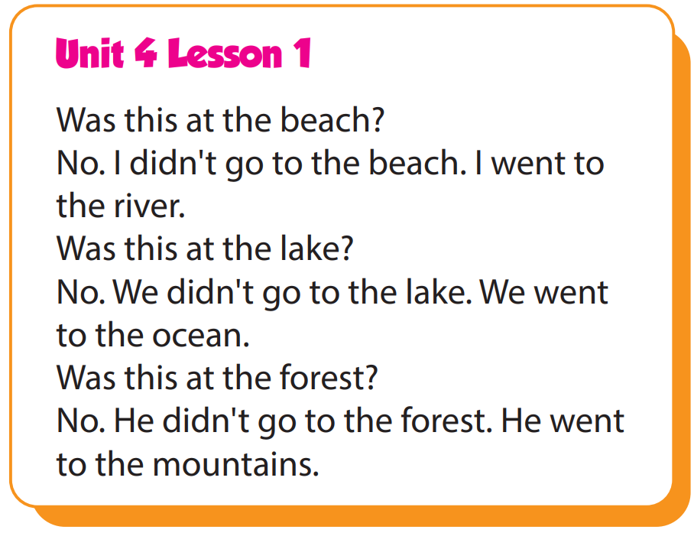

Slide 15

Structure
I didn't go to the river.
I went to the beach.

Slide 16

Speaking

Slide 17
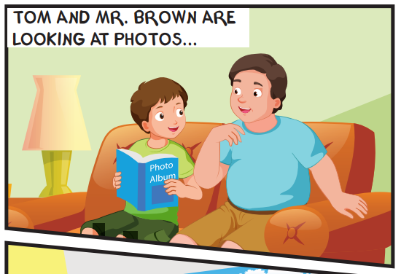
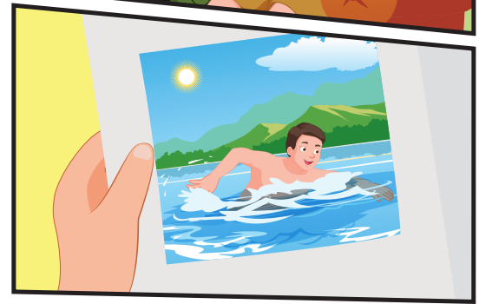
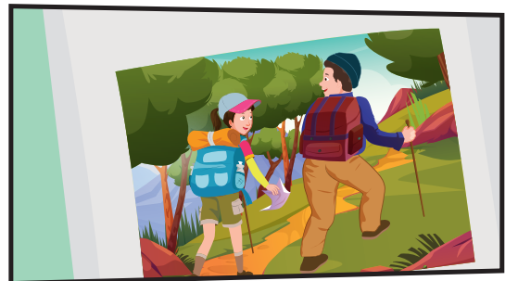
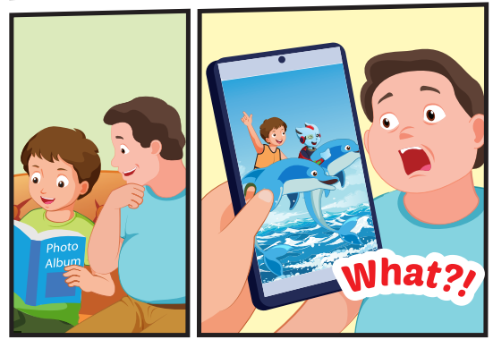
Who can you see?
Tom, Mr. Brown, Mrs. Brown, Alfie

Slide 18
Where are they?
They're at home.

Slide 19
What are the people doing in the photos?
Mr. Brown: swimming, Mr. Brown and Mrs. Brown: walking, Alfie and Tom: playing with dolphins

Slide 20

Listening

