Slide 1

Unit 3: MY FRIENDS AND I
Lesson 2.1
Page 37

Slide 2
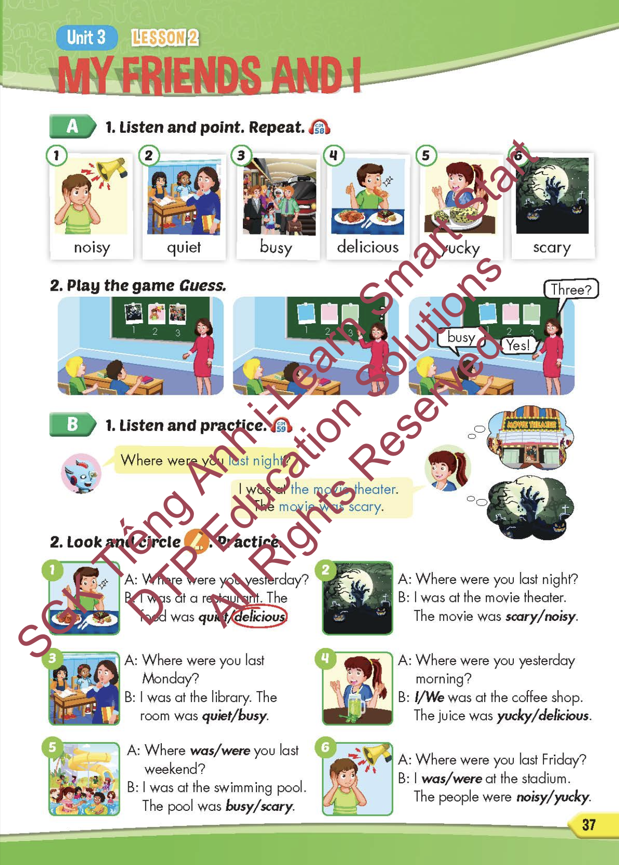
Lesson Outline
Warm-up
Vocabulary
Structure
Consolidation
Wrap-up

Slide 3
Objectives
By the end of this lesson, students will be able to identify different adjectives.
Vocabulary: noisy, quiet, busy, delicious, yucky, scary.
Structure: Where were you last night?
I was at the movie theater. The movie was scary.

Slide 4

WARM-UP

Slide 5

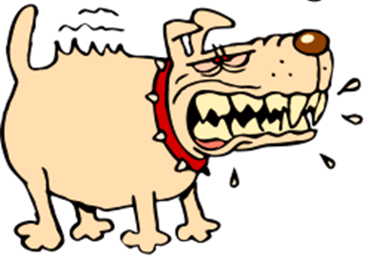


GAME
GAME ON ADVERBS OF MANNER
Notes:
5

Slide 6
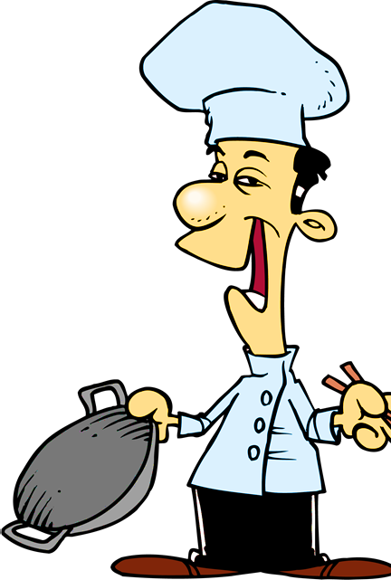

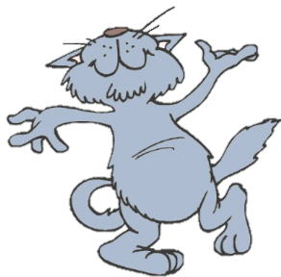
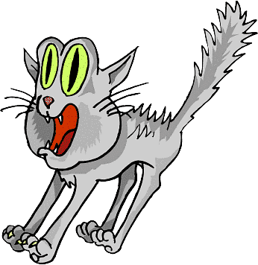

He sings ____________.
You got it!
badly
bad
NEXT
Notes:
6

Slide 7
She sings beautifully.
She is a _________ singer.
You got it!
good
well
NEXT

Slide 8
This bus is too _______ .
We will be late for school.
You got it!
slow
slowly
NEXT
Notes:
8

Slide 9
They are fantastic dancers.
They dance really _______.
You got it!
well
badly
NEXT
Notes:
9

Slide 10
I don’t want to go with him.
He drives too ________ .
You got it!
fast
slow
END

Slide 11

It’s time to learn …

Slide 12

New words
noisy,
quiet,
busy,
delicious,
yucky,
scary.

Slide 13

Presentation

Slide 14


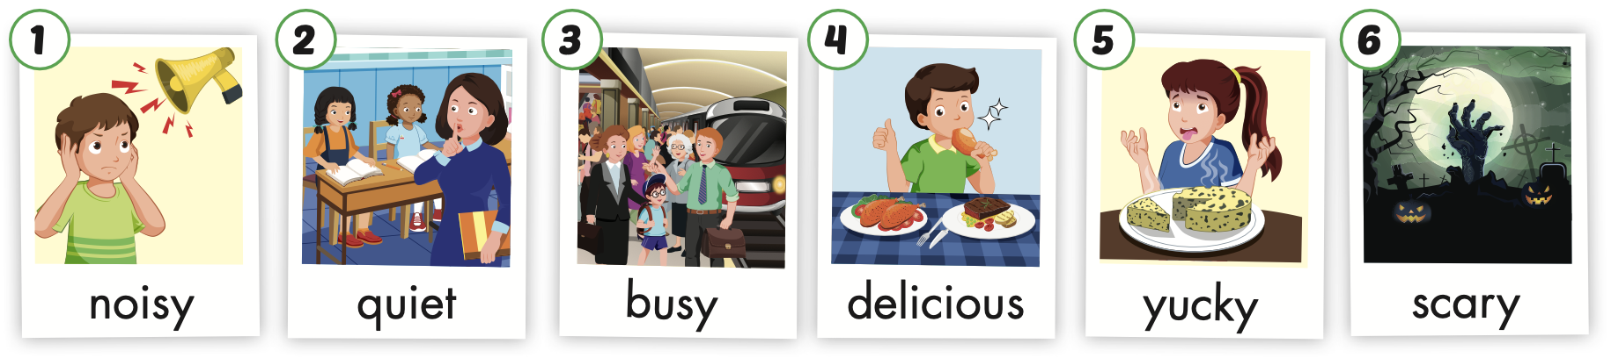
/ˈnɔɪzi/
ồn ào
/ˈkwaɪət/
yên lặng
/ˈbɪzi/
bận rộn,
nhộn nhịp
/dɪˈlɪʃəs/
ngon
/ˈjʌki/
dở, kinh tởm
/ˈskeri/
đáng sợ
Notes:
Click vào hình A. 1. Listen and point. Repeat để cho cả audio full chạy

Slide 15
noisy
/ˈnɔɪzi/
ồn ào

Slide 16
quiet
/ˈkwaɪət/
yên lặng

Slide 17
busy
/ˈbɪzi/
bận rộn,
nhộn nhịp

Slide 18
delicious
/dɪˈlɪʃəs/
ngon

Slide 19
yucky
/ˈjʌki/
dở, kinh tởm

Slide 20
scary
/ˈskeri/
đáng sợ

Slide 21
Practice

Slide 22
Listen and choose. Then say.

