Slide 1

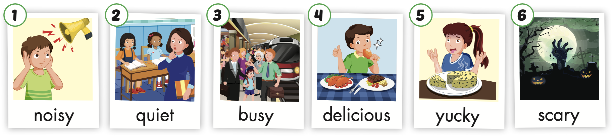


A
B
C
Listen and choose. Then say.

Slide 2
A
B
C
Listen and choose. Then say.

Slide 3
A
B
C
Listen and choose. Then say.

Slide 4
C
A
B
Listen and choose. Then say.

Slide 5

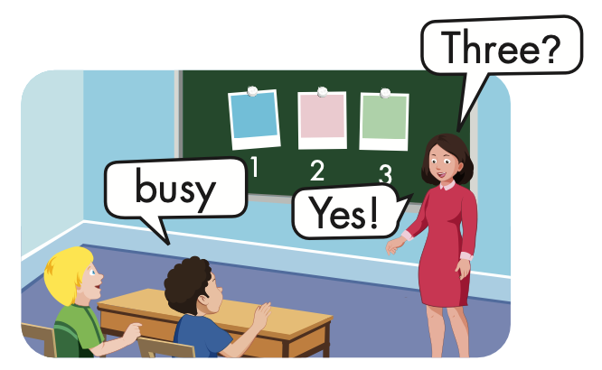
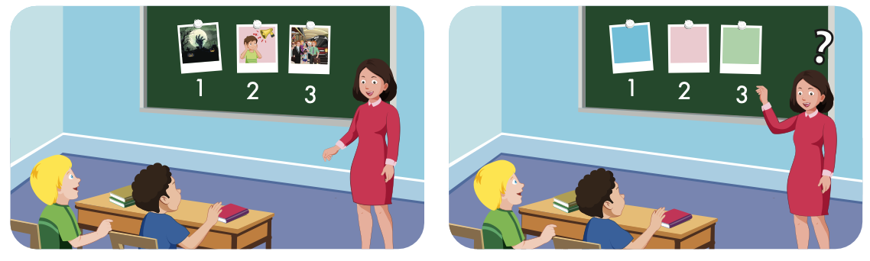

Slide 6

Structure
Where were you last night?
- I was at the movie theater.
The movie was scary.

Slide 7

Presentation

Slide 8
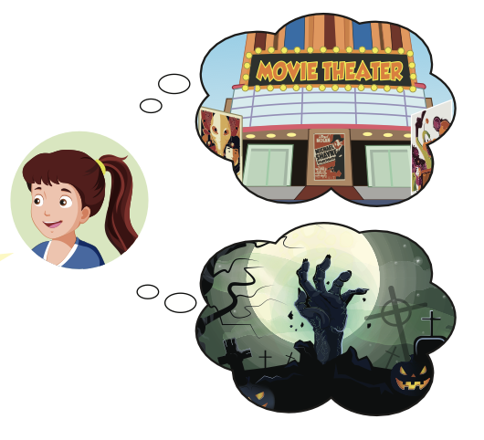
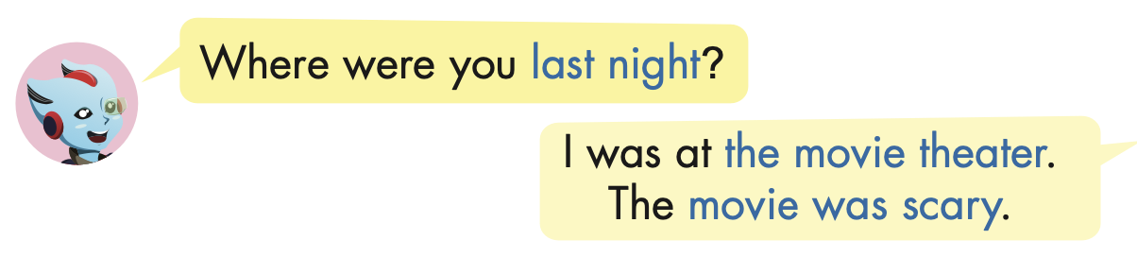
Structure

Slide 9

Practice

Slide 10


Slide 11

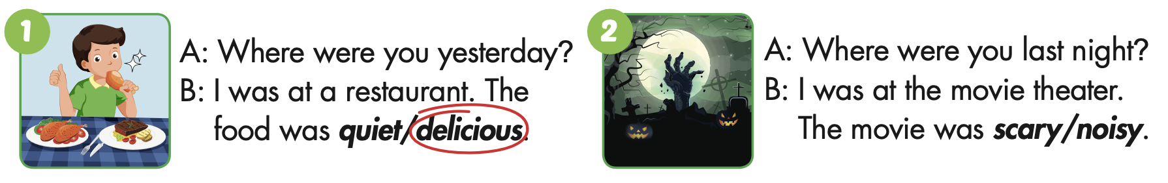

Slide 13
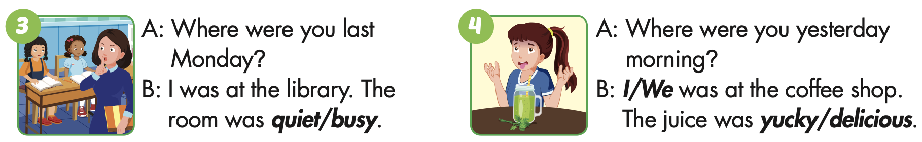

Slide 15
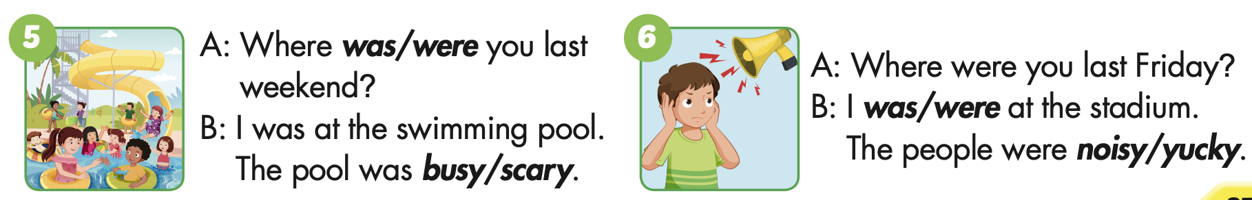

Slide 17

Production

Slide 18

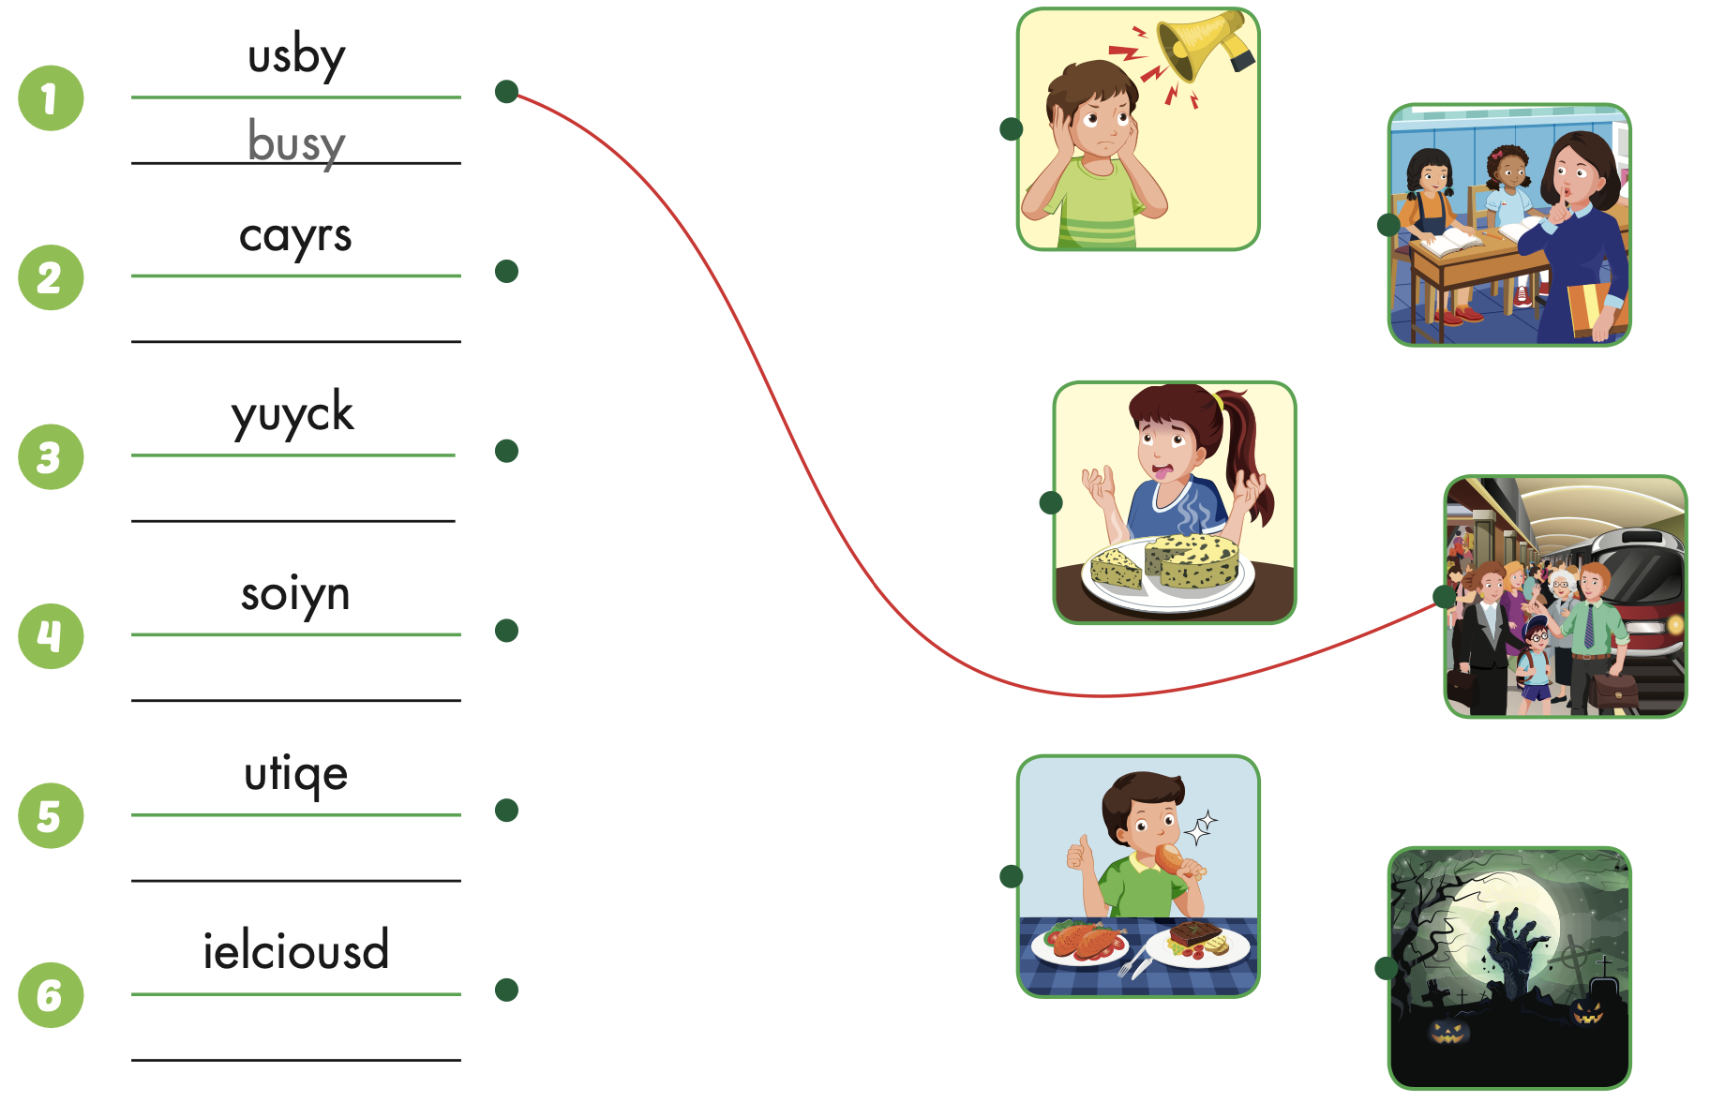
Extra Practice
WB, page 24
scary
yucky
noisy
quiet
delicious

Slide 19

CONSOLIDATION

Slide 20

WRAP-UP

Slide 21
Today’s lesson
Vocabularies
noisy,
quiet,
busy,
delicious,
yucky,
scary.
Structures/ Sentence patterns
Where were you last night?
I was at the movie theater. The movie was scary.

Slide 22
Homework
Practice the vocabularies and structure, and make sentences using them.
Do the exercises in Tiếng Anh 5 i-Learn Smart Start WB (page 24).
Do the exercises in Tiếng Anh 5 i-Learn Smart Start Notebook.
Prepare the next lesson (page 38 SB).
Play the consolidation games in Tiếng Anh 5 i-Learn Smart Start DHA App on www.eduhome.com.vn

Slide 23

Enjoy your day!

Slide 24

Lesson 3
Stay positive and have a nice day!

