Slide 1
Objectives
By the end of this lesson, students will be able to…
Vocabulary: Pronounce and use the words related to the topic properly: stop, do not enter, turn left, turn right, no parking.
Structure: What does that sign mean? - It means "Stop".
Phonics: Identify the /g/ sound and practice the conversations.

Slide 2

WARM UP

Slide 3
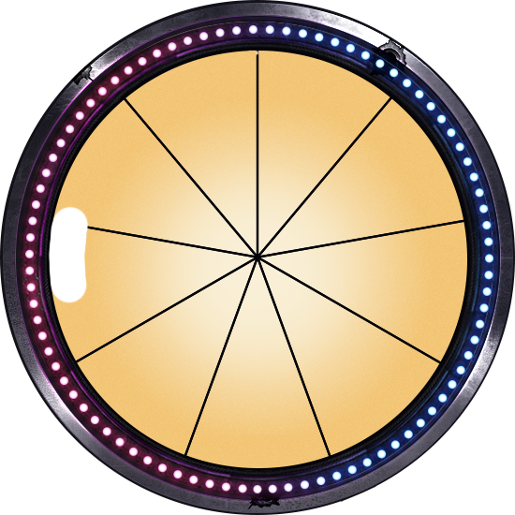

9
1
8
2
SPIN STOP
SPIN STOP
7
3
6
4
5

Slide 4




Question
stop
do not enter
turn right

Slide 5

Question
turn right
do not enter
turn left

Slide 6

Question
do not enter
stop
no parking

Slide 7

Question
turn left
do not enter
turn right

Slide 8

Question
turn left
stop
turn right

Slide 9

It’s time to learn …

Slide 10

Speaking

Slide 11


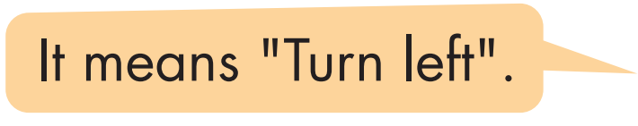
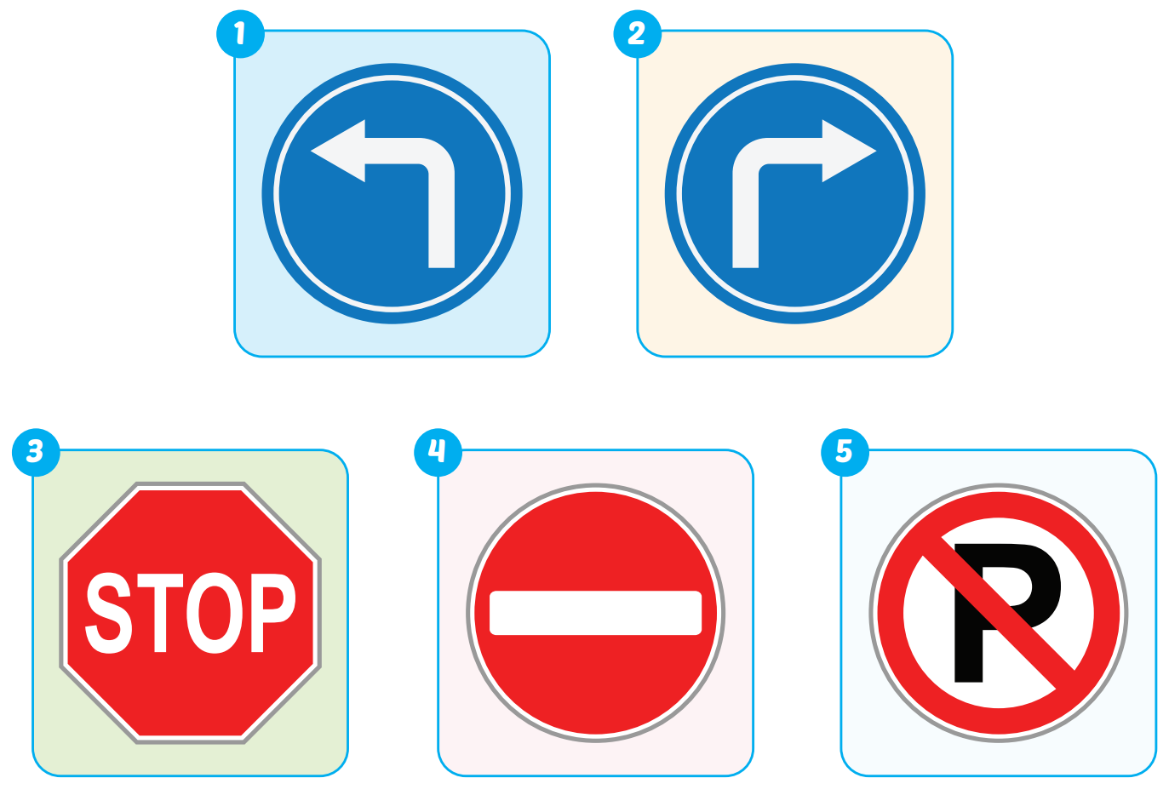

Slide 12



What does that
sign mean?
It's means "Turn left".

Slide 13
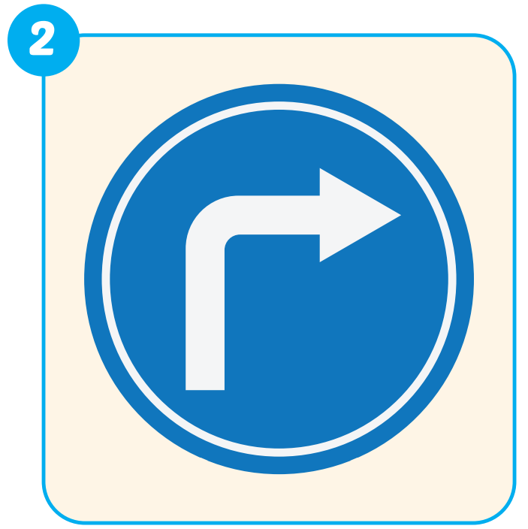
What does that
sign mean?
It's means "Turn right".

Slide 14

What does that
sign mean?
It's means "stop".

Slide 15

What does that
sign mean?
It's means "do not enter".

Slide 16
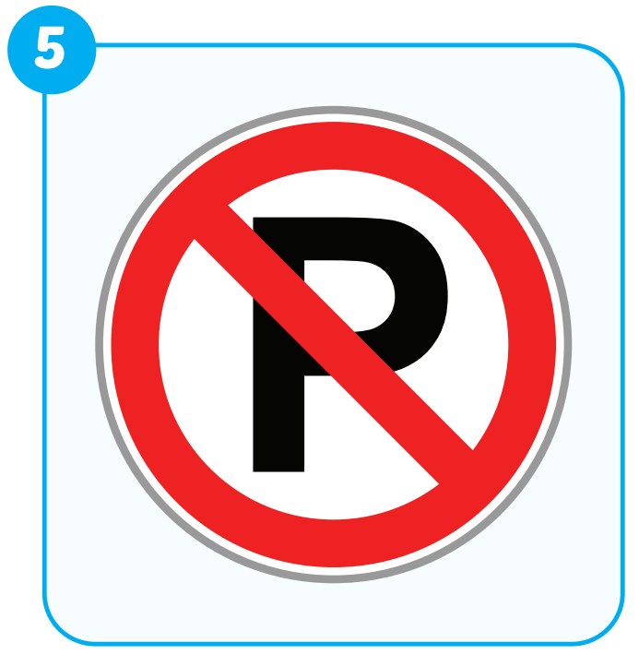
What does that
sign mean?
It's means "no parking".

Slide 17

Production

Slide 18

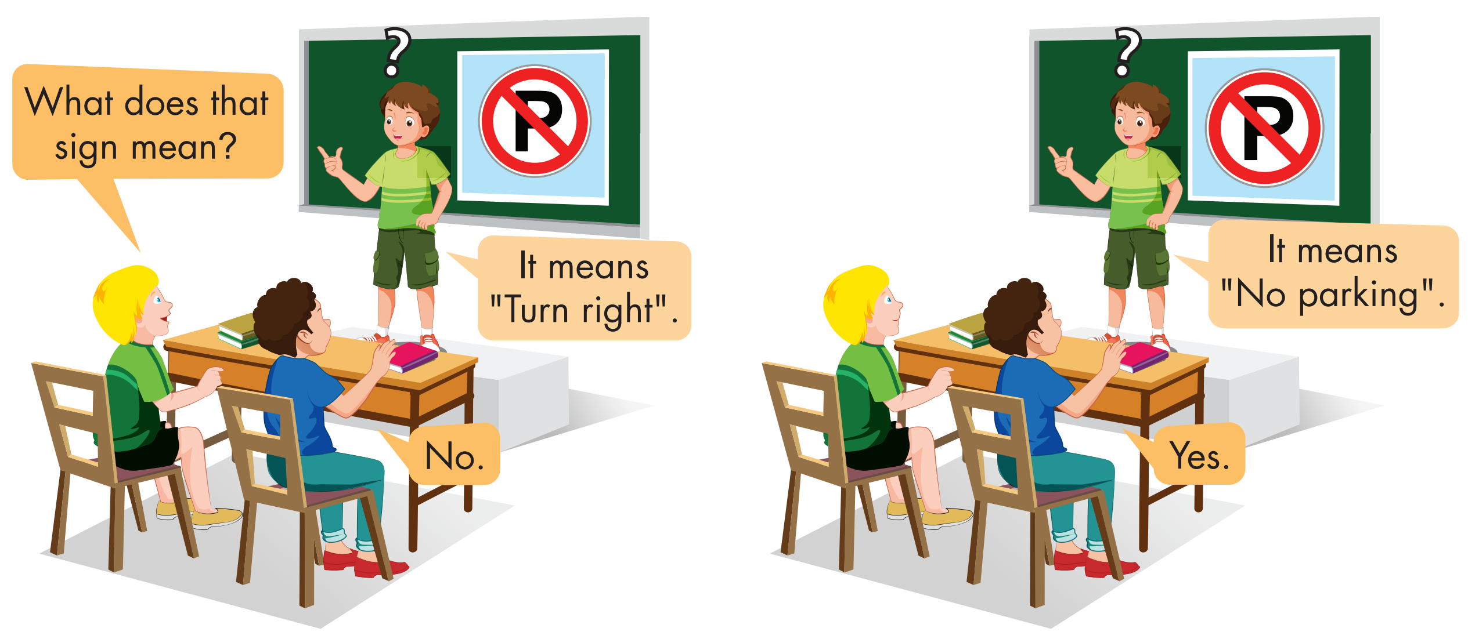

Slide 19
GUESSING PICTURE
GAME

Slide 20
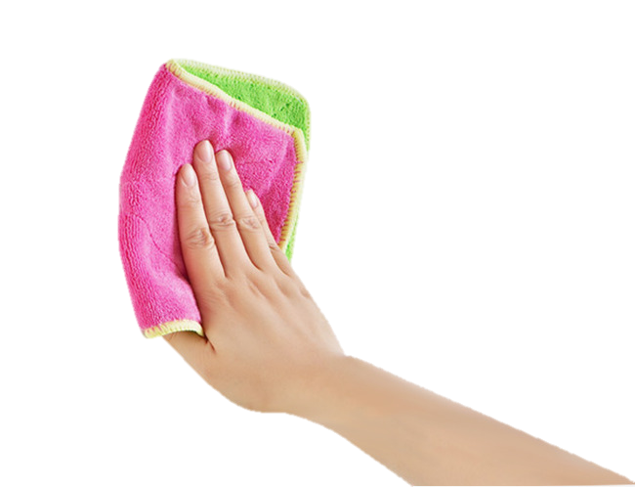




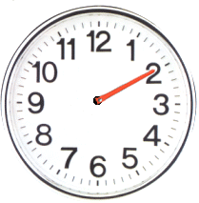
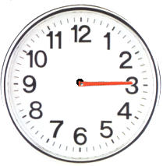
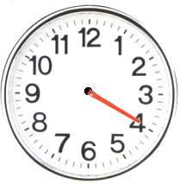
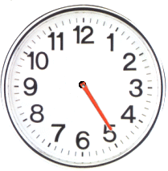
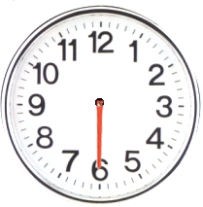
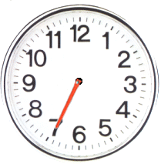

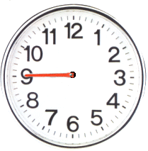
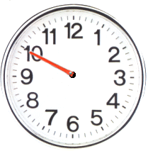
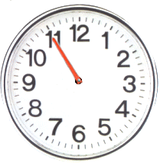
  What does that sign mean?
  It means stop.
CHECK

Slide 21
  What does that sign mean?
  It means do not enter.
CHECK

Slide 22
  What does that sign mean?
  It means turn left.
CHECK

Slide 23
  What does that sign mean?
  It means turn right.
CHECK

Slide 24
  What does that sign mean?
  It means no parking.
CHECK

Slide 25

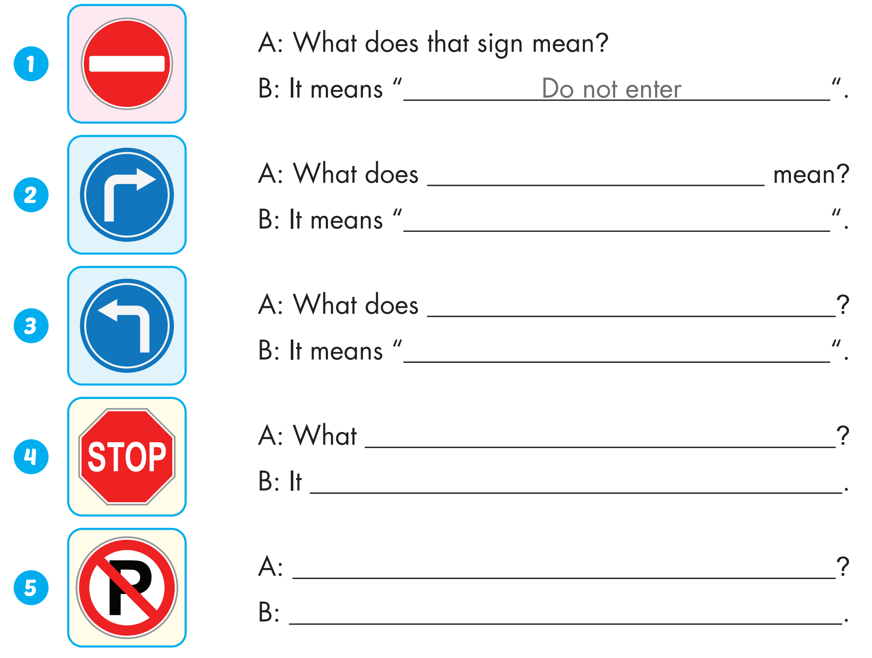
Extra Practice
WB, P. 43
that sign
turn right
that sign mean
turn left
does that sign mean
means "stop"
What does that sign mean
It means "no parking"

Slide 26

WRAP-UP

Slide 27
Today’s lesson
Vocabularies
stop, do not enter, turn left, turn right, no parking.
Structures/ Sentence patterns
What does that sign mean?
It means "Stop".
Phonics
Identify the /g/ sound and practice the conversations.

Slide 28
Homework
Practice the vocabularies and structure; and make sentences using them.
Do the exercises in Tiếng Anh 4 i-Learn Smart Start WB (page 43).
Prepare the next lesson (page 67 SB).
Play the consolidation games in Tiếng Anh 4 i-Learn Smart Start DHA App on www.eduhome.com.vn

Slide 29

Enjoy your day!

