Slide 1

AI MO SECONDARY SCHOOL
WARMLY WELCOME TO OUR CLASS
TUESDAY, MARCH 28, 2023

Slide 2
HIDDEN PICTURES
ENERGY SOURCES - ENERGY SOURCES
ENERGY SOURCES - ENERGY SOURCES

Slide 3

WHAT ARE THEY DOING?
She is teaching Maths.
SHOW ALL

Slide 4
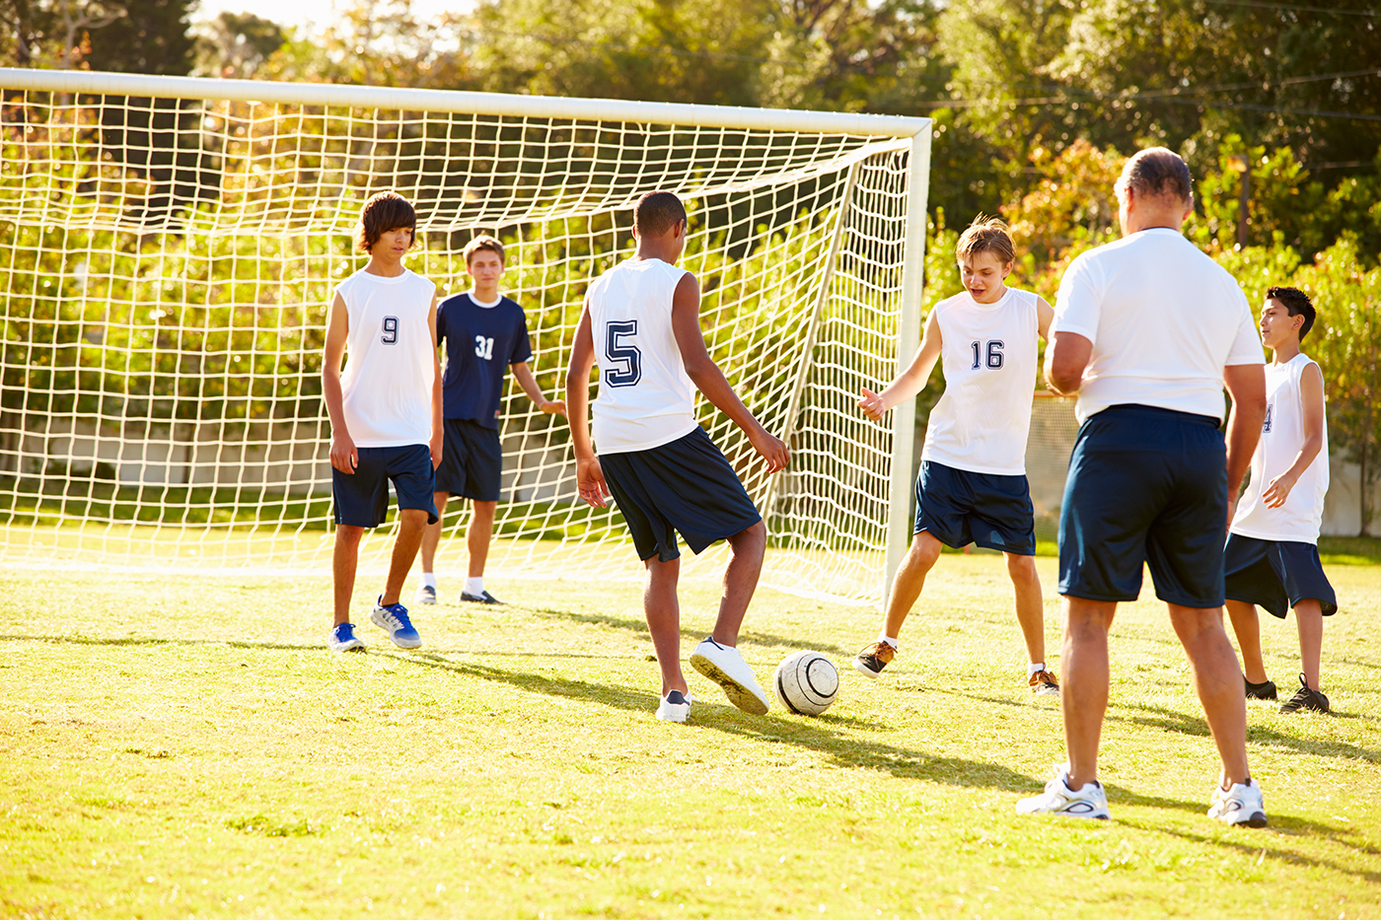
WHAT ARE THEY DOING?
They are playing football.
SHOW ALL

Slide 5
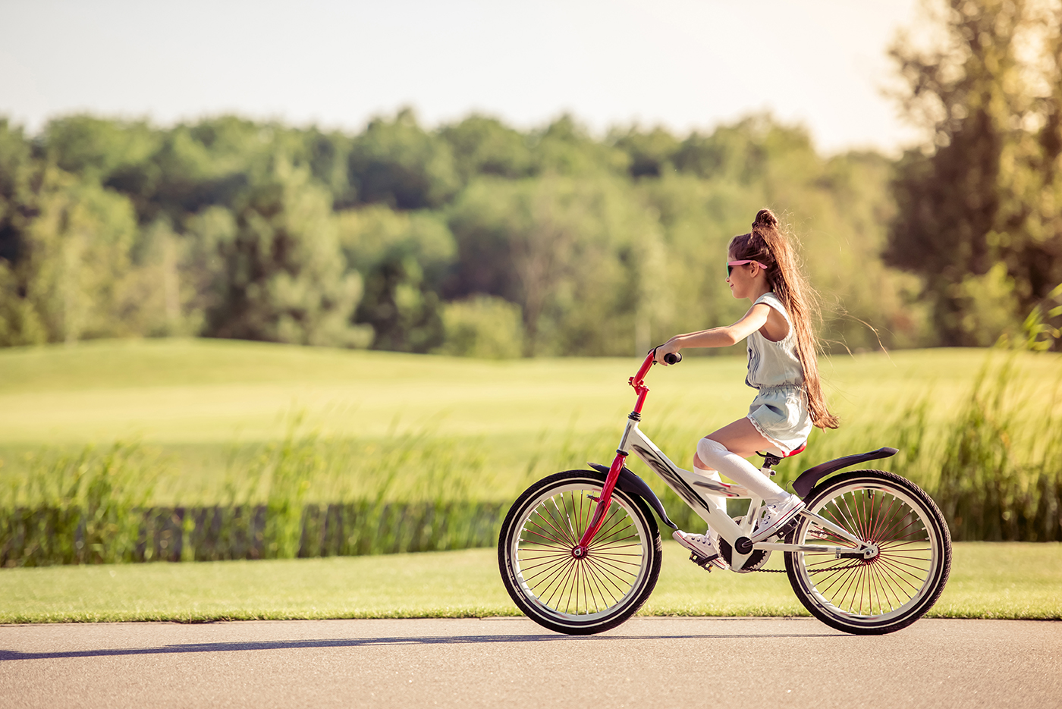
WHAT ARE THEY DOING?
She is riding her bike.
SHOW ALL

Slide 6
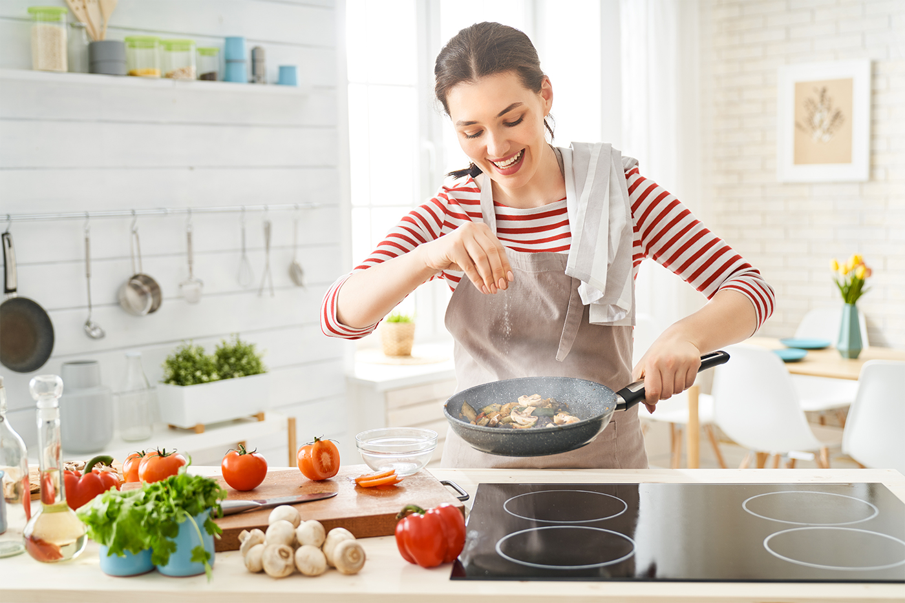
WHAT ARE THEY DOING?
She is cooking.
SHOW ALL

Slide 7
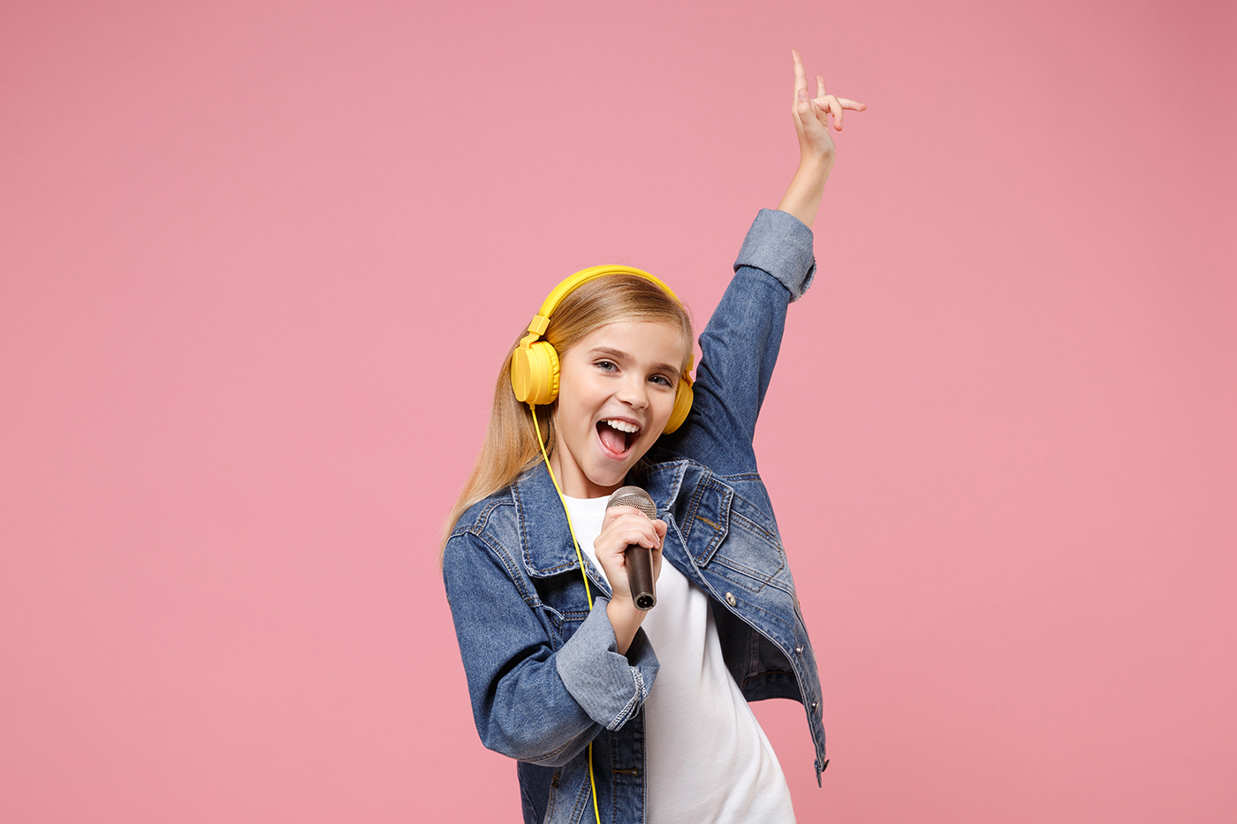
WHAT ARE THEY DOING?
She is singing.
SHOW ALL

Slide 8
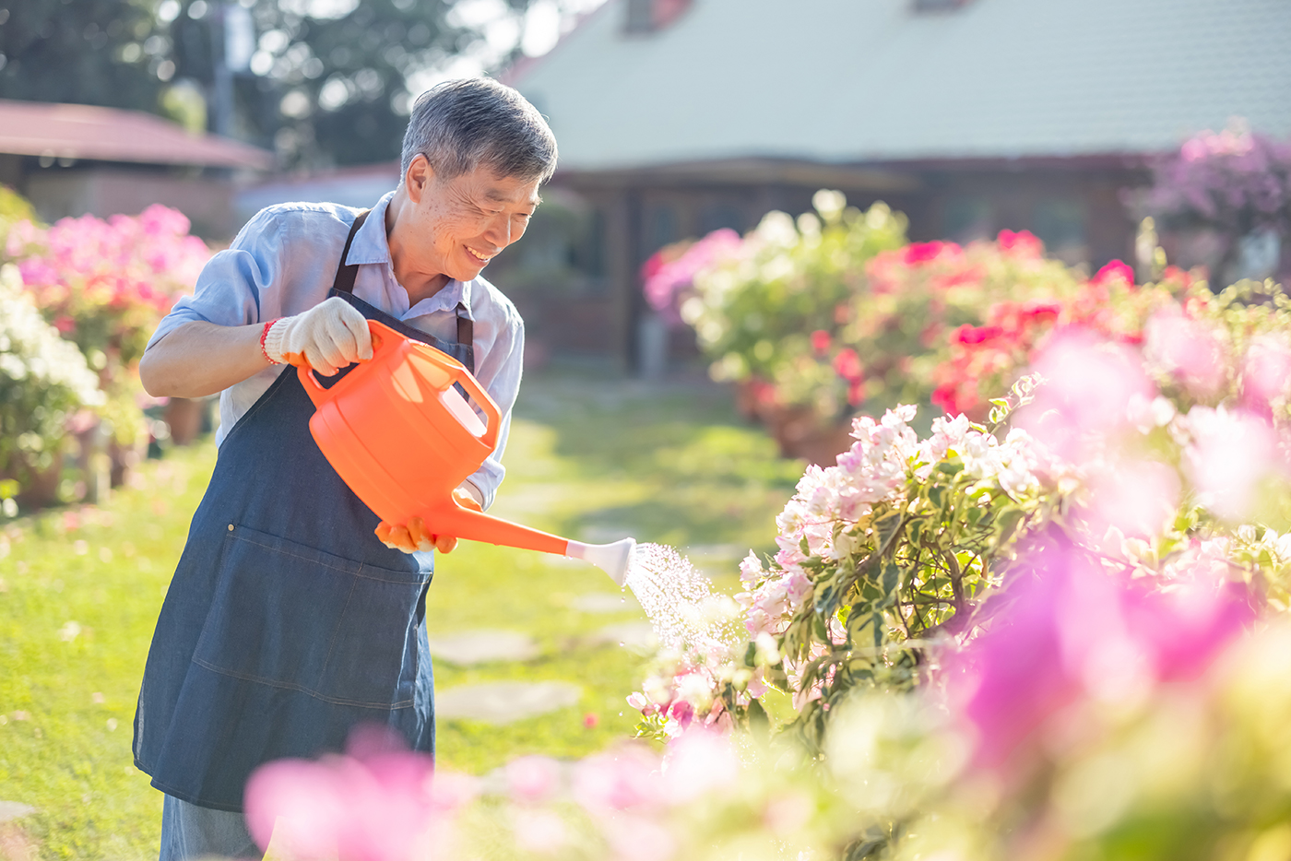
WHAT ARE THEY DOING?
He is watering flowers.
SHOW ALL

Slide 9

What are they doing?
1. She is teaching Maths.
2. They are playing football.
3. She is riding her bike.
4. She is cooking.
5. She is singing.
6. He is watering flowers.
The actions happen in the ______.
past
present
future
What tense is it?
A. Present simple
B. Present continuous
C. Present perfect

Slide 10
PRESENT CONTINUOUS
ENERGY SOURCES - ENERGY SOURCES - ENERGY SOURCES - ENERGY SOURCES - ENERGY SOURCES
Thì hiện tại tiếp diễn
ENERGY SOURCES - ENERGY SOURCES - ENERGY SOURCES - ENERGY SOURCES - ENERGY SOURCES

Slide 11
UNIT 10: ENERGY SOURCES
Lesson 3: A closer look 2
ENERGY SOURCES – ENERGY SOURCES - ENERGY SOURCES - ENERGY SOURCES - ENERGY SOURCES

Slide 12

OBJECTIVES
Use the Present continuous properly

Slide 13
PRESENT CONTINUOUS
now
They are playing football now.
to express an action happening now or at the moment of speaking.
Scientists are looking for a new energy source to replace coal.
to express an action happening around now.
Hints: Right now, now, at the moment, today, nowadays, this week/ month, etc.

Slide 14
FORM
POSITIVE
They are playing football now.
Scientists are looking for a new energy source to replace coal.
S + be + V-ING
I + am + V-ing.
He/ She/ It + is + V-ing.
You/ We/ They + are + V-ing.

Slide 15
FORM
NEGATIVE
She is riding her bike. She is not walking now.
She isn’t walking now. (is not = isn’t)
S + be not + V-ING
I + am not V-ing.
He/ She/ It + is not V-ing.
You/ We/ They + are not V-ing.

Slide 16
FORM
QUESTION
Are you looking for a new apartment?
Be + S + V-ING?
Am I + V-ing?
- Yes, I am./ No, I am not.
Is he/ she/ it + V-ing?
- Yes, he/ she/ it is. / No, he/ she/ it isn’t.
Are you/ we/ they + V-ing?
- Yes, you/ we/ they are./ No, you/ we/ they aren’t.

Slide 17
Ex 2. (P.107) Complete the sentences, using the present continuous form of the verbs in brackets.
150,000,00$
1. Mai (talk) ____________ about types of energy sources now.
2. We (use) ____________ solar energy to replace energy from coal today.
3. Keep quiet! The students of Class 7C (take) ____________ a test.
4. Scientists (develop) ____________ new energy sources to protect the environment.
5. We (reduce) ____________ the use of nuclear energy nowadays.
is talking
now
Gross revenues in 2021
are using
today
Keep quiet!
are taking
are developing
action happening around now.
are reducing
nowadays

Slide 18
GAME
TYPHOON
Ex 3. (P108)
ENERGY SOURCES - ENERGY SOURCES - ENERGY SOURCES - ENERGY SOURCES - ENERGY SOURCES

Slide 19



Pick a box
Answer the question
Get a random prize below
The winning team has the most points
10
Blow friend’s point
Swap point
Your point

Slide 20

PICK A BOX
10
1
20
2
3
20
4
5
10
6

Slide 21
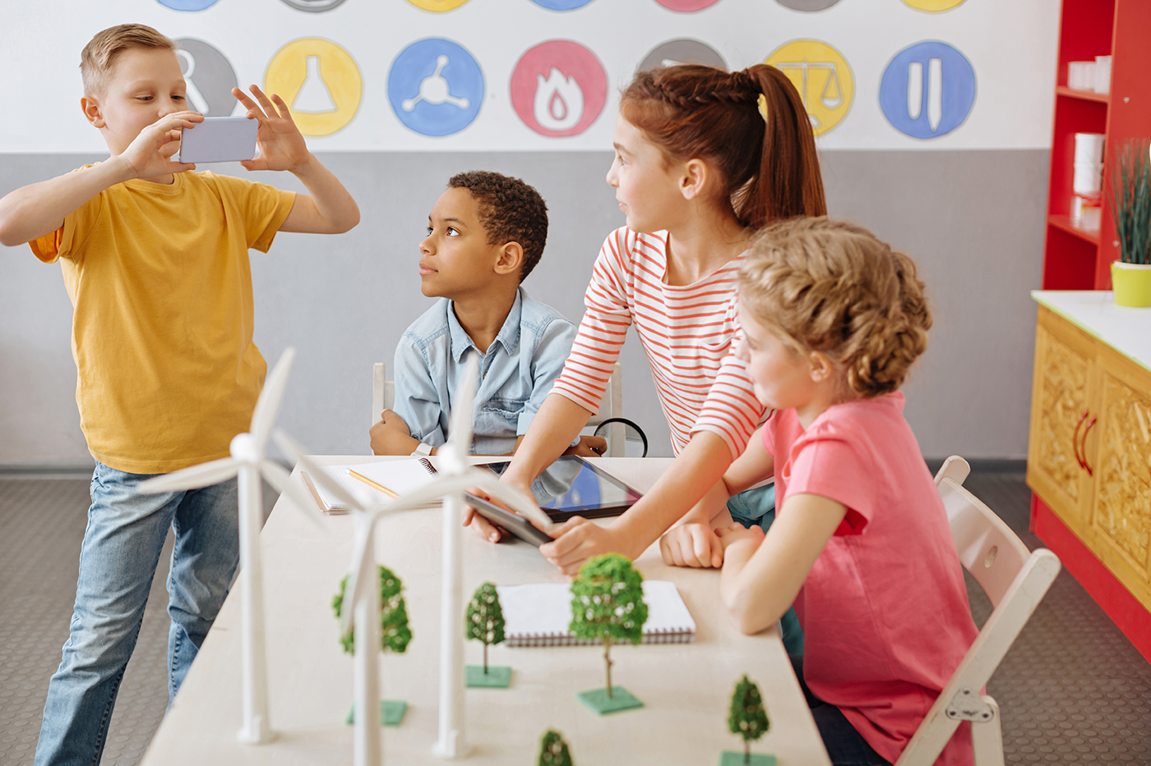

Circle the correct answer
1. Are you still work / working on your project now?
Are
now

Slide 22

Circle the correct answer
2. Nam and Lan do / are doing quite well at school this year.
this year

Slide 23

Circle the correct answer
3. Does she study / Is she studying at the school library at the moment?
at the moment

Slide 24

Circle the correct answer
4. Hoa studies / is studying for her exam, so she can’t come to the party right now.
right now

Slide 25

Circle the correct answer
three times a week
5. We have / are having English three times a week.

Slide 26


Slide 27
Ex 4. (P.108) Write sentences about what the people are doing or not doing, using the suggestions.
1. The students / do the project / now.
2. Mrs Lien / teach us about solar energy / at the moment.
3. They / learn about energy / this month.
4. She / not swim / in the swimming pool / right now.
5. Nowadays, people in Iceland / not use energy from coal.
The students are doing the project now.
Mrs Lien is teaching us about solar energy at the moment.
They are learning about energy this month.
She isn’t swimming in the swimming pool right now.
Nowadays, people in Iceland aren’t using energy from coal.
OUR PLANS - OUR PLANS - OUR PLANS - OUR PLANS - OUR PLANS - OUR PLANS

Slide 28


Ex 4. (P.108) Work in pairs. Ask and answer the following questions.
1. What book are you reading now?
2. What sport are you playing these days?
3. What courses are you taking this term?
4. What are you doing to save energy?

Slide 29

RECAP
The present continuous tense is used to express:
an action happening in the past
an action happening at the moment of speaking
time table or schedules
an action happening around now
REVIEWS - REVIEWS - REVIEWS - REVIEWS - REVIEWS - REVIEWS - REVIEWS

Slide 30

HOMEWORK
Do exercises in the workbook.
HOMEWORK - HOMEWORK - HOMEWORK - HOMEWORK - HOMEWORK - HOMEWORK - HOMEWORK

Slide 31
THANKS!
THANKS! - THANKS! - THANKS! - THANKS!
THANKS! - THANKS! - THANKS! - THANKS!

