Slide 1



She’s
American.

Slide 2

He’s
British.

Slide 3

She’s
Polish.

Slide 4
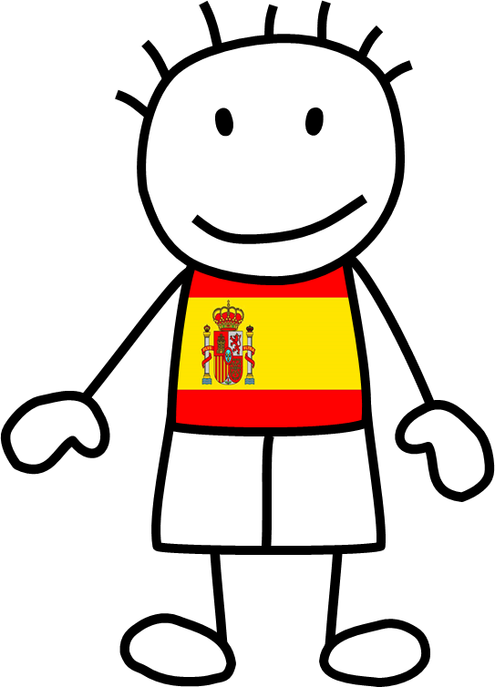
He’s
Spanish.

Slide 5

She’s
French.

Slide 6

He’s
German.

Slide 7
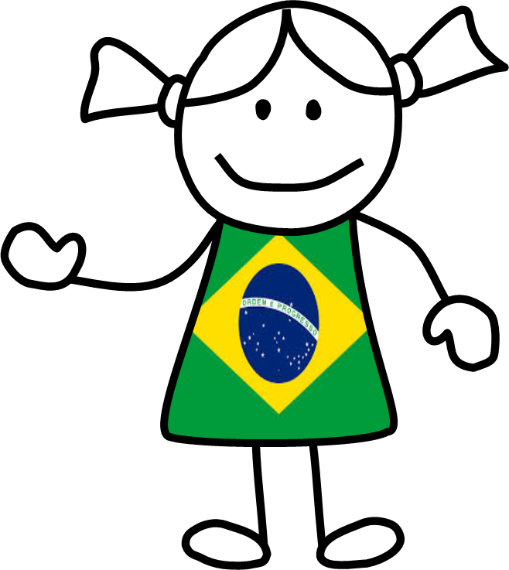
She’s
Brazilian.

Slide 8

He’s
Canadian.

Slide 9

She’s
Greek.

Slide 10
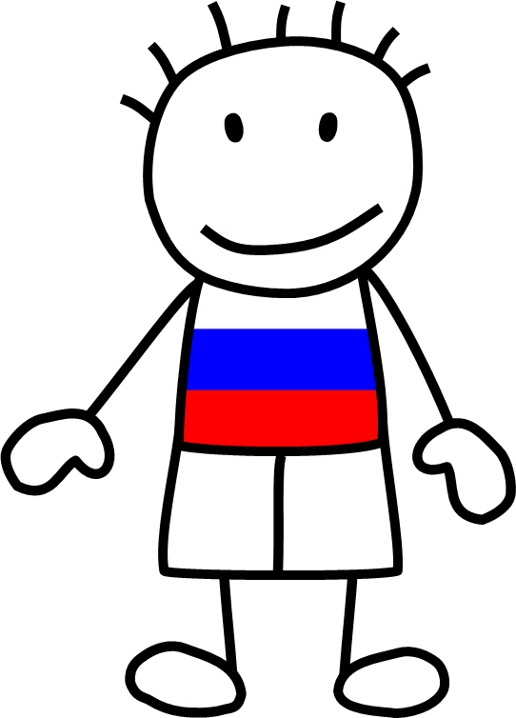
He’s
Russian.

Slide 11

She’s
Czech.

Slide 12
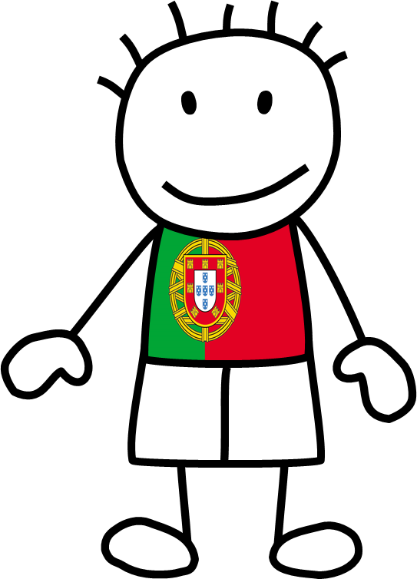
He’s
Portuguese.

Slide 13

She’s
Australian.

Slide 14

He’s
Italian.

Slide 15

She’s
Mexican.

Slide 16
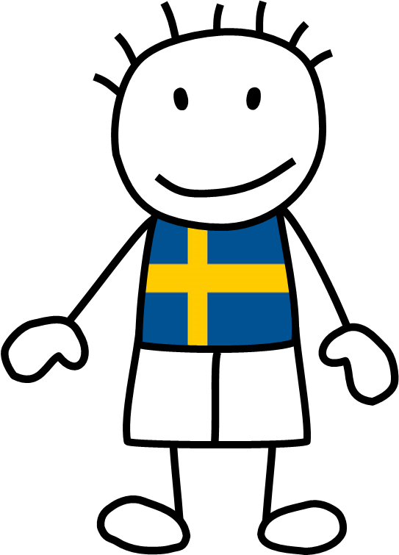
He’s
Swedish.

Slide 17
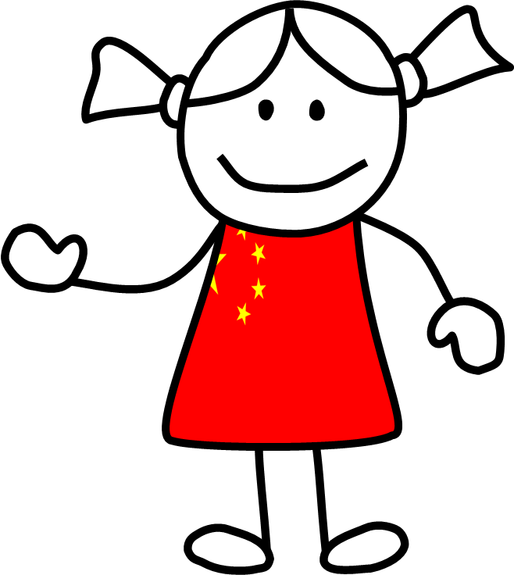
She’s
Chinese.

Slide 18

He’s
Egyptian.

Slide 19

She’s
Dutch.

Slide 20

He’s
Japanese.

