Slide 1

WELCOME TO OUR CLASS!

Slide 2

TOPIC
ANIMALS

Slide 3
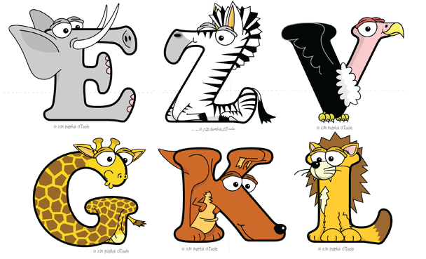

Slide 4
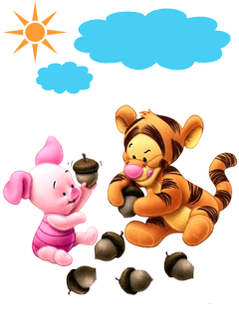
Would you like listen a song?

Slide 5


Slide 6
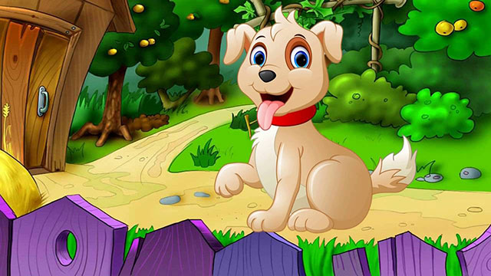
DOG /

Slide 7
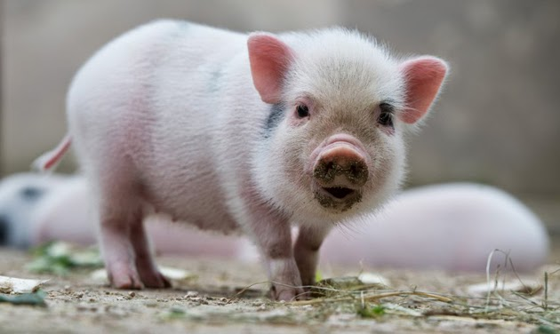
PIG

Slide 8
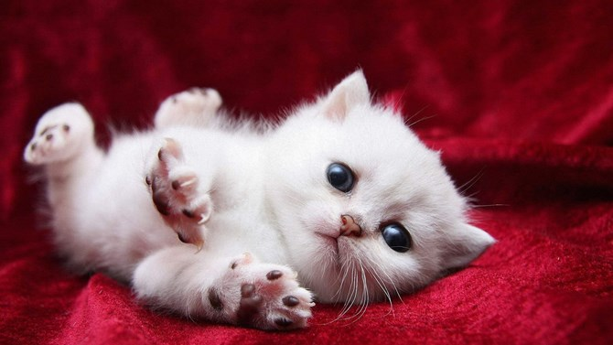
CAT

Slide 9
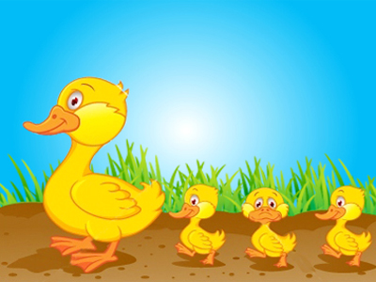
DUCK /dʌk/

Slide 10
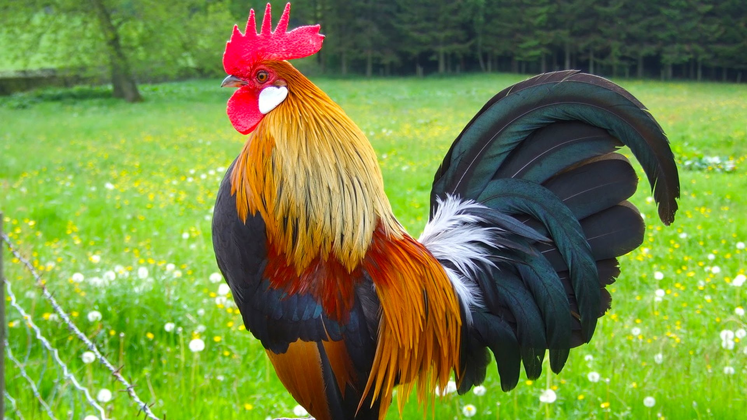
CHICKEN /ˈtʃɪk.ɪn/

Slide 12
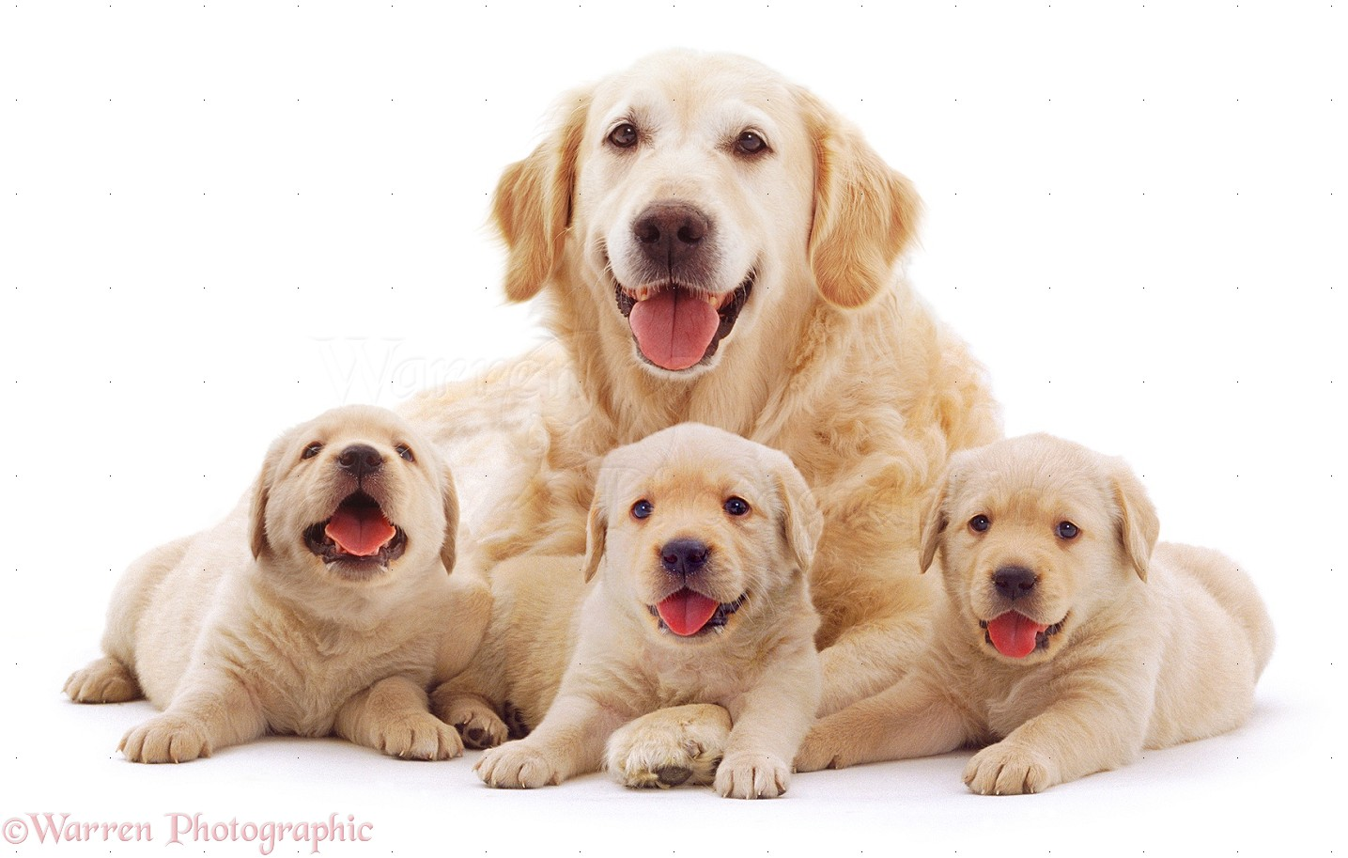

Slide 13
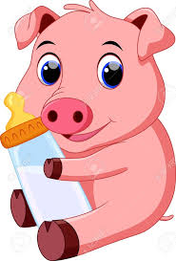

Slide 14
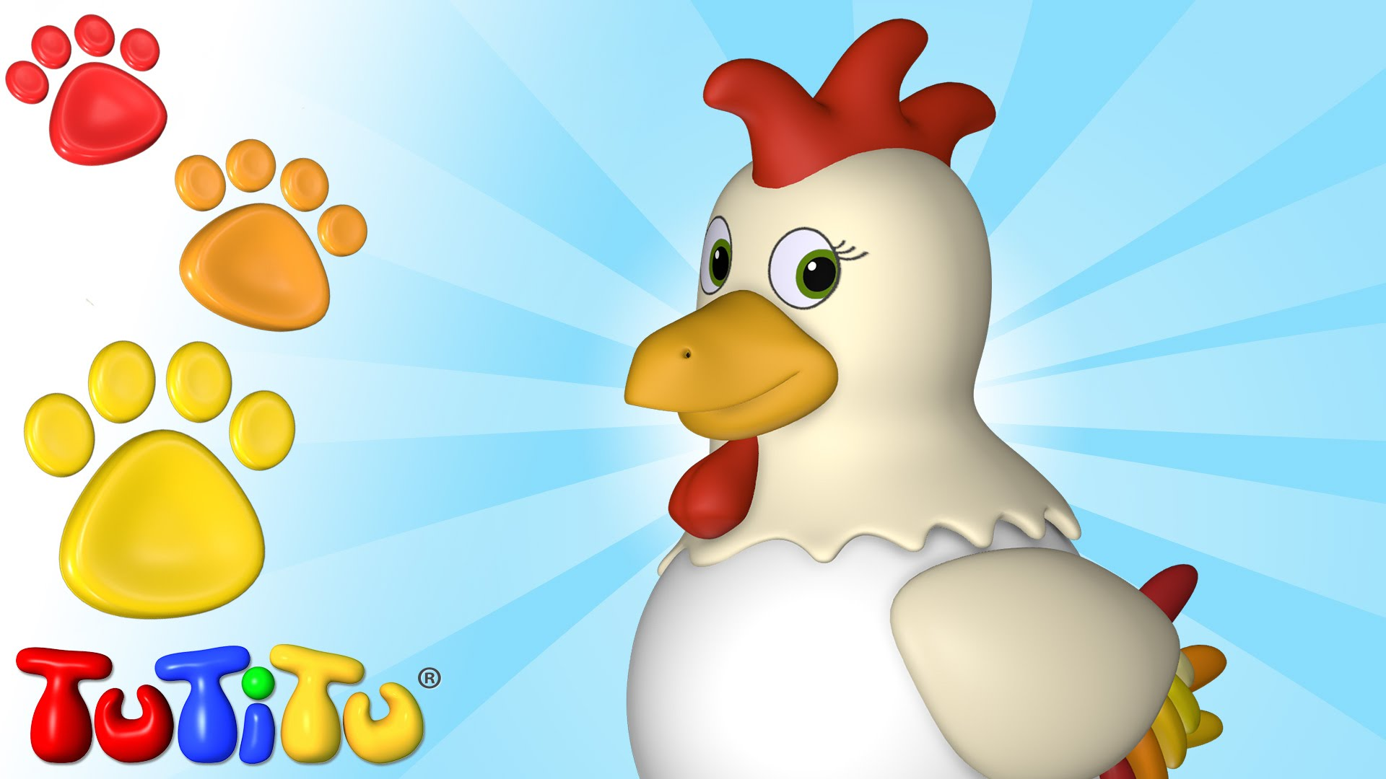

Slide 15


Slide 16


Slide 17

GOOD BYE!

Slide 18


Slide 19
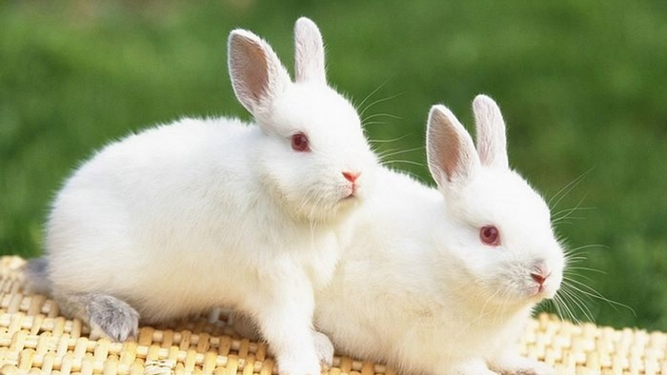
RABBIT

Slide 20
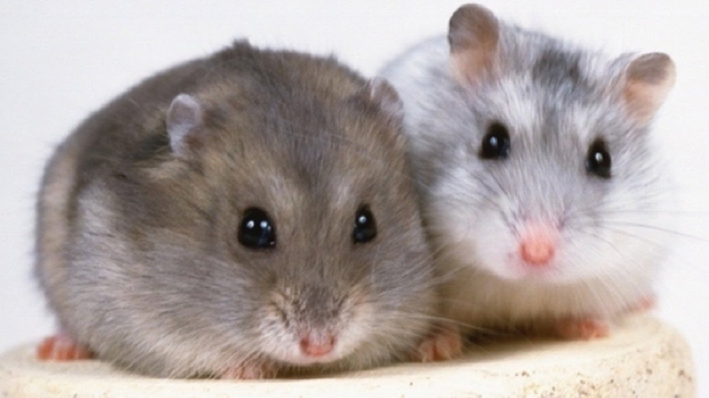
MOUSE /maʊs/

Slide 21
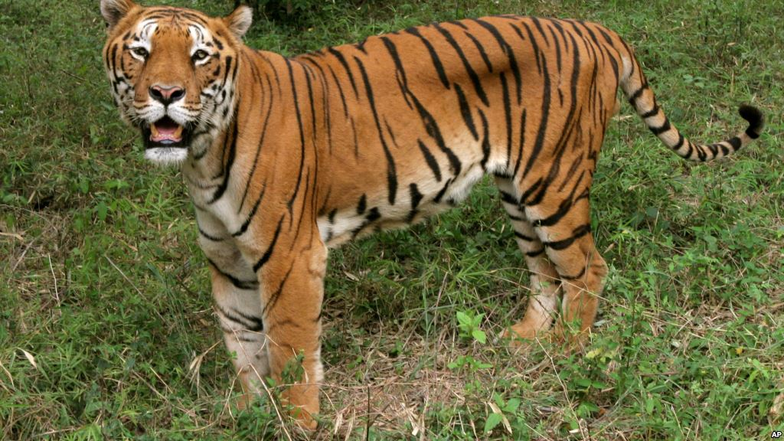
TIGER /ˈtaɪ.gəʳ/

Slide 22
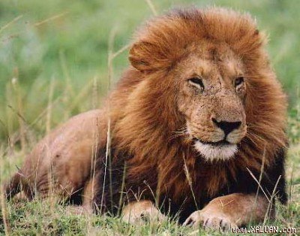
LION /ˈlaɪ.ən/

Slide 23
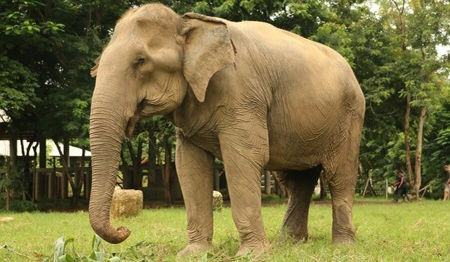
ELEPHANT /ˈel.ɪ.fənt/

Slide 26
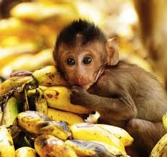
MONKEY /ˈmʌŋ.ki/

Slide 27
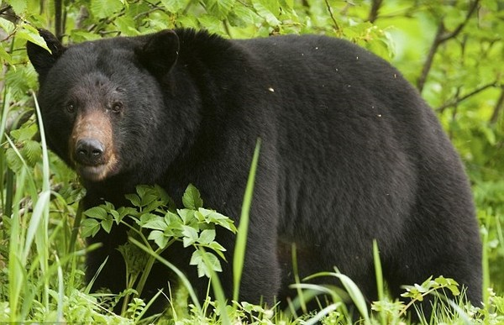
BEAR /beəʳ/

Slide 28
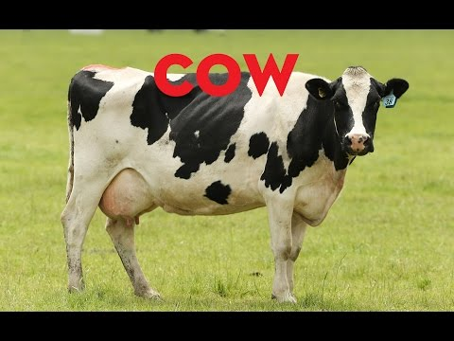
COW /kaʊ/

Slide 29
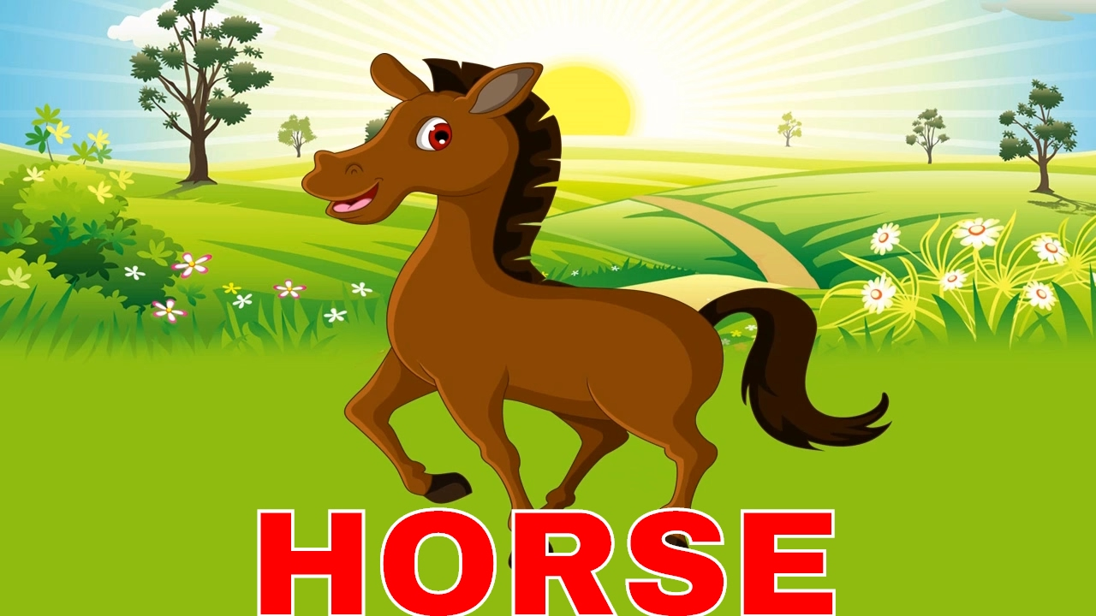
HORSE /hɔːs/

Slide 30
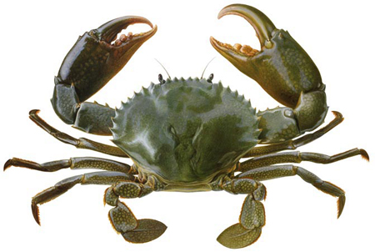
CRAB /kræb/

Slide 31
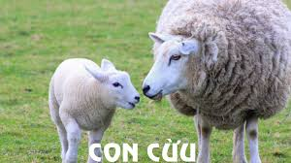
SHEEP/ʃiːp/

Slide 32

BEE /biː/

Slide 33
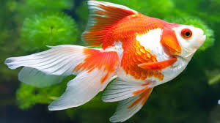
FISH

